Slide 1
JA1 Service Integration
Giacinto Donvito, Paolo Manghi
(today presenting the work of other 10 people from OpenAIRE and EOSC-Hub)

Slide 2
View from the moon
Scholarly communication services
(sharing, evaluating, monitoring science)
Research infrastructure services
(performing science)
EOSC as Access facilitator
E-infrastructure
(enabling digital services for science)

Slide 3
Scholarly communication services
(sharing, evaluating, monitoring science)
Interoperability across EOSC services for Open Science
Towards Open Science-oriented Scientific Impact
JA1.2
JA1.3
Research infrastructure services
(performing science)
EOSC as Access facilitator
Machine-consumable Data Management Plans
Enabling Services Integration in support of EOSC
JA1.1
JA1.4
E-infrastructure
(enabling digital services for science)

Slide 4
Machine-consumable Data Management Plans
JA1.1
Type of output
Beneficiaries
OpenDMP Service uptake and EOSC onboarding
Researchers and data stewards
Service providers
Funder and research communities

Slide 5
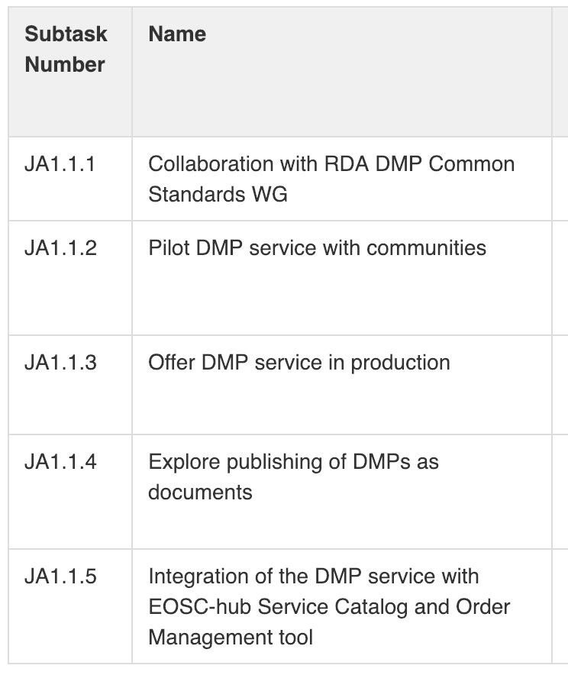
Roadmap

Slide 6
Deliverables
Benefits

Slide 7
Results so far
Benefits
Delivery of OpenDMP system embracing:
Elaborated DMP data model as per design.
Interoperable services to handle DMPs.
End user and administrative user interfaces.
Integrated with several external service and data providers (OpenAIRE, EUDAT, EGI AAI etc).
Deployment on showcasing and development infrastructures:
Opendmp.eu
Demonstration and feedback gathering in several occasions:
DI4R DMP training workshop (PT).
Open Science Fair (GR).
Bilateral / institutional meetings in Norway and Greece.

Slide 8
Next actions
Benefits
Experiment with additional DMP templates and validate the assumptions.
Further work on DMP actionability in partnership with major task-forces on the field (RDA)
Expanding its baseline features w.r.t. security model, interoperability, integration with infrastructures etc.
Further promote the tool and its use and gather feedback on tools capacities.
Provisioning of services on top and by OpenDMP (on-premises / cloud based).

Slide 9
Define and promote common guidelines
JA1.2.A
Interoperability across EOSC services for Open Science
JA1.2
Facilitating publishing and exchanging information on scientific products in EOSC
JA1.2.B

Slide 10
Define support guidelines for scientific product content providers in EOSC
JA1.2.A
Type of output
Beneficiaries
Specifications for metadata exchange
Specifications for community identification and relationships
OpenAIRE guidelines dissemination and support
Researchers and data stewards
Research communities
Content and service providers

Slide 11
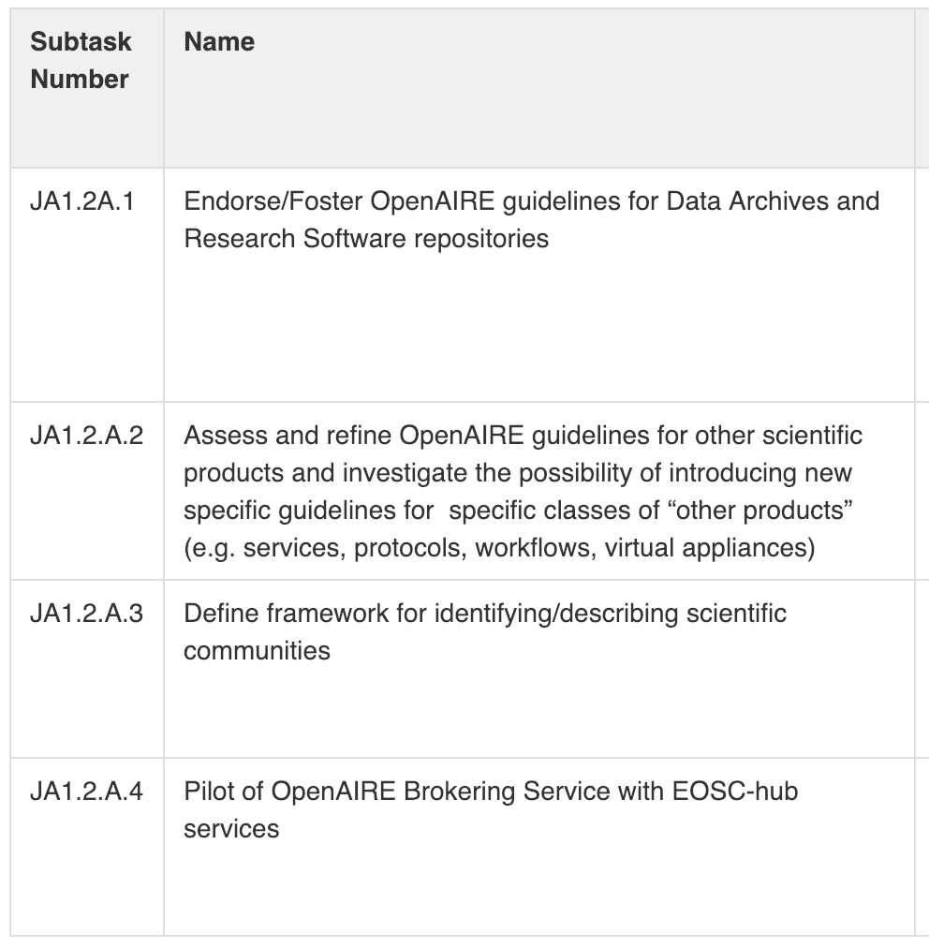
Roadmap
Roadmap

Slide 12
Deliverables
Benefits

Slide 13
Results so far
Next actions
Deliverable JAM1.5 (M6)
Feedback on OpenAIRE Guidelines for Data archives (B2SHARE, B2FIND)
Feedback on OpenAIRE guidelines for Research Software Repositories (EGI AppDB - software repository)
Feedback on OpenAIRE guidelines for Other products Repositories (EGI AppDB - virtual appliance repository)
Deliverable JAM1.6 (M18)
Virtual Appliances guidelines, not needed for the moment
Implementation and feedback on:
OpenAIRE Guidelines for Data archives: EGI Data Hub
OpenAIRE guidelines for Other products Repositories: EOSC-Hub MarketPlace

Slide 14
Facilitating publishing and exchanging information on scientific products in EOSC
JA1.2.B
Type of output
Beneficiaries
Adapting EOSC services to OpenAIRE guidelines
Aligning scholarly communication practices
Content providers
Funders
Researchers
SMEs

Slide 15
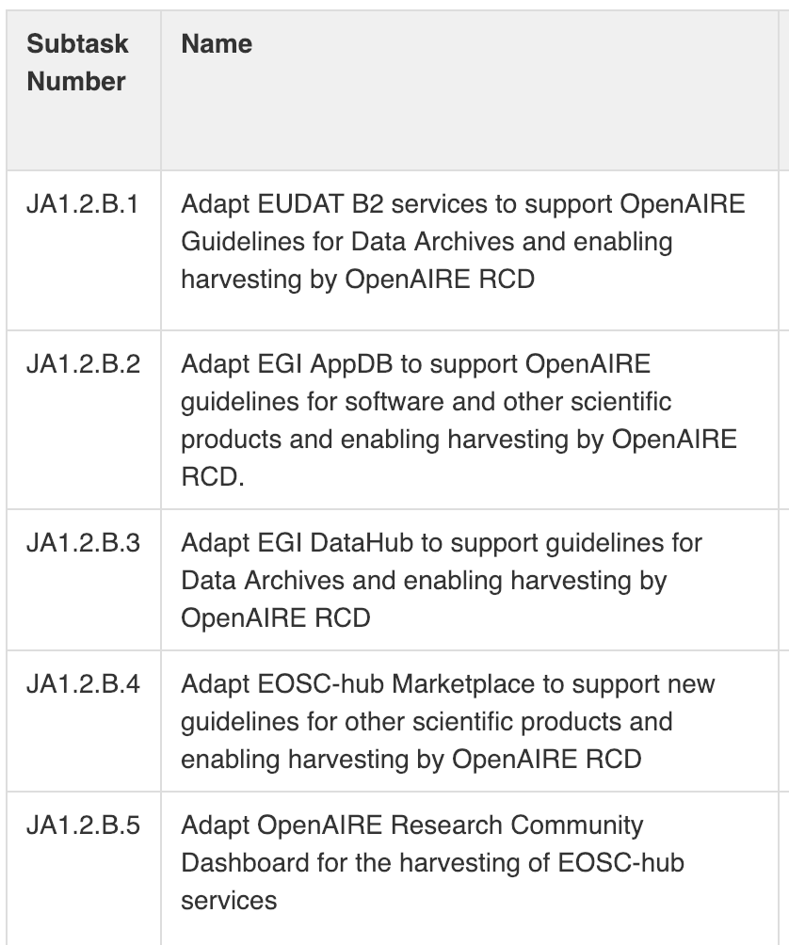
Roadmap
Roadmap

Slide 16
Deliverables
Benefits

Slide 17
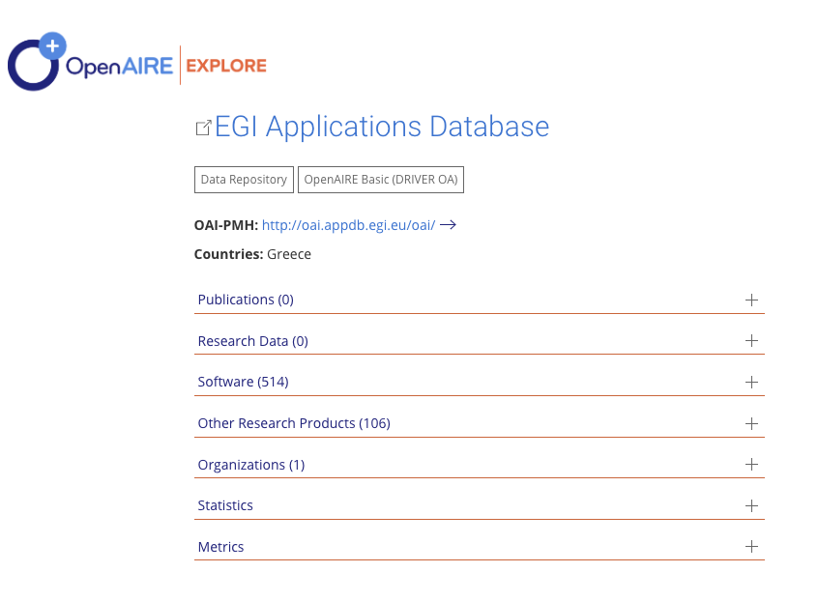
Results so far
Benefits
Implementation of OpenAIRE Guidelines for Data archives
B2SHARE, B2FIND (ongoing)
Implementation of OpenAIRE guidelines for Research Software Repositories
EGI AppDB - software repository
Implementation of OpenAIRE guidelines for Other products Repositories
EGI AppDB - virtual appliance repository

Slide 18
Next actions
Benefits
Implementation of OpenAIRE Guidelines for Data archives
EGI Data Hub
Implementation of OpenAIRE guidelines for Other products repositories – experimenting with services as entities
EOSC-Hub MarketPlace/eInfraCentral Catalogue

Slide 19
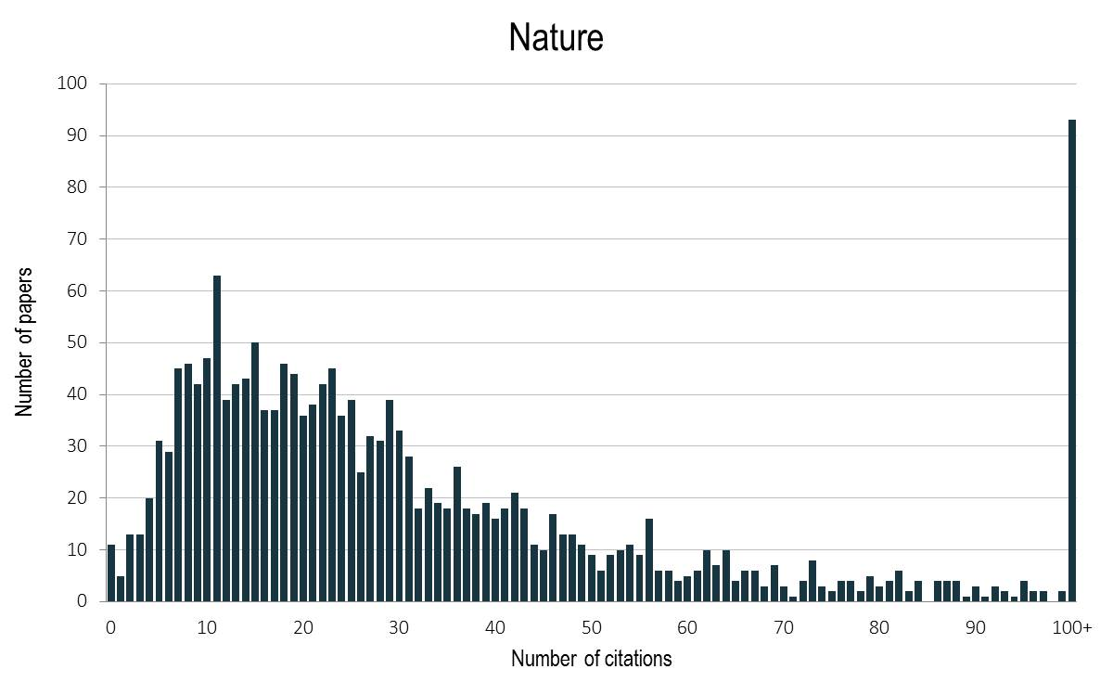
Towards Open Science-oriented Scientific Impact
JA1.3
Type of output
Beneficiaries
Services upgraded to provide usage stats
Researchers and data stewards
Research communities and funders
Content and service providers

Slide 20
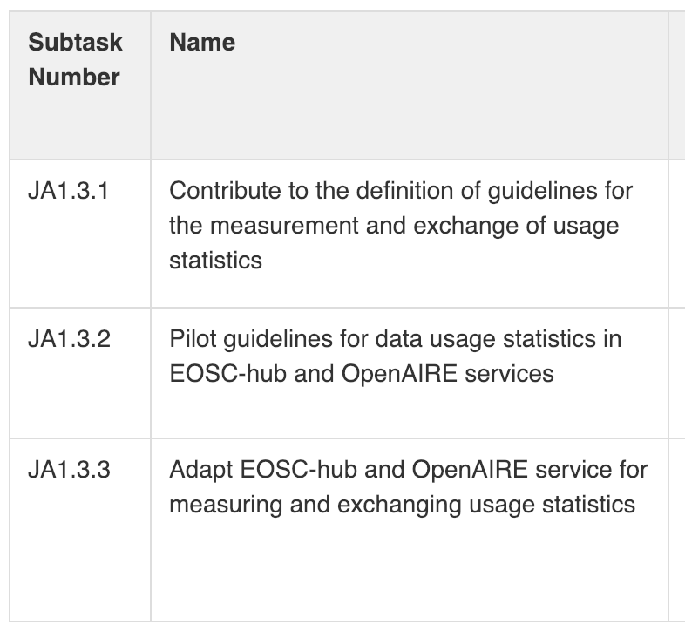
Roadmap

Slide 21
Deliverables
Benefits

Slide 22
Results so far
Next actions
Identifying and analysing scientific products / services which are relevant for usage statistics
Feedback on OpenAIRE’s usage statistics specification and guidelines, including
Feedback on Standards for exchange usage events (SUSHI-API)
Feedback on usage event tracking
Feedback on COUNTER Code of Practice for scientific products
Explore how to collect usage events from EOSC-Hub services
Description of EOSC-Hub services and their attributes where usage statistics service would apply.
Description of the objectives of recording / sharing usage stats on the resources in EOSC-Hub infrastructures / services.
Requirements specification for implementing the task

Slide 23
AAI Integration
JA1.4.A
Enabling Services Integration in support of EOSC
Annotation
JA1.4
JA1.4.B
Anonymization of sensitive data
JA1.4.C

Slide 24
AAI Integration
JA1.4.A
Type of output
Beneficiaries
Allowing users to access EOSC-hub and OpenAIRE services with the same credentials
Attributes harmonization
Policy harmonization
EOSC end-users
Service consumers

Slide 25
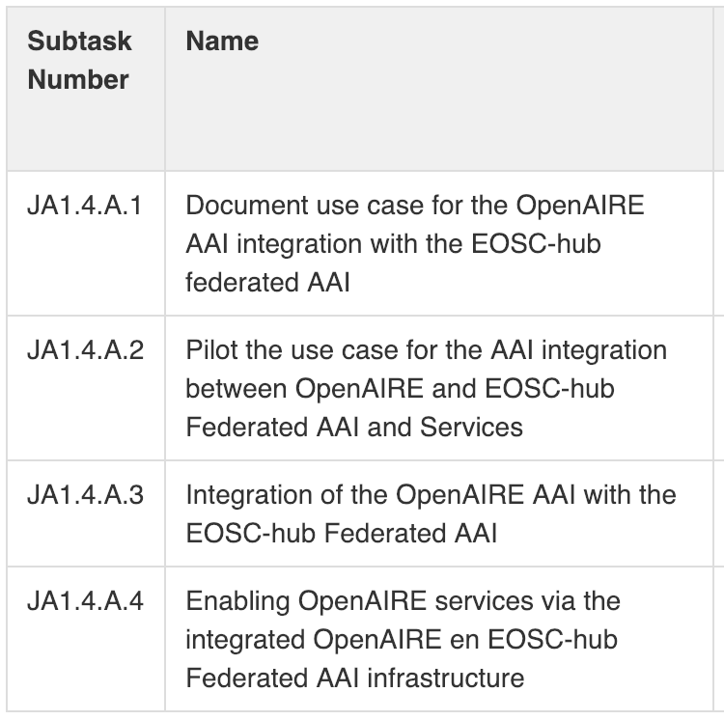
Roadmap

Slide 26
Deliverables
Benefits

Slide 27
JAM 1.17 Report
Objective of AAI integration between OpenAIRE and EOSC-hub
Allow end-users to transparently access EOSC-hub and OpenAIRE services using their institutional credentials from the national identity federations in eduGAIN or other parties (social media, etc)
AAI harmonisation activities:
Results so far
Architecture | AARC Blueprint Architecture | ✓
User attributes | User identifier | ✓
 | Group membership and role information | ✓
 | Affiliation information | ✓
 | Assurance information | ✗
Policy | Release of unique shared user identifier and common attributes - REFEDS Research & Scholarship entity category | ✓
 | Operational security, incident response, and traceability - REFEDS Sirtfi | ✓
 | Privacy requirements for processing personal information - GÉANT Data Protection Code of Conduct | ✓
 | Rules and conditions that govern access to and use of service and resources - WISE Baseline Acceptable Use Policy (AUP) | ✓
 | Assurance and its expression - REFEDS Assurance Framework | ✗
Notes:
The OpenAIRE AAI infrastructure will be integrated with the EOSC-hub federated AAI infrastructure to allow end-users to transparently access services and resources across OpenAIRE and EOSC-hub using their institutional credentials from the national identity federations in eduGAIN or other parties as allowed by the communities, such as social media or other community-managed identity providers
Results so far:
AAI harmonisation activities: (green: already aligned, amber: in progress, red: not started yet)
AARC Blueprint Architecture: Both the EOSC-hub and the OpenAIRE AAI build on the AARC BPA, a proxy-based architecture that builds on top of eduGAIN and adds the functionality required to support multi-protocol access to web- and non-web-based services based on community membership
Alignment of user attributes: To allow the flow of user information across AAIs the following user attribute types need to be aligned
User identifier: Use eduPersonUniqueId format for expressing a user’s unique, persistent and non-targeted identifier
Group membership and role information: Use of URN scheme proposed by AARC (AARC-G002)
Affiliation information: Use of voPerson schema/upcoming recommendations from AARC (AARC-G025)
Assurance information (trust in user attribute assertions): Use of REFEDS Assurance Framework and AARC guidelines
Compliance with policy frameworks:
Release of unique shared user identifiers and mandatory set of attributes, including name & email information (and optionally affiliation): Adoption of REFEDS Research and Scholarship entity category
Best practices in operational security, incident response, and traceability: Adoption of REFEDS Sirtfi:
Privacy requirements for processing personal information: GÉANT Data Protection Code of Conduct
Rules and conditions that govern access to and use of service and resources: WISE Baseline Acceptable Use Policy (AUP):
Framework for assurance (trust in user attribute assertions) and its expression using common identity protocols: REFEDS Assurance Framework and AARC guideline documents

Slide 28
JAM 1.17 Report
Next actions
Candidate use cases for piloting AAI integration
B2NOTE service accessed via OpenAIRE RCD:
members of a community in OpenAIRE are able to use B2NOTE to create annotations on objects present in RCD
Zenodo service accessed via EOSC-hub AAI managed by communities
EOSC-hub compute/storage resources accessed via OpenAIRE RCD (e.g. Neuroinformatics community)
Actions
Finalise analysis of exemplar integration use cases that involve services requiring cross-infrastructure usage
Conduct pilot in the first few months of 2019 to validate the feasibility and the benefits of the AAI integration for the identified use cases
Roll out the AAI integration in production (planned for the second quarter of 2020)

Slide 29
Annotation
JA1.4.B
Type of output
Beneficiaries
EOSC-Hub and OpenAIRE Service integration: users can extend data record descriptions with structured annotations (i.e. semantic tag, keyword, comments,...) to describe, curate, retrieve and aggregate data records.
Researchers and Funders
Data stewards, Data curators, Content providers

Slide 30
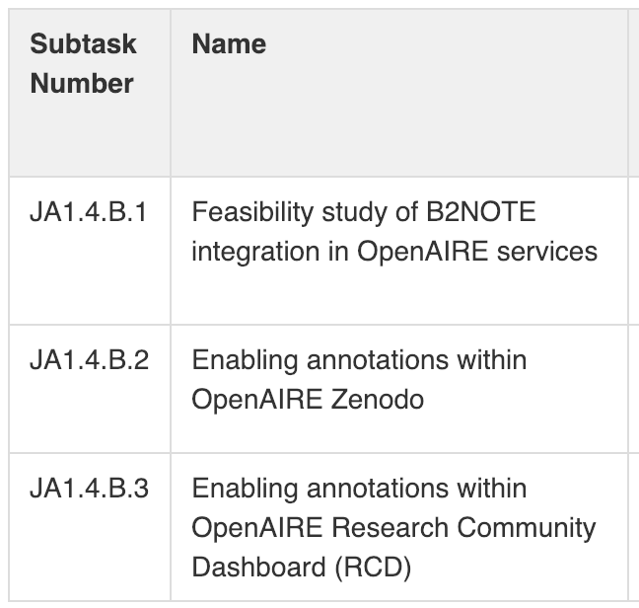
Roadmap

Slide 31
Deliverables
Benefits

Slide 32
Next actions
Benefits
Define the scope and the process of the feasibility study
Evaluate technical integration
Evaluate service usability
Define tests for integration and user testing

Slide 33
Anonymization of sensitive data
JA1.4.C
Type of output
Beneficiaries
Service delivery: researchers to anonymize their data and safely share them with third parties. Data anonymization provides formal statistical guaranties like k-anonymity.
Researchers
Data stewards
Data curators
Content providers
Funders

Slide 34
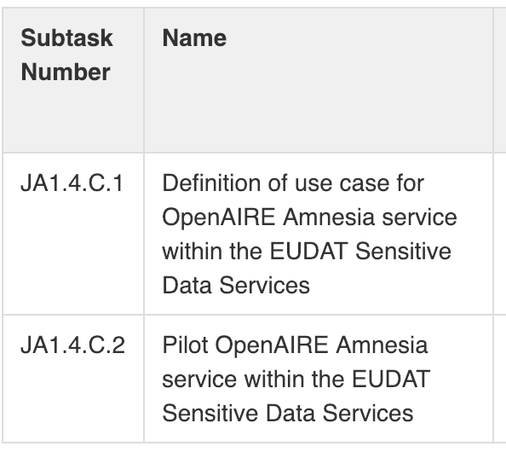
Roadmap

Slide 35
Deliverables
Benefits

Slide 36
Results so far
Use case
Status
EOSC-hub: TSD/SIGMA2 and ePouta/CSC
OpenAIRE: AMNESIA
Scenario:
Analyse data in one of the EOSC “Sensitive data services” and use AMNESIA for exporting data
Publishing/discovery of sensitive in B2SHARE and findable via B2FIND after anonymisation
Amnesia will be evaluated against national and European regulations.
AMNESIA is already installed in the TSD ecosystem
The TSD team is testing the usage
Testing against standard dataset

Slide 37
Next actions
Benefits
Extensive tests of the latest version of Amnesia with EUDAT sensitive data services
Iterative cycles on testing and updating of the Amnesia software to reach an adequate level of service provision

