Slide 1
Security monitoring
EGI CSIRT meeting, 6.4.2011

Slide 2
Pakiti
Statistics available on-line
Basic overview for each site
Machine-friendly reports
CSV format
XML feeding into Dashboard
Synchronization with GOC DB & EGI SSO
Mail notifications to the EGI-CSIRT
Ready to go to sites
Integration with RT more difficult (any impacts of RTIR?)
SSC

Slide 3
Pakiti
Simple monitoring of monitoring applied :-)
Presentations & publications
Presentation at ISGC 2011, paper submitted for publication
Article in local „managerial“ journal (in Czech)
Basic graphs generated on-demand
A lot of manual work

Slide 4
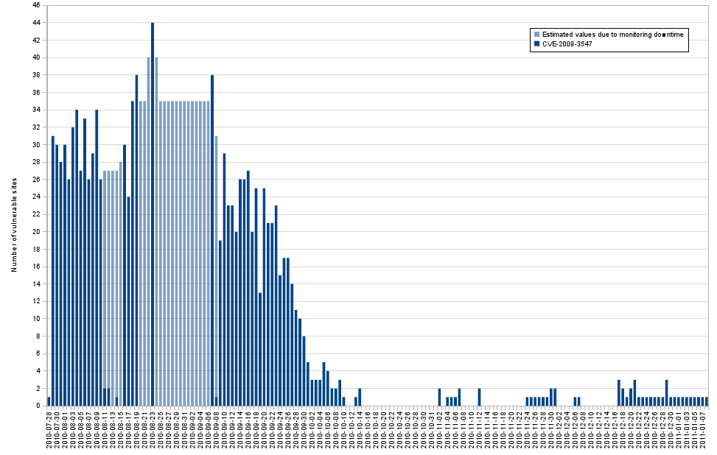

Slide 5
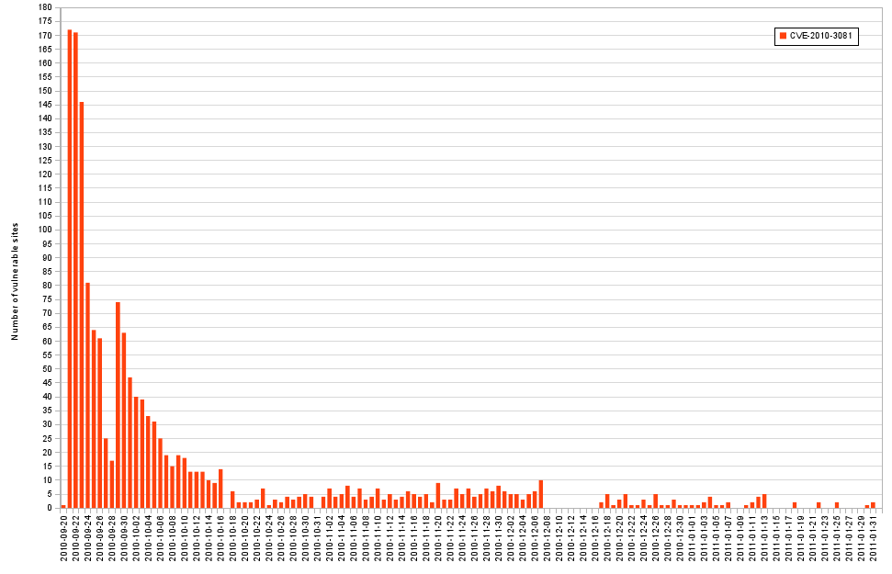

Slide 6
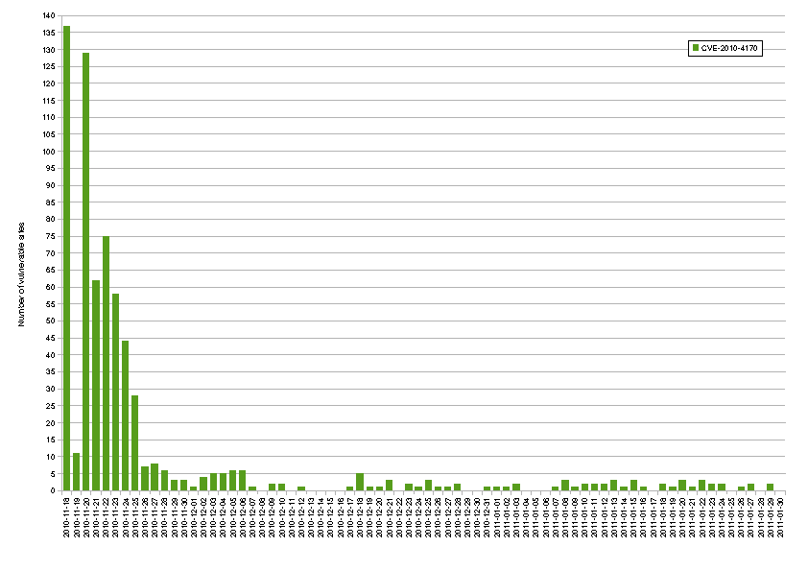
CVE-2010-4170
CVE-2010-4170 Number of Vulnerable Hosts
04/06/11
6

Slide 7
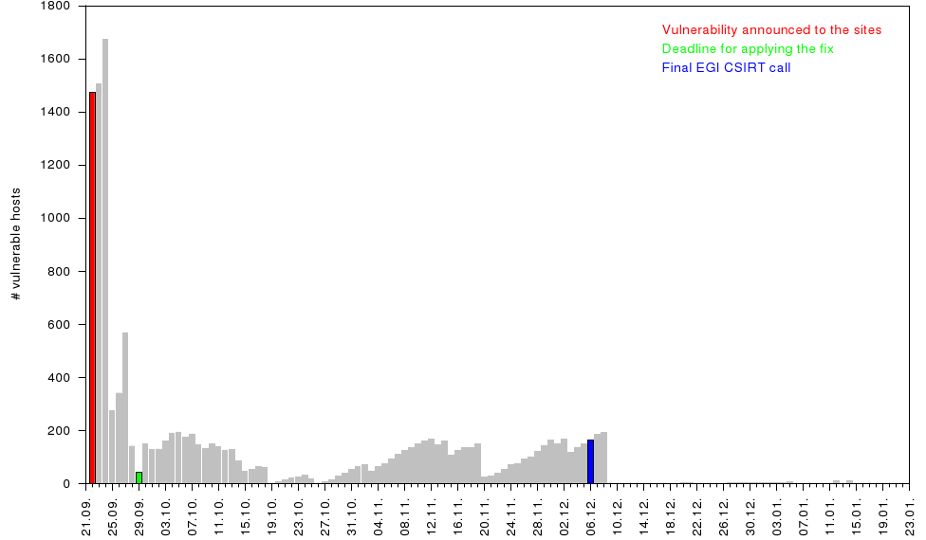
CVE-2010-3081

Slide 8
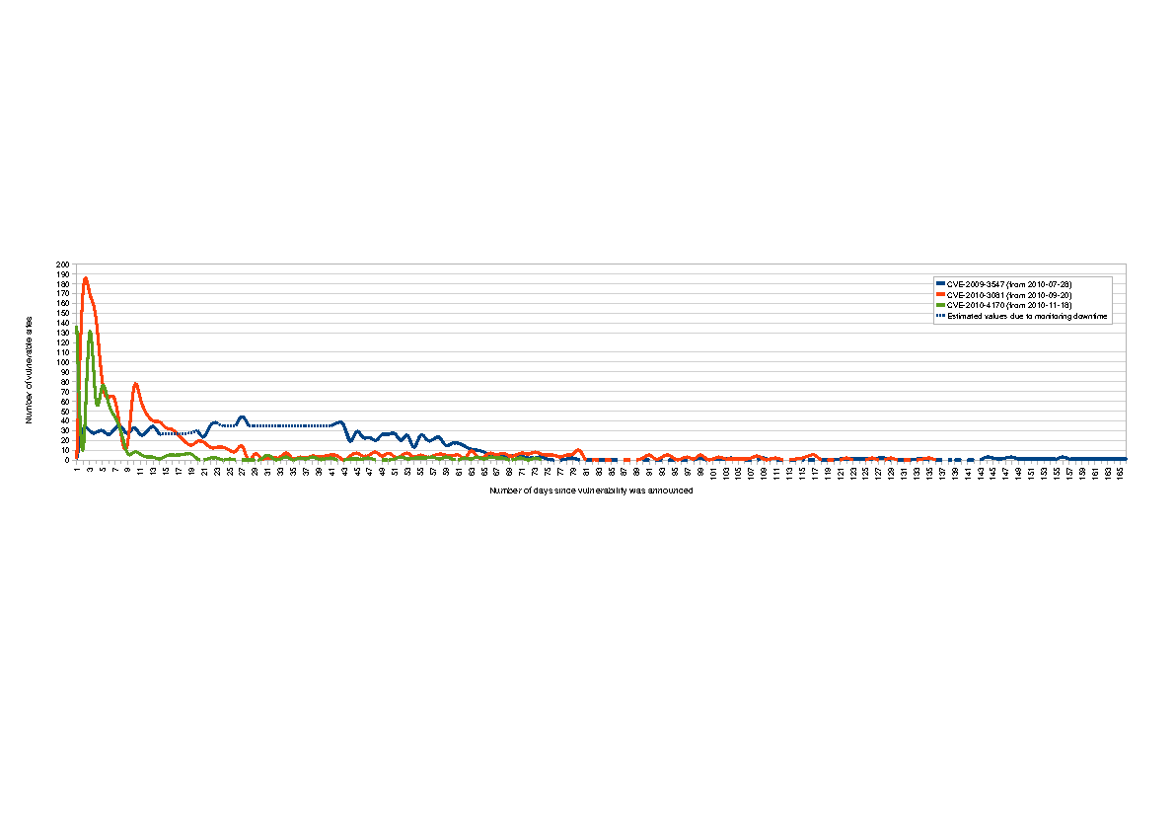
Number of Vulnerable Hosts
Number of Vulnerable Hosts in Days
EGI Pakiti monitors around 1600 hosts from 306 sites with average 865 installed packages every day

Slide 9
Pakiti v3
New design based on previous discussions and implementations
Again in PHP, modular architecture, OO
Focus on performance
First version available from Sourceforge CVS

Slide 10
Plans
Pakiti v3 piloted and gradually get integrated
„site-wide“ monitoring
Don‘t just rely on jobs landing on some WNs
SWAT and/or cron-jobs
Increased load of the server

Slide 11
Security dashboard
Aggregation results of multiple tools at single place
Handling normal security issues as part of standard operations procedures
Use cases
Incident resolution
Vulnerabities chases
Producing reports

Slide 12
Security Dashboard
Goal : detect and inform sites about security incidents and vulnerabilities. Propose an adapted display and workflow to open tickets against sites in the Operations Dashboard.
Define/adapt/implement/ the XML (CSV,...) format of the reports for Nagios and Pakiti and make them available for Dashboard.
Correlate and consolidate Pakiti and Nagios information
Define and implement the mechanism of passing this information to the Dashboard.
Extend the dashboard with the capability of displaying the information in the site view
Establish the work-flow of the ticket creation ( templates , assignment, RTIR ticket system integration)
Integrate an additional ACL model => Make sure proper authorization is applied (based on GOC DB and EGI SSO) and make sure that EGI CSIRT/operations people can access all the data collected.

Slide 13
Current Situation
Current Situation
Nagios and Pakiti information is integrated in the Lavoisier Web Service.
https://pakiti.egi.eu/api/tags_sites.php?type=xml
https://srv-102.afroditi.hellasgrid.gr/nagios-oat-cgi/cgi-bin/nagstat2xml.cgi
The correlation between Pakiti and Nagios information is done around the site
Credentials based on GOC DB rules : NGI/site security officer

Slide 14
Next Steps
Next Steps
Provide an secure html interface with the information stored in Lavoisier WS
2 solutions are possible :
We use the current interface of the dashboard and we add extra information about security (2 weeks of development)
We add a new page dedicated to CSIRT activity ( one month of development )
Extend the credentials with the SSO system (2 weeks )
Study the creation of ticket in RT (3 weeks )

Slide 15
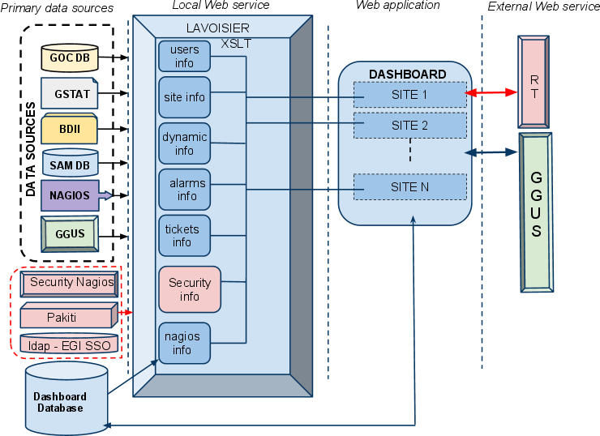
Global architecture
Global architecture

Slide 16
Timelines
Timelines
The first prototype : May – June 2011
The first version in production : September 201
For questions, feedback : cic-information@in2p3.fr

Slide 17
Other plans
Automated correlations & processing result
Mainly for alerting

