Slide 1
EGI Cloud Compute Service
NILs meeting
Enol Fernández
enol.fernandez@egi.eu

Slide 2






EGI Cloud Federation
Multi-cloud IaaS with Single Sign-On
Federation features:
  Common VM image catalogue
  Discovery, accounting, SLO monitoring
  Unified GUI dashboard
EGI Services powered by the Cloud Federation
Cloud Compute
Online Storage
Applications on Demand BETA
Cloud Container Compute BETA
Training Infrastructure
Notebooks BETA
Notes:
List of services of EGI powered by the EGI Cloud Federation

Slide 3





EGI Cloud enables research oriented computing
Research Communities
Platforms
Research Communities
Orchestration
Federation Services
IaaS
providers
Research Platforms
Operators
Check-in : Common AuthN and AuthZ across all layers

Slide 4



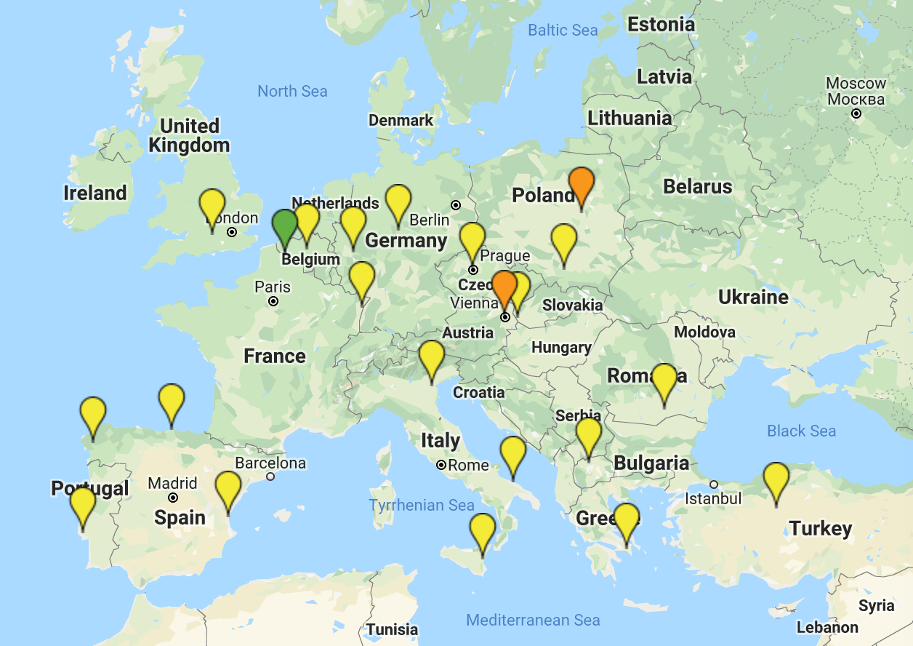














The infrastructure
New!
Finalising integration!
Notes:
IN2P3 highlighted just in case ☺

Slide 5
Access and capacity allocation
VO | fedcloud.egi.eu | access.egi.eu (AoD) | Community VOs
Membership requirements | X.509 certificate | Member of European research institutions (i.e. Check-in account) | Depends on VO (most still require X.509 certificate), new ones can be Check-in only
AppDB VMOps | ✅ | ✅ | Depends on VO
CLI/API access | ✅ | ❌ | ✅
Membership duration | 6 m, extensible up to 1 yr | 6 m, extensible up to 1 yr | 1 year renewable membership
Resource limits | Opportunistic, varying quota at providers. Limited lifetime per VMs may be applied | Opportunistic, varying quota at providers. Limited lifetime per VMs may be applied | Specified in the SLA: opportunistic, pledged, time based
Available providers | All providers | Providers of the Applications on Demand platform: INFN-Catania-Stack, CESGA, RECAS-Bari | As specified in the SLA

Slide 6

Usage
Last 12 Months:
26,4M CPU hours
500K VMs
fedcloud.egi.eu

Slide 7

New: Check-in & EGI Cloud
Check-in provides:
  Single Sign-On through eduGAIN, social media and other institutional or community-managed identity providers
  Harmonised authorisation information, aggregated from multiple sources
  Industry Standard OpenID Connect technology allowing web and non-web access to services
Integration:
  Native support at all the EGI Cloud layers (IaaS providers, IaaS Orchestration, AppDB VMOps) and at EGI services/platforms running on top: Notebooks, AoD, Container
  FedCloud client https://aai.egi.eu/fedcloud for easily getting individual tokens for CLI/API access

Slide 8

Interfaces and Check-in
GUI Access
AppDB VMOps
AAI: Check-in
Federated
Access
IaaS Federated Access Tools
GUI Users
Developers/
Advanced users
Direct API
Access
IaaS API
IaaS API
Cloud Management Framework
Cloud Management Framework
EGI Federation features:
Accounting, Monitoring, Conf. DB, Info Discovery, AppDB
Notes:
User communities build either on top of orchestration tools that allow to deal with multiple providers in a homogeneous way or directly interact with the native APIs of the provides. Both cases they can use single sign-on thanks to Check-in.
A common GUI provided by AppDB VMOps brings a user-friendly dashboard to manage the resources at the distributed providers
The EGI federation services are integrated with the providers using their native APIs to deliver the extra features of EGI Cloud mentioned in previous slide
GUI access:
AppDB VMOps https://dashboard.appdb.egi.eu/vmops
API/CLI access:
Discovery: AppDB IS API (REST and GraphQL) https://wiki.egi.eu/wiki/Federated_Cloud_Discovery#AppDB
IaaS Federated Access Tools: https://wiki.egi.eu/wiki/Federated_Cloud_IaaS_Orchestration
Direct IaaS access, several APIs depending on the provider: https://wiki.egi.eu/wiki/Federated_Cloud_APIs_and_SDKs

Slide 9
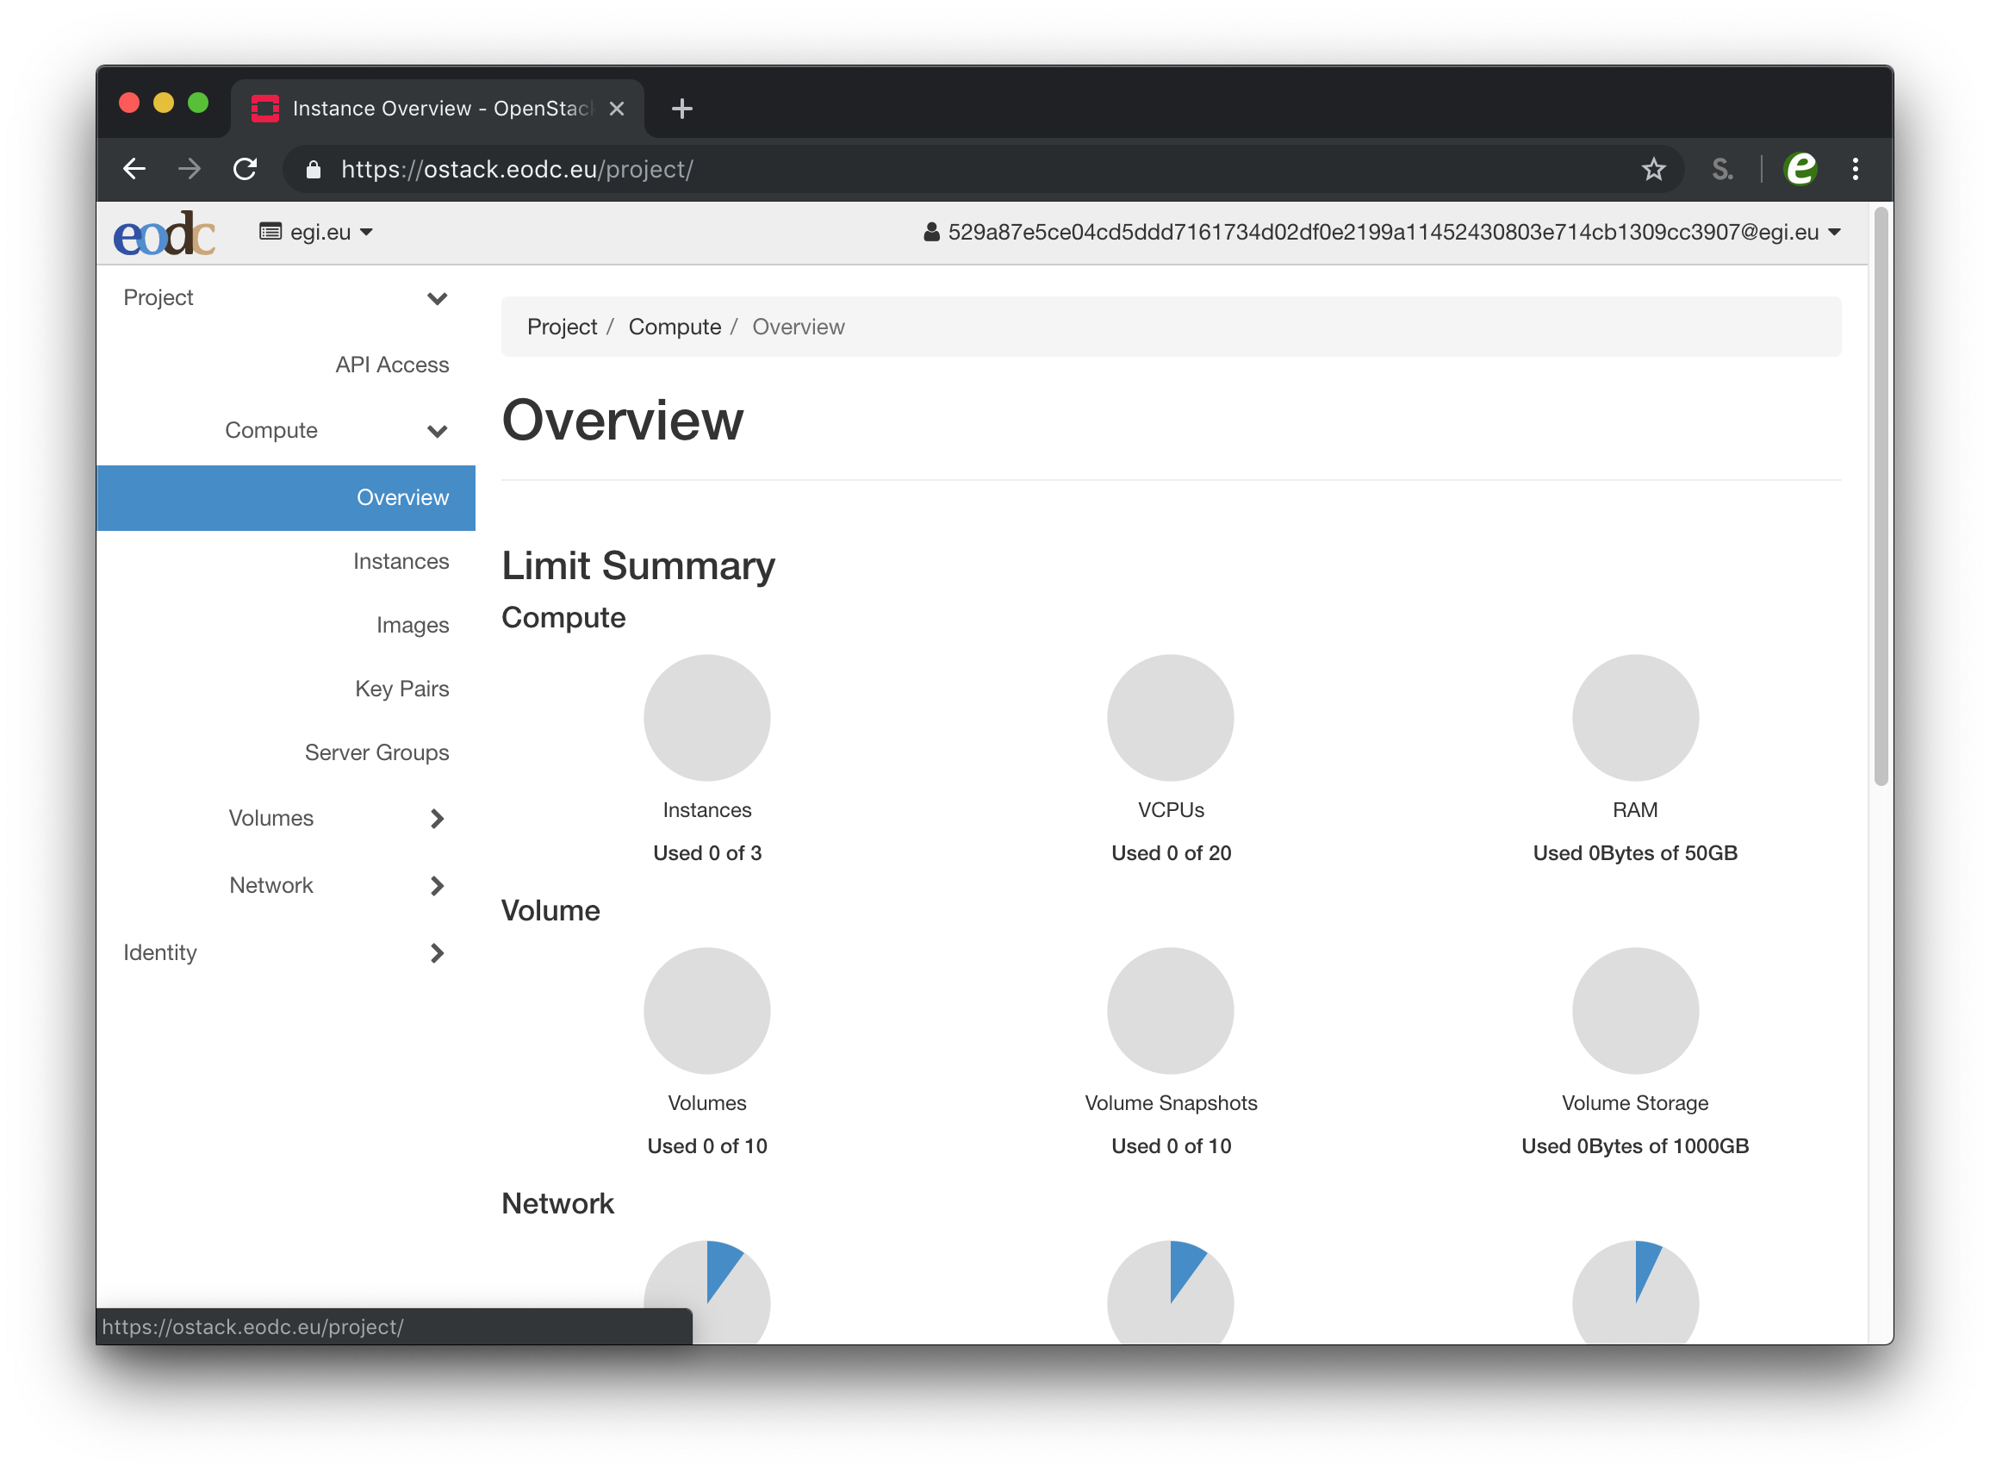
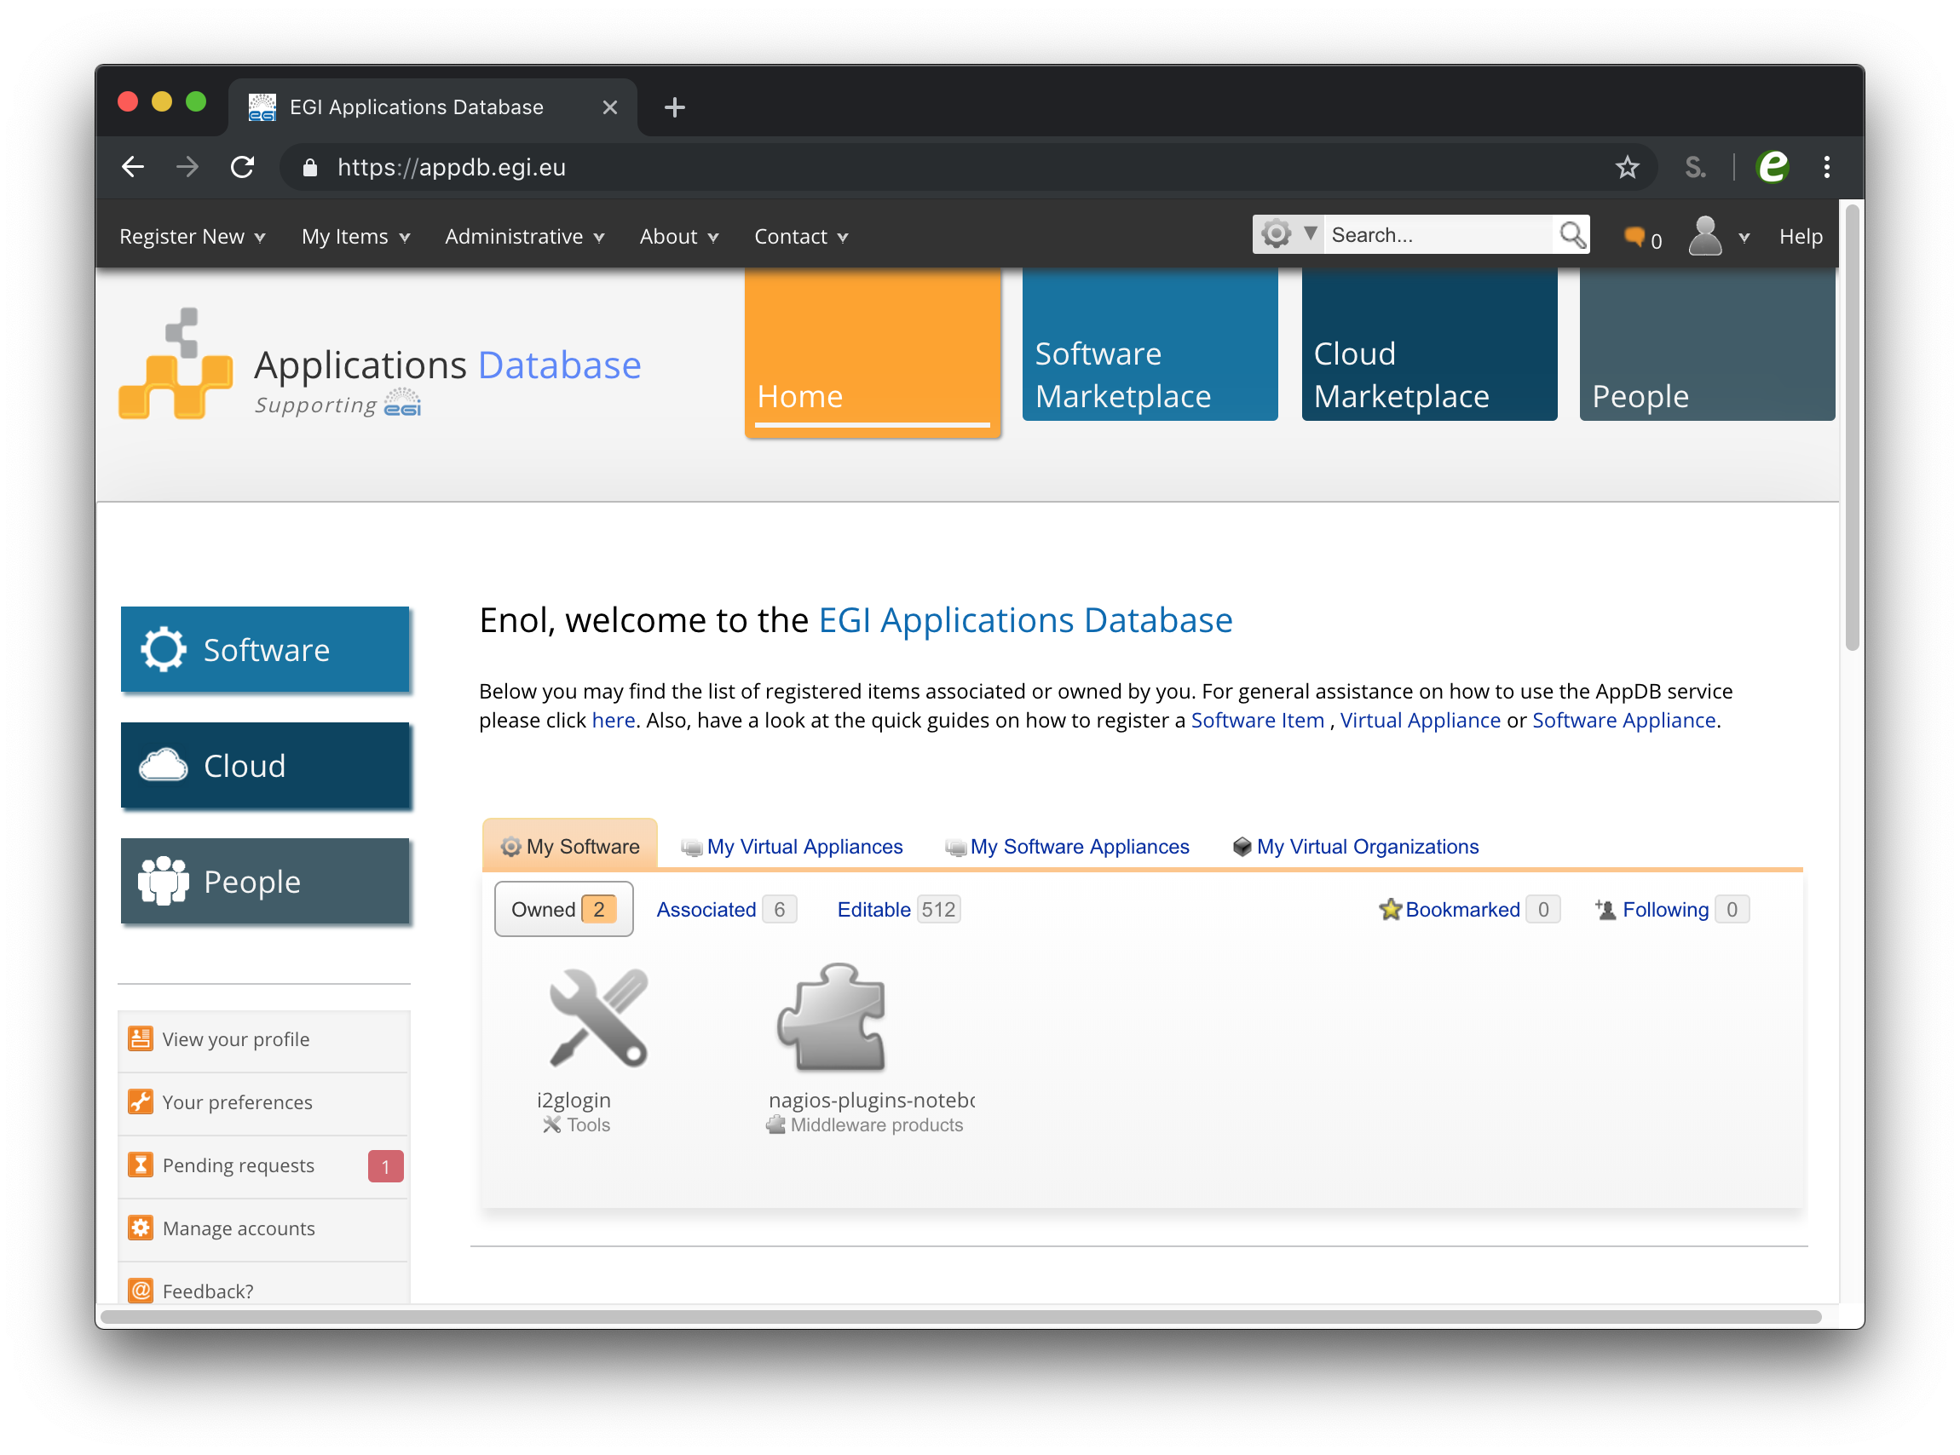
Check-in – web based tools

Slide 10
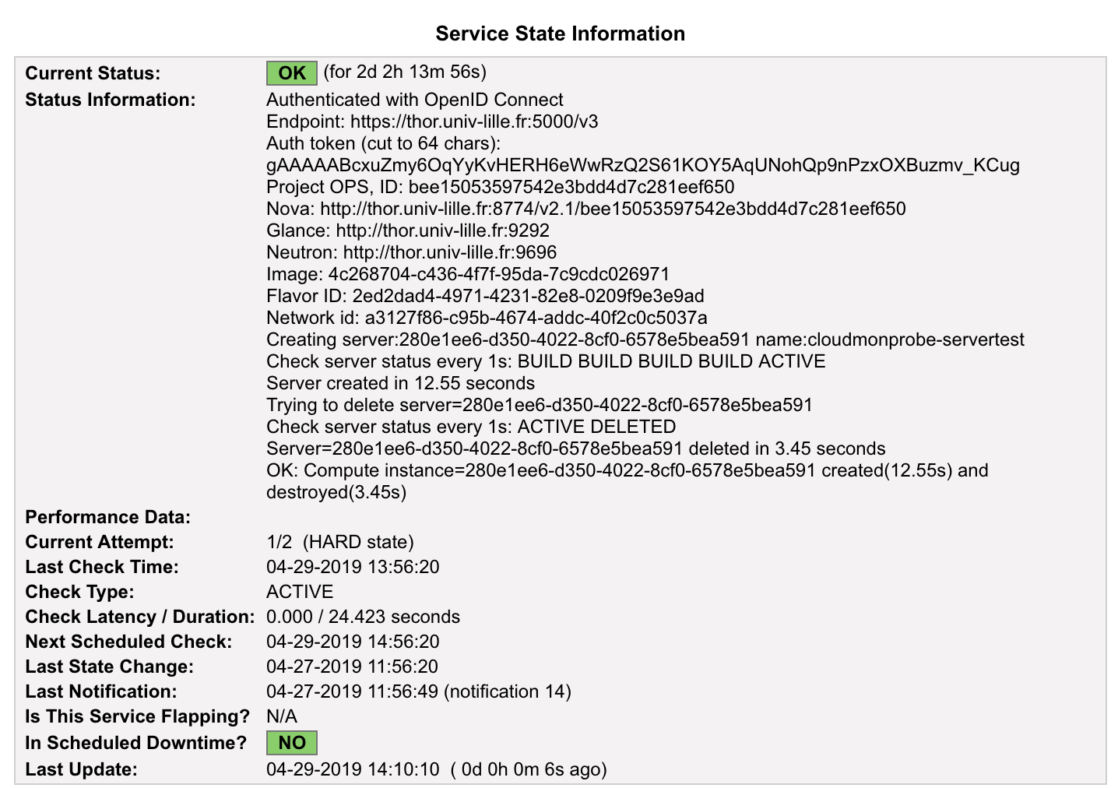
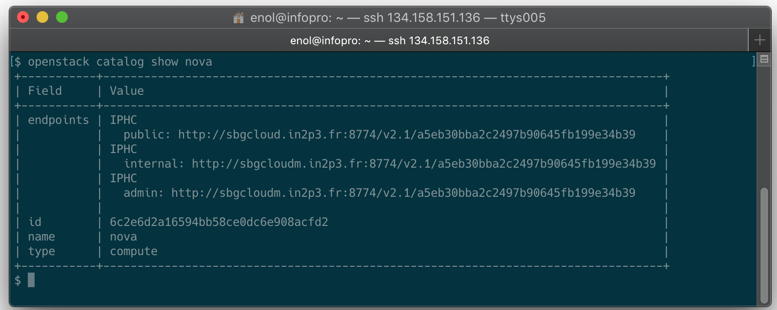
Check-in – CLI / API access

Slide 11
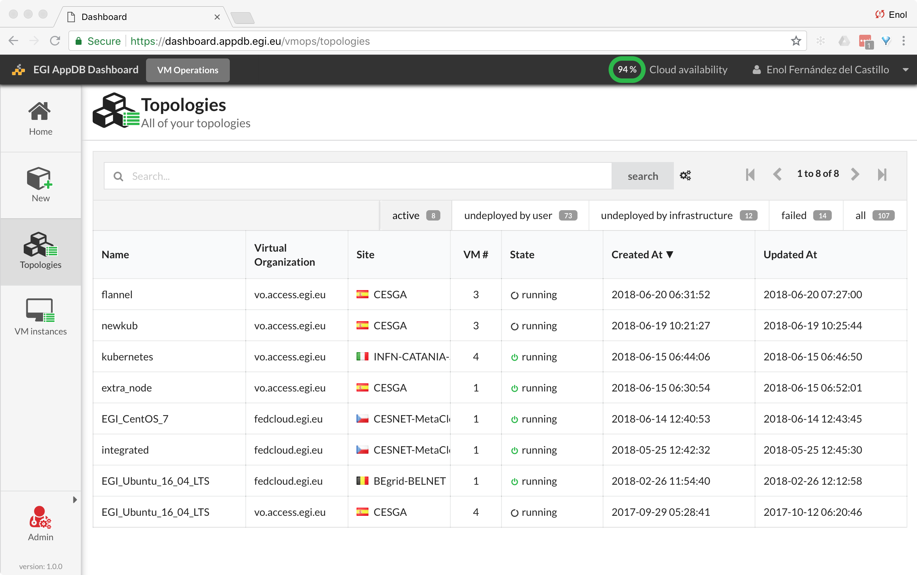
AppDB VMOps - User Friendly GUI
Single Web dashboard to manage VMs in the federation
  Point-and-click solution to create new VMs
Integrated with:
  Check-in, discovery, VM catalogue, monitoring
Powered by Infrastructure Manager

Slide 12
Evolution, federation features
Information discovery
  Transition to message-based information discovery
  GlueSchema 2.1
Native API support
  OpenNebula as a first-class citizen of the federation
  AppDB improvements to support native APIs
Cloud Container
  Automated deployment of Kubernetes

Slide 13


Evolution, site perspective
EGI Check-in
Social Logins
Legacy VOMS
Authentication
OpenStack APIs
OCCI API
Keystone-VOMS
Neutron
ooi
OpenID Connect
Authentication
Keystone
Nova
Glance
Extract usage
information
Extract
information
Sync VM images
cASO
info-provider
cloudkeeper
EGI Federation Services

Slide 14
Summary
EGI Cloud brings together IaaS resources from NGIs to support (federated) research communities
Pilot and test with fedcloud.egi.eu or access.egi.eu VOs, production usage with community VOs with SLAs
Check-in enabled federation: access the service with your own credentials, both web and CLI/API
AppDB VMOps, a common dashboard for the federation
Evolution
  Improved native API support, more complete information
  Even more lightweight federation, while keeping same user features

