Slide 1
EGI Notebooks
Update for the NILs EGI Conference 2019
Gergely Sipos
EGI Foundation

Slide 2
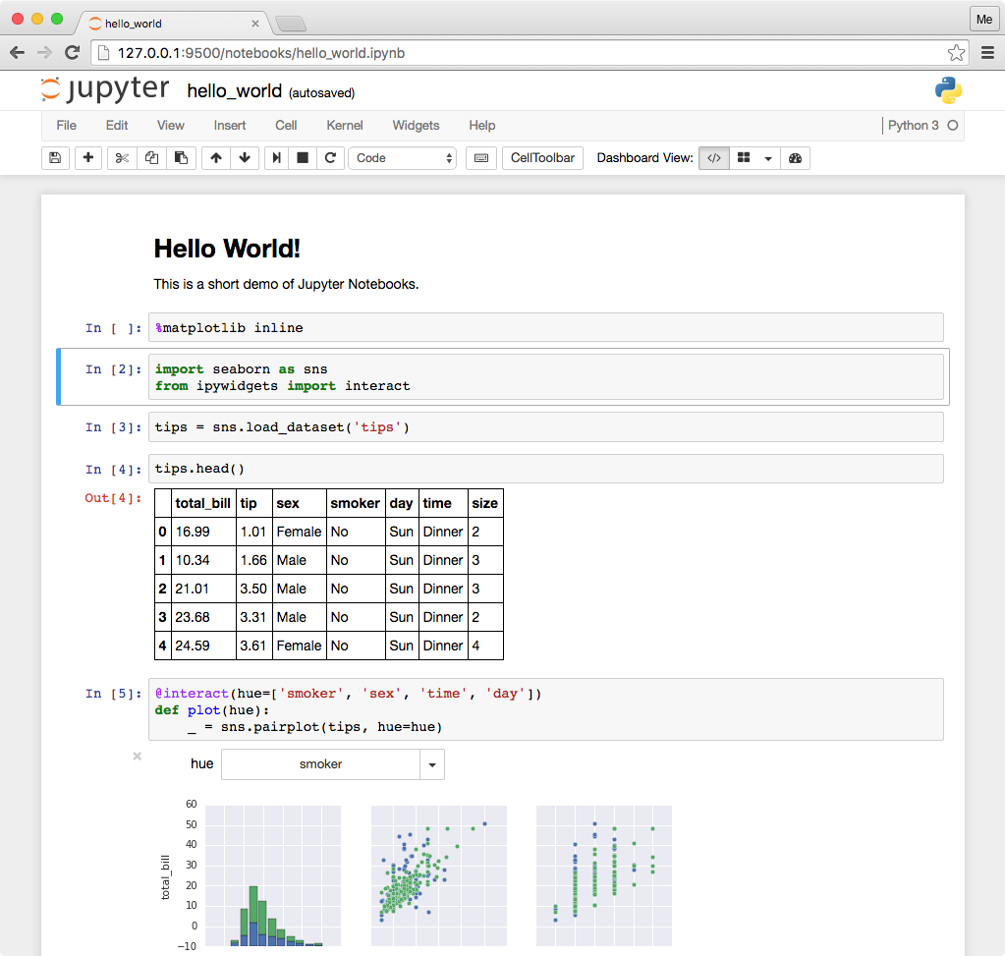
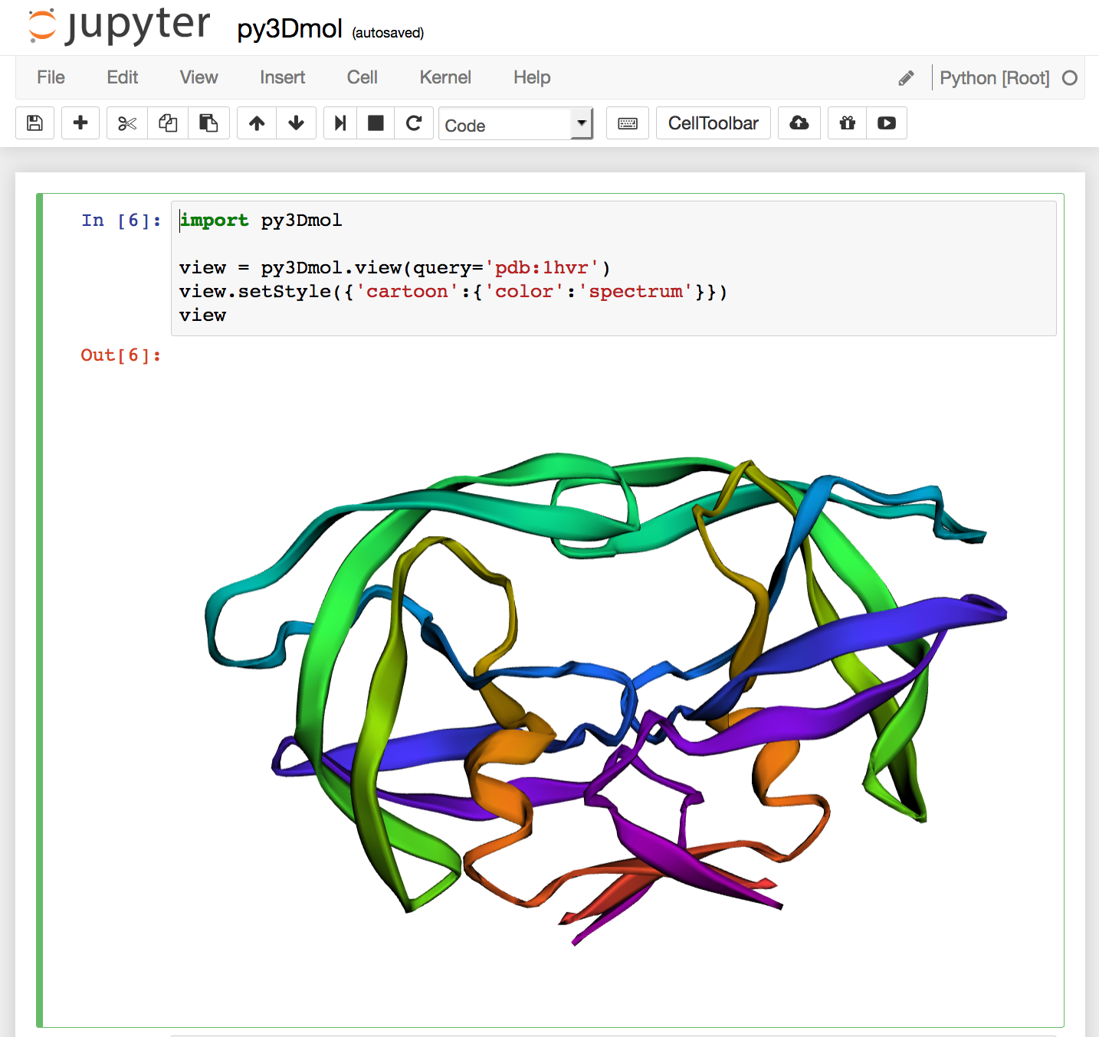
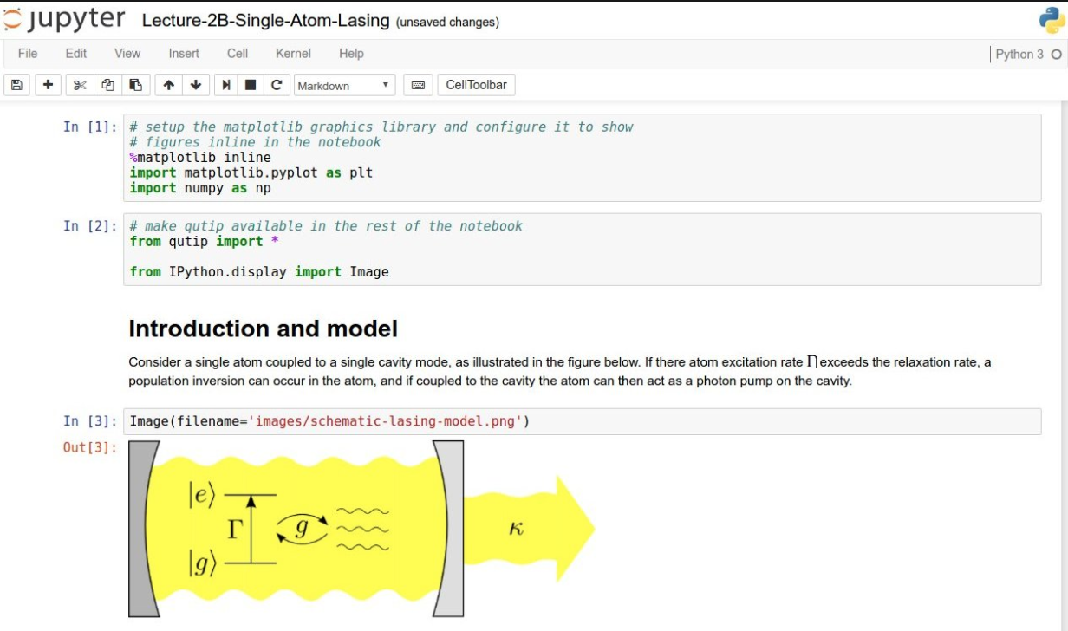

Slide 3
EGI Notebooks
User guide
https://notebooks.egi.eu
JupyterHub: a multi-user version of notebook
Manages Authentication
Spawns single-users notebooks servers on-demand
Gives each user a complete Jupyter server
EGI Notebooks: JupyterHub hosted on EGI Cloud
Integrated with Check-in (AAI proxy)
Persistent storage for notebooks
Bring your own environments/kernels
Access EGI computing and storage from the notebooks
Login

Slide 4
Service modes
Available via the Marketplace
Catch-all instance: https://notebooks.egi.eu
Limited resources: 1 CPU, 1GB RAM and 10GB of persistent storage
Sponsored access (free for the users)
One-click access: No need to Order it
Kills notebooks after 1 hour of inactivity (Use the persistent folder → Don’t loose your work!)
VO/Community deployments
Tailored to specific VO with custom computing/storage, e.g.:
access to GPUs, fat nodes
access to Spark, other BigData/ML environments
auto-mount filesystems on notebooks
…
Community deployment for training
1 CPU / 1GB RAM and 10GB storage / user

Slide 5
Notebooks
User statistics
Community specific deployments
AGINFRA+ instance: 28 Users
Parthenos instance: 9 users
EPOS-ORFEUS instance: 4 users
PaNOSC instance: Under setup
Training instance (deployed for specific events):
CODATA-RDA Summer School July 2018 (55 participants)
TU Wien course Jan 2018 (25 participants)
DI4R October 2018 (15 participants)
ISGC tutorial April 2019 (50 participants)
Bielefeld University May 2019 (30 participants)
Current supporting infrastructure:
10 VMs at INFN-Catania with a total of 52 CPUs and 104GB RAM
3 VMs at CESNET with 24 CPUs and 96GB RAM

Slide 6
Open Science tutorial @ ISGC’19 https://documents.egi.eu/document/3442
EGI Notebooks services
MyBinder.org
Download ipynb file
Execute
Re-execute
Create repository
Upload ipynb file
Add requirements.txt
GitHub
Your repository
Provide GitHub project reference
Your laptop
Specify GitHub repo
Generate DOI
Zenodo
Data repository
Obtain GitHub project reference
Fellow researchers
Discover Notebook (use DOI)
Journal paper
DOI

Slide 7
Target scenario
DataHub
B2DROP
B2SAFE
Etc.
EGI Notebooks & Binder services
Distributed big data
Download ipynb file
Execute
Create repository
Upload ipynb file
Add requirements.txt
GitHub
Your repository
Your laptop
Provide GitHub project reference
Generate DOI
Re-execute
Specify GitHub repo
Generate DOI
Zenodo
Data repository
Obtain GitHub project reference
Fellow researchers
Discover Notebook (use DOI)
Journal paper
DOI

Slide 8
Conclusions
EGI Notebooks: A success story
Growing usage of the catch-all instance
Growing number of community-specific instances
Embedded in Open Science scenario
H2020 proposals under evaluation to expand with an EGI Binder
Integration with data access technologies
EGI DataHub and EUDAT B2DROP – Prototypes available
Join the new task forces to explore:
Grid computing from Jupyter
Binder on EGI
Email enol.fernandez@egi.eu

Slide 9
Thank you!
Experience it at https://notebooks.egi.eu

