Slide 1
Alexander Nakos <nakos.al@iasa.gr>, et al.
Institute of Accelerating Systems and Applications (IASA)

Slide 2
What is the EGI AppDB VMOps Dashboard?
It is a sub-service of the EGI AppDB Service for deploying registered Virtual Appliances to the EGI Fedcloud infrastructure.
It enables users to perform cloud-related operations without the need of any special technical skills.
It is designed to hide the inherent complexities of heterogeneous infrastructures and focus on the user’s intentions.

Slide 3
What does it provide?
A user-friendly web interface, guiding users through the deployment and lifecycle of any VM.
Monitoring of VMs so that users may view the latest information regarding the state of their VMs.
A generic report with respect to the state of the infrastructure itself.
Easy authentication/authorization through the EGI AAI check-in.
Troubleshooting issues regarding running VMs.
Support for 46 Virtual Organizations and 14 sites to deploy to.

Slide 4
Usage requirements
Be able to authenticate using EGI AAI check-in service
Have membership in a supported Virtual Organization and be granted the role of VM Operator (more on that later).

Slide 5
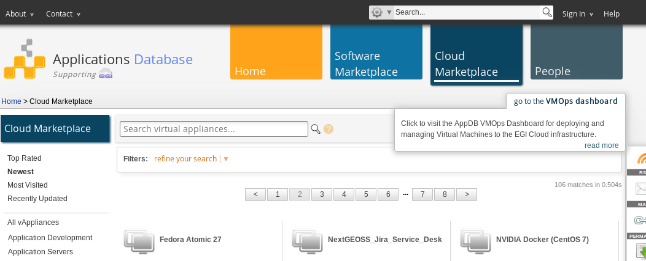
How to access the VMOps dashboard
Through the AppDB portal at https://appdb.egi.eu
1
2

Slide 6
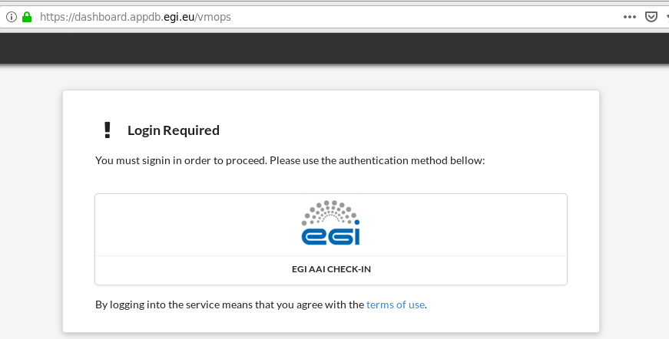
How to access the VMOps dashboard
Or directly, by visiting the VMOps dashboard at https://dashboard.appdb.egi.eu

Slide 7
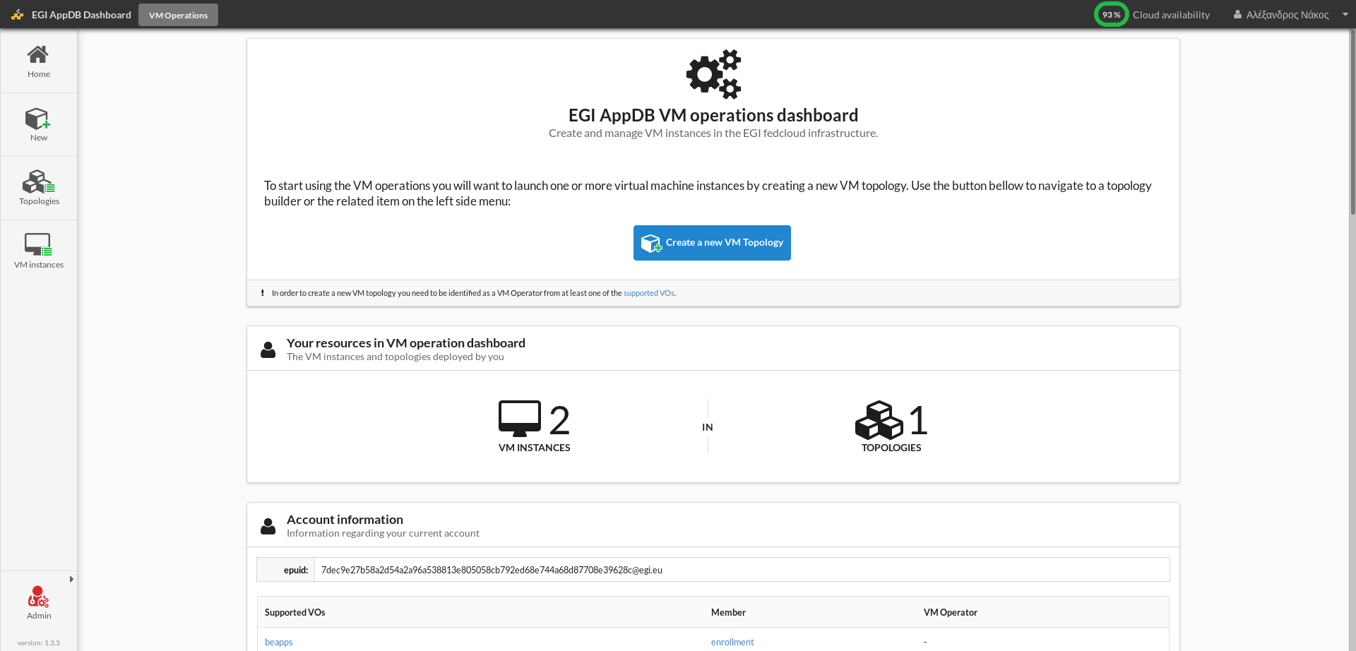
VMOps dashboard home page (1 / 4)
Notes:
Once we log in, the first thing that we see is some helpful information, a summary of running topologies and VM instances, and our account info in the middle of the screen; there’s also a navigation bar on the left, and a toolbar on the top of the screen.

Slide 8
Home page: Active VM instances (2 / 4)
Currently running VMs

Slide 9
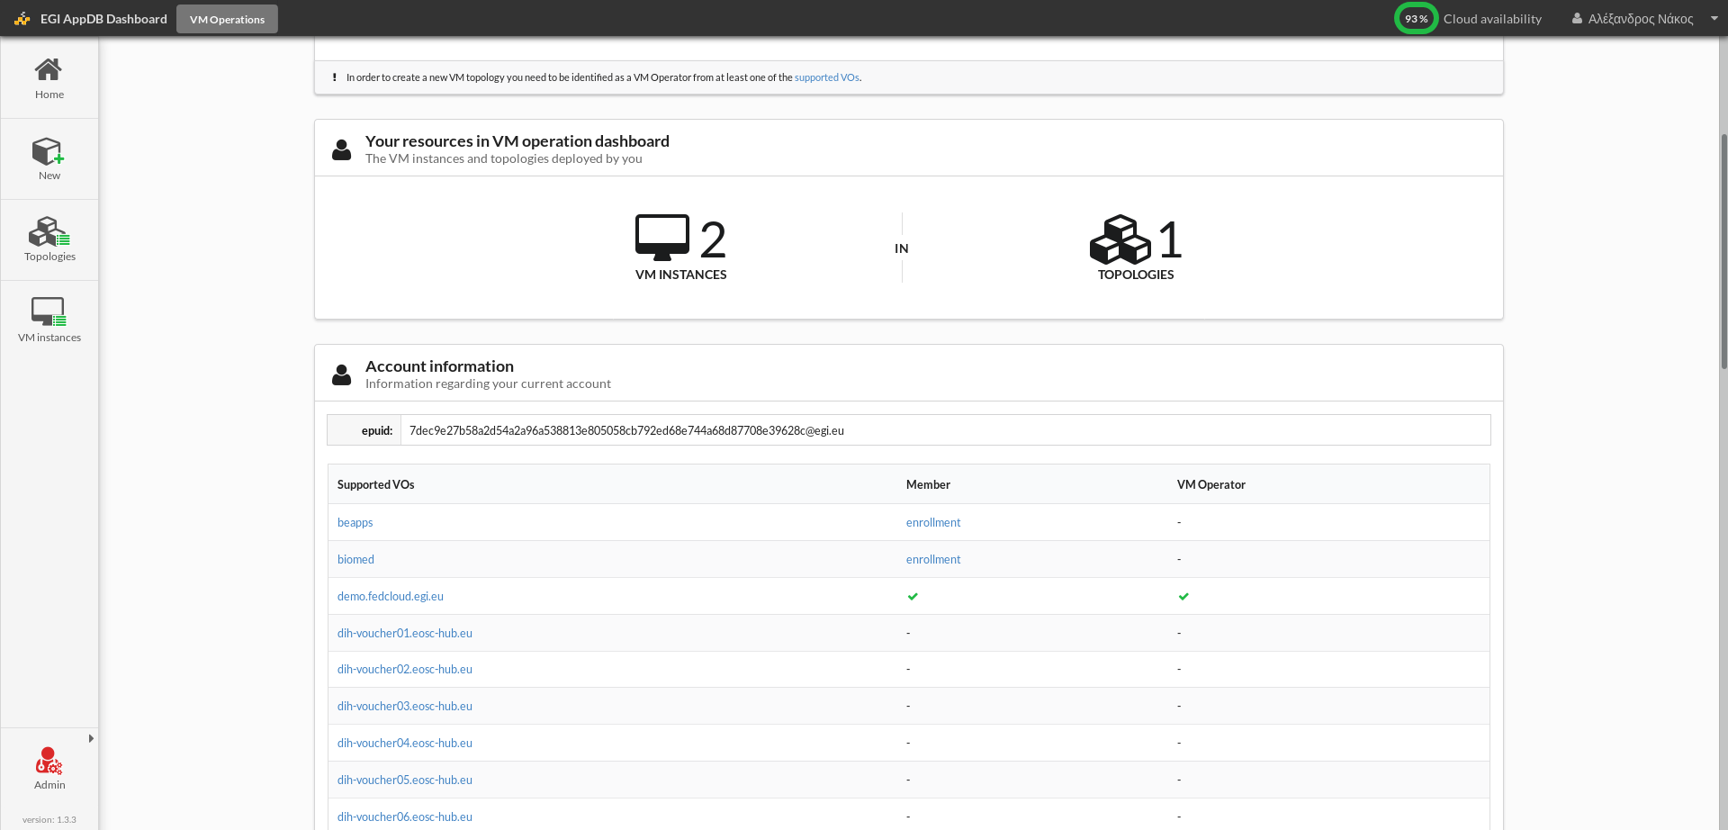
Home page: VO memberships (3 / 4)
Users with membership to the supported VOs, granted with the “VM operator” role
can deploy VM instances in the EGI VM operations dashboard.
Notes:
Now, in order to be able to do anything meaningful, we must belong to one of the supported Vos and have been granted with the VM Operator role withing that VO. We can check this on the account information section, where you can see that I am a member of the fedcloud.egi.eu VO and that I do indeed have VM Operator rights. You can also check this at any time by clicking on your name on the top toolbar right here. If you do not belong to any of these Vos yet, you may pick any one that you might be eligible for and click on its “enrollment” link.
To become a VO member the user must first obtain a personal X.509 access certificate from a recognised Certification Authority as it will be needed to access the voms servers to request membership.
If not sure which VO to select fedcloud.egi.eu serves as a test ground for users to try the EGI cloud and to prototype and validate applications. It can be used for up to 6 month by any new user.

Slide 10
Home page: Create a new VM topology (4 / 4)
Click on the “Create a new VM topology” link on the homepage, to start the process of VM selection, configuration, and deployment.
Notes:
So let’s assume that everything related to accounts, memberships and the rest is in order and go launch a new simple topology, which will contain a single VM instance of a cloud appliance.
we can do this by clicking on the big blue button in the center of the screen if we are still on the home page, or from any other page by clicking on the “new” button in the navigation bar on the left

Slide 11
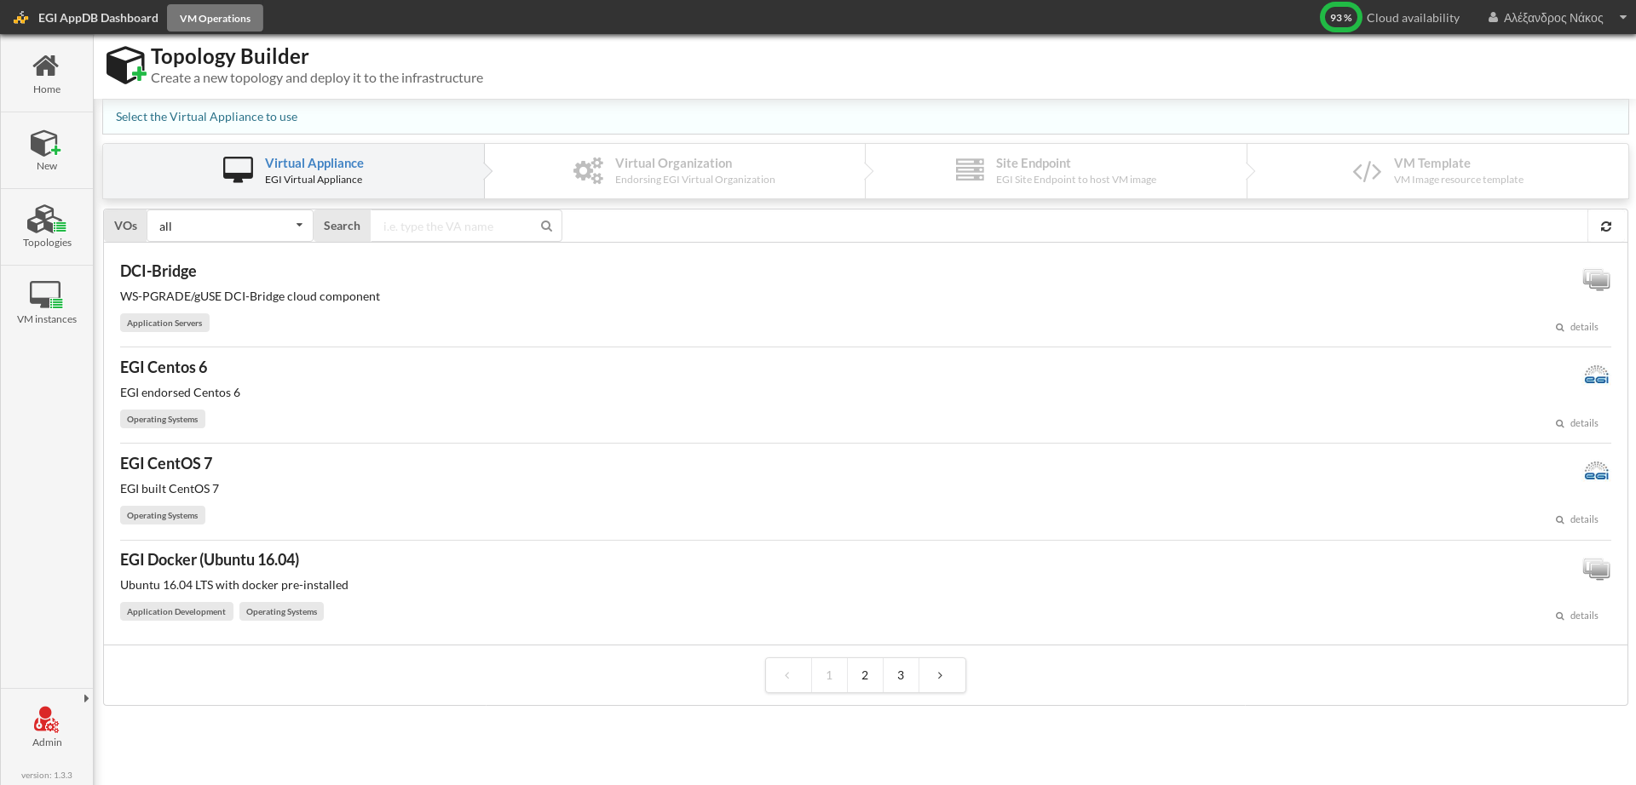
Topology builder: Select a Virtual Appliance (1 / 5)
The user first selects the desired Virtual Appliance, as registered in the AppDB portal.
Notes:
This takes us to the topology builder, which is a wizard that helps us specify all the needed parameters.
On the 1st step, we choose the appliance, one or more instances of which we wish to deploy as a VM

Slide 12
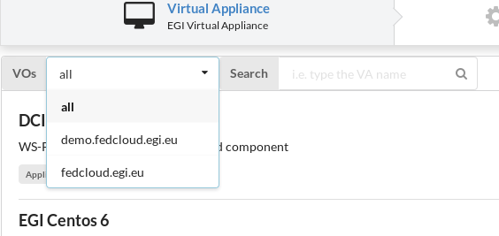
Topology builder: Filtering Virtual Appliances (1 / 5)
Virtual Appliances can be filtered by the VO supporting them and their name.
Notes:
The displayed list of appliances can be filtered by name and by the VO which supports them in the search bar above the list

Slide 13
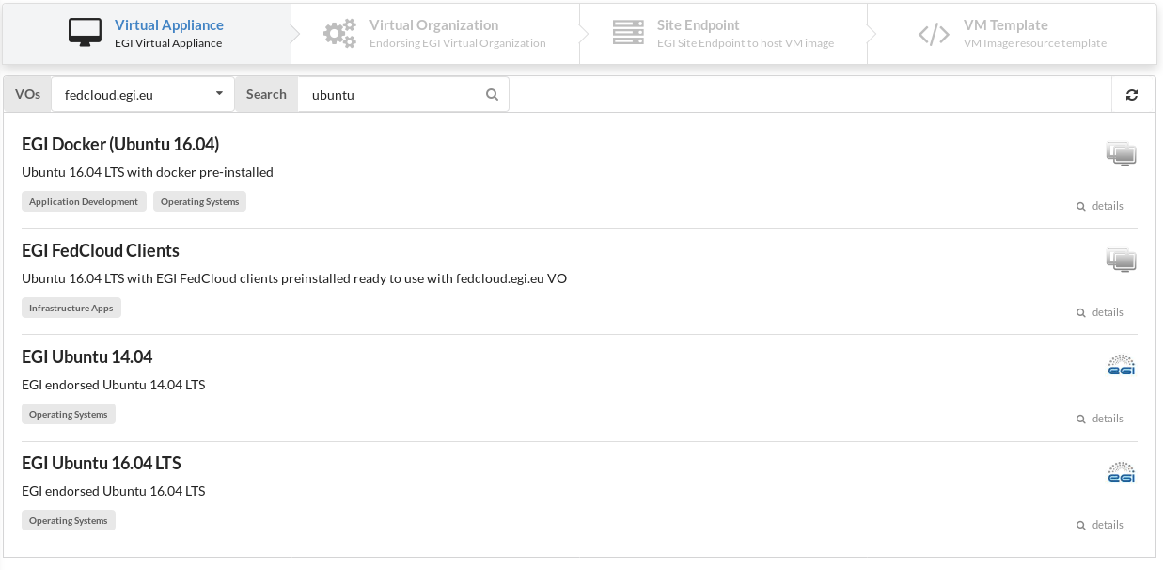
Topology builder: Select a Virtual Appliance (1 / 5)
User can select a Virtual Appliance by clicking on it
Notes:
Lets suppose that we search for ubuntu based appliances supported by the fedcloud.egi.eu. Some tags about the appliance are displayed under its name, but we can see more details about each appliance in case we are not sure which one best fits our purposes, by clicking on the details icon on the right, which takes us the appliance’s entry in the AppDB.

Slide 14
Topology builder: Select a Virtual Organization (2 / 5)
After selecting a Virtual Appliance, the user can select the Virtual Organization under which the topology will run
Notes:
After selecting the virtual appliance we are taken to the second step where we will select a Virtual Organization. If you are a member in more that one of the supported Vos and the appliance selected is also supported by more that one of those VO’s, then you’ll have to choose one – if not, this step is trivial and you just click on the single displayed entry, like in my case.
The listed VOs are the ones that also have sites supporting them. This means that even if a VO supports the appliance it won’t be displayed here if no site supports it.

Slide 15
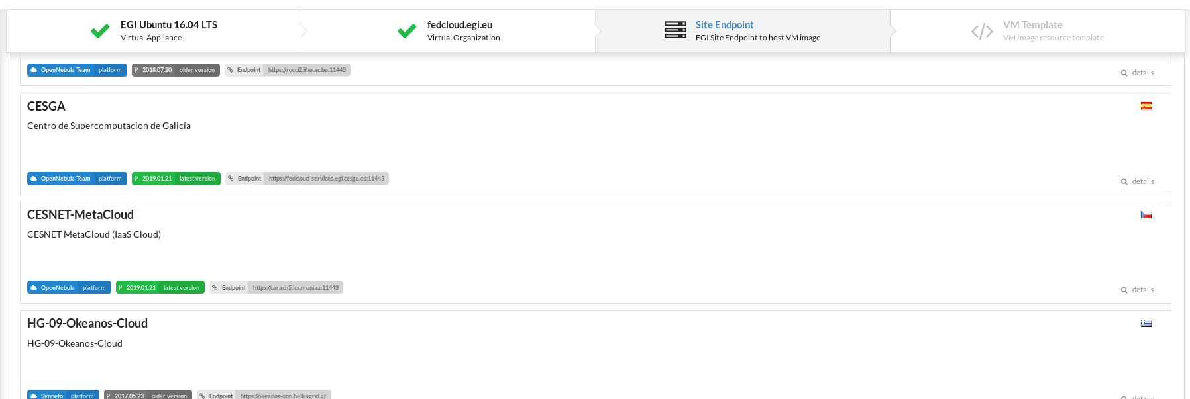
Topology builder: Select the site endpoint to deploy VM (3 / 5)
In this step users can select which site will instantiate and host the VM. This list also displays some properties of each site, e.g. CMF, country, health status, etc
Notes:
After the VO selection we are taken to the step where we have to choose where we want our Virtual Appliance to run. Sites that support the preselected VO are displayed here, along with some rather technical details about the site, such as the cloud platform they offer and the cloud access enpoint; there’s also a button showing us the version of the appliance that the site supports, which is green if that’s the latest version, or grey if it’s an older one, that hasn’t gotten around being updated yet.
Some of the sites might display but be disabled if they experience technical difficulties or are in a scheduled downtime at that moment. Y

Slide 16
Topology builder: Select the template of the VM (4 / 5)
Depending on the selected site, users can select from a list of predefined templates to run the VM, which vary based on the CPU count, memory size, disk size, etc.
Notes:
After the selection of site we are taken to the fourth and final step of selecting the template of the VM instance.
Templates are a way to define the optimal set of resources we need to run the VM instance – to the best of out knowledge. Each site may provide a different set of templates, so we’ll have to choose one based on the numbers provided for each resource. A good rule-of-thumb is to choose the minimum resources needed for the VM based on our experience, in order to avoid wasting resources.
One thing to notice is that the templates depend of the resource provider and may vary from site to site.

Slide 17
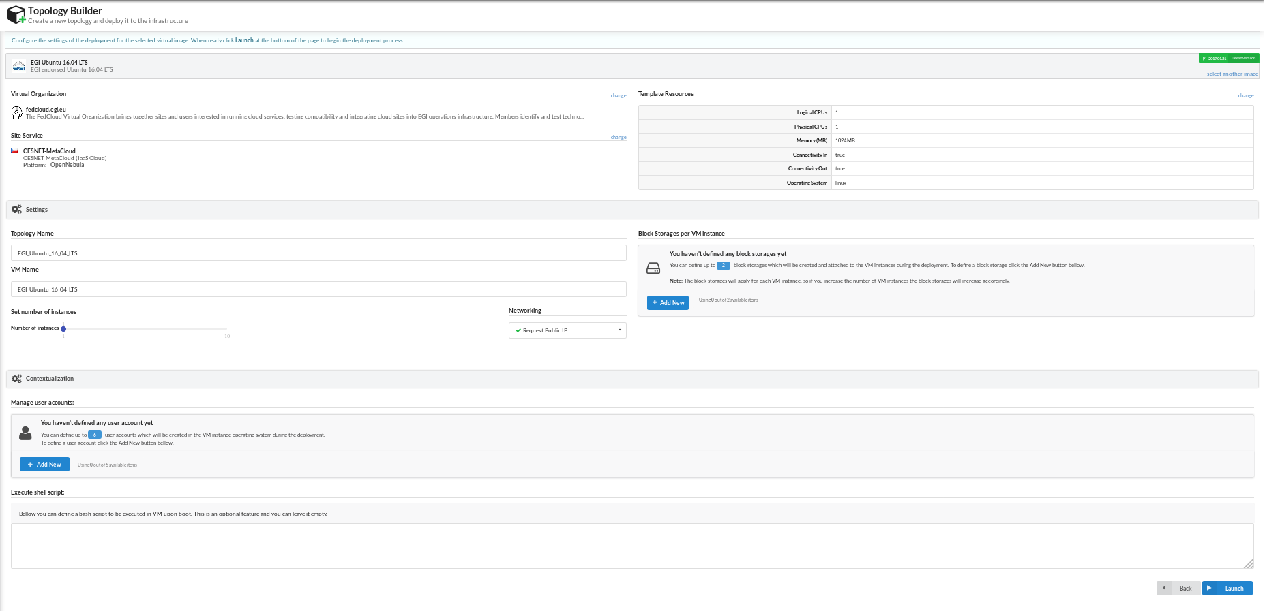
Topology builder: VM configuration (5 / 5)
After selecting which Virtual Appliance and infrastructure to use, users can launch the deployment process. Optionally, users can further configure the topology before deploying.
Notes:
Having completed the wizard, we are taken to the launch page, where we can directly launch our VM to the infrastructure. However we can optionally configure it. On the next few slides we will briefly see the sections this page provides.

Slide 18
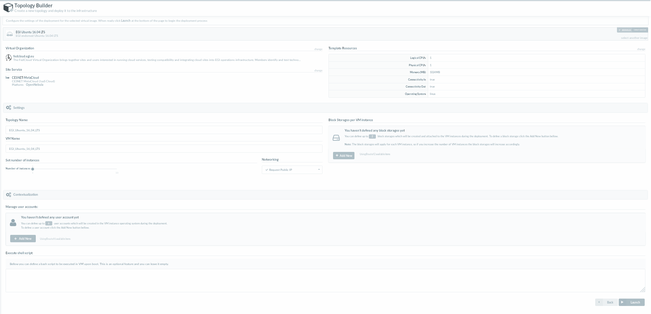
VM configuration: General information (1 / 5)
The top section of the VM configuration displays the current user selection set
Notes:
In the 1st section on the top, we’ve got a summary of our choices regarding the appliance we want to use, the resources we are willing to allocate and the site we have selected. Clicking on any of the “change” links will take us back to the wizard, where we can revise our selection, in case we’ve had a change of heart.

Slide 19
VM configuration: General settings (2 / 5)
Users can configure up to 10 VM instances to be deployed under the current topology
Notes:
In this section we can configure our VM topology to deploy up to 10 instances of the selected virtual appliance. It is suggested to be careful with that as the selected site might not have as many resources ot the time of the deployment.

Slide 20
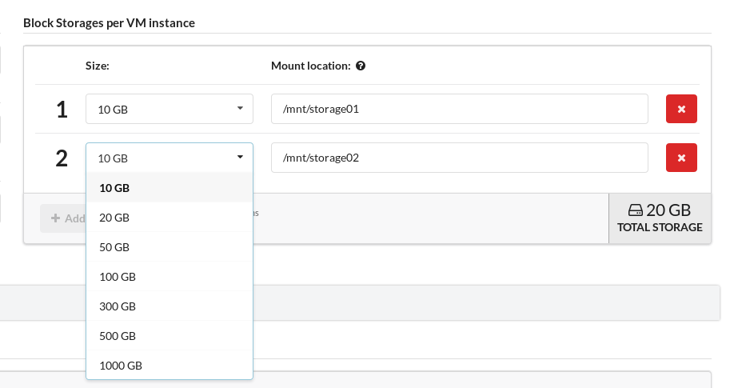
VM configuration: Attach block storages (3 / 5)
Users can attach up to 2 block storages for each VM instance and configure their mount points
Notes:
In this section a form is provided to instruct the VMOPs to create and attach block storages for each VM instance of the topology and where to mount them in the filesystem.
As with the number of VM instances, we need to be careful with how much storage we try to claim, as the selected site might not be able to provide us.

Slide 21
VM configuration: Add user accounts (4 / 5)
Users can contextualize the VMs with custom user accounts created for each VM instance
Notes:
This can be a handy feature for VMs that you want to give access to other users

Slide 22
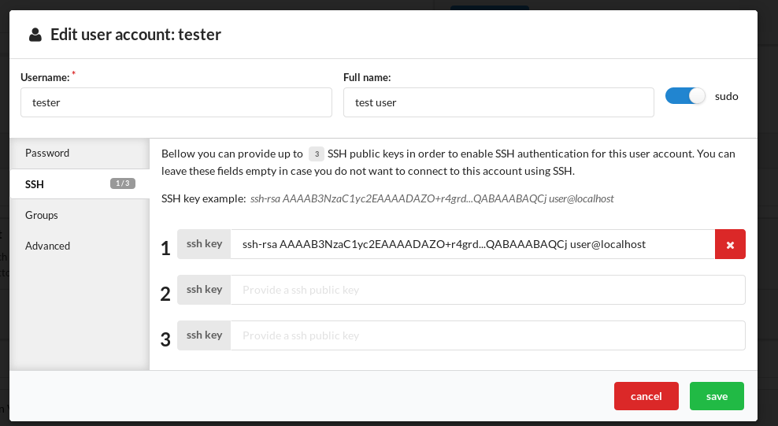
VM configuration: Add user accounts (4 / 5)
Pre-install ssh keys for the user accounts to enable remote access to the VM instances
Notes:
There are more settings for the user accounts as defining sudo access, user groups, home directories etc.

Slide 23
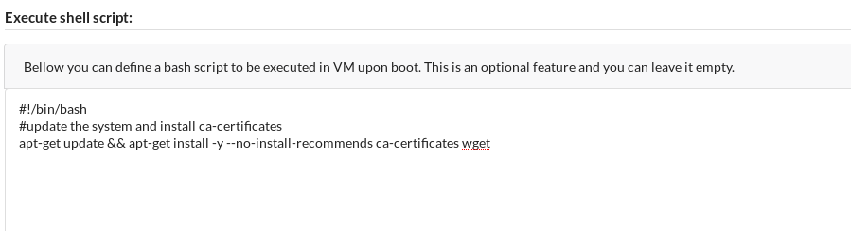
VM configuration: User defined shell script (5 / 5)
Users can define shell scripts that will get executed during VM deployment, to install and pre-configure applications in each VM instance
Notes:
This feature is indented for more experienced users that want to execute their own shell scripts and setup the VM instance during the deployment.

Slide 24
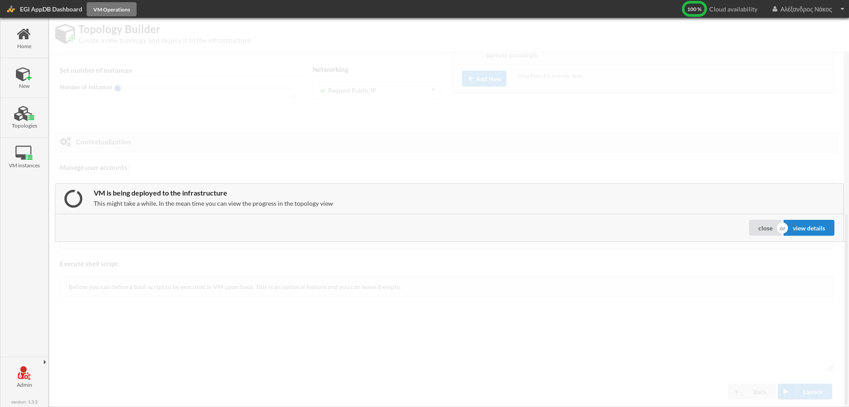
Deploying the VM topology
After initiating deployment, users can view the topology details

Slide 25
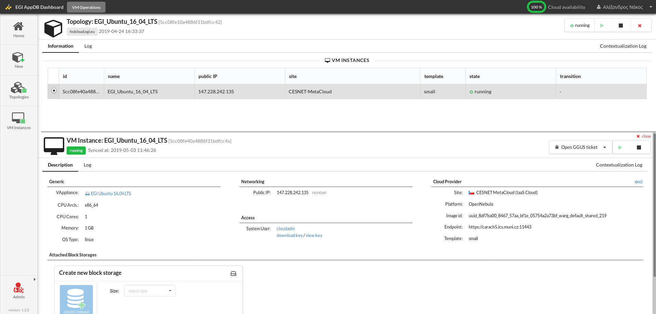
VM Topology details page
Here the users can see an overview of the deployed VM topology
Notes:
The deployed topology is split in half. The top section displays information regarding the topology and the bottom one displays the first VM instance that is preselected by default. In this screenshot we only have one VM instance

Slide 26
VM Topology details page
Users can view the current state of the VM topology and start/stop or undeploy all of its VM instances

Slide 27
VM Topology details page
Users can select and view any VM of the topology and perform individual start/stop actions

Slide 28
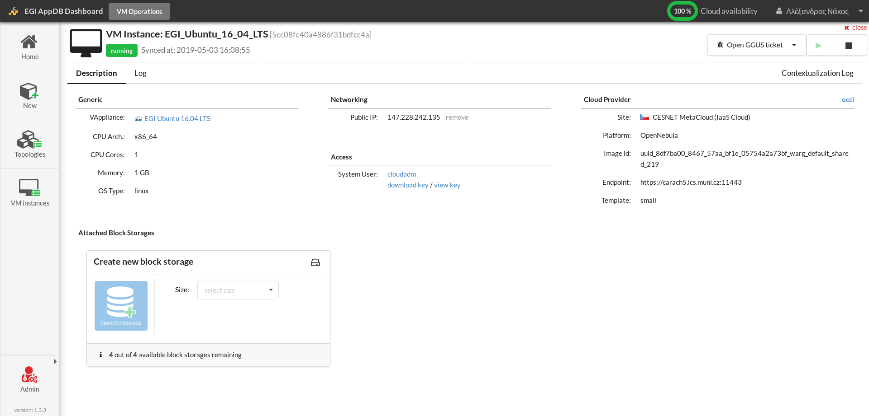
VM Topology details page
Here the users can view information about the resources allocated by the VM and its location within the infrastructure

Slide 29
VM Topology details page
Users have the option to attach additional block storage devices to the running VM instance
Notes:
If we had attached a block storage during the configuration phase it would be displayed here.

Slide 30
VM Topology details page
Networking and access information is also provided to allow remote access to the VM instance

Slide 31
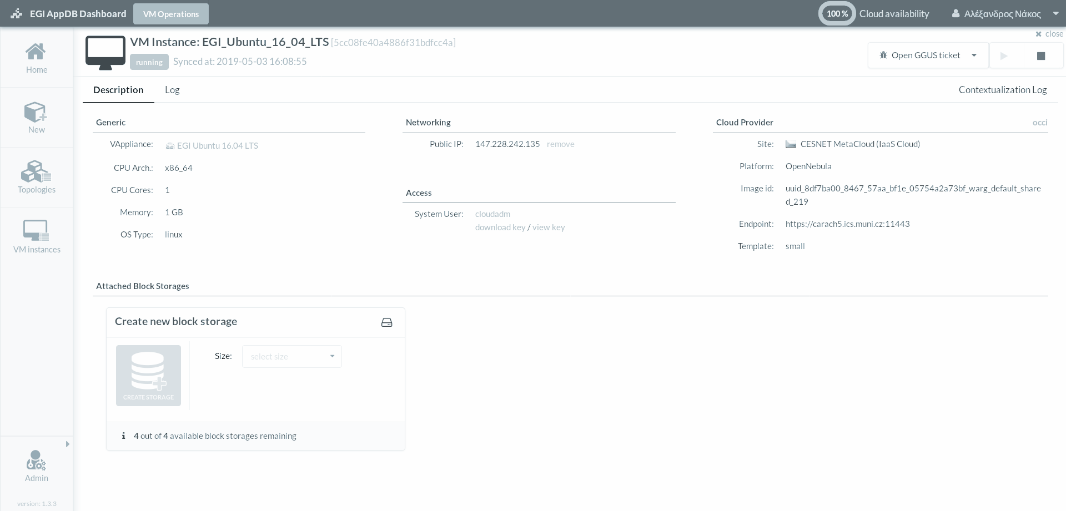
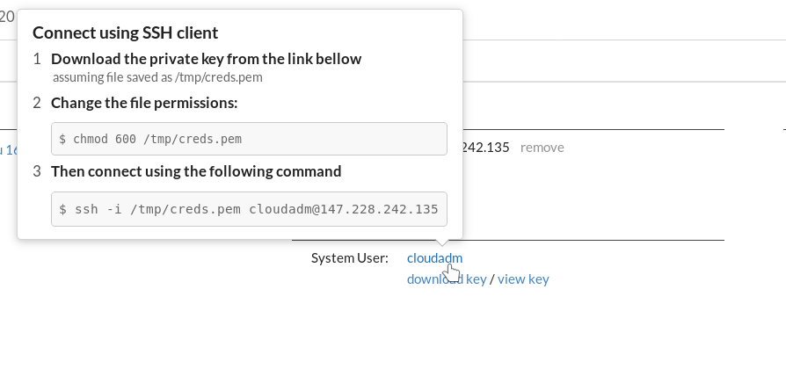
Accessing VM Instance
The users can download a private key, follow the instructions provided and connect remotely via SSH to the VM instance

Slide 32
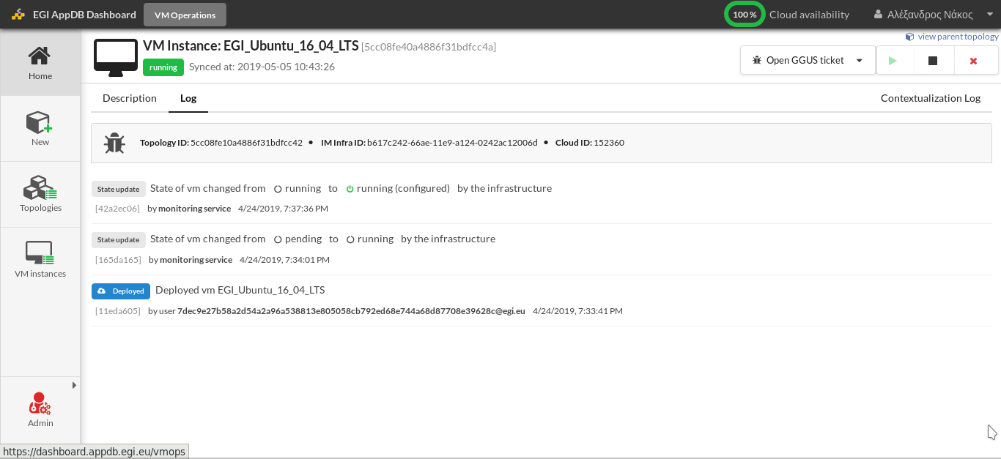
VM Instance logs
The users can view the changes of the VM instance state and the user actions requests and outcomes

Slide 33
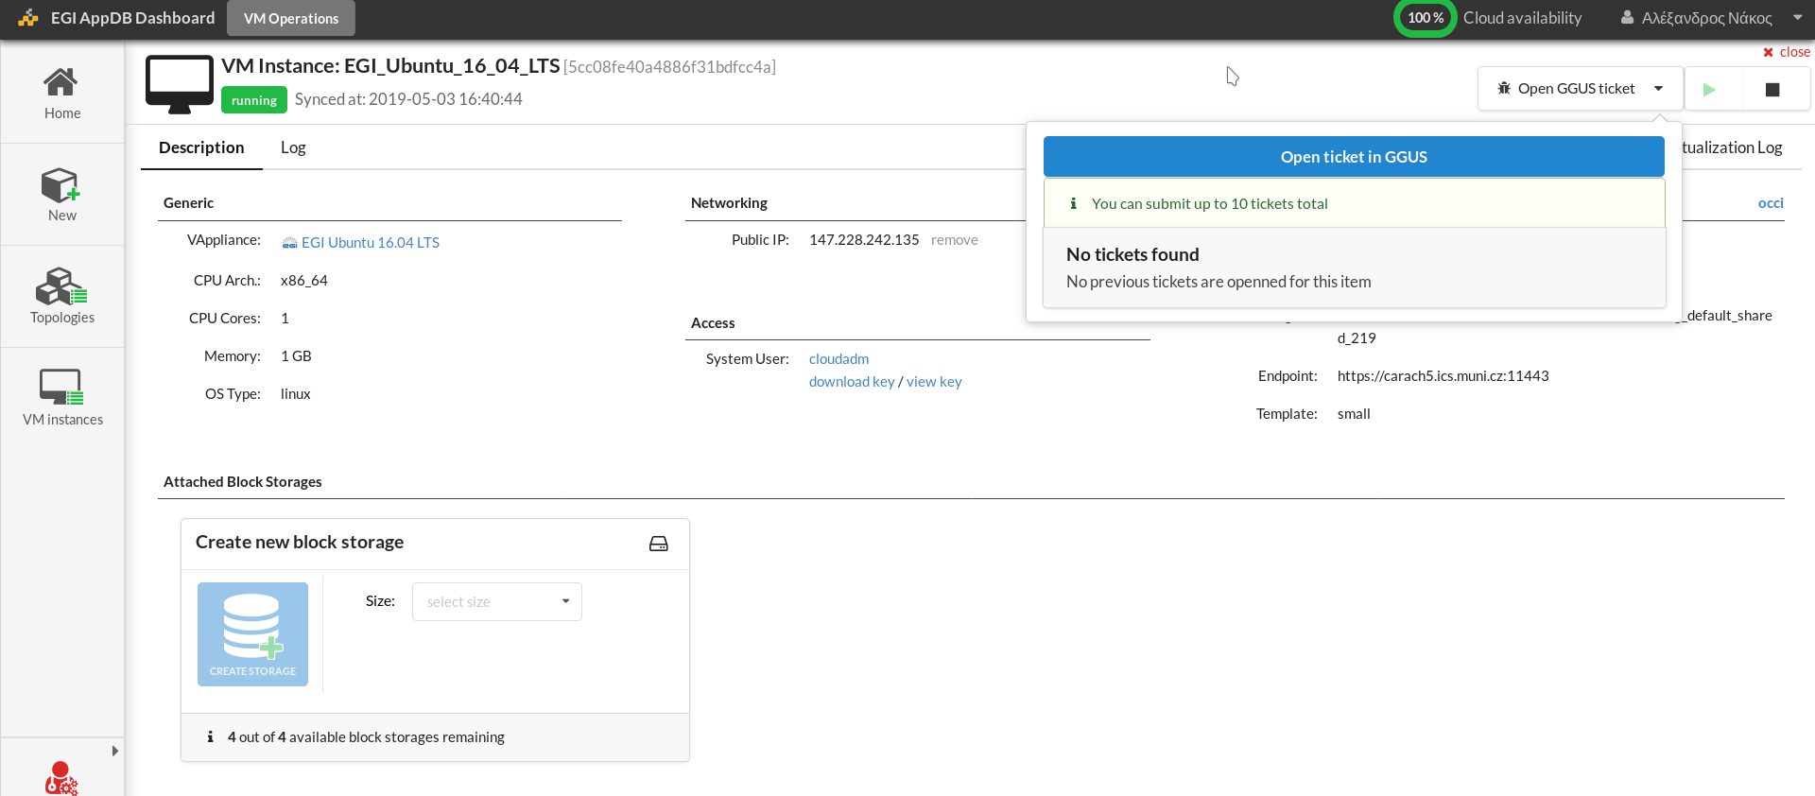
VM instance error handling (1 / 2)
In cases where the VM instance does not behave as expected, the user may communicate with the site administrators to resolve any issues via GGUS service

Slide 34
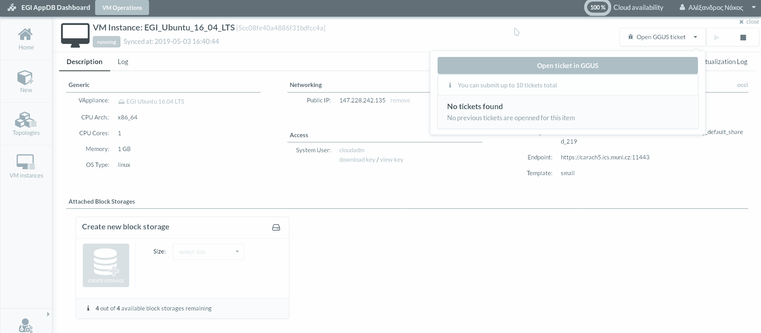
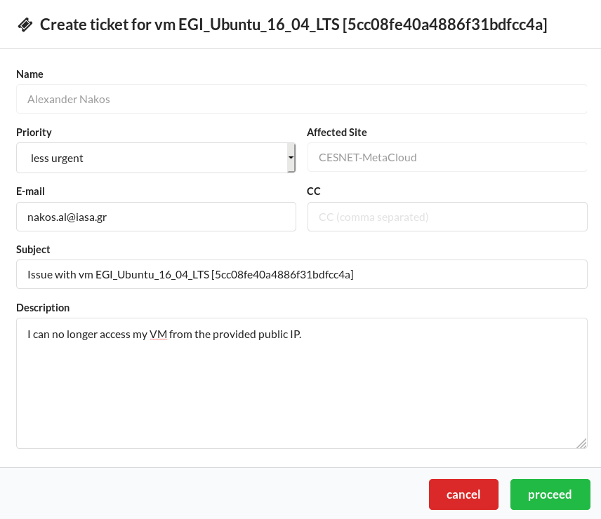
VM instance error handling (2 / 2)
In cases where the VM instance does not behave as expected, the users may communicate with the site administrators to resolve any issues via GGUS

Slide 35
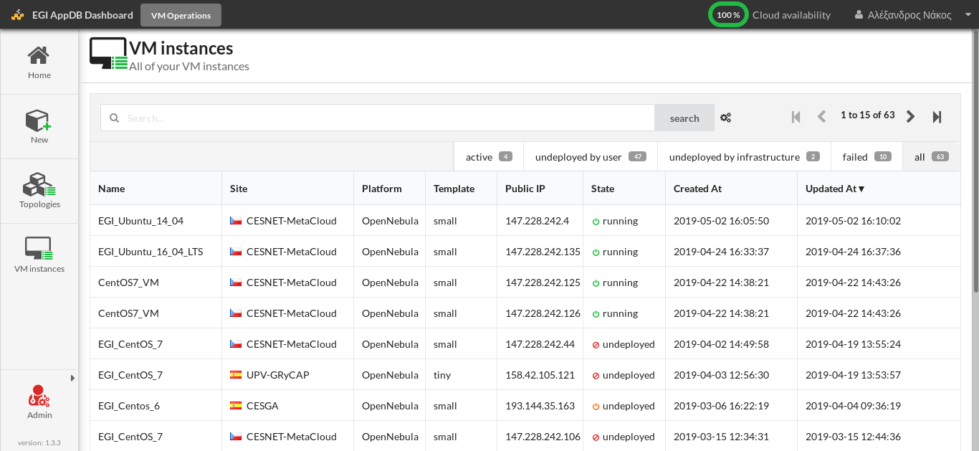
Viewing VM instances (1 / 3)
The users can view the full list of all of the deployed VM instances along with information regarding their current state, site, VO, public IP, etc

Slide 36
Viewing VM instances (2 / 3)
The list can be filtered based on the current state of each VM instance

Slide 37
Viewing VM instances (3 / 3)
Or perform a free text search for virtual organizations, site names, CMFs, etc

Slide 38
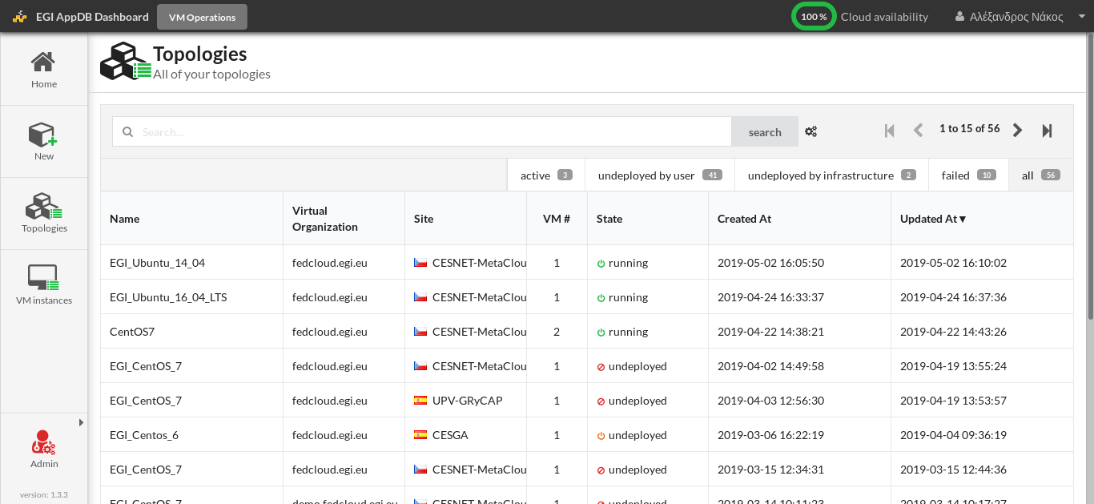
Viewing topologies
The users can also view the currently deployed topologies, as in the VM instances list

Slide 39
Thank you for your attention!
Questions? AppDB SU: appdb-support@iasa.gr
Alexander Nakos: nakos.al@iasa.gr

