Slide 1
EGI Contributions to the
European Open Science Cloud
Tiziana Ferrari
Technical Director, EGI Foundation
EGI Conference 2019, Closing Plenary

Slide 2
Milestones/2015-2017
Nov 2015, First EOSC Community Workshop in Bari and joint Position Paper of the e-infrastructures
Sep 2016, First DI4R Conference, Krakow
Oct 2017, EGI endorses the EOSC Declaration

Slide 3
EGI Actions 1/3
Governance and funding
Support the definition, implementation and operation of the governing structure benefiting from its long-standing experience with hundreds of data centres and providers worldwide
Contribute its best practices and experience to the definition of the EOSC “rules of engagement”, i.e. the policies for the EOSC actors (e.g. end-users, customers and providers) leveraging for the lightweight federation of services capabilities ensuring interoperability among e-Infrastructures and Research Infrastructures.

Slide 4
EGI Actions 2/3
FAIR
Provide and improve implementation guidelines for FAIR services in the area of advanced compute, federated identity provisioning, authentication and authorization, and contribute to the definition of the EOSC minimum set of reference standards and interoperation agreements and service accreditation models for EOSC
Develop the skills and certification schemes necessary to become users or operators of digital research infrastructures

Slide 5
EGI Actions 3/3
Services and Architecture
Define and Operate the EOSC Hub
The Service Integration and Management system (SIAM) accountable for ensuring that all EOSC service providers perform to provide a seamless service that is compliant to contractual obligations made with customer organizations
Operate an open hybrid e-infrastructure offering data-driven advanced compute – Cloud Compute and High-Throughput Compute – and data services from publicly funded and commercial organisations and maintain and evolve the related implementation guidelines to make the related services FAIR.
Operate a federated identity provisioning, authentication and authorization services for the EOSC users and service providers.

Slide 6
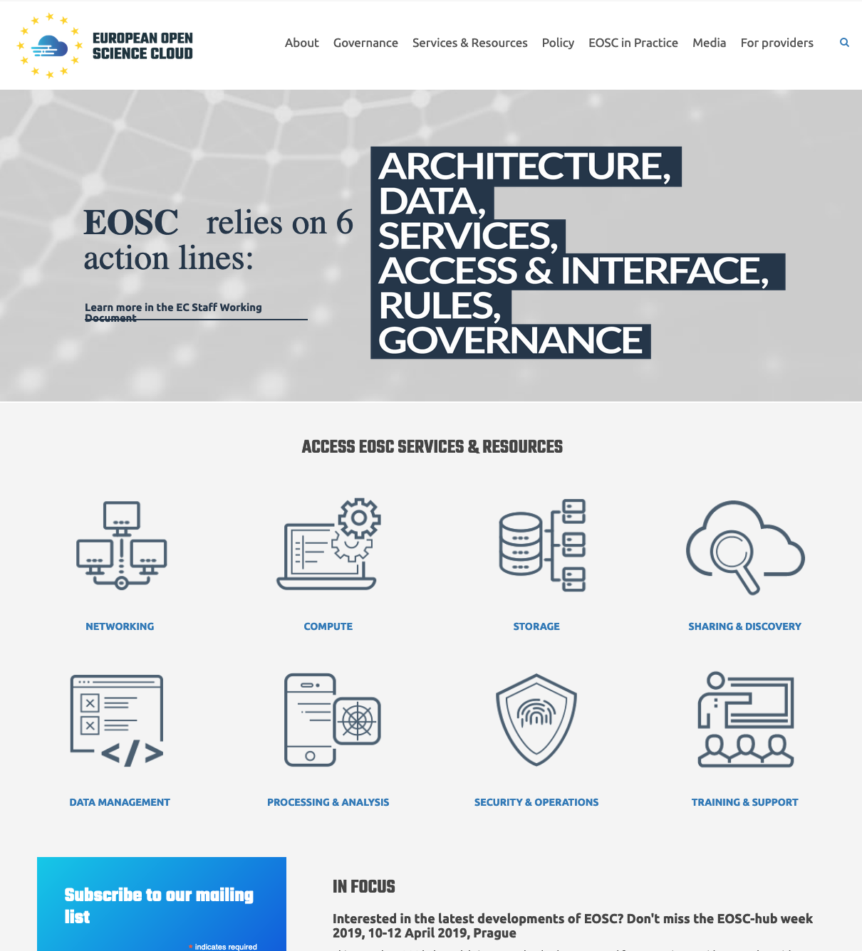
Milestones
Jan 2018, Start of EOSC-hub
Apr and Jun 2018: Collaboration Agreements with OpenAIRE and GEANT (open science, engagement and training, AAI, Cloud)
Nov 2018: EOSC Launch: Portal leveraging Marketplace and AAI experience
Jan 2017: Start of EOSCpilot. EGI leads services pilots

Slide 7
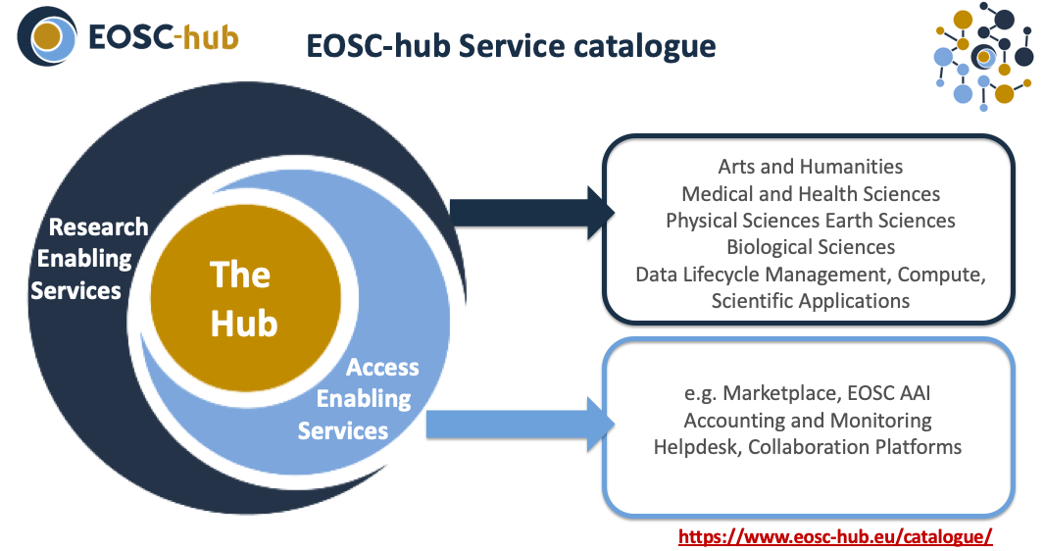

Slide 8
EOSC-hub Competence Centres
HTC and Cloud
DIRAC
AAI, Cloud
Cloud, Data
Management,
Notebooks
Cloud, Distributed Data Management
Cloud, Notebooks

Slide 9
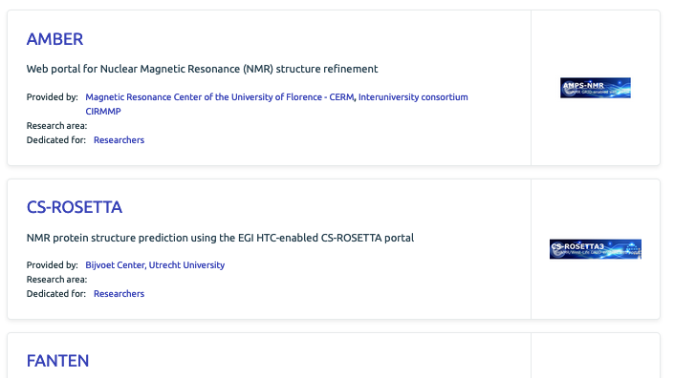
Thematic Services 1/2
Cloud Compute & Containers
HTC
Check-in

Slide 10
Thematic Services 2/2
A European Cloud and Earth Observation data infrastructures
for Copernicus data exploitation in science
Cloud Compute & Containers
Check-in

Slide 11
Milestones/2017-2018
Jan 2018, Start of EOSC-hub
Apr and Jun 2018: Collaboration Agreements with OpenAIRE and GEANT (open science, engagement and training, AAI, Cloud)
Nov 2018: EOSC Launch: Portal leveraging Marketplace and AAI services
Jan 2017: Start of EOSCpilot. EGI coordination of services pilots

Slide 12
Coordinate
Coordinate
Coordinate
Contribute
Coordinate

Slide 13
Widen the User Base
Towards Research and Industry/SMEs
Digital Innovation Hub
A platform that allows facilitates engagement between private industry and public institutions participating in the EOSC
Competence Centres
Research communities, service providers and experts contributing to
Co-design: Requirements, gap analysis and technical development
Piloting and pre-production
Co-design
Requirements and Gap Analysis
Piloting and pre-production service provisioning
Technical development and service deployment

Slide 14
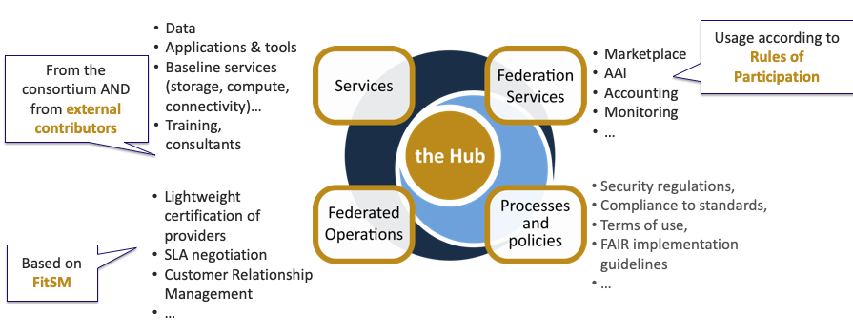
The Hub
Leveraging federation know-how of EGI and EUDAT

Slide 15
EOSC-hub contributions to the EOSC Federating Core
EOSC Portal website and Marketplace
EOSC AAI
Processes e.g. IT security mgm and quality verification
Accounting Monitoring
Helpdesk
Polices Users/Provider
(input to RoP)
Service Portfolio and technical roadmap
Service integration processes, support and training
Engagement with users and service providers

Slide 16
Milestones/2019
~ Sep: Collaboration Agreement with EaP Connect ==> Federated Cloud piloting with Eastern Europe countries
~ June: Collaboration Agreement EOSC-hub - OCRE ==> Cloud procurement and provisioning
July/Sep: EOSC National projects and ExPaNDS
June 15: First call EOSC Early Adopter Programme

Slide 17
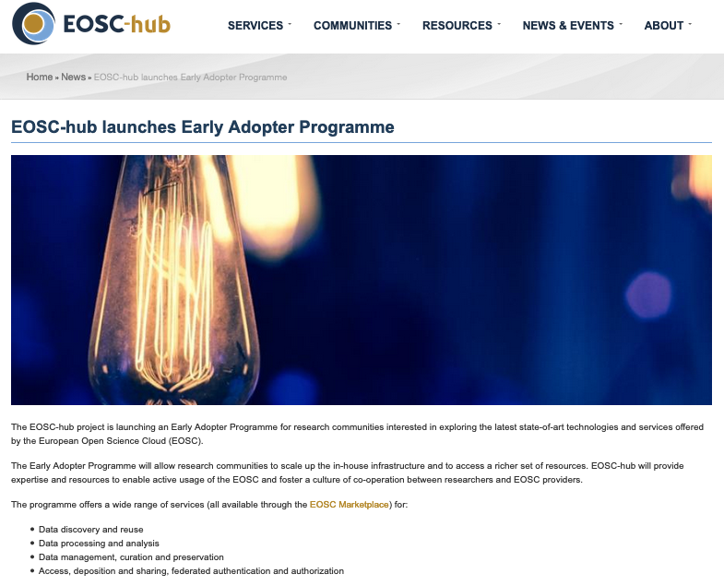
EOSC Early Adopter Programme – 15 June
The EOSC Early Adopter Programme is oriented to communities whose research activities have complex digital needs involving multiple, different technologies, and benefiting from access to state-of-the-art technologies, research infrastructures and services that are not available in their current research environment.
➔ An opportunity for NGIs to be involved in technical support and engagement with researchers!
https://www.eosc-hub.eu/news/eosc-hub-launches-early-adopter-programme

Slide 18
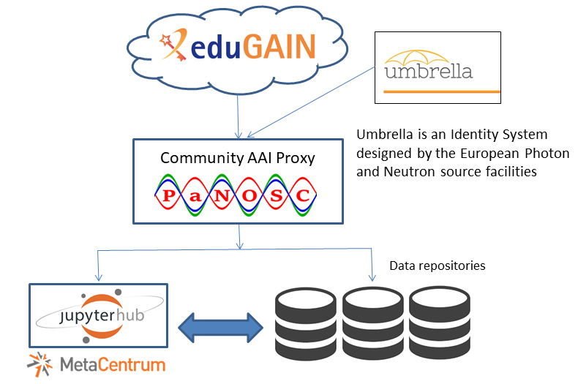
Support to the Photon/Neutron RIs - PaNOSC
ESRF (France)
ILL (France)
ESS (Sweden)
ELI-DC (Belgium)
XFEL (Germany)
CERIC-ERIC (Italy)
EGI Foundation (Netherlands)
Setup an EGI Notebooks instance, federated cloud and distributed data management
Connect with community-specific AAI
Connect with community-specific storage

Slide 19
NGIs: opportunities for consolidation and positioning in the EOSC landscape
The EOSC national perspective

Slide 20
Future H2020 Proposals 1/2
INFRAEOSC-06 call (March 2019): EOSC Portal evolution
Technical development and operations with CYFRONET
INFRAEOSC-03 (April 2020)
Integration and consolidation of the existing pan-European access mechanism to public research infrastructures and commercial services through the EOSC Portal
Enhance operational aspects of the EOSC Portal (Engage with the supply side of EOSC and Interact with the EOSC end users)
Fostering and enabling secure service composability
User enhanced experience & Widening the EOSC user base
Widening the service offer with commercial services
➔ support to the EOSC “federating core” leveraging the EOSC-hub experience

Slide 21
Future H2020 Proposals 2/2
INFRAEOSC-07-2020: Increasing the service offer of the EOSC Portal
(a1) Distributed and cloud computing resources enabling researchers and other users to process and analyse data in a distributed computing environment. The services should include, but not be limited to, running virtual machines on demand with complete control over computing services, executing compute and data-intensive workloads, analysing large datasets and executing parallel computing tasks, utilizing large amount of processing capacity over long periods of time, sharing resources and enabling collaborative research.
➔ EGI proposal to support the EGI strategic agenda and the EGI-specific contribution to the EOSC

Slide 22
Conclusions
EGI contributed to the definition and shaping of the EOSC implementation roadmap
EGI is contributing to the EOSC implementation
EOSC Compute Platform
EOSC Federating Core
NGI consolidation
Preparatory activities in QR3/QR4 to shape the EGI participation to the next round of H2020 calls

Slide 23
Programme Committee
Thank you for your contribution!
Ian Collier - STF
Enol Fernández - EGI Foundation
Luciano Gaido - INFN Torino
Aneta Karainova - Bulgarian Academy of Sciences
Ivana Krenkova - CESNET
Nicolas Liampotis - GRNET
Pablo Orviz - IFCA
Jerôme Pansanel - CNRS / IPHC
Geneviève Romier - CNRS / CC-IN2P3
Mirek Ruda - CESNET
Gergely Sipos - EGI Foundation
Oxana Smirnova - University of Lund
Matthew Viljoen - EGI Foundation

Slide 24
EGI Conference 2019
We planned for 100, but we welcomed 170 participants
Thank you for attending!
If you have feedback, events@egi.eu

Slide 25
EGI Conference 2020
We are looking for a host for the next EGI Technical Conference!
Period: late June 2020
If you are interested in hosting the EGI Conference 2020: email events@egi.eu

