Slide 1
ARC: a short introduction at the Future After CREAM Workshop, Amsterdam, 7 May 2019
Balázs Kónya, Lund University
NorduGrid Technical Coordinator

Slide 2
outline
What is ARC?
Why to choose ARC? …. also mentioning when not to go for ARC

Slide 3
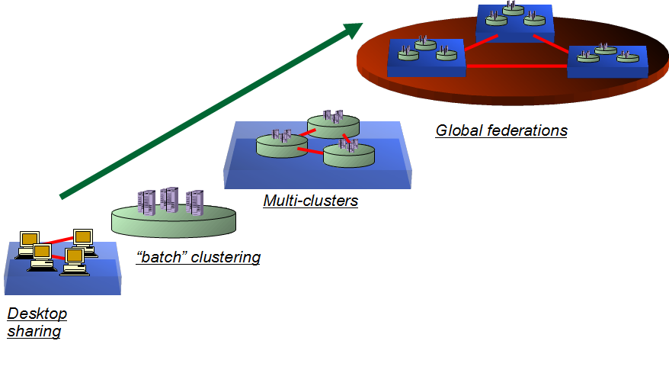
Advanced Resource Connector
connects computing resources in a streamlined standard manner
ARC

Slide 4
What is ARC?
A light-weight, non-intrusive middle layer
built in line with scandinavian design
Adds several „clever features” on top of the cluster layer
so the jobs don’t need to do those on their own
Much more than a simple cluster gateway

Slide 5
What is ARC?
Middleware to enable distributed computing & data handling
Motivated by the needs of LHC experiments
Main goal: common interface to disparate computing facilities
Designed with a distributed Nordic Tier1 in mind
Optimised for HPC deployment
Built-in data caching
Open Source, mostly volunteer contributors
Coordinated by the NorduGrid Collaboration
Supported by EU in past, NeIC now (partially)
Preview in 2002, first release in 2004, Version 6 in 2019

Slide 6
ARC major releases 2004-2018
http://www.nordugrid.org/arc/releases/
Release nr | Release Date | Major Change
Version 0.4 | April13, 2004 | First official release of ARC after two-year of development
Version 0.6 | May 22, 2007 | Same protocols nevertheless minimal backward compatibility with v04
Version 0.8 | Sept 30, 2009 | Contains technology preview of SOA ARC
NOX | Nov 30, 2009 | Separate release of SOA ARC
11.05 (v1.0) | May 10, 2011 | Very substantially re-enginered CE & clients
12.05 (v2.0) | May 21, 2012 | Further client-side changes, libarcclient
13.02 (v3.0) | February 28, 2013 | Several obsoleted components, numerous library name changes (libarcdata2 -> libarcdata)
13.11 (v4.0) | November 27, 2013 | new client-side job database
15.03 (v5.0) | March 27, 2015 | arc-ur-logger got replaced by JURA, removed several components, modules (old data staging)
VERSION 6.0 | 2019 (!) | RC5 is under production testing

Slide 7
ARC-CE instances in GOCDB
compare to appx 370 CREAM-CE instances

Slide 8
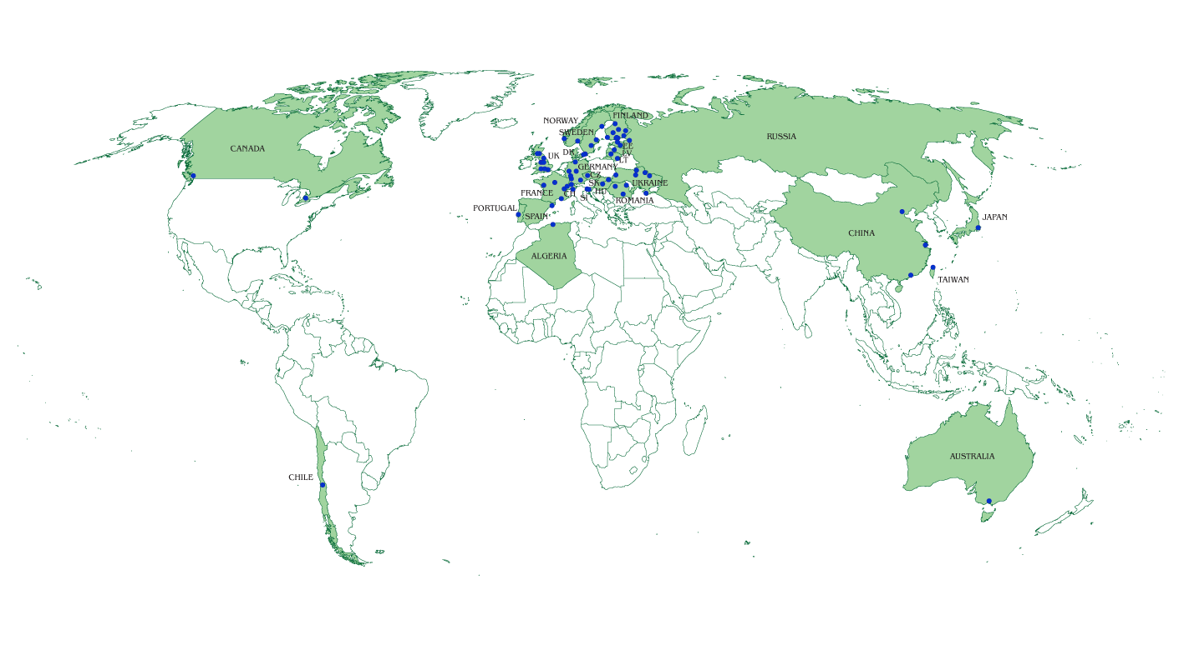
ARC-CE geography
Data as of end-2018

Slide 9
Integration with the (WLCG) world
ARC interacts with:
Storage Elements: Dcache, StoRM, DPM, ...
Security services: ARGUS, VOMS
Accounting servers: APEL, SGAS
Info and monitoring services: Top-BDII, GOCDB,..
ARC-CE is fully integrated into WLCG and EGI operations
Registered service in GOCDB, accounting reports sent to APEL by ARC’s JURA module, GLUE2 Info
Part of UMD releases, User support via GGUS
Widely used by ATLAS sites, also by LHCb, CMS, ALICE and smaller VOs that are supported by respective WLCG sites

Slide 10
Key ARC components
Key components:
ARC CE – a Compute Element, providing interfaces to computing resources
Modular, consists of several sub-components (services and utilities)
Interface for job control
Interface for exposing resource and job status info
Data staging and shared cache management utilities
Jobs do not need to stage data in or out
CLI client tools to interact with ARC CE and relevant third-party services
CLI for jobs management
CLI for X509 proxy management (client to VOMS)
CLI for file transfer (a wide range of protocols)
API: C++ and Python, for interfacing to full software stack
Enables custom services and clients, including arcControlTower (aCT)

Slide 11
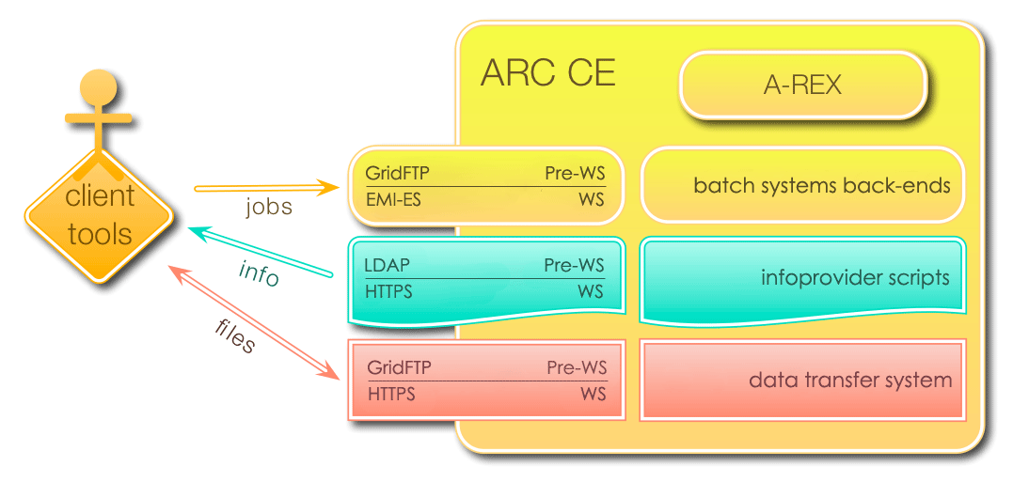
ARC CE internals & interfaces
DATA
DATA
Notes:
Shall REST be added?

Slide 12
Why to chose ARC?
it is almost trivial to provide a service that acts as a simplistic gatekeeper, i.e.
executes a job either directly on a node or hands over to a batch system

Slide 13
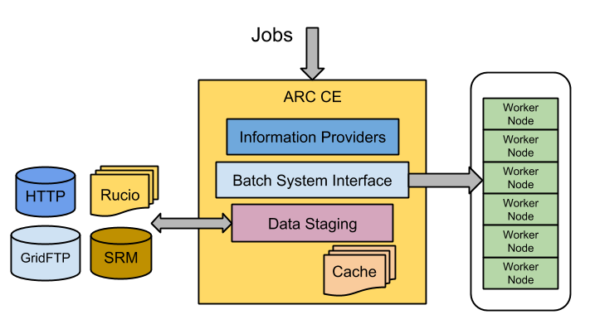
WHY ARC? Powerfull data staging with CACHE
The DTR subsystem of ARC CE performs the critical role of transferring input and output data for jobs, [arex/data-staging]
Generally copying data between a shared file system and Grid storage
transfershares, speedcontrol, transferretries, etc..
tech descripition: https://wiki.nordugrid.org/wiki/Data_Staging
The CACHE module of an ARC CE may keep a cache of input data on the shared file system, [arex/cache], [arex/cache/cleaner]
Jobs requiring already cached files do not need to re-download them
Cache is self-managing using LRU and/or a file lifetime based cleanup
Multiple cachedirs, cache draining
tech description: Section 6.4 sysadmin guide

Slide 14
Data staging protocols
Largely influenced by WLCG evolution, the current data transfer protocols supported by ARC are:
ACIX (ARC Cache Index)
File
GridFTP
HTTP(S)
LDAP
Rucio (ATLAS data management system)
SRM (Meta-protocol for access to WLCG storage, now deprecated)
S3
Xrootd (Native protocol to access files stored in ROOT format)
LFC, dcap, rfio, ... (legacy WLCG protocols supported through gfal2 library)
Note that ARC CE does not do 3rd party transfer, all data is transferred to or from a local file system

Slide 15
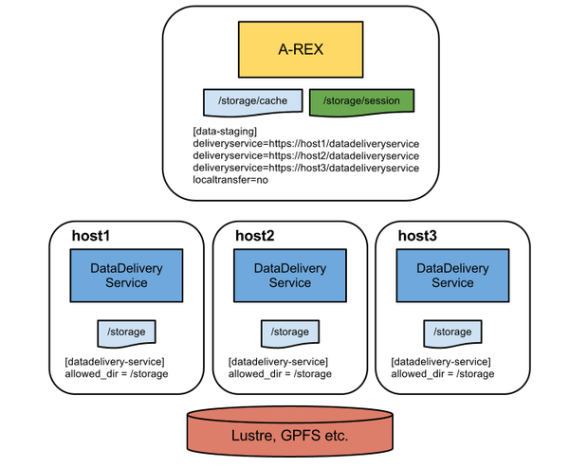
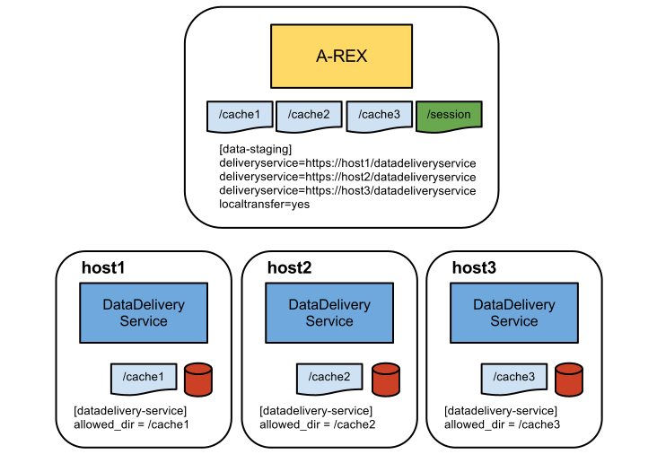
Datadelivery-service: scaling up data staging
Data transfer capability can be scaled up by adding extra data staging hosts, [datadelivery-service]
The master CE hosts delegates data transfer to the other hosts
tech description: https://wiki.nordugrid.org/wiki/Data_Staging/Multi-host
Multiple hosts with one large shared FS
Multiple hosts each with own cache

Slide 16
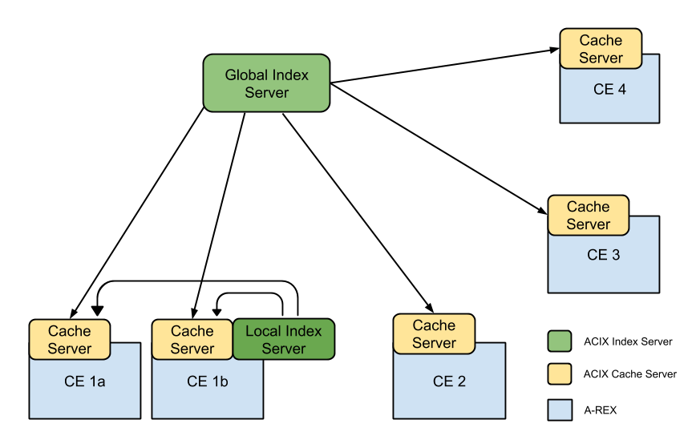
More on cache, ACIX and Candypond
Caching of remote files is a very powerful feature for workloads which require the same input data for many jobs
Several related services also exist:
CacheAccess: extension of A-REX service allowing the cache to be exposed to the outside, [arex/ws/cache]
CandyPond (cache and deliver your pilot on-demand data): extension of A-REX service allowing on-demand caching of files by a running job, [arex/ws/candypond]
ACIX: A catalog of cache content - useful for brokering jobs to CEs where data is already cached, [acix-scanner], [acix-index]
Whistleblower: Publication of cache content to an external service (e.g. Rucio) through message queues
Possible ACIX deployment, with one global Index Server and a local Index Server for CE 1a and CE 1b

Slide 17
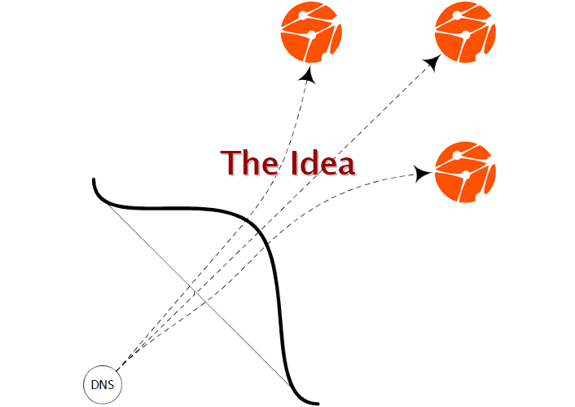
WHY ARC? strong INFOSYS gets even better with the new ARCHERY
ARC was always strong wrt. INFOSYS, with ARC 6 it gets even stronger
ARC Hierarchical Endpoint RegistrY: a service endpoint catalogue embedded in DNS
Use DNS infrastructure
Store essential, mostly static data as DNS TXT RRs
Organize endpoints in a natural hierarchy
Top-bottom management

Slide 18
WHY ARC? it comes with a sophisticated RunTimeEnvironment framework
RTE (RuntimeEnvironment) is a named reference for a feature (ENV/PROXY), software (APPS/HEP/ATLAS), hardware (ENV/GPU) offered to the job by ARC in a consistent way
Basically various scripts executed by ARC in connection with job processing
RTEs contextualise job execution in a standard manner
The connection point for containers
RTEs are advertised, can be used in resource discovery, filtering and site authorization
RTE parameters, DEFAULT RTEs, enable/disable RTEs

Slide 19
Examples for RTEs
ENV/PROXY
Copy proxy and CA certs (optionally) to the worker node
ENV/RTE
Copy the RTE scripts to the WN
ENV/LRMS-SCRATCH
Define local scratch, move files to the local WN disk, that is created dynamically by the LRMS
ENV/PREPOD-TEST
Declare the cluster as a test site (advertisement only)

Slide 20
WHY ARC? dedicated tools for sysadmins
GOAL: make it easy to deploy and operate an ARC CE
A new tool, arcctl was delivered to simplify the life of an ARC CE sysadmin/manager:
BASH-completion for subsystem names, arguments, jobIDs, cert DNs, RTE names…
DEPLOY, TEST-CA: voms-lsc, IGTF, missing dependencies, generate test certificates
JOB: complete job management, job logs, job statistics
ACCOUNTING: archived records, accounting logs, APEL re-publishing (sysadmin tool for JURA)
CONFIG: arc.conf management
RTE: RTE subsystem management
SERVICES: enable/disable ARC services, start/stop/restart sub-components

Slide 21
WHY ARC: it offers a powerful and flexible control over the entire CE
Sophisticated global (grid) -> local (unix) user identity mapping framework:
map_to_user, map_to_pool, map_with_file, map_with_plugin, policy_on_nomap, policy_on_nogroup
[authgroup] based authorization
an authgroup represents set of user identities that are defined by matching configured rules
subject,file,voms,userlist,plugin,authgroup
Access control on submission interface AND queue level
Additional control mechanisms for jobs and data:
statecallout: AREX runs an external executable at a job state transitions to decide upon job cancellation
maxjobs, maxrerun, speedcontrol, maxdelivery

Slide 22
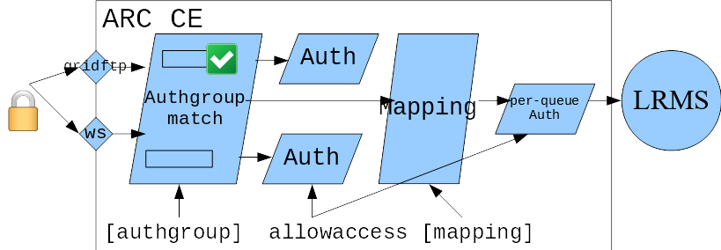
Powerful authorization & mapping scheme

Slide 23
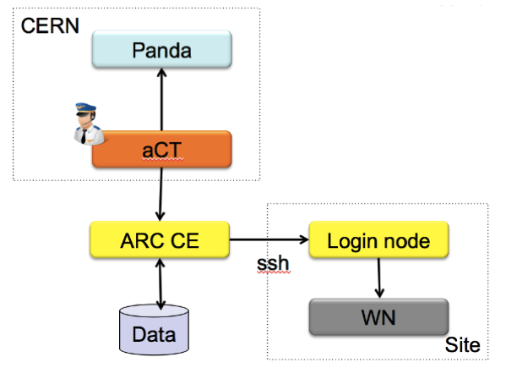
WHY ARC? HPC friendly…., nevertheless fully EGI integrated
HPC sites are very restrictive allowing only ssh communication with outside world.
ARC jobs can still run on these sites e.g. with ARC-CE ssh-ing to site’s login-node (remote lrms feature of ARC)
pull requests
Some HPC sites are even more restrictive and don’t want any unusual service with open network interfaces
Solution: pull jobs/data to the HPC site: using aCT@site
a tightly integrated aCT and a networkless ARC CE on the HPC the site
HPC-Site
aCT
tight integration
ARC CE
WN

Slide 24
WHY ARC? ARC 6: major release soon out!
Major changes:
Internal scalability
Manageability: configuration redesign
Clean-up, retirement, interface consolidation: kept only what is needed
New sysadmin tools
Redesigned RTE
Reworked accounting subsystem (JURA)
New Infosys component for service registry: ARCHERY
With ARC6 you’ll get a modern CE, stay tuned: http://www.nordugrid.org/arc/arc6/

Slide 25
ARC 5 support statement
No new feature development is planned or going on for ARC5 for at least half a year by now
No bug-fixing development will happen on ARC5 code base in the future except for security issues.
Security fixes for ARC5 will be provided till end of June 2020.
Production sites already running ARC 5 will be able to get deployment and configuration troubleshooting help for their ARC 5 sites via GGUS till end June 2021. This we call "operational site support".
ARC5 is available in EPEL7 and will stay there. EPEL8 will only contain ARC 6.

Slide 26
Sometimes ARC is not the best option
Communities not familiar with the “x509 grid security” world
Native Condor sites

Slide 27
ARC CE: the summary
ARC has a long history of being an efficient CE for EGI/WLCG
Reliable Open Source community
Long-term sustainability thanks to the governing NorduGrid Collaboration behind
In addition to being a “normal CE”, ARC offers numerous innovative and attractive features:
Data caching, provisioning
Job environment framework (RTEs)
Information system solutions
Server-side manageability, sysadmin friendliness
Powerful Authorization & resource control
Stability, non-intrusiveness, HPC friendly
The new major release, ARC 6 offers a unique opportunity to experiment with ARC

Slide 28
Documentation, support, availability
Documentation:
ARC5: documentation is distributed with the software
ARC CE sysadmin guide is the must
ARC6: modernised documentation online at http://www.nordugrid.org
Still in works
Support:
For those familiar with GGUS, submit tickets to “ARC” unit
For community support, subscribe to either:
nordugrid-discuss@nordugrid.org – generic
CERN e-group wlcg-arc-ce-discuss@cern.ch – WLCG-specific
For bug reports and feature requests, submit tickets to:
https://bugzilla.nordugrid.org
Code:
https://source.coderefinery.org/nordugrid/arc
Linux packages:
Global Linux repositories (CentOS, Debian, EPEL)
Upstream: http://download.nordugrid.org/repos.html

