Slide 1
OMB May 2019
Matthew Viljoen – EGI Foundation
EGI Operations Manger
EGI Conference 2019, Amsterdam

Slide 2
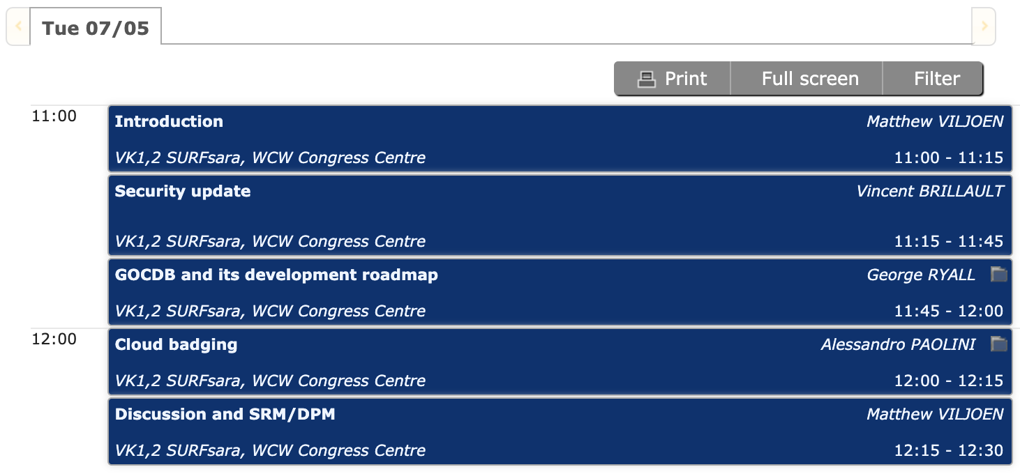
Agenda

Slide 3
EOSC-hub Security Policy updates
3 baseline EOSC policies: AUP, Security Policy, Site Security Policy
Draft Presented at last OMB
Awaiting formal feedback from EUDAT CDI
Once finalized, will be approved by EOSC-hub AMB
AUP to initially cover AAI, Marketplace
Plan to supersede existing EGI, EUDAT policies

Slide 4
High Level Operations Objectives Updates
CREAM CE end of life
Integration of HTCondor into EGI continuing
Migration path to ARC-CE, HTCondorCE, Dirac
2 dedicated sessions at conference after OMB
Cloud site badging
Covered later in this session
Management of Operational Tools Development
To be covered at future OMBs: GGUS, Argo, Ops Portal, AppDB

Slide 5
Moving WebDav nagios probe into CRITICAL profile
webdav probes included in ARGO_MON_OPERATORS profile since January 2018
failures generates an alarm on the ROD dashboard
39 service endpoints registered in GOC-DB
30 production and monitored
32 monitored endpoints
CRITICAL status: 2
WARNING status: 1
OK STATUS: 90.6%
More than 75% of webdav endpoints are passing the tests
Proposal: webdav probes moved to ARGO_MON_CRITICAL profile from Jun 1st.

Slide 6
INFRAEOSC-03 and 07
Future EOSC-hub funding under -03 (Apr’20)
Future EGI ops/dev funding under -07 (Apr’20)
(a1) Distributed and cloud computing resources
Enabling researchers to process/analyse data in distributed environments.
Preparations for proposal to start later this year
Ops Tools development funded separately for EGI, EOSC-hub

Slide 7
Next OMB
Next OMB
Thu 20 Jun, Thu 18 Jul
To be confirmed on ML

