Slide 1
Data Management in EGI
Status of EGI Services for Data Management
Baptiste Grenier
EGI Foundation

Slide 2
Outline
A quick overview of all EGI Data-related services
Archive Storage
Online Storage
Data Transfer
DataHub
Looking forward
Offering services for the whole data lifecycle
Interesting complementary solutions

Slide 3
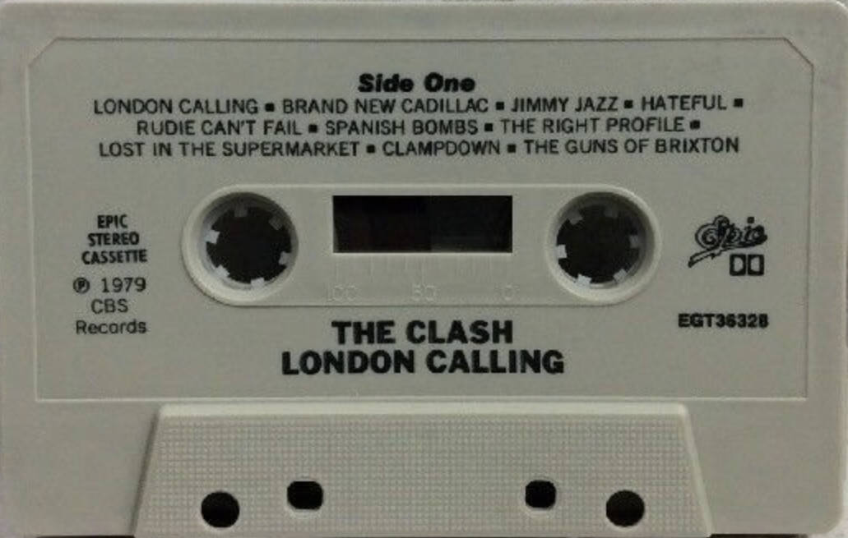
EGI Archive Storage
Back-up data for the long term
Legacy service for long term archival of data
Initially based on Tape
Multiple EGI participants using tape for their internal needs
Other technologies could be used
Currently discussing access models with service providers
Any interested service provider is welcome
May be retired from EGI Service Catalogue if no way to offer it is found

Slide 4
Online storage
Store, share and access your files and metadata
A production service covering multiple data storage and access technologies
“Grid” Storage Elements
DPM, dCache, StoRM…
“Cloud” object-storage
OpenStack Swift
Providing data access to other services
Cloud Compute, Cloud Container Compute
High Throughput Compute
Workload Manger

Slide 5
Data Transfer
Transfer large sets of data from one place to another
A production service for managing data transfers reliably and efficiently
FTS- and WebFTS-based
Two providers have recently agreed an OLA with EGI
CERN – FTS and WebFTS
UKRI/RAL - FTS
Next steps
Integration of a with EGI Check-in and RCauth
OIDC
Online CA

Slide 6
DataHub
Data as a Service, distributed data management
A service for federated access, sharing, publishing, discovery of data
based on Onedata, operated by CYFRONET
EGI’s central Onezone: https://datahub.egi.eu
A reference/central Oneprovider connected to the DataHub
Providers at various sites can be federated
Integration with various other services
EGI: Check-in AAI, Cloud Compute, Cloud Container Compute, Online Storage, Notebooks,…
EOSC-hub: B2HANDLE, B2FIND,…
A long exploratory phase with various piloting activities was conducted
Lots of improvements on stability, performance
Lots of new features
Discoverability through the EGI Service Catalogue being finalized

Slide 7
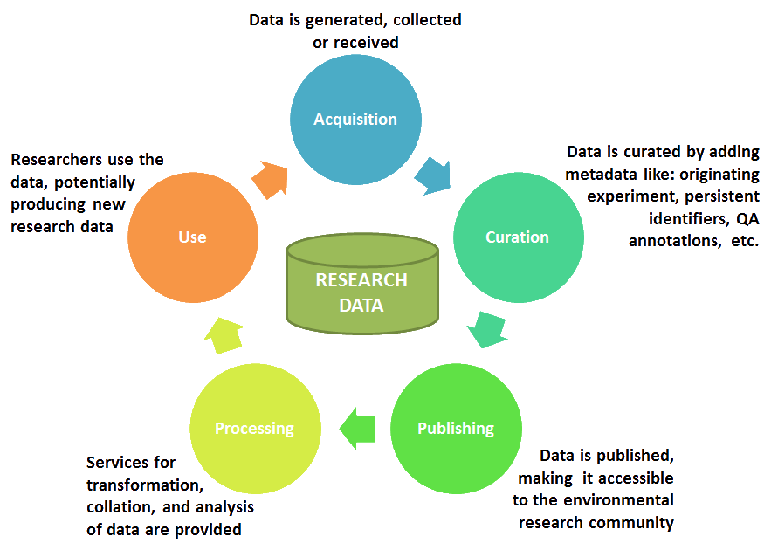
Looking forward
The Research Data Lifecycle
Ambition: Providing an interoperable and composable service offer supporting the research data lifecycle
Supporting FAIR practices
Persistent Identifiers
Cataloguing, Discovery
Interoperability, Integration
Data orchestration
Source: ENVRI Reference Model

Slide 8
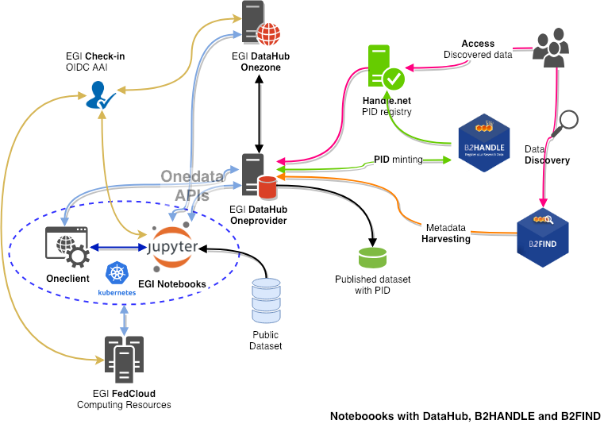
Integration example

Slide 9
Technology scouting
Rucio: distributed data management
Rucio
A distributed data management solution
A rule-based engine for automated data management
FTS for Data Transfer scheduling and management
A central service able to connect to existing storage endpoint
No new component to be deployed at a site level

Slide 10
Technology scouting
Invenio: building data repositories
Invenio
A framework for building data repositories
DOI/PID, discoverability, citation
Multiple “implementations”: Zenodo, CERN Videos, CERN Open Data, Reana, B2SHARE,…
Multiple options
Using/adapting/investing effort in an existing implementation
Creating a new one targeting EGI needs

