Slide 1
BIOMED, VIP and the long tail of science
Achievements and lessons learnt
Sorina POP
EGI Conference, Amsterdam, 6-8 May 2019

Slide 2
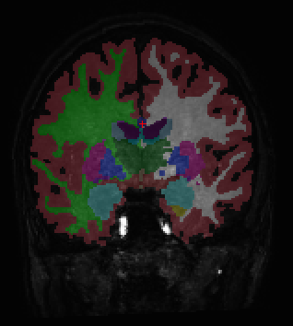
Biomed community
Life Sciences sector with three main thematic groups
Medical image analysis
Bioinformatics
Drug discovery
EGI's biomed VO
Operating since 2004
Approx 50 supporting sites
Heterogeneous resources and user profiles
2.5 million jobs and 500 CPU years/year
Technical teams on shift for monitoring
Open access
For non-commercial users
For life-science applications
Brain tissue segmentation
with Freesurfer
Hepatic perfusion index (%)
Credits: B. Leporq, O Beuf
http://lsgc.org

Slide 3
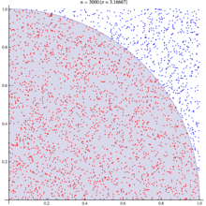
Application Example
Monte-Carlo simulations
Repeated random sampling of solution space
Large number of independent events
Parallelisation: split and merge
GATE simulator
Simulation of particle tracking
Based on GEANT4
Nuclear medicine simulations for Positron Emission Tomography (PET) and radiation therapy imaging
OpenGATE international collaboration ([Allison et al., 2006])
Computing π
Source: Wikipedia
3D whole-body F18-FDG PET scan simulated with GATE, representing 4,000 CPU hours (5.3 months). Credits: IMNC-IN2P3.

Slide 4
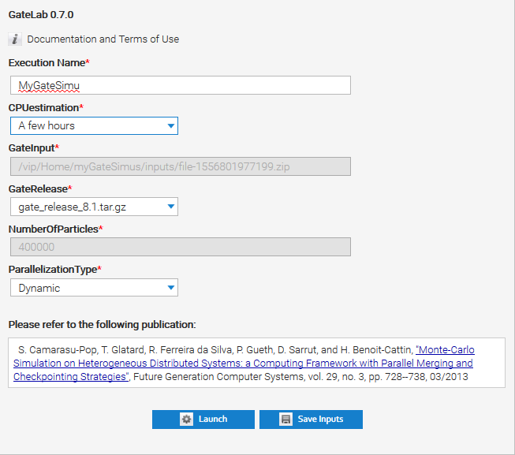
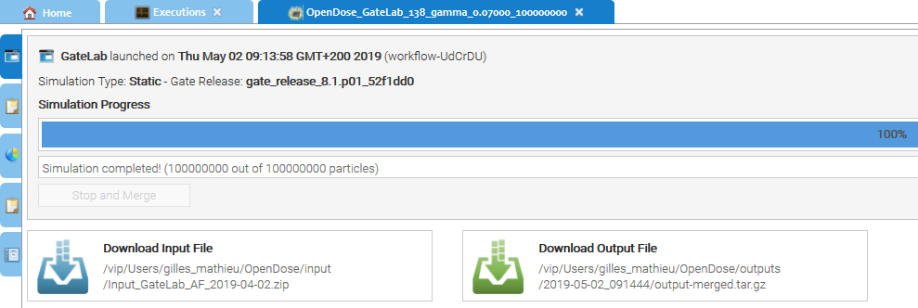
How do we get it run on biomed resources?
Back in 2009…
Obtain a personal Grid certificate and convert it to the right format…
Write your JDL and submit your jobs (Yes! :-))
Check their status… and (Oh, no!...) resubmit…
=> Need for completely transparent access to resources
Today: Application as a Service (Cloud approach)
Login into a web portal
Click to launch your favourite application
Click to retrieve your results

Slide 5
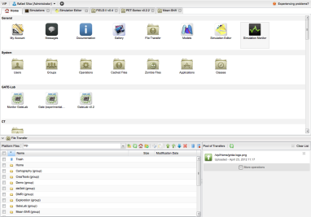
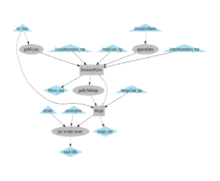
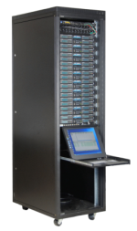
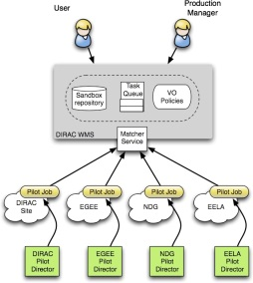
How does it work?
0. Login
1. Send input data
3. Launch workflow
User
Workflow Engine
(Moteur + GASW)
Web Portal
2. Transfer
input files
4. Generate and
submit task
Storage
Element
7. Get files
8. Execute
9. Upload results
6. Get task
Pilot Manager
(DIRAC)
Computing site
5. Submit
pilot jobs

Slide 6
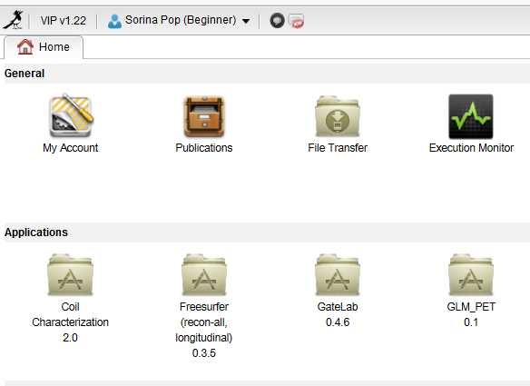
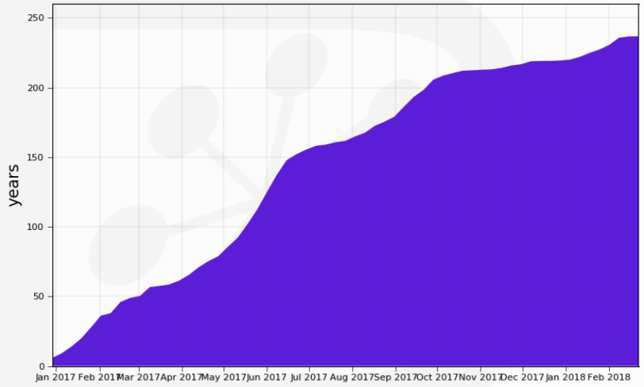
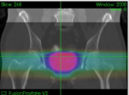
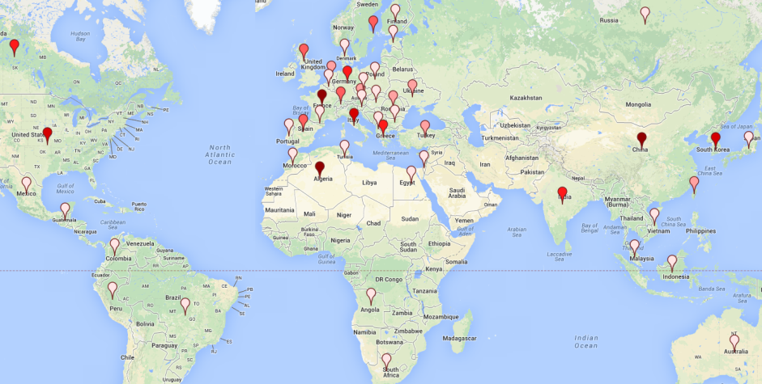
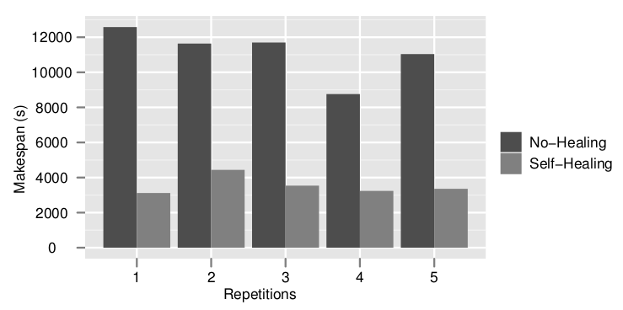
The Virtual Imaging Platform
https://vip.creatis.insa-lyon.fr
Supported by EGI Infrastructure
Uses biomed VO (~65 sites in Europe and beyond)
230 cumulated CPU years utilized by VIP applications in 1 year
France-Grilles
Cancer therapy simulation
Neuro-image analysis
DIRAC
1000+ registered users in May 2019
55 publications identified since 2011
Prostate radiotherapy plan simulated
with GATE(L. Grevillot and D. Sarrut)
Brain tissue segmentation
with Freesurfer
Image simulation
Modeling and optimization of
distributed computing systems
Echocardiography simulated with
FIELD-II (O. Bernard et al)
Acceleration yielded by non-clairvoyant
task replication (R. Ferreira da Silva et al)

Slide 7
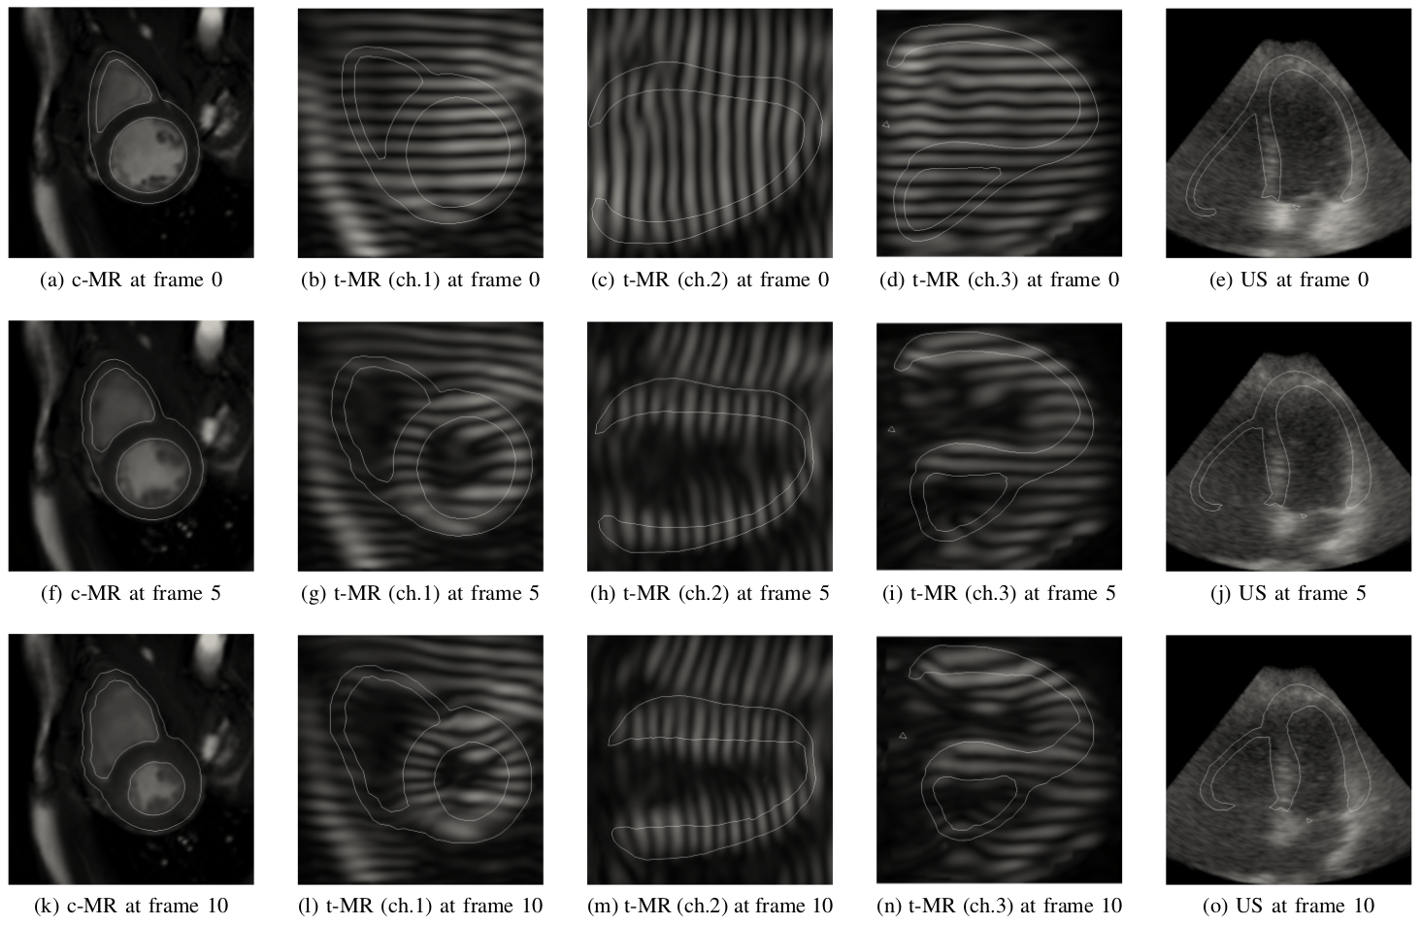
Example of a VIP success story
Generate virtual ultrasound and magnetic resonance images using VIP
Reference: Bernard et al. 2018. IEEE Transactions on Medical Imaging
EGI Research story
MRI simulator integrated into VIP
Catalogue of 18 virtual patients
2700 image volumes
benchmarked myocardial motion for validation purposes
The generation of one full 3D sequence took 6 hours on VIP
it would have taken over 280 hours on a personal laptop

Slide 8
Miccai Challenge on VIP
France Life Imaging
Coordinated and harmonized network of biomedical imaging in France
Organisation of 2 challenges at the Miccai 2016 conference
Challenge aim
Compare different segmentation methods provided by challengers
Challenge description and setup
The methods are integrated into VIP as independent pipelines
The challenge in numbers
15 challengers and 23 pipelines integrated from June to Sept 2016
Two journal articles

Slide 9
VIP achievements and challenges
Transparent access to distributed computing resources
VIP relies on the France Grilles DIRAC instance (https://dirac.france-grilles.fr/DIRAC)
Exploit parallelism through workflows
Scientific applications as a service
No need for installation on the users’ side
Facilitate the sharing of applications and data
GPU usage
Foster open and reproducible science
Can I have my results reproduced (e.g., by reviewers)?
Can I share/exchange applications/data across platforms?
...

Slide 10
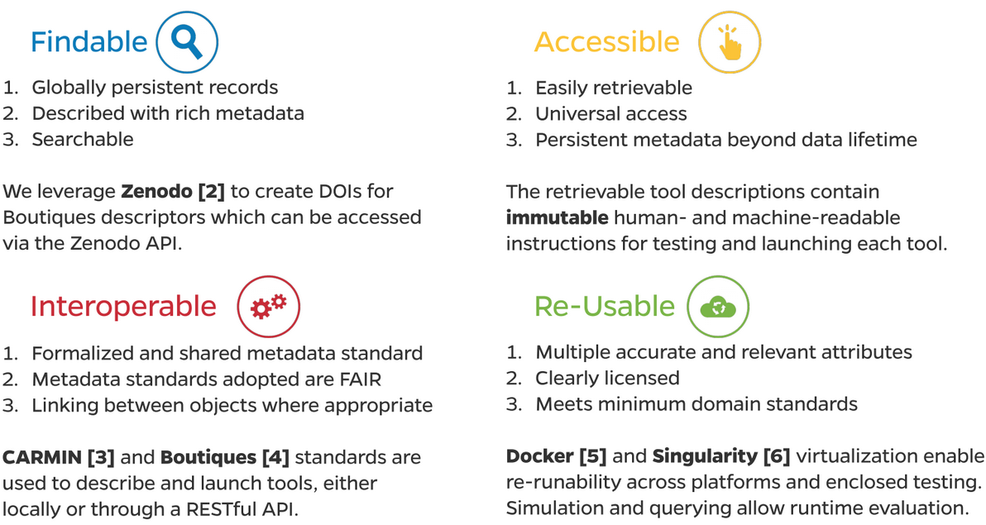
Boutiques and FAIR data analysis
Describe, publish, integrate and execute applications across platforms
facilitate application porting
import and exchange of applications
https://github.com/boutiques
FAIR tools. Credits: Gregory Kiar and Tristan Glatard

Slide 11
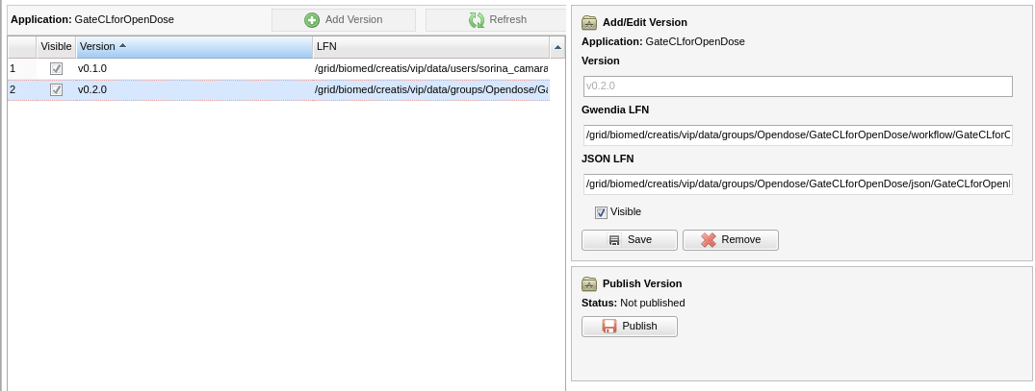
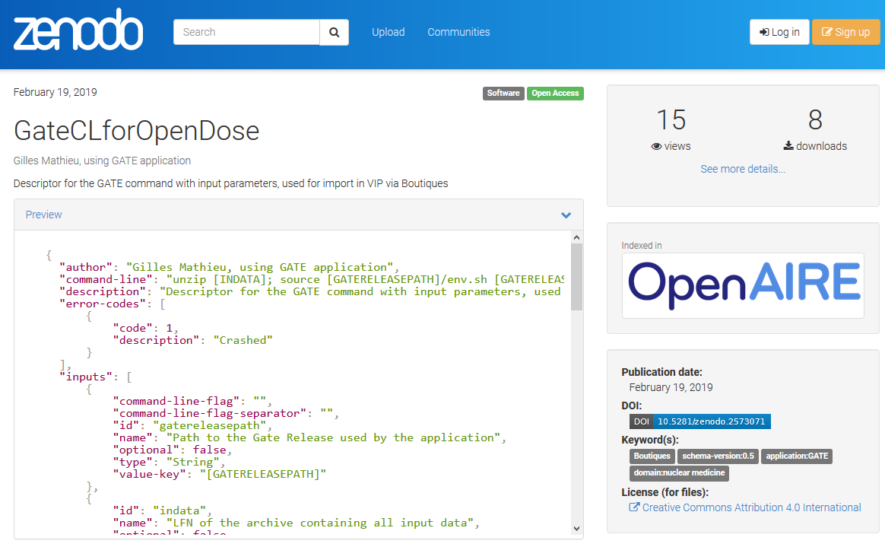
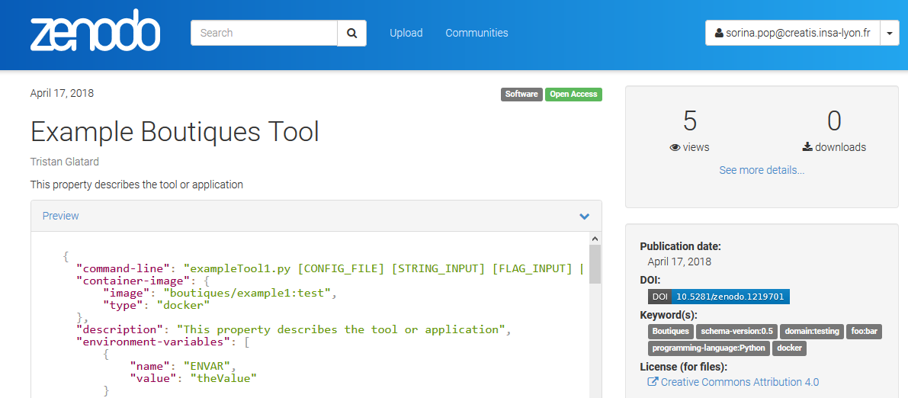
Application publishing in VIP with Boutiques
Share your tools in a packaged and fully described fashion
Boutiques publishes descriptors to Zenodo (https://zenodo.org)

Slide 12
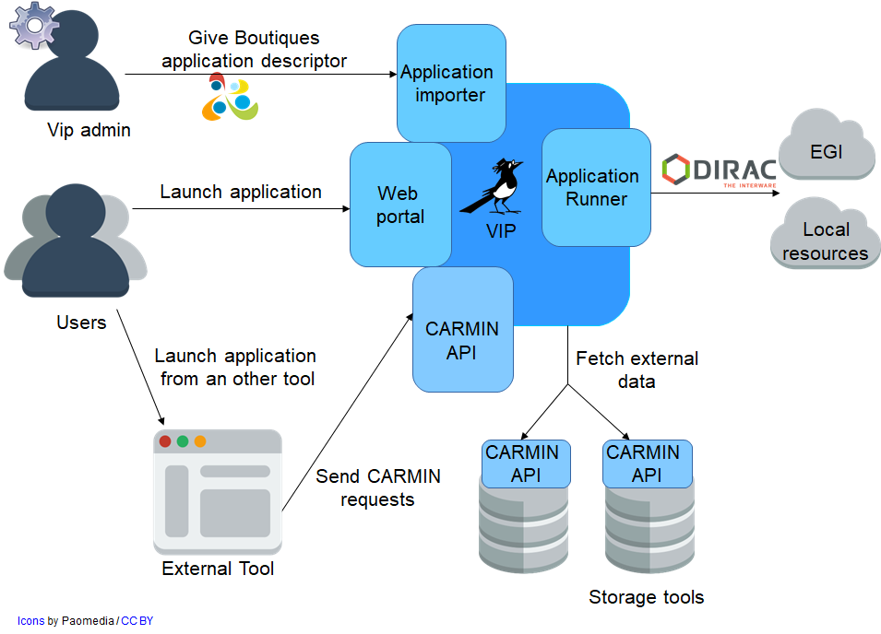
Interoperability and CARMIN
Common API for Research Medical Imaging Network
https://github.com/CARMIN-org
Enables communication between services
Interoperability among data and computing platforms

Slide 13
Conclusions
Achievements
Transparent access to distributed computing resources
Scientific applications as a service
Lessons learnt
Do not neglect community support
Collaboration and tool “re-use”
Looking to the future
Support and sustainability
Open and reproducible science

Slide 14
Thank you for you attention! Questions?
sorina.pop@creatis.insa-lyon.fr

Slide 15
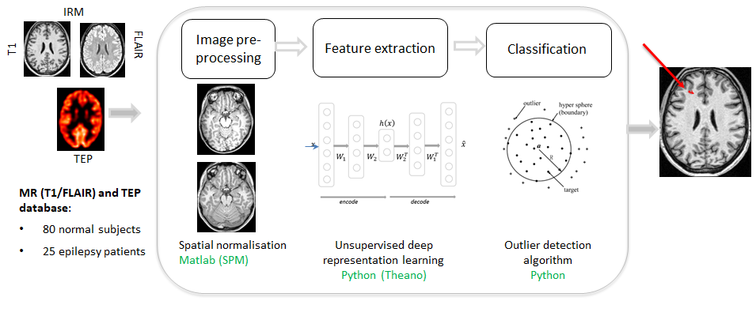
CAD for Epilepsy
Crédits: Carole Lartizien, PhD work of Zara Alaverdyan
[Alaverdyan MIDL 2018]

Slide 16
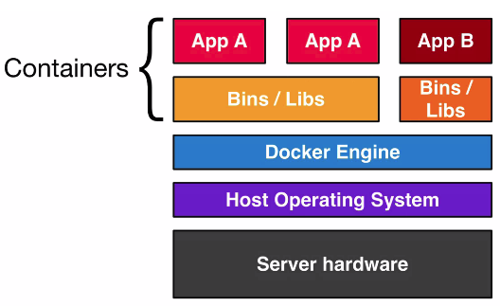
Containers
A container = an entire runtime environment
An application + all its dependencies, libraries and other binaries, and configuration files needed to run it, bundled into one package
Facilitates application installation and sharing
Docker has become synonymous with container technology because its success, but
Container technology is not new
Other containers exist (Singularity)
DockerHub
Image discovery and distribution
https://hub.docker.com
Credits: https://stackoverflow.com

Slide 17
A Docker container for our application
Prepare the Dockerfile
Use an existing nvidia image having cuda and cuDNN already installed (nvidia/cuda:7.5-cudnn5-devel-centos7)
Install and configure anaconda, theano and keras
Bring in code source with git clone (or “ADD” local files)
Build the image
docker build -t feature-extraction .
Use nvidia-docker
docker runtime enabling access to the GPU
Start the container using the nvidia runtime
docker run --runtime=nvidia -it feature-extraction

Slide 18
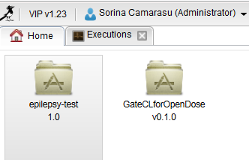
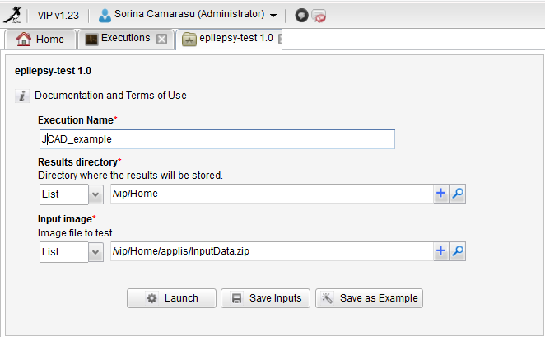
Application execution on VIP
What users see (VIP)
What users DON’T see (Dirac)

Slide 19
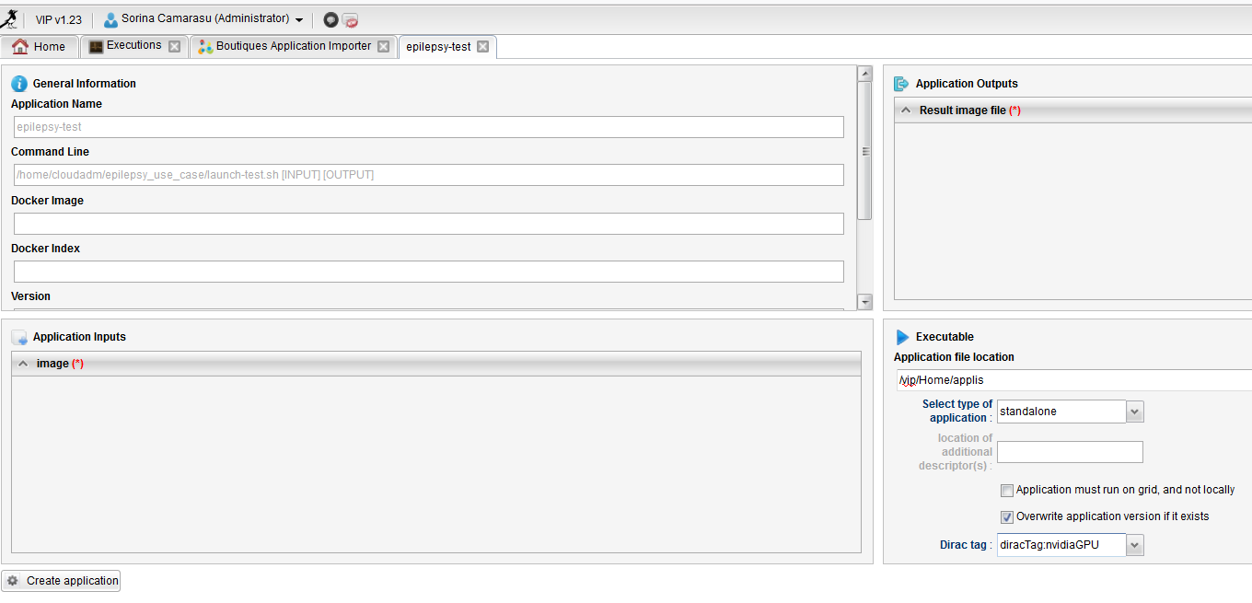
Automatic import into VIP with Boutiques

Slide 20
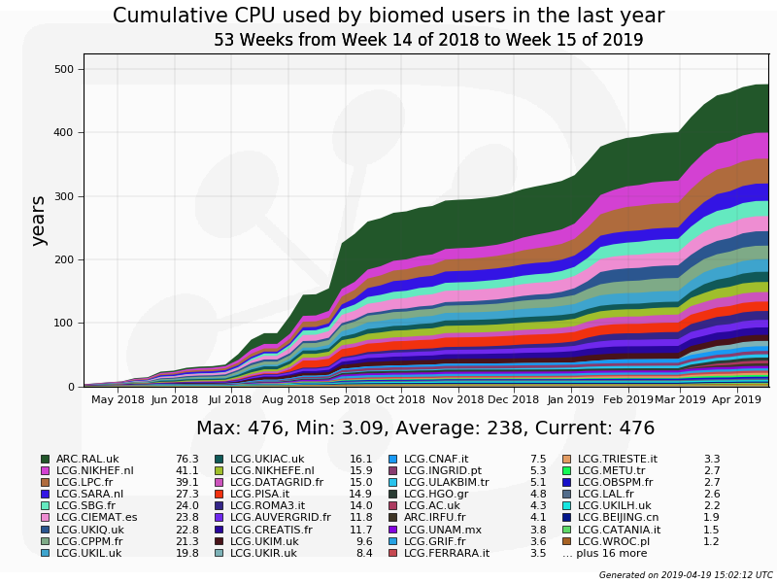
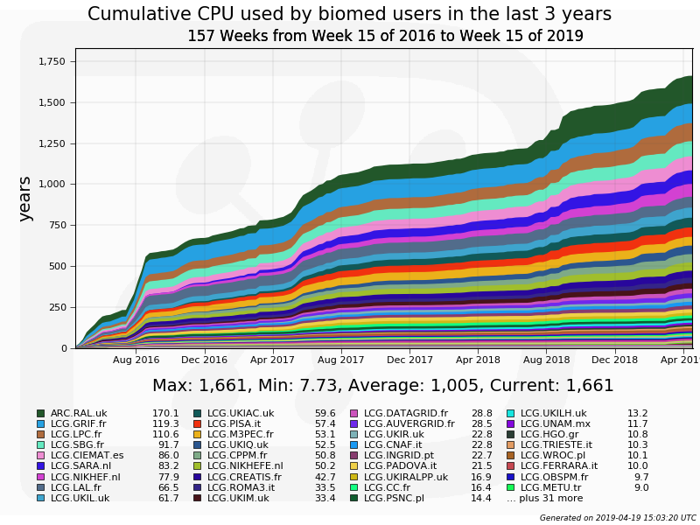
Biomed community: a few numbers

