Slide 1
European Open Science Cloud: what next?
Andreas Veispak
European Commission, DG CONNECT

Slide 2
The role of the EOSC is to ensure that European scientists reap the full benefits of data-driven science, by offering:
“1.7 million European researchers and 70 million professionals in science and technology a virtual environment with free at the point of use, open and seamless services for storage, management, analysis and re-use of research data, across borders and scientific disciplines”
2016 Communication on the “European Cloud Initiative”
Notes:
The European Open Science Cloud was introduced in the European Cloud Initiative, as the instrument to capitalise on the data revolution.
The Cloud can be understood as a combination of 3 interdependent elements:
the data infrastructures which store and manage data;
the high-bandwidth networks that transport data;
and the powerful computers which can be used to process the data.
The European Open Science Cloud aims to give Europe a global lead in scientific data infrastructures to ensure that European scientists reap benefits of data-driven science. It contributes to the wider effort to:
Maximize the incentives for sharing data
Ensure that data can be used across disciplines and between the public and private sector
Interconnect data infrastructures across Europe
Support the infrastructures as they move towards exascale computing.

Slide 3
Why the EOSC?
Enable Open Science and the Digital Single Market
Offer researchers anywhere in the EU the resources they need
Build an open and inclusive research data commons in Europe and help develop a system of FAIR digital objects
Reduce fragmentation and reduce costs through increased mutualisation and federating existing Research Infrastructures
Enabler of an open, transparent, rule-of-law-based, federated digital ecosystem, providing access to core digital infrastructure and service resources with the objective of:
Maximising digital capacities available to researchers
Supporting public authorities in informed policy development and implementation, including for key societal challenges
Enable the Digital Single Market and stimulate the emergence of a competitive EU cloud sector

Slide 4
What is the EOSC?
Trusted and open virtual environment with seamless access to services (with highest TRLs) addressing the whole research data life cycle:
Federating core services to federate and connect existing or planned RIs
Services to make data FAIR, store them, ensure their long-term preservation
Services to find, access, combine, analyse and process data
Protected, personalized work environment
Multi-layered federation (federating core, rest of the ecosystem), which brings together supply and demand in a trusted environment
Open, transparent, rule of law based: no lock-in by individual service providers, data portability, IPR, cloud security…
Adaptively user-oriented and inclusive (across borders and disciplines)
Accessible through a non-exclusive, simple, universal hub/ gateway
Governed by a minimal set of Rules of Participation
Steered by an inclusive governance structure

Slide 5
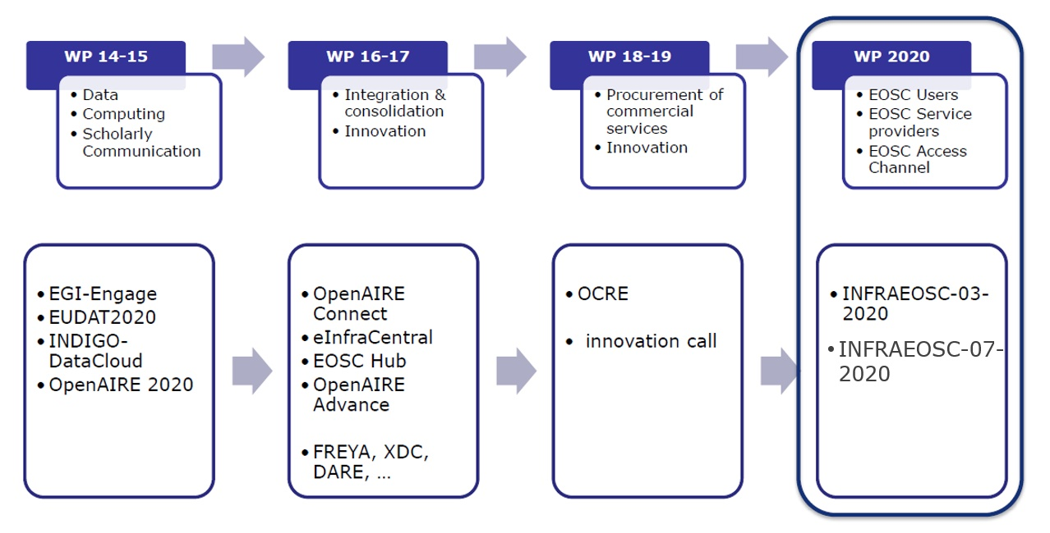
e-infrastructure funding in Horizon 2020 (excl. Network and HPC)
Notes:
From the perspective of digital infrastructures, and based on the objectives of the European Cloud Initiative, the EC support has shifted from supporting individual infrastructures to the integration and consolidation of these infrastructures (in 2016-2017).
This shift is now reflected in the service provisioning: as the EOSC evolves, researchers will access and reuse data, through a single entry point, combine services from different providers, discover all resources they need for getting better scientific results in less time. They will work in a collaborative, open and cost-efficient way.
The next steps were to stimulate the usage of commercial digital services in the EOSC (12 Meuro 2018) and to support the prototyping and development of additional new innovative services (28,5 Meuro, 2019).
At the end of 2019, we will launch the last calls under Horizon 2020, to scale up the integration and increase the service offering.

Slide 6
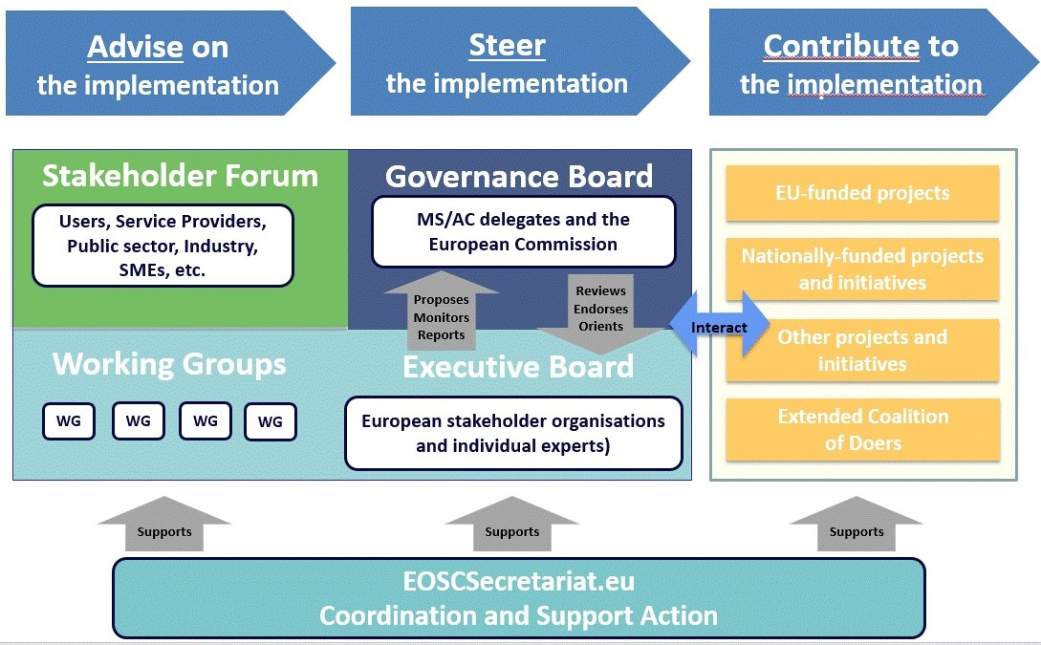
The Governance structure
Notes:
Regarding the governance of the EOSC, you do know that the development of EOSC is a collective effort:
- High-level experts, delegates of Member States and Associated Countries and diverse stakeholders co-create the future of the European Open Science Cloud
- There will be also a direct interaction with users, services providers, SMEs, etc., through the Stakeholder Forum, which is currently set up.

Slide 7
Council conclusions of May 2018
STRESSES the importance of coordinating the various ongoing and future projects funded by the EU Framework Programmes on EOSC
UNDERLINES that the start of the second phase is dependent on an evaluation by the Commission and the Member States of the first phase
INVITES the Commission and the Member States therefore, to jointly explore the creation of a map of national research data infrastructures and initiatives in the Member States which could be federated
STRESSES in particular the importance of developing a sustainable business model and of choosing the best fit legal vehicle for the second phase of development
Notes:
The governance structure addresses several topics that were highlighted in the Council Conclusions of last May:
The mapping of national infrastructures and the links/compatibility with EOSC (EOSC-readiness)
The business models that could be used for the future EOSC
And issues that come up as the EOSC evolves, e.g. technical issues, etc.
This is an open and transparent process, the information on the governance work is available on EOSC sites (secretariat, etc.). The governance structure will work till the end of 2020 (end of H2020).

Slide 8
Implementing the future EOSC
By end 2020:
Governance model and best-fit legal vehicle for post-2020
Financing model(s) to sustain EOSC in the long run
Rules of participation that will govern the future EOSC
Coordination of EOSC-relevant H2020 projects and of national initiatives
FAIR digital objects: turning principles into practice
Expansion of the EOSC service offering to the researchers Evolution of the EOSC Platform and its interfaces
Widening of the EOSC user base and increasing demand
Interaction between EOSC and EDI (cloud, HPC, network)
EOSC in the international context

Slide 9
INFRAEOSC-03-2020: Integration and consolidation of the pan-European access mechanism to public research infrastructures and commercial services through the EOSC Portal
INFRAEOSC-07-2020:
Increasing the EOSC portal service offer
Notes:
More specifically, we foresee 64,9 Meuro for 2 different topics – NOT YET PUBLISHED:
the first one will focus on scaling up the EOSC portal and its underlying service platform; it will address challenges such as the increasing service offering from different providers; the inclusion of commercial services; the composability of services, AI techniques, the attraction of more users, etc.
- the second one will support the service offering itself, and the interaction between service providers and the EOSC portal operators.

Slide 10
Thank you

