Slide 1
Open Science Policy Platform
FAIR Data Stakeholder Engagement Group
Call 25/1/2019 14-16 CET

Slide 2
OSPP Second Mandate (OSPP-M2):
Chair: Eva Mendez
Duration: Sep 2018 - 2020
Objectives
Reach and affect all the members of the European Open Science operational Ecosystem
Advise the Commission on how to further develop and practically implement Open Science Policy in order to radically improve the quality and impact of European science across member states and beyond.
To develop a roadmap and co-assist for its implementation under Horizon Europe with the help of advice of the Expert Groups on the subject matter. In this context, the European Open Science Agenda, will be adapted and updated in light of the upcoming OSPP roadmap.

Slide 3
OSPP-M2: How
Activities planned and piloted at stakeholder level pinning down the OSPP-REC in Practical Commitments for Implementation (PCIs)
All the eight challenges will be addressed but orchestrated around the main barriers to overcome
Rewards and Incentives, Research Indicators and Next-Generation Metric, Future of Scholarly Communication, European Open Science Cloud, FAIR Data, Research Integrity, Skills and Education, Citizen Science
A high level of communication and impact:
from OSPP members to their constituencies,
from the OSPP to the Commission
from the OSPP to the entire Open Science EU ecosystem (and beyond).

Slide 4
PCIs
Practical Commitments for Implementation:
You, at your institution, at your office, with your attributions, etc. what can you do for Open Science? (regarding the 8 challenges and your condition as stakeholder…
I am a researcher….
I am a librarian…
I am a policy maker in a RPO
…etc.

Slide 5
OSPP-M2: Tasks
T1. Engage stakeholders and define PCIs
This task will address the initial plan of the EC to organize stakeholder meetings
T2. Define and engage the European Open Science Ecosystem.
Map of projects and initiatives
T3. Create an effective communication system for Open Science.

Slide 6
OSPP FAIR Data – Stakeholder Engagement Group
OSPP member | Organisation | Stakeholder Group
Eva Mendez* | YERUN | Universities & RPOs
Sergio Andreozzi** | EGI Foundation | Research & e-Infrastructures
Kristiina Hormia Poutanen** | LIBER | Research & e-Infrastructures
Karel Luyben | CESAER | Universities & RPOs
Lidia Borrell-Damian/Lennart Stoy | European University Association | Universities & RPOs
Natalia Manola/Najla Rettberg | OpenAIRE | Research & e-Infrastructures
Carolina Venturini | Business Europe
Luc van Dyck/Christophe Rossel | European Physical Society | Scientific Societies & Academies
Michela Bertero | EU-LIFE | Universities & RPOs
Stephan Kuster | Science Europe | Research Funding Organisation
John Wood | RDA | Research & e-Infrastructures
* OSPP Chair ** OSPP FAIR Data SG Co-chair
Full list of OSPP Members: https://ec.europa.eu/research/openscience/pdf/ospp_nominated_members.pdf

Slide 7
OSPP FAIR Data SG – Initial actions
For each stakeholder group represented in the OSPP
Analyse the HLEG FAIR Data report
Extract the top 5 actions from section 8.4 for which the represented stakeholder(s) can support the implementation
Identify PCIs (practical commitment for implementation) that could be performed by the stakeholder group
Identify related events where to discuss PCIs with stakeholders

Slide 8
HLEG FAIR Data Report - Structure
Addresses the following key areas:
Concepts for FAIR
Creating a FAIR culture
Creating a technical ecosystem for FAIR
Skills and capacity building
Incentives and metrics
Investment and sustainability

Slide 9
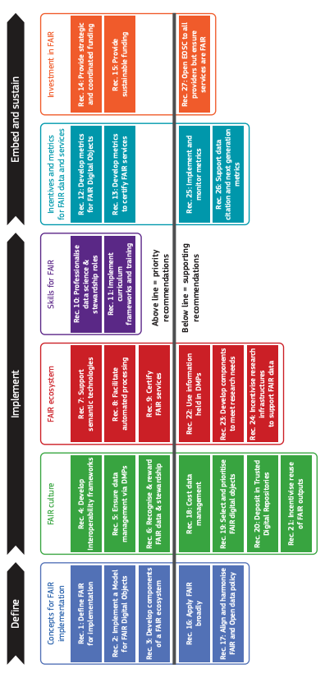
HLEG FAIR Data report - FAIR Action Plan
15 priority recommendations
12 supporting recommendations

Slide 10
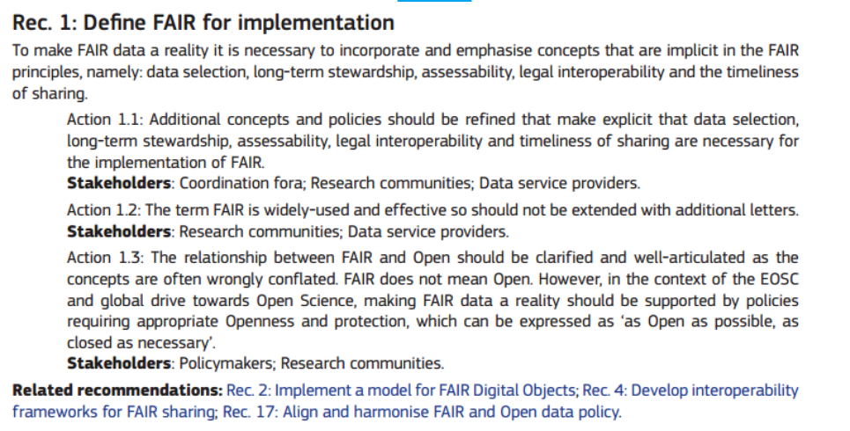
HLEG FAIR Data Report Example of Recommendation

Slide 11
Stakeholder Categories - Mapping
OSPP Stakeholder Categories | HLEG FAIR Data Report
Researchers | Research communities
Research and e-Infrastructures | Data service providers
Research libraries (and data stewards) | Data stewards
Research Funding Organisations | Research funders
Policy Making Organisations | Policymakers
Universities and Research Performing Organisations | Institutions
Publishers | Publishers
Scientific Societies & Academies
Citizen Science & Public Engagement Organisations
 | Coordination fora
 | Standards bodies

Slide 12
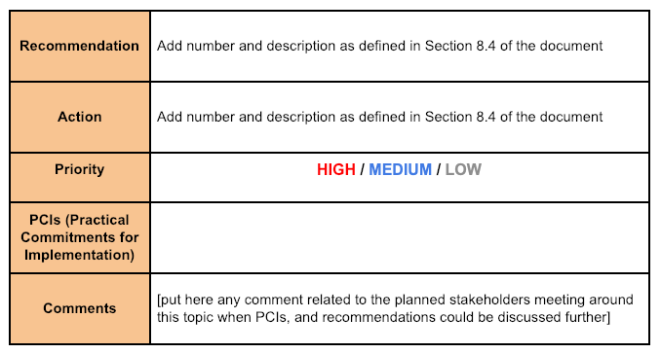
Template to define a PCI in the final form

Slide 13
Possible approach to collect individual commitments

Slide 14
Contributions so far by OSPP stakeholders
EOSC-hub: Sergio – identified top 6 relevant recommendations
LIBER: Kristiina – identified key recommendations and actions
DARIAH: Jennifer – identified key recommendations, actions and PCIs
EPS: Luc/Chris – identified key recommendations, actions and initial PCIs
Science Europe: identified relevant recommendations and actions
…

Slide 15
Discussion

