Slide 1
EGI services
EGI User Community Support Team
Design Your e-Infrastructure Workshop
Amsterdam, 9 May 2019.

Slide 2
EGI: Federation of national e-Infrastructures
May 2019: Collaboration agreement under finalization with Austria/Tech University of Wien

Slide 3
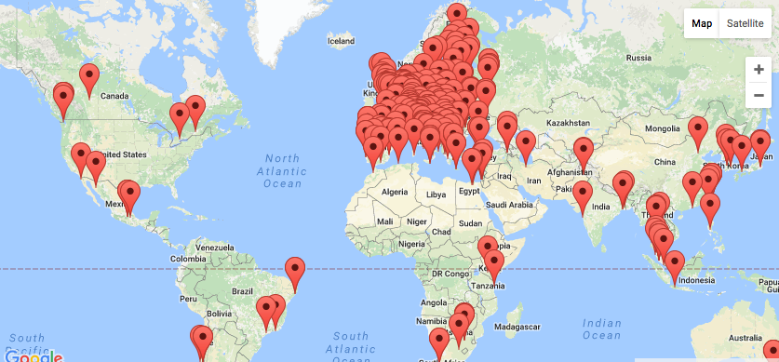
EGI: The largest distributed compute e-Infrastructure of the world
EGI Foundation (Amsterdam)
200 compute centres
21 Cloud providers
1m CPU cores
700 PB storage
1.7 Million jobs/day
2.6 Billion CPU hours/year
240 Virtual Organisations
>60,000 users

Slide 4
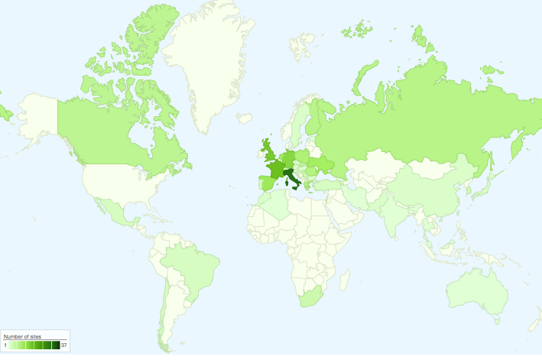
International partners
Canada
China Inst. Of HEP
Chinese Academy
of Sciences
USA
India Centre for
Development of
Advanced Comp.
Africa and Arabia
Council for Scientific and
Industrial Research, South Africa
Asia Pacific Region
Academia Sinica
at Taiwan
Latin America
Universida de Federal do
Rio de Janeiro
Ukraine
Ukrainian National
Grid

Slide 5
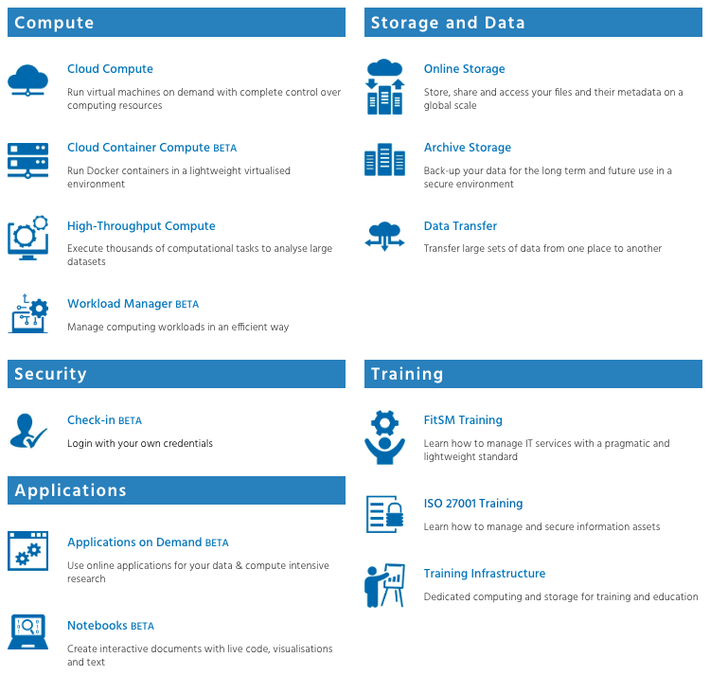
EGI Service Catalogue: www.egi.eu/services
+ some in ‘Alpha’ state (not on the website)

Slide 6
Resource allocation to communities
Trigger the process with a service request in the EOSC-hub Marketplace
Type, number, size, cost, availability, etc.
Applic. provider
Instance requirements
Conditions
Storage provider
Cloud provider
Negotiator
Grid provider
Project/Community representative
Service Level Agreement
Operation Level Agreement
Training
Support
Performance reports
Satisfaction review (every 3/6/12 months)

Slide 7
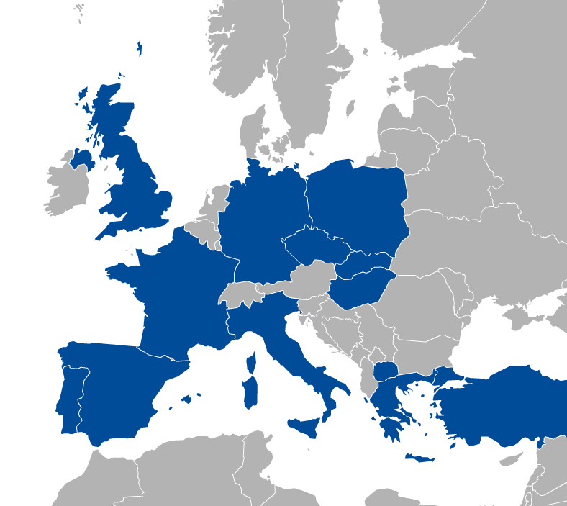
Community allocation: Virtual Organisation (VO)
VO 1 (cloud a, b, c
HTC d, e)
a
b
VO 2 (HTC x, y, z)
c
d
f
e

Slide 8
Compute services

Slide 9
EGI Cloud Federation
Multi-cloud IaaS with Single Sign-On
Federation features:
Common VM image catalogue
Discovery, accounting, SLO monitoring
Unified GUI dashboard
EGI Services powered by the Cloud Federation
Cloud Compute
Online Storage
Applications on Demand BETA
Cloud Container Compute BETA
Training Infrastructure
Notebooks BETA
Notes:
List of services of EGI powered by the EGI Cloud Federation

Slide 10
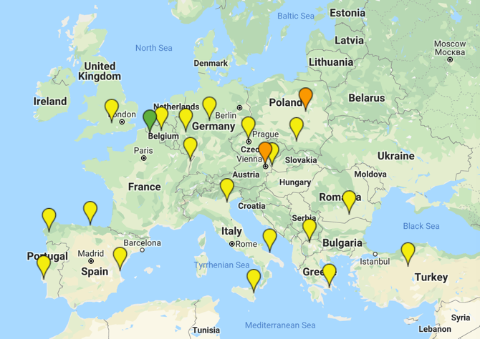
The infrastructure
New!
Finalising integration!

Slide 11
Cloud Compute
Deploy and scale virtual machines on-demand.
API-controlled computational resources in a secure and isolated environment without the overhead of managing physical servers.
Cloud Compute offers the possibility to select pre-configured virtual appliances (e.g. CPU, memory, disk, operating system or software) from a catalogue replicated across all EGI cloud providers. With Cloud Compute you can:
Execute compute- and data-intensive workloads (both batch and interactive)
Host long-running services (e.g. web servers, databases or applications servers)
Create disposable testing and development environments on virtual machines and scale your infrastructure needs
Select virtual machine configurations (CPU, memory, disk) and application environments to fit your requirements
Manage your resources in a flexible way with integrated monitoring and accounting capabilities

Slide 12
Interfaces and Check-in
GUI Access
AppDB VMOps
AAI: Check-in
Federated
Access
IaaS Federated Access Tools
GUI Users
Developers/
Advanced users
Direct API
Access
IaaS API
IaaS API
Cloud Management Framework
Cloud Management Framework
EGI Federation features:
Accounting, Monitoring, Conf. DB, Info Discovery, AppDB
Notes:
User communities build either on top of orchestration tools that allow to deal with multiple providers in a homogeneous way or directly interact with the native APIs of the provides. Both cases they can use single sign-on thanks to Check-in.
A common GUI provided by AppDB VMOps brings a user-friendly dashboard to manage the resources at the distributed providers
The EGI federation services are integrated with the providers using their native APIs to deliver the extra features of EGI Cloud mentioned in previous slide
GUI access:
AppDB VMOps https://dashboard.appdb.egi.eu/vmops
API/CLI access:
Discovery: AppDB IS API (REST and GraphQL) https://wiki.egi.eu/wiki/Federated_Cloud_Discovery#AppDB
IaaS Federated Access Tools: https://wiki.egi.eu/wiki/Federated_Cloud_IaaS_Orchestration
Direct IaaS access, several APIs depending on the provider: https://wiki.egi.eu/wiki/Federated_Cloud_APIs_and_SDKs

Slide 13
Access and capacity allocation
VO | fedcloud.egi.eu | access.egi.eu (AoD) | Community VOs
Membership requirements | X.509 certificate | Member of European research institutions (i.e. Check-in account) | Depends on VO (most still require X.509 certificate), new ones can be Check-in only
AppDB VMOps | ✅ | ✅ | Depends on VO
CLI/API access | ✅ | ❌ | ✅
Membership duration | 6 m, extensible up to 1 yr | 6 m, extensible up to 1 yr | 1 year renewable membership
Resource limits | Opportunistic, varying quota at providers. Limited lifetime per VMs may be applied | Opportunistic, varying quota at providers. Limited lifetime per VMs may be applied | Specified in the SLA: opportunistic, pledged, time based
Available providers | All providers | Providers of the Applications on Demand platform: INFN-Catania-Stack, CESGA, RECAS-Bari | As specified in the SLA

Slide 14
Cloud Container Compute
Deploy and scale Docker containers on-demand using Kubernetes technology
Cloud Container Compute offers users offers guaranteed computational resources in a secure and isolated environment with industry-standard Kubernetes container orchestration platform that:
Manages the nodes where to run the containers
Automates the deployment, management, scaling, networking, and availability of container-based applications running on that cluster.

Slide 15
Service architecture and interfaces
EGI Cloud Container Compute
2. Deploy Kubernetes cluster
on provisioned VMs
1. Provision cluster VMs
3. Use native Kubernetes tooling
with EGI Check-in authentication
IaaS Federated Access Tools
IaaS API
Cloud Management Framework
EGI Cloud Compute Service

Slide 16
High Throughput Computing
aka the grid
Execute thousands of computational tasks to analyse large datasets
Supported by a distributed network of computing centres:
>1,000,000 cores of installed capacity
> 1.6M computing jobs per day.
Integrated monitoring and accounting tools to provide information about the availability and resource consumption
Large amounts of processing capacity over long periods of time

Slide 17
EGI Compute Services
EGI Cloud Compute, Cloud Container Compute and HTC
 | Cloud Compute | Cloud Container Compute | High Throughput Compute
What is it? | Multi-cloud IaaS | Kubernetes on top of EGI Cloud Compute | The grid, a scalable batch system
What you run? | VMs | (Docker) Containers | Jobs
Typical workloads | Lift and shift existing applications Specific OS (kernel) requirements | Cloud-native containerised applications. | Execution of parallel computing tasks to analyse large datasets.
Pros / Cons | [+] Complete control on resources, run (almost) anything you’d like [-] Complex operation | [+] Industry standard [+] Hides complexity of Kubernetes setup [-] Kubernetes steep learning curve | [+] No management of resources, just submit jobs [-] Legacy interfaces [-] Porting of applications
Configurability
Abstraction

Slide 18
Workload Manager
Optimise the distribution of the computing jobs on HTC and Cloud
Workload Manager provides a DIRAC-based service for managing jobs on the EGI infrastructure with:
A user-friendly interface, web and CLI access
Support for both HTC and cloud resources of the federation: all resources perceived as a single large batch system

Slide 19
Data and storage services

Slide 20
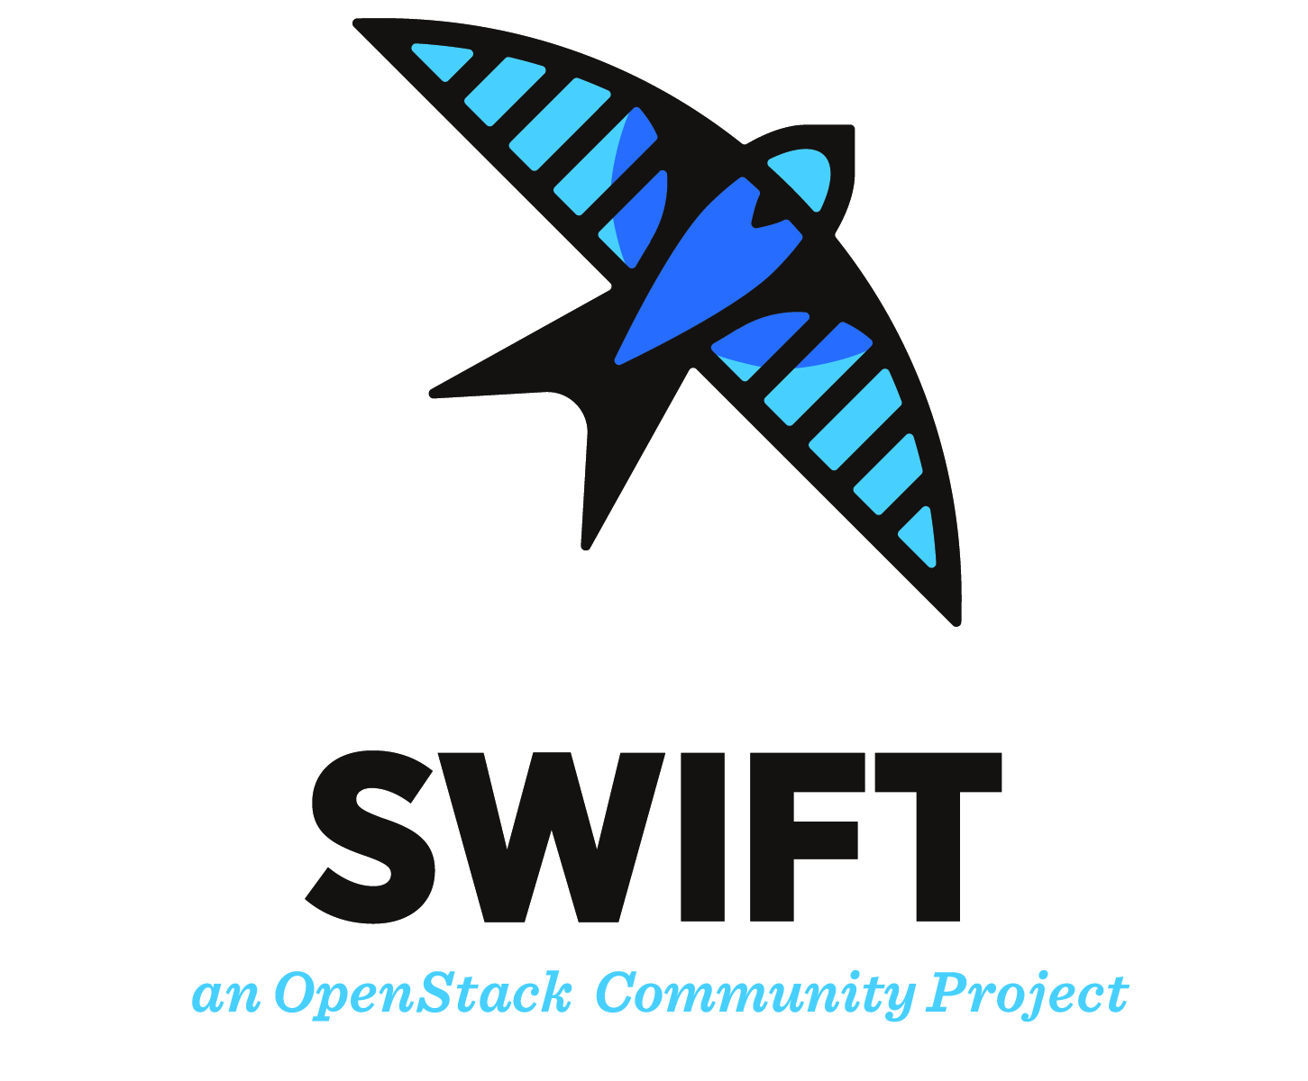
Online storage
Store, share and access your files and metadata
A production service covering multiple data storage and access technologies
“Grid” Storage Elements
DPM, dCache, StoRM…
“Cloud” object-storage
OpenStack Swift
Providing data access to other services
Cloud Compute, Cloud Container Compute
High Throughput Compute
Workload Manger

Slide 21
Data Transfer
Transfer large sets of data from one place to another
A production service for managing data transfers reliably and efficiently
FTS- and WebFTS-based
Two providers have recently agreed an OLA with EGI
CERN – FTS and WebFTS
UKRI/RAL - FTS
Next steps
Integration of a with EGI Check-in and RCauth
OIDC
Online CA

Slide 22
DataHub
Data as a Service, distributed data management
A service for federated access, sharing, publishing, discovery of data
based on Onedata, operated by CYFRONET
EGI’s central Onezone: https://datahub.egi.eu
A reference/central Oneprovider connected to the DataHub
Providers at various sites can be federated
Integration with various other services
EGI: Check-in AAI, Cloud Compute, Cloud Container Compute, Online Storage, Notebooks,…
EOSC-hub: B2HANDLE, B2FIND,…
A long exploratory phase with various piloting activities was conducted
Lots of improvements on stability, performance
Lots of new features
Discoverability through the EGI Service Catalogue being finalized

Slide 23
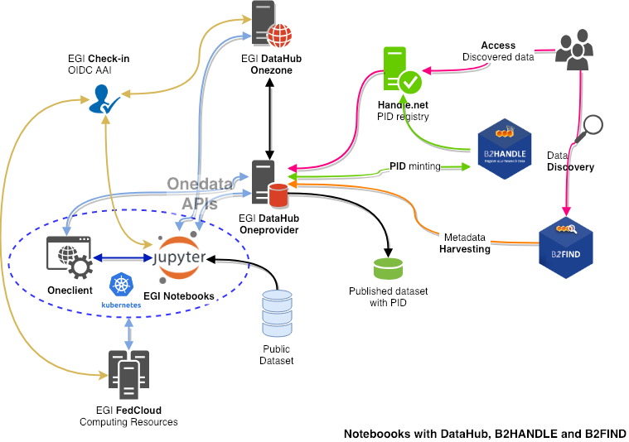
Integration example

Slide 24
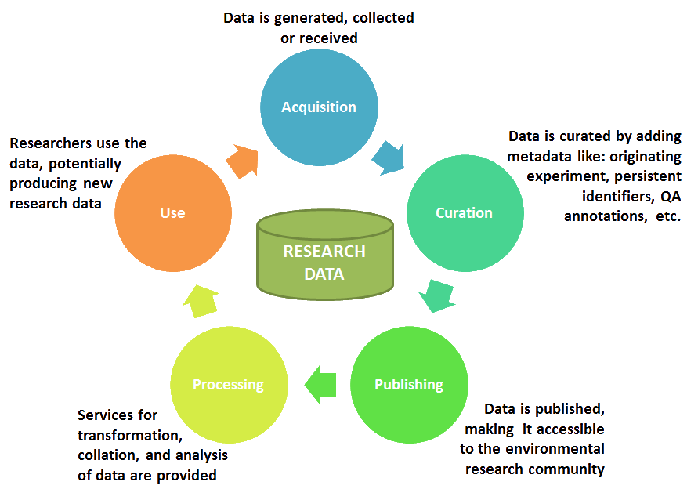
Looking forward
The Research Data Lifecycle
Ambition: Providing an interoperable and composable service offer supporting the research data lifecycle
Supporting FAIR practices
Persistent Identifiers
Cataloguing, Discovery
Interoperability, Integration
Data orchestration
Source: ENVRI Reference Model

Slide 25
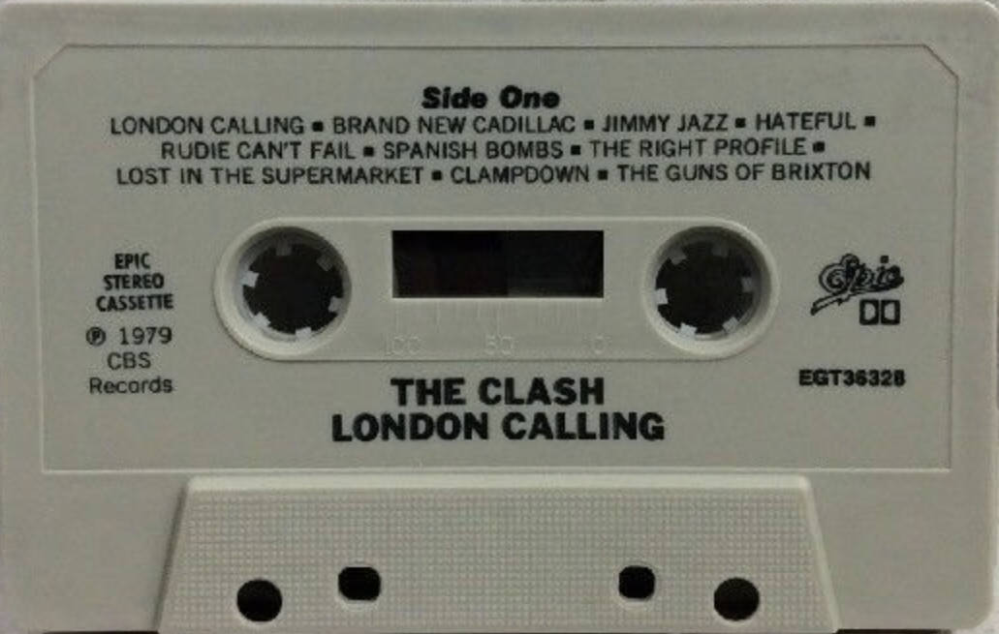
EGI Archive Storage
Back-up data for the long term
Legacy service for long term archival of data
Initially based on Tape
Multiple EGI participants using tape for their internal needs
Other technologies could be used
Currently discussing access models with service providers
Any interested service provider is welcome
May be retired from EGI Service Catalogue if no way to offer it is found

Slide 26
Technology scouting
Rucio: distributed data management
Rucio
A distributed data management solution
A rule-based engine for automated data management
FTS for Data Transfer scheduling and management
A central service able to connect to existing storage endpoint
No new component to be deployed at a site level

Slide 27
Technology scouting
Invenio: building data repositories
Invenio
A framework for building data repositories
DOI/PID, discoverability, citation
Multiple “implementations”: Zenodo, CERN Videos, CERN Open Data, Reana, B2SHARE,…
Multiple options
Using/adapting/investing effort in an existing implementation
Creating a new one targeting EGI needs

Slide 28
Other technical services

Slide 29
The EGI AppDB’s overview
https://appdb.egi.eu/
The EGI Applications Database (AppDB) is an “open registry” that stores and provides to the public information about:
Software solutions originated from almost every scientific area/discipline
Programmers and Scientists responsible for them
Publications derived from the registered items
The EGI VMOps dashboard
Currently, the following types of Software solutions are offered through the EGI Applications Database:
Software items, in its classical sense, i.e. applications, tools, utilities, etc..,
Virtual Appliances, composed by one or more pre-configured virtual machine images
Software Appliances, a pair of a virtual appliance and a contextualization script

Slide 30
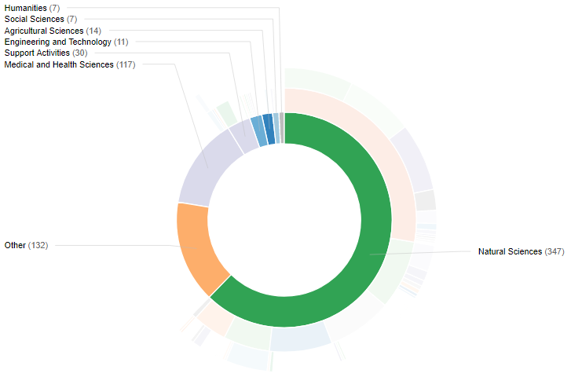
The Software Marketplace
513 Software in total
392 Applications
84 Tools
52 Science Gateways
32 Science Workflows
34 Middleware products
Notes:
Software items, in its classical sense, i.e. applications, tools, utilities, etc..,
Virtual Appliances, composed by one or more pre-configured virtual machine images
Software Appliances, a pair of a virtual appliance and a contextualization script

Slide 31
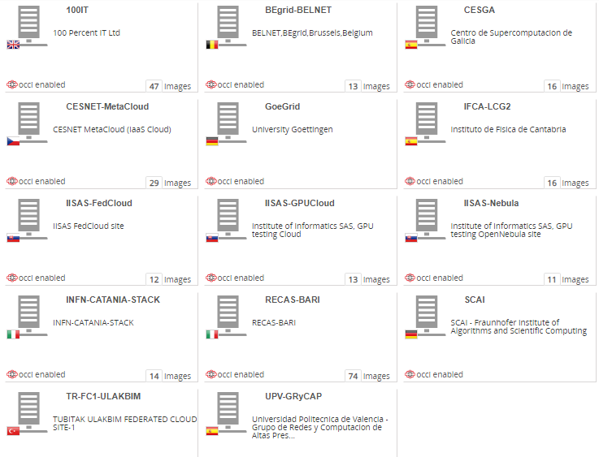
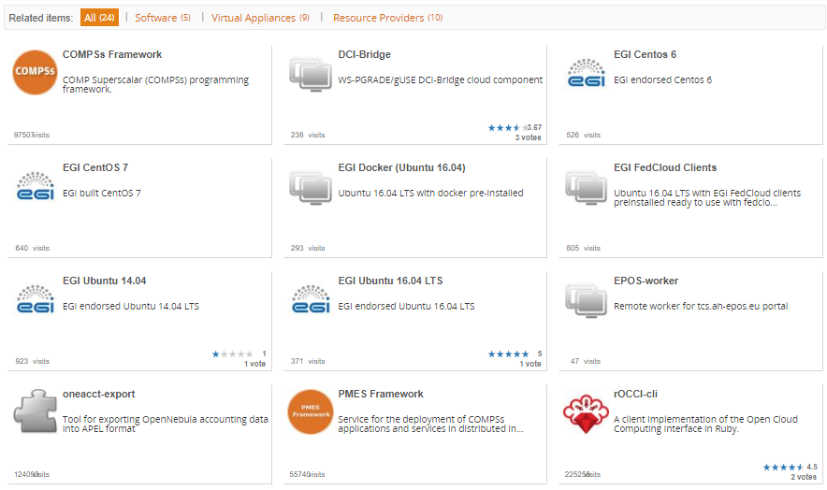
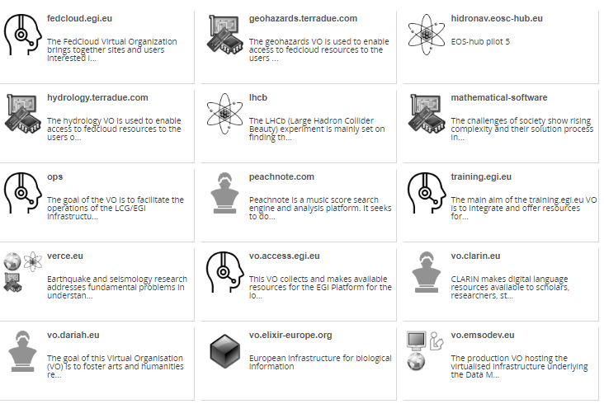
The Cloud Marketplace

Slide 32
Orchestrator & PaaS solutions
Research Communities
Platforms
Research Communities
Orchestration
Federation Services
IaaS
providers
Research Platforms
Operators
Check-in : Common AuthN and AuthZ across all layers

Slide 33
The EGI notebooks in a nutshell
User guide
JupyterHub: a multi-user version of notebook
Manages Authentication
Spawns single-users notebooks servers on-demand
Gives each user a complete Jupyter server
EGI Notebooks: JupyterHub hosted on EGI Cloud
Integrated with Check-in (AAI proxy)
Persistent storage for notebooks
Bring your own environments/kernels
Access EGI computing and storage from the notebooks
Login

Slide 34
Service modes
Available via the Marketplace
Catch-all instance: https://notebooks.egi.eu
Limited resources: 1 CPU, 1GB RAM and 10GB of persistent storage
Sponsored access (free for the users)
One-click access: No need to Order it
Kills notebooks after 1 hour of inactivity (Use the persistent folder → Don’t loose your work!)
VO/Community deployments
Tailored to specific VO with custom computing/storage, e.g.:
access to GPUs, fat nodes
access to Spark, other BigData/ML environments
auto-mount filesystems on notebooks
…
Community deployment for training
1 CPU / 1GB RAM and 10GB storage / user

Slide 35
What does the Applications on Demand Service offer ?
It is an “open platform” to share and reuse applications.
The service consist of:
A pool of cloud compute resources for both compute/data intensive applications and for hosting of scientific services.
Applications enabling tools (e.g.: Science Gateways and portals).
A simplified access to the EGI infrastructure (based on EGI AAI Check-In + robot).
A portfolio of scientific applications offered “as a services” through online graphical environments.
A network of consultants who can provide guidance on the use of the service.

Slide 36
The high-level service overview
App. 1
…
App. K
App. 1
…
App. L
Application hosting framework 1
Application hosting framework 2
Cloud compute and storage resources
The EOSC Marketplace
Usage stats
EGI Accounting system
Users
Application hosting framework 3
Application hosting framework X
Scientific publications
Identity vetting
Approve,suspend users
App. 1
…
App. M
App. 1
…
App. N
Support teams
Usage stats
The Marketplace is the entry point to access the Service and request the available applications

Slide 37
The EGI AAI Check-In architecture
Federated Identity Access Management (IAM) solution for research communities.
Combines multi-protocol federated access and flexible group/Virtual Organization management capabilities in one single platform.
Designed to enable users to transparently access distributed federated service providers.
Minimize overhead for end users, communities and service providers.
Implements the AARC blueprint
Identity
Providers
IdP (outside EGI)
Identity
Providers
IdP (from EGI)
Service Providers SP (from and outside EGI)

Slide 38
EGI Operations services
Community specific e-Infrastructure
EGI Website and Marketplace
Authentication-Authorization Infrastructure
Accounting Monitoring
Helpdesk
Service integration support and training
Engagement with new service providers
Making services robust
Making problems resolvable
Making services accessible
Making services usable
Making services discoverable
and orderable

Slide 39
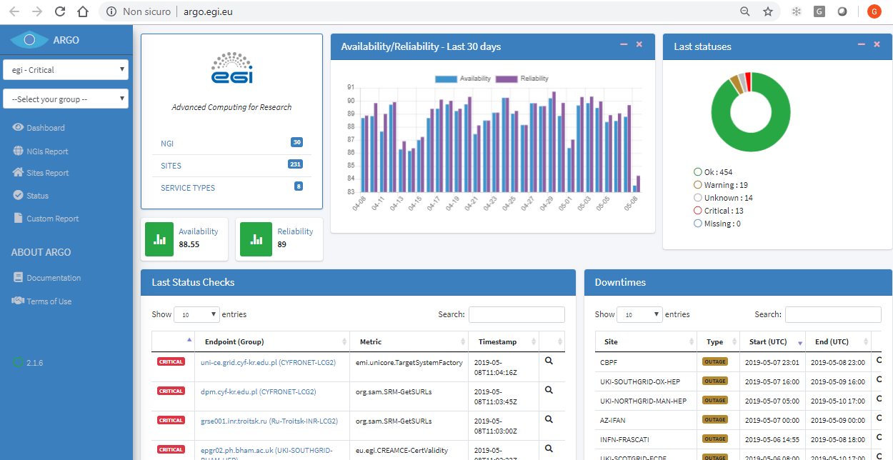
ARGO – The EGI Monitoring System
https://argo.egi.eu

Slide 40
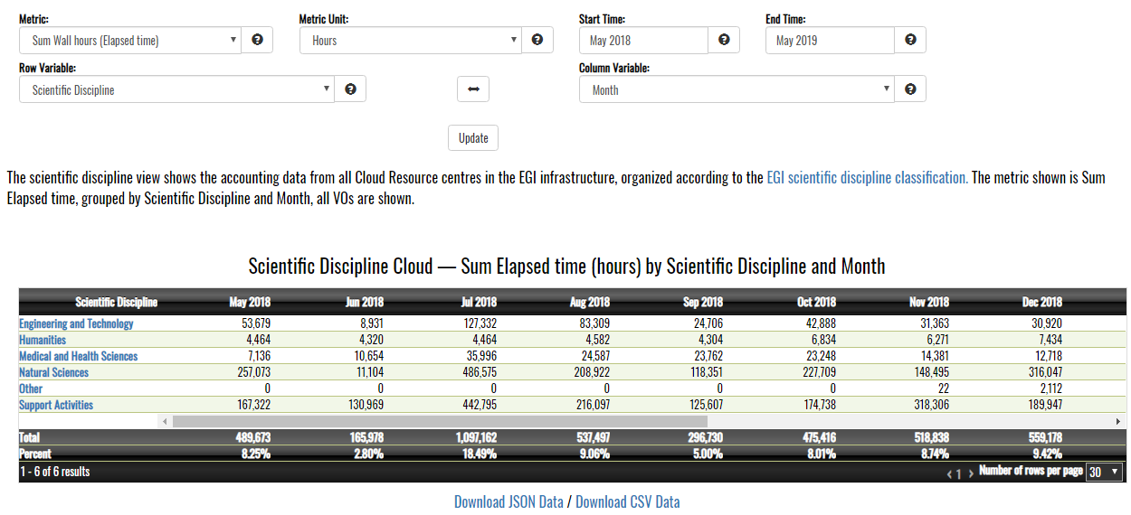
The EGI Accounting System
https://accounting.egi.eu

Slide 42
Extra slides

Slide 43
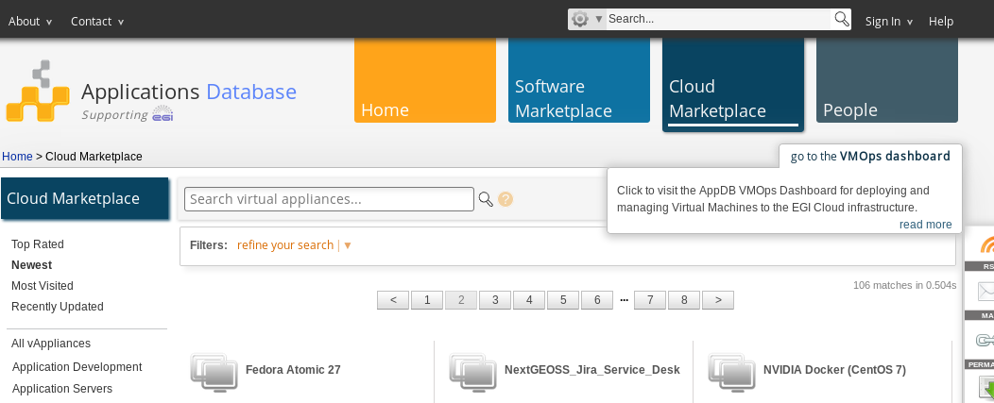
The EGI VMOps dashboard
Through the AppDB portal at: https://appdb.egi.eu/
1
2

Slide 44
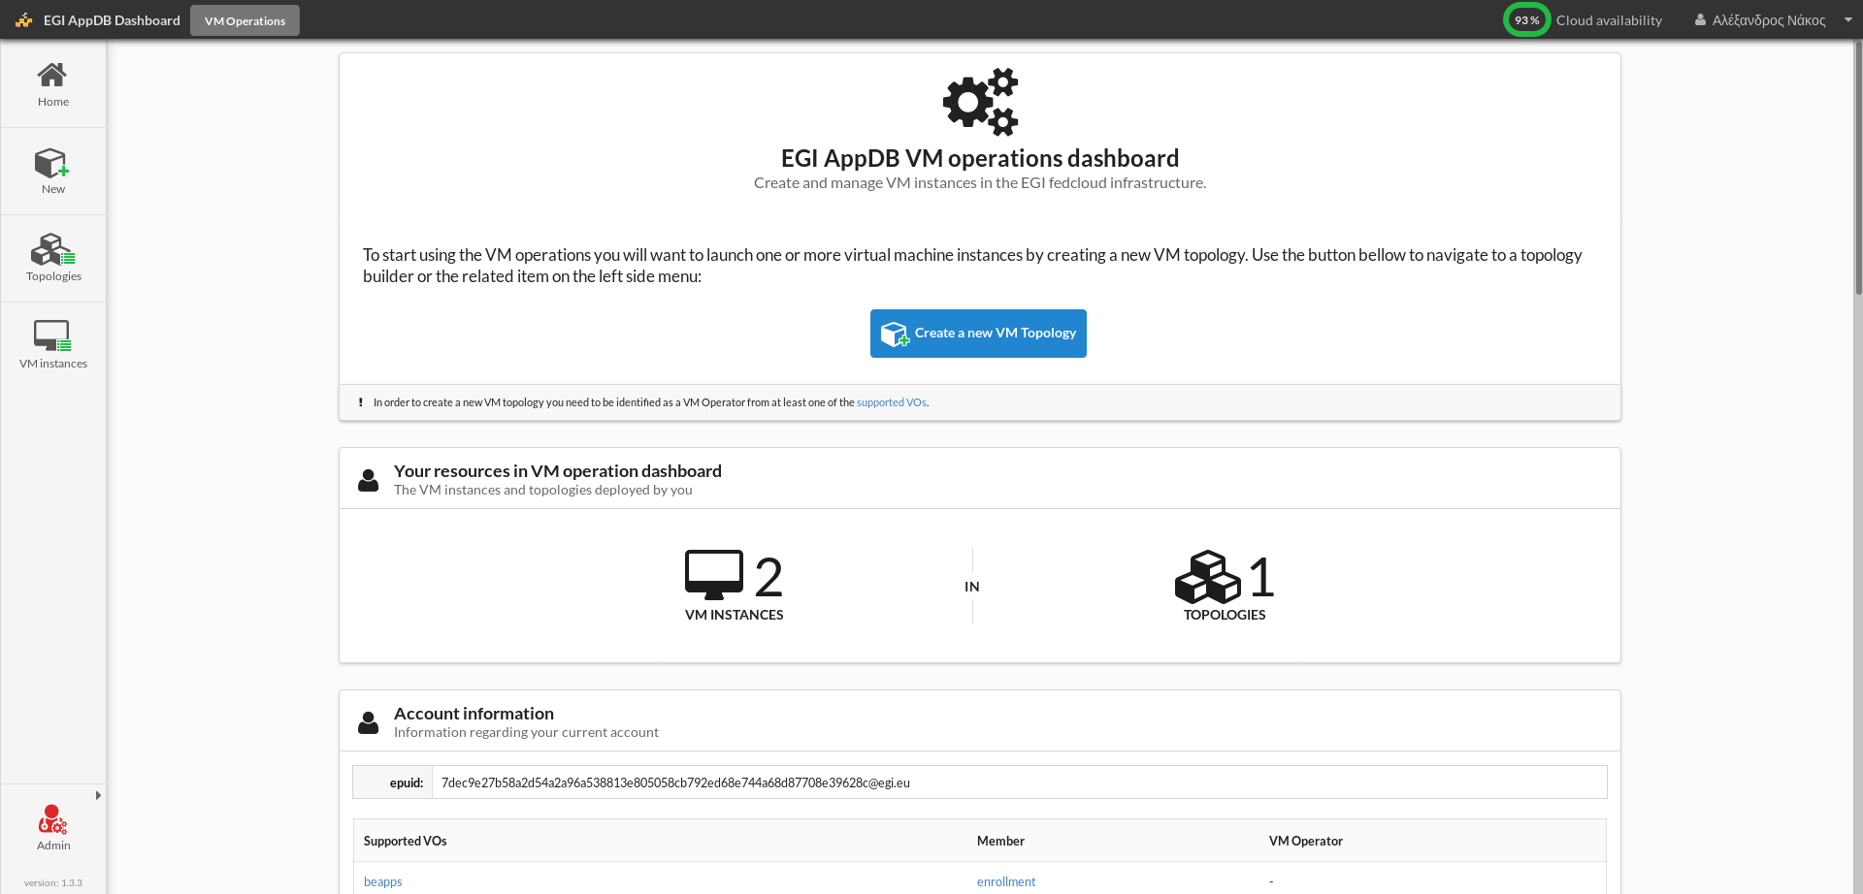
Create a new VM topology
Click on the “Create a new VM topology” link on the homepage, to start the process of VM selection, configuration, and deployment.

Slide 45
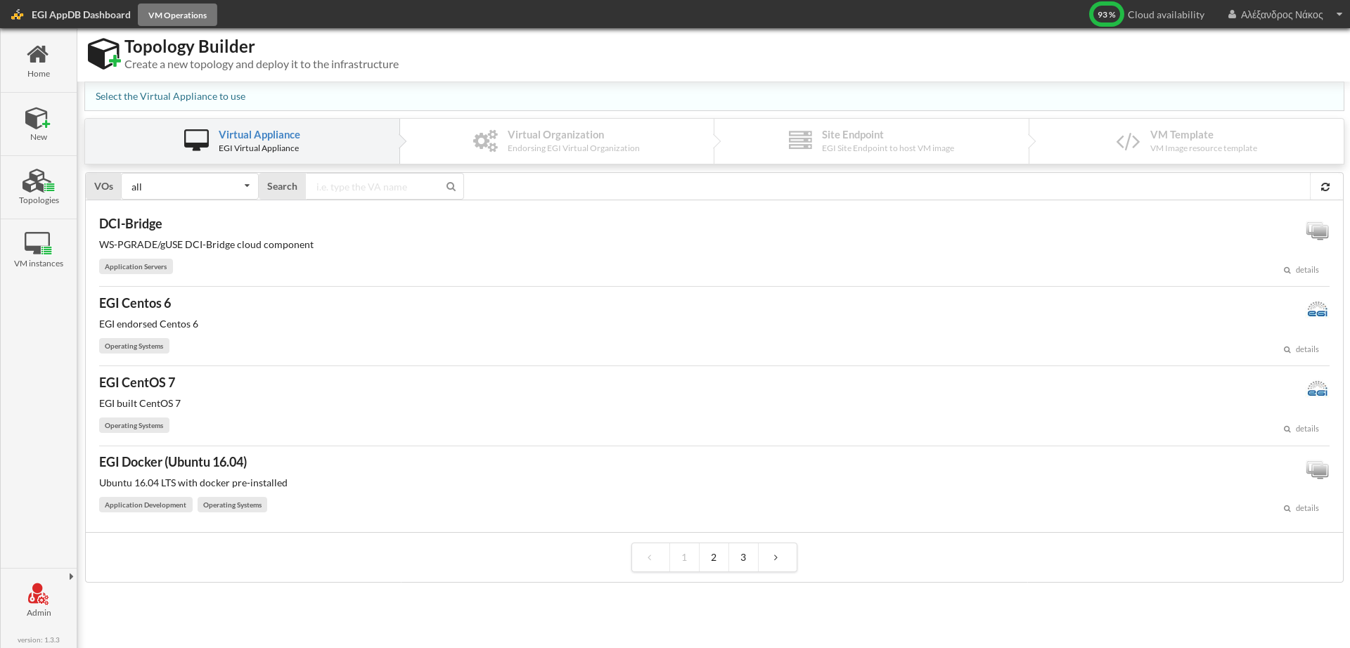
Topology builder: select a Virtual Appliance

Slide 46
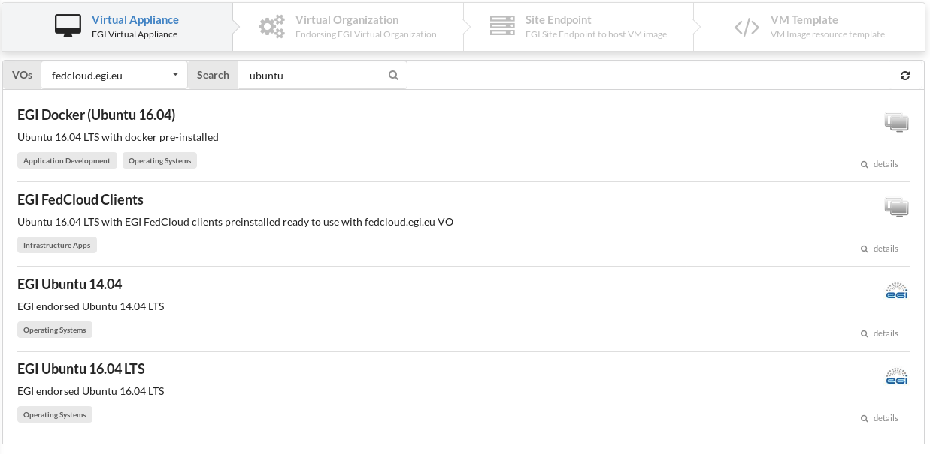
Topology builder: select a Virtual Appliance

Slide 47
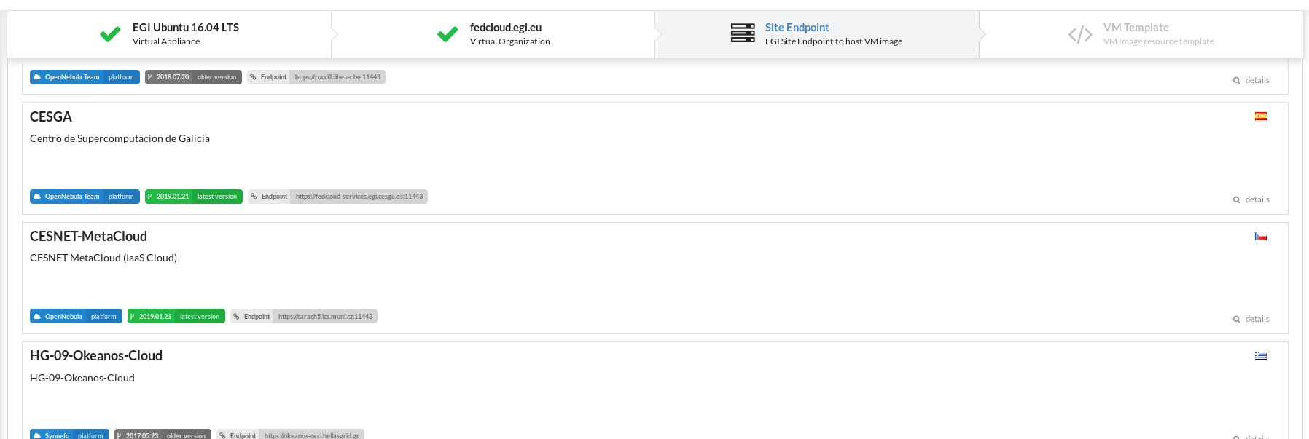
Topology builder: select the endpoint
In this step users can select which site will instantiate and host the VM. This list also displays some properties of each site, e.g. CMF, country, health status, etc

Slide 48
Topology builder: select the template
Depending on the selected site, users can select from a list of predefined templates to run the VM, which vary based on the CPU count, memory size, disk size, etc.

Slide 49
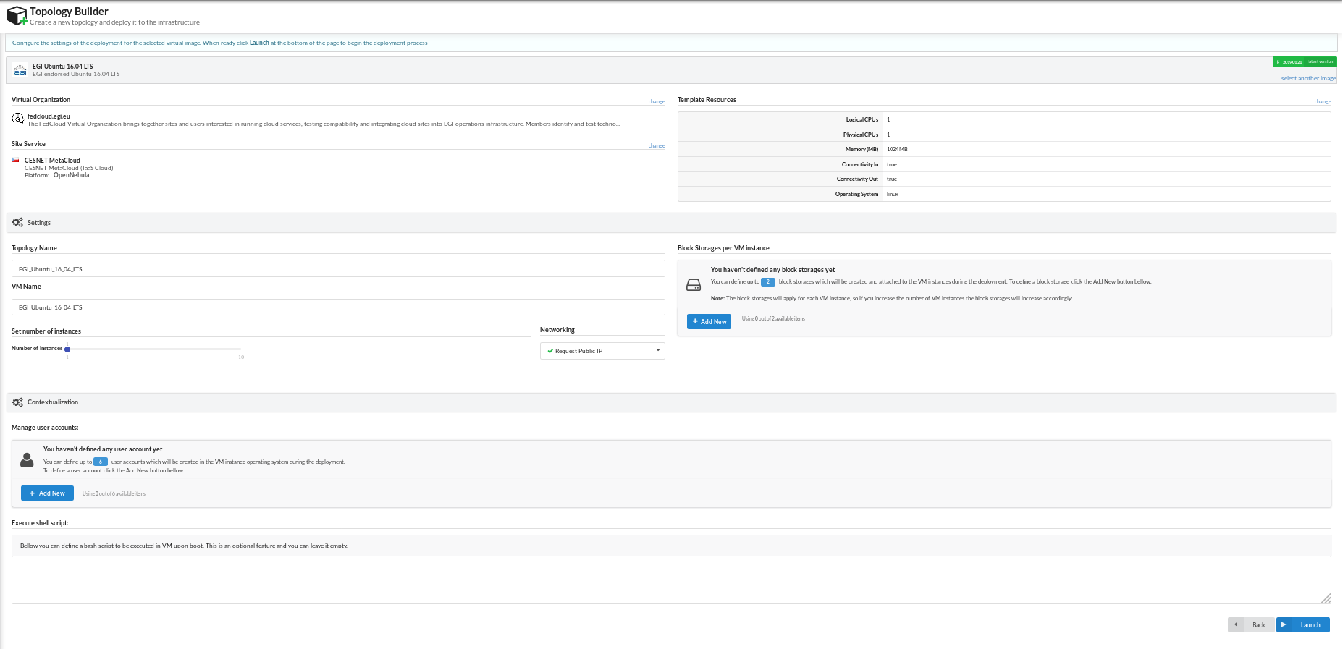
Topology builder: launch the VM

Slide 50
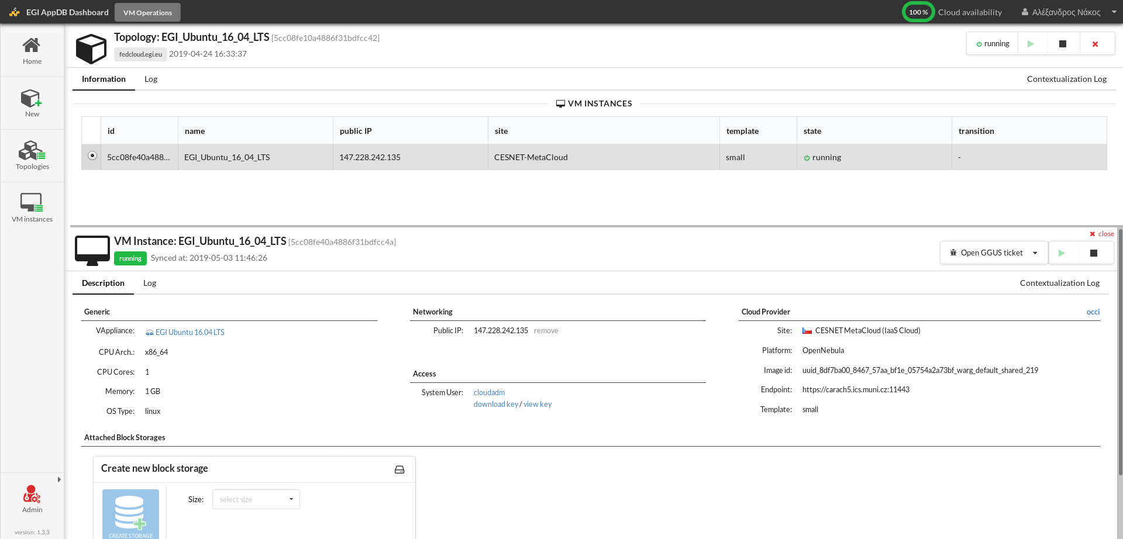
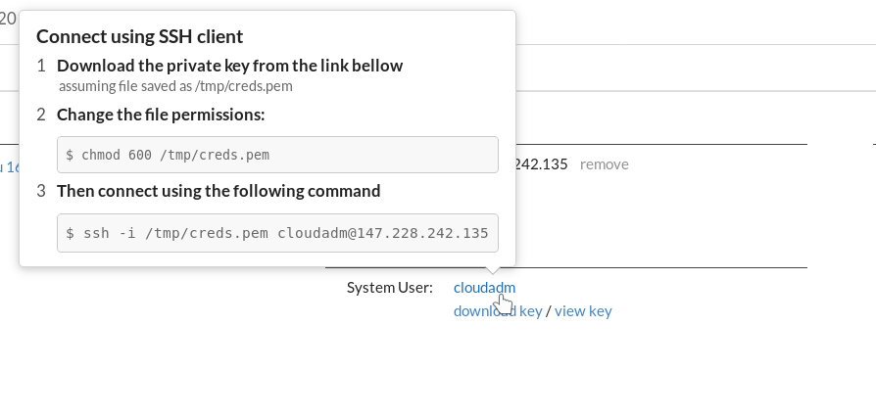
Topology builder: VM topology detail

Slide 51
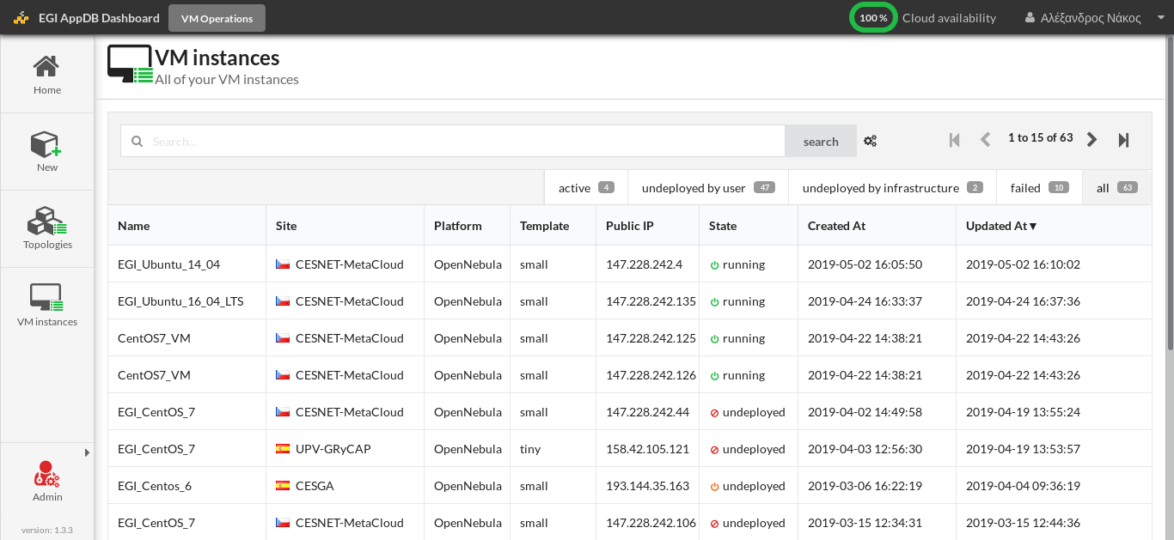
Check running VM topologies

