Slide 1
Design your e-infrastructure! https://indico.egi.eu/indico/event/4434/ Use case: ARIADNEplus
Break out group coordinator:
Giuseppe La Rocca (EGI Foundation)
Amsterdam, 9. May, 2019.

Slide 2
Group members
Achille Felicetti (PIN)
Luciano Milanesi (CNR)
Laure Barbot (DARIAH)

Slide 3
First break-out
Background and Users

Slide 4
Who will be the user? Can the users be characterised? How many are they?
Researchers in archaeological & cultural heritage
The plan is to reach more scientific disciplines (e.g. heritage-related sciences, museum curators, etc.)
Approx. 35,000 archaeological researchers.

Slide 5
What value will the envisaged system deliver for them (the whole setup)? What will the system exactly deliver to them?
New/evolve existing services:
Visualization for graphics 3D (*),
Annotation Services,
Text Mining (*),
National Language Process (NLP) (*),
Space-time and data aggregation,
Provide back-office features for advanced query services.
Address the interoperability of different Thesauruses
(*) evolution of existing services

Slide 6
How should they use the system?
Users will access the dedicated VREs (one per topic) with federated authentication credentials
The D4Science framework will be used to create the VREs
For advanced use-cases via REST APIs

Slide 7
What's the timeline for development, testing and large-scale operation? (Consecutive releases can/should be considered.)
Services will be developed till end of 2022
A more detailed scheduled is expected to be ready by Sept. 2019
Currently cataloguing the list of available services

Slide 8
Second break-out
Design and implementation plan

Slide 9
What should the first version include? - The most basic product prototype imaginable already bringing value to the users (the so-called Minimal Viable Product - MVP)
Integration with the EGI AAI framework
Configure the ARIADNEplus Collaboration in COManage
Data access based on user’s membership
Integration of the EGI Jupyter Notebooks in the D4Science VREs.
Create a dedicated set-up for the community
Identify resources providers for hosting the dedicated resource.
A dedicated budget may be available (TBC)
Integration with Zenodo.
To be checked the amount of space needed
First set of services published in the VRE.

Slide 10
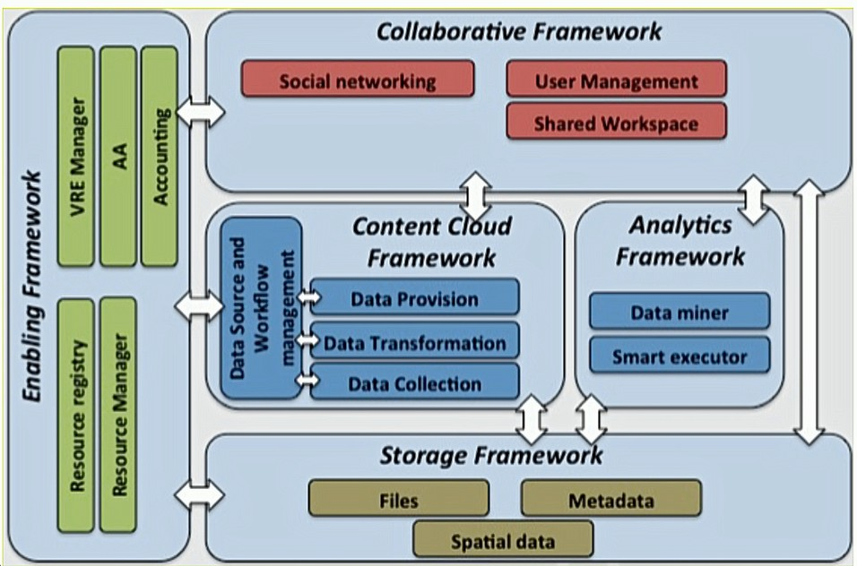
Which components/services already exist in this architecture?
D4Science VRE framework
Enabling Framework:
EGI AAI Check-In
Collaborative Framework:
EGI Jupyter notebooks
Zenodo

Slide 11
Which components/services are under development (and by who)?
Front-office services
ARIADNEplus Visual Services (including visualization of archaeological imagery and visual organization of archaeological data) ~ Developers: CNR-ISTI, CYI
ARIADNEplus Annotation Services (including archaeological text annotation and image annotation) ~ Developers: USW, CNR-ISTI
Text mining and NLP services ~ Developers: USW, CNR-ISTI, PIN
Space-time Services (to be used for geographical queries and data aggregation): UGOT
Back-office services
Query services ~ Developer: UGOT
Cloud geoserver ~ Developers: CNR-ISTI, UGOT

Slide 12
Which components/services should be still brought into the system? Which EGI (or other) partner can do it?
EGI AAI Check-In
EGI Jupyter notebooks
A more clear vision will be available after Q1 2020

Slide 13
Are there gaps in the EGI service catalogues that should be filled to implement the use case? Which service provider could fill the gap?
Facilities for geographic services
Integrate data from different partners
Provide a standard query and visualization frameworks
Investigate possible interoperability issues between EGI and D4Science services
To be checked

Slide 14
Next steps
Update the list of available services (PIN, Q1 2020)
Collecting technical requirements of the new services (All partners, end of this year)
Start the design of the ARIADNEplus VREs (D4Science, EGI, services providers, end of 2020)
Configure the EGI AAI proxy/Collaboration in COManage
Jupyter Notebooks set-up
Investigate possible interoperability issues between EGI and D4Science services (EGI, CNR)
Testing of the VREs (All, end users)

