Slide 1
Marketplace and service order management in EOSC-hub
Diego Scardaci – AMB co-Chair (EGI Foundation)
Dissemination level: Public/Confidential If confidential, please define:
Disclosing Party: (those disclosing confidential information)
Recipient Party: (to whom this information is disclosed, default: project consortium)

Slide 2
Outline
Project in the EOSC marketplace
The EOSC Marketplace: interfaces towards third-party service registry
Distributed order management

Slide 3
Projects in the EOSC Marketplace
Set of (interoperable/composable) services
As they are now
As they will be soon
As they could become

Slide 4
Projects in the EOSC Marketplace General concepts
Projects have been introduced in the Marketplace to allow users to group services
Both orderable and open-access services
Expected to be used together to implement a certain use-case
Projects are key instruments to foster EOSC service integration and composability
Project
Common Service A
+
Common Service B
+
New Thematic Service
Federation service A

Slide 5
Projects in the EOSC Marketplace As they are now (1/2)
All services can be added to a project
An order is submitted each time a service is added to a project
The project is reported in the service order
From JIRA issue

Slide 6
Projects in the EOSC Marketplace As they are now (2/2)
Complex orders (many providers, unclear way to interface services, etc.) trigger technical support
Use case analysis
Adoption of integrated solutions from WP5 and WP6
New tech requirements for tech WPs → to be prioritised
Complex orders
Use cases analysis
Technical Support
(WP10)
Service Developers
(WP5/WP6)
Tech requirements
Hub Services
New service releases
Service adoption

Slide 7
Projects in the EOSC Marketplace As they will become soon
All services can be added to a project
A single order corresponds to a simple project
No additional complexity for the user
Possibility to add more services in a second time
Users can fully manage a project
Add/remove services, save the projects, delete the projects, etc.
Service orders will be submitted only when the users save the project
Better user journey → project ordered in a transactional way
Master ticket for all the project and sub-tickets for each involved service provider

Slide 8
Projects in the EOSC Marketplace Offering integrated solutions in the EOSC Marketplace
Integration activities achieved within the project can become solutions accessible via the EOSC Marketplace
Leveraging on WP5, WP6 works
Leveraging on WP7 and WP8 experiences
Some examples:
EGI Cloud Compute + EUDAT B2STAGE & B2FIND
EUDAT B2FIND and EGI Data Hub
INDIGO Orchestrator and EGI Cloud Compute
Enabling creation of projects from integrated solution
Service composition templates → to be published in the MP
Allowing the customisation

Slide 9
Projects in the EOSC Marketplace As they could become in a (far) future
MP will allow users to select various services offered by the Hub and compose them according to their needs
Why?
to create added-value solutions for research
Example: an end-user can compose together different scientific algorithms creating new workflows/solutions that use as input datasets (made available by the Hub as well).
How?
Leveraging on the adoption of open and standard interfaces
Promoting integration
Highlight interoperable services → assigning TAGs
Dashboard to compose (interoperable) services

Slide 10
The EOSC Marketplace: interfaces towards third-party service registry
Push & pull interfaces

Slide 11
The EOSC MP: interfaces towards third-party service registry Some considerations
The EOSC Marketplace offers a service registry of EOSC services
They can be accessed through the Hub processes and procedures
Other service registries exist in the European Research Area
Large collaborations have their own registry
Large collaborations maintain their catalogue with their own SPM process
It is not realistic having a unique central registry in the whole ERA
It is unlikely that small collaborations have their own registry
They will leverage on EOSC
The EOSC Marketplace should expose interfaces to gather information from third-party service registry
EOSC-Pilot terminology: https://eoscpilot.eu/eosc-glossary#overlay-context=eosc-glossary

Slide 12
The EOSC MP: interfaces towards third-party service registry Push & Pull interfaces (1/2)
Pull interface: to retrieve service metadata from registries
Service registries should publish service metadata in an agreed format
Push interface: for registries using their own metadata schema
Service registry X
Pull
Marketplace
Push
Service registry A
Service registry Y
Pull
EOSC-hub Core Services/SPMT
Marketplace also allows manual service registration
Service registry Z
EGI/EUDAT/INDIGO services

Slide 13
The EOSC MP: interfaces towards third-party service registry Push & Pull interfaces (2/2)
The pull interface should be agreed/designed with/together organisations running their service registries
We can leverage on previous experiences
Schema.org used by the LS Science community in EOSC pilot → to be assessed
See https://www.esfri.eu/sites/default/files/Andy-Smith.pdf
SPMT should be the first service registry compliant with the EOSC MP pull interface
SPMT can be offered to other organizations as a service to manage their service portfolio
Dedicated instance or as a service

Slide 14
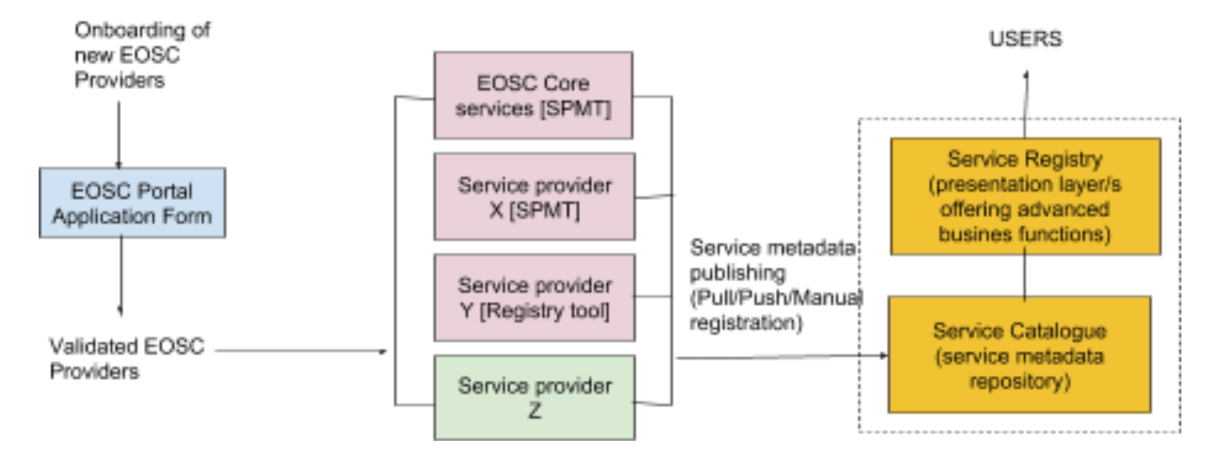
The EOSC MP: interfaces towards third-party service registry A possible scenario
Marketplace

Slide 15
Distributed Order Management
Central service order registry
Open interface towards service providers
Catch-all EOSC-hub service order management tool

Slide 16
Distributed Order Management Some considerations
The Marketplace should have a unique central registry for service orders
Tracking/Accounting aims
Each service provider should be free to choose how to handle orders received through the marketplace
Orders need to be forwarded to the order mgmt tool of the provider
We need to define an (open) interface between the MP order registry and the order mgmt tools of the providers
Bi-directional to maintain the central order registry up-to-date
A catch-all EOSC-hub service order mgmt tool will be offered to all the interested providers

Slide 17
Retrieve information about order status
Customer Dashboard
Marketplace Frontend
EOSC Marketplace
Catch-all service
EOSC-hub Service Order Mgmt tool
Today JIRA
Service orders
Marketplace Back Office
An order cointans a set of related services (E.g. Cloud Compute and Online Storage)
Open interface
Passthrough
Service Provider 1 Order Mgmt tool
Service Provider 2 Order Mgmt tool
Service Provider N Order Mgmt tool

