Slide 1
The Role of Standards for Risk Reduction and Inter-operation in XSEDE
Andrew Grimshaw

Slide 2
“Less is more.” —Jerry Brown “Perfection is achieved not when there is nothing more to add, but when there is nothing left to take away.” —Antoine de Saint-Exupery “Give me simple abstractions and make them work reliably” — Kent Blackburn

Slide 3
Agenda
Takeaway message
Background on XD in the US
Architecture design goals and philosophy
XSEDE Architecture & Implementation
Summary

Slide 4
Takeaway message
The use of standards permits XSEDE to interoperate with other infrastructures, reduces risks including vendor lock-in, and allows us to focus on higher level capabilities and less on the mundane

Slide 5
Agenda
Takeaway message
Background on XD in the US
Architecture design goals and philosophy
XSEDE Architecture & Implementation
Summary

Slide 6
The NSF eXtreme Digital RFP
Follow on to TeraGrid
Narrowed to two teams in 2009
Team announced in July 2011
Best of both

Slide 7
XSEDE is about …
Increased productivity
leading to more science
sometimes the difference between a feasible project and an impractical one
Transformative qualities
active, formal requirements gathering processes
understand the needs of the community
drive the evolution of XSEDE
centralized AUSS
expedites knowledge transfer across disciplines
provide input into needed CI capabilities
engaging new and under-represented communities
campus bridging will increase inter-campus collaborations

Slide 8
Infrastructure designed for innovation and evolution
An environment in which all resources, data and services relevant to a researcher can be embedded and shared
campus bridging creating a single virtual system with interactive data transfer and resource sharing capabilities
“make my data accessible everywhere I want to be”
coordinated archival approach to ensure persistence of important datasets beyond the lifetime of particular service providers
An underlying infrastructure to support this
open architecture with judicious use of standards designed to evolve in a non-disruptive way
interoperability of XSEDE with other cyberinfrastructures
Notes:
These are salient features of XSEDE’s architecture and services provided….

Slide 9
XSEDE’s distinguishing characteristics
Foundation for a national cyberinfrastructure ecosystem
comprehensive suite of advanced digital services will federate with other high-end facilities and campus-based resources
Unprecedented integration of diverse digital resources
innovative, open architecture making possible the continuous addition of new technology capabilities and services

Slide 10
Distinguishing characteristics: Architecture
XSEDE is designed for innovation and evolution
there is an architecture defined
based on set of design principles
rooted in the judicious use of standards and best practices
Professional systems engineering approach
responds to evolving needs of existing, emerging, and new communities
incremental development/deployment model
new requirements gathering processes
ticket mining, focus groups, usability panels, shoulder surfing
ensure robustness and security while incorporating new and improved technologies and services
process control, quality assurance, baseline management, stakeholder involvement

Slide 11
Agenda
Takeaway message
Background on XD in the US
Architecture design goals and philosophy
XSEDE Architecture & Implementation
Summary

Slide 12
What we mean by architecture
Architecture defines the XSEDE system’s components and how they interact
each component is motivated by one or more requirements
each component is defined in terms of required capabilities: interfaces and qualities of service
Equally important is the process by which we revise the architecture over time
key point: driven by new or revised requirements
Notes:
Paul Clements: I found myself wanting to hear you say that architecture is the primary design means for satisfying the needs and concerns of the system's stakeholders. Now, that manifests itself as the system's elements (the word we prefer, since "component" to us is a run-time entity, and non-run-time elements -- modules -- are equally important) and how they interact. I very much liked making architecture revision over time a first-class concern as well.

Slide 13
System Architecture
What is a system architecture?
Set of design principles
A definition of the basic components
A definition of how the components refer to one another and interact in order to meet requirements
An abstraction on top of the underlying components

Slide 14
Systems Architecture: Why is it important?
A distributed system is like a puzzle-ball, you can deal with the pieces
If separate pieces are used, then the programmer must integrate the solutions.
If all the pieces are not present, then the programmer must develop enough of the missing pieces to support the application.

Slide 15
Systems Architecture: Why is it important?
Or you can give the user a functioning whole and let them substitute in different pieces as needed.
Don’t put the cognitive burden on the programmer and end-user, let them focus on the science.

Slide 16
Systems Architecture: Basic Components
Functional components
Similar service and capabilities as an operating system
processes, inter-process communication, security, file systems, memory management
Non-functional – “ilities”
reliability, availability, extensibility, usability, performability, etc.
Note trade-offs
cost
kind of service
“Give me simple abstractions and make them work reliably.”
Kent Blackburn
level of service

Slide 17
XSEDE Architecture: Design Principles
learn from earlier work in both grids and distributed systems
where appropriate embrace standards to mitigate risk, avoid vendor lock-in, and facilitate interoperation with other Grid infrastructures;
implementation agnosticism – provided the implementation follows the standards and profiles defined, and can interoperate as specified;
define a small number of powerful primitives and then combine and re-use them in many different ways;
assume very little about the underlying resources;
separation of concerns and good software engineering practices including the separation of mechanism and policy;
it’s all about users - provide simple, intuitive interfaces to users and applications while recognizing the end-to-end principle;
stakeholder (including RPs) driven development process.

Slide 18
Why Open Standards?
Risk reduction
Best-of-breed mix-and-match
Allows innovation at more interesting layers
Facilitates interoperation with other infrastructures

Slide 19
Other implementations are possible
Remember the puzzle!
We can use multiple implementations of the same component at the same time!
OGSA-BES QoS example
Max jobs
Job rate
User-id mapping
Failure rate, persistence of data
UNICORE 6 at Service Providers
Genesis II (or others) on campuses

Slide 20
Agenda
Takeaway message
Background on XD in the US
Architecture design goals and philosophy
XSEDE Architecture & Implementation
Summary

Slide 21
XSEDE Architecture
Applications, Portals and Gateways, XUAS
Transparent access via the file system
APIs and CLIs
Access Layer
Services &
Web Services
Infrastructure
XSEDE Enterprise
Services
GRAM5
Community Provided
Services
JSDL/BES
HPC-BP
GridFTP
REST/RMI
Amazon EC2
WSI-BSP
RNS/ByteIO
Application Deployment
Core Enterprise
Resources, e.g.,
RP resources
Other Resources, e.g.
Campus centers, Amazon,
Research group data
Resources

Slide 22
XSEDE XES– Simple services combined in many ways
Resource Namespace Service 1.1
OGSA WSRF BP – metadata and notification
OGSA Basic Execution Service
OGSA-ByteIO
WS Trust Secure Token Services
WSI BSP for transport of credentials
…

Slide 23
Resource Namespace Service
Used to create a global shared namespace
Analogous to Unix directories, entries “point” to grid resources
Most resources can be named using an intuitive path
/home/grimshaw/myfile or /bin/bio/blastp
Directories organized resources based on human relevant semantics
Namespace can be mapped into local file system, and grid resources accessed as if local

Slide 24
Most everything can have an RNS path
Files
Directories
Web pages
Execution services – queues and BESs
Jobs
Applications
Archives
Instruments
Relational Databases
Global Federated File System (GFFS) brings it all together and makes it accessible via the local file system and a FUSE driver

Slide 25
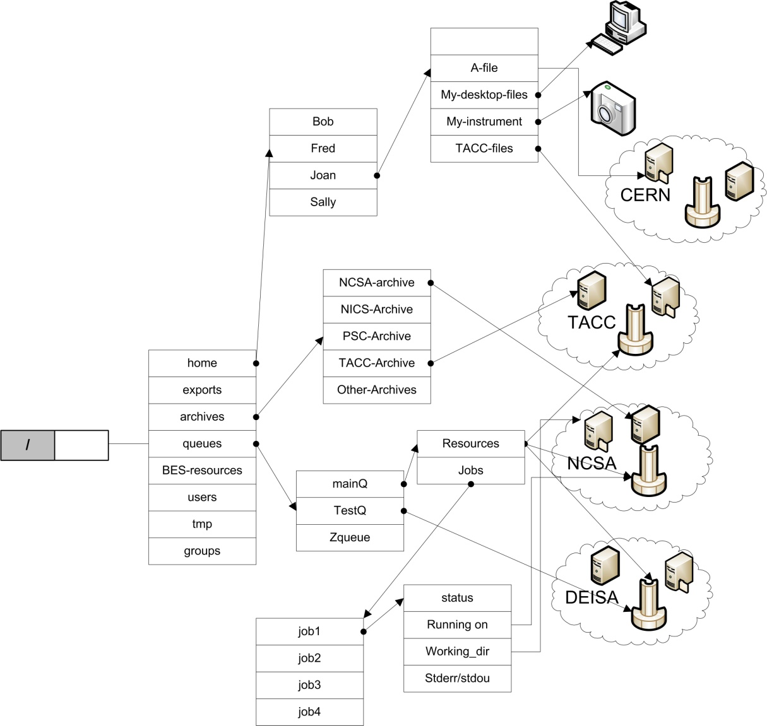
Single global namespace

Slide 26
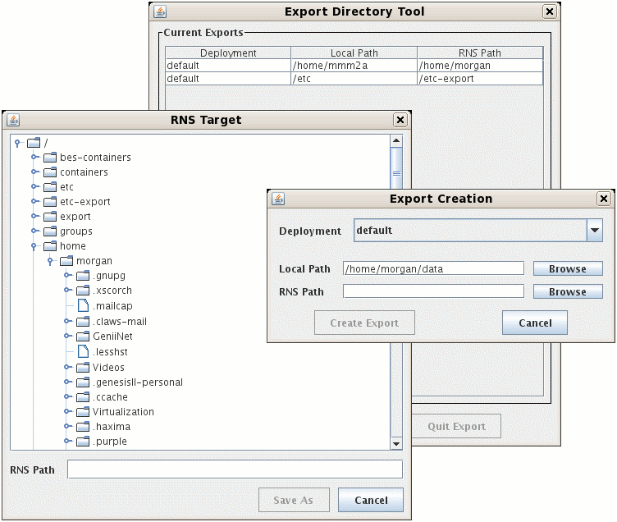
Data sharing with exports and RNS

Slide 27
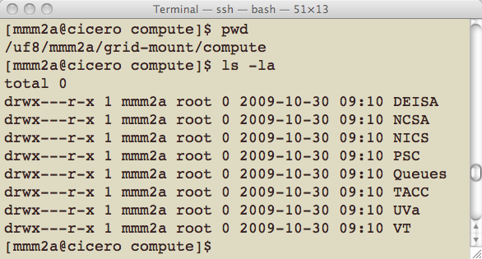
Directory listing of Compute resources

Slide 28
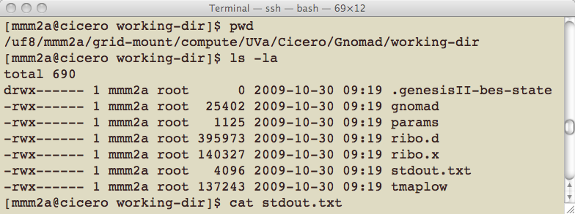
Directory listing of a running job

Slide 29
XSEDE Users Access Layer
There are different users with different capabilities – users view will reflect that
We will stay out of the way of advanced users!
We will mask as much of the underlying complexity as we can for the rest
Folks can go in at multiple levels

Slide 30
Access layer mediates interaction
<<system>>
Access Layer: Interactive & programmatic access
<<system>>
Services Layer
<<system>>
XSEDE Enterprise Services
Genesis II Client
& FUSE
Genesis II
Grid-FTP
SAGA
Gateways
UNICORE 6
XSEDE Scientist
Resource owner
System Administrator
Student
XSEDE CUE
<<system>>
Community Provided Services
UNICORE Rich Client
<<system>>
Externally Hosted Services
Globus online
XUP
Browser-Based
Access to XSEDE User Portal and Globus on-line

Slide 31
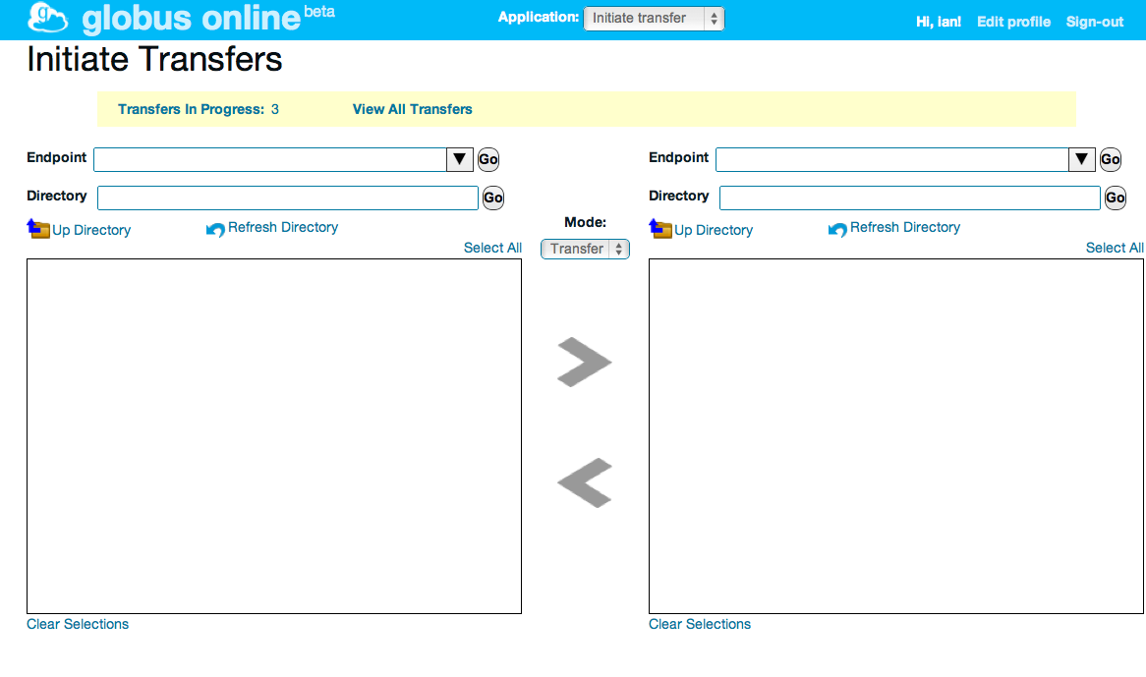
Globus Online data mover (XD-Data)
HTTP REST interface
POST https://transfer.api. globusonline.org/ v0.10/ transfer <transfer-doc>
Command line interface
ls alcf#dtn:/
scp alcf#dtn:/myfile \
nersc#dtn:/myfile
Web interface
Fire-and-forget data movement
Many files and lots of data
Credential management
Knowledge of endpoints
Expert operations and monitoring
GridFTP servers
FTP servers
Global Federated
File System (GFFS)
Globus Connect
on local computers

Slide 32
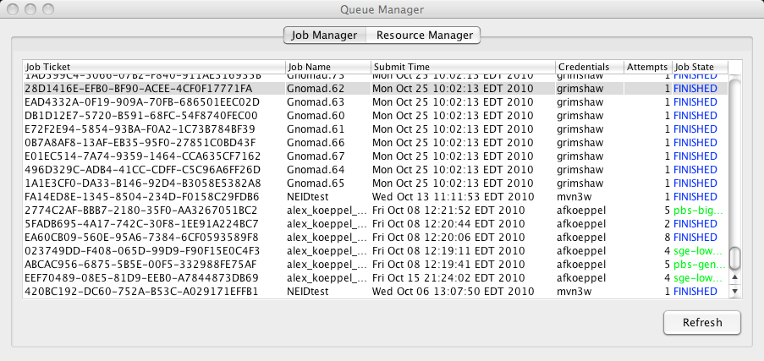
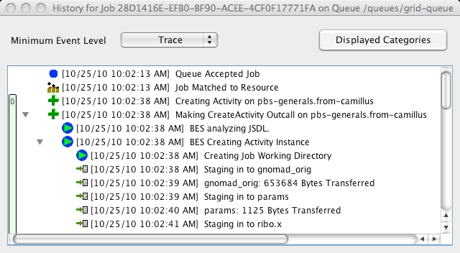
Sample job management screen shots

Slide 33
XSEDE Implementation
Externally hosted Globus online
Artful mixture of best-of-breed standards where appropriate and specialized implementations
Chose two robust, well-used, standards-compliant systems
Recall the puzzle ball
UNICORE 6 (DEISA) for core compute functionality at the centers
Genesis II for GFFS and for campus bridging
Interop with other standards-compliant implementations world-wide – GIN and PGI are important to us

Slide 34
Agenda
Takeaway message
Background on XD in the US
Architecture design goals and philosophy
XSEDE Architecture & Implementation
Summary

Slide 35
Summary
XSEDE will:
enhance the productivity of scientists and engineers and provide them with new capabilities
and thus
facilitate scientific discovery and enable transformational science and engineering and innovative educational programs
The architecture provides the foundation
The architecture utilizes standards to mitigate risk and enhance interoperability with other infrastructures
We are committed to standards

Slide 37
High Level capabilities
Capability | Brief description
Traditional user interfaces to HPC resources | “Do no harm” for experienced users of HPC resources. E.g., shell access, direct submission to schedulers, etc.
Bridge/Integrate with diverse resources and providers | Implementation independent specifications for interoperation with campus, lab and personal resources, (inter-)national cyberinfrastructures, and cloud providers
Support for diverse application pes | Remote access to capability (HPC), capacity (HTC), workflows, data sharing, etc.
Easy user interfaces to diverse resources and task types | Support wide range of user needs and abilities. E.g., GUIs (thick and thin, gateways)and CLI (shells, file systems) to HPC, HTC, storage, viz, etc.
Programmatic access to resources | APIs, SDKs, scripting interfaces, development tools, etc.
Uniform global names to access resources | Location and implementation independent names to refer to most resources
Access and manage data across diverse storage resources from many providers | File transfer, file sharing, remote access, replication, archives, metadata, etc.
Secure, researcher controlled resource sharing across organizational boundaries | Users will be able to manage access control to their files, computers, storage, and other resources.
Identity management and federation | Ability to create and manage your own identities and groups.
Login using campus and other identities | Support InCommon (e.g., SAML) and Web standards (e.g., OAuth) for single sign-on.
Unified user administration and support | Single point of contact for help desk, resource requests, accounting, documentation.
Unified operations | Cross-provider operational monitoring, problem determination, etc.
Discovery and monitoring | Find resources of all types, determine properties, monitor and receive notifications
Support mission critical science applications | The infrastructure must be sufficiently secure, reliable, available, extensible (i.e., classic “ilities”) so that communities do not feel the need to build their own

