Slide 1
Data management services in EGI
Overview and requirements
Gergely Sipos
gergely.sipos@egi.eu

Slide 2
EGI functions – the virtuous cycle
National
Resource Providers
European Grid Infrastructure
Ecosystem
Used by Researchers
Gathering New Requirements
New Technology Assessed
Deployed Infrastructure Services
Current User Communities
MoUs & OLAs
MoUs
Technology flexibility
EGI.eu
Coordinated by EGI.eu User Community Support Team
MoUs & SLAs
LoIs
New User Communities
Technology Providers

Slide 3
The EGI requirement gathering and tracking process
The EGI Community
Channels for Operation requirements
UCST and EGI-InSPIRE developers
HUCs
1)
2)
EGI technology providers
VOs
Channels for User requirements
EGI Requirements Tracker
TCB
EIROs
UCB
3)
4)
5)
VRCs
NGIs
projects
ESFRIs
EMI
IGE
SAGA,
...
Helpdesks
(EGI, NGIs, projects,...)

Slide 4
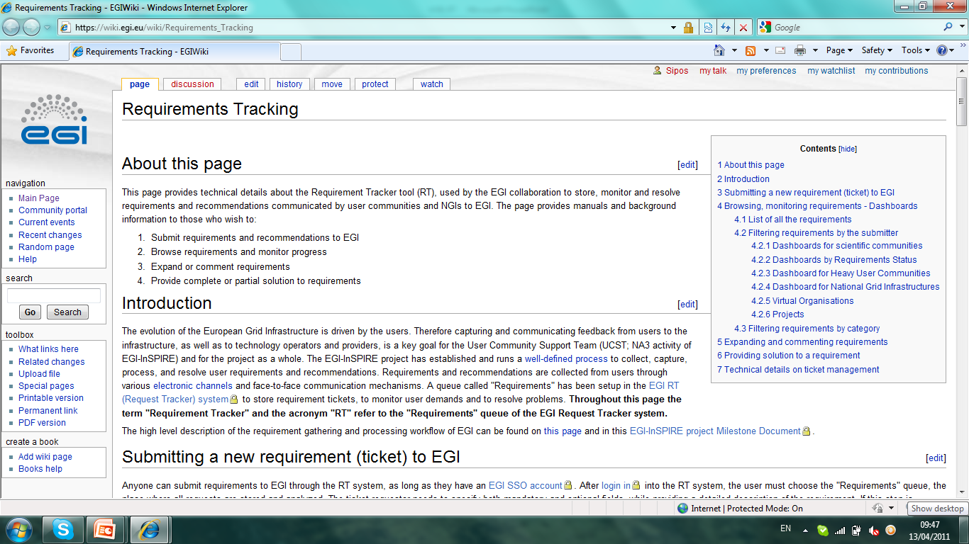
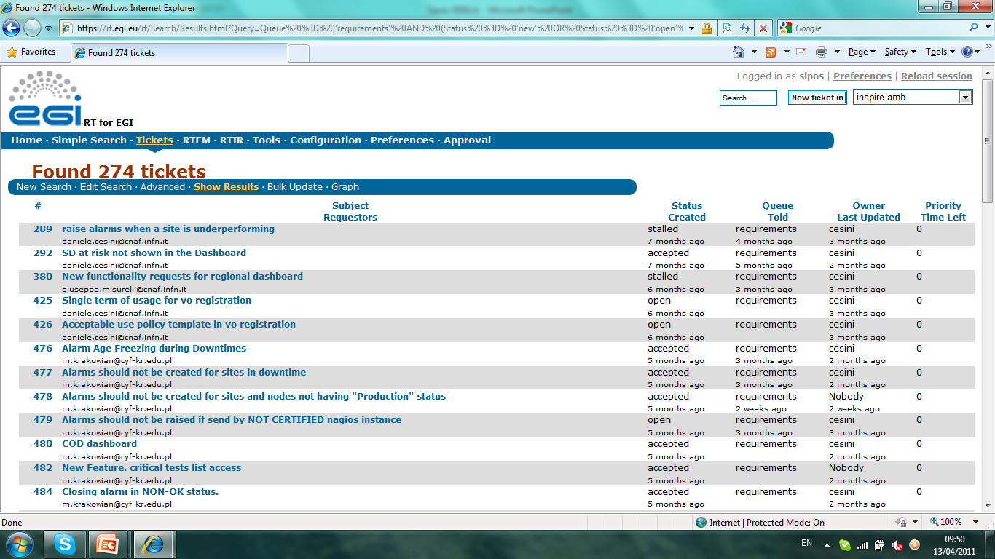
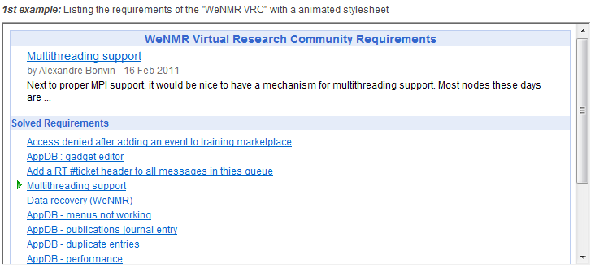
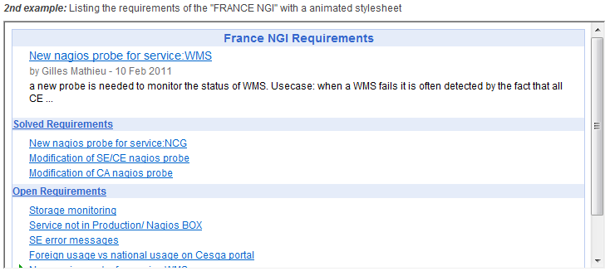
EGI Requirements Tracker: http://www.egi.eu/user-support/getting_help
Permanent storage for EGI requirements
User
Operational
Complete transparency
For user communities
For NGIs
For technology providers
Web interfaces:
Public browsing
Authenticated commenting, replying (with EGI SSO)
NEW: web gadgets
To list your requirements
To submit requirements
Complete customisability

Slide 5
User Community Board
Develops the strategy and defines the priorities for the human and technical user community support services provided by EGI
Monthly meetings (https://www.egi.eu/indico/categoryDisplay.py?categId=21)
Representatives of EGI VRCs and Heavy User Communities http://www.egi.eu/user-support/vrc_gateways:
Structural Biology and NMR
High Energy Physics
Digital Research Infrastructure for the Arts and Humanities
Research Infrastructure for Language Resources
Life Sciences
Earth Science
Computational Chemistry and Material Science
Fusion
The study of e-Science
Astronomy and Astrophysics
Hydrometeorology

Slide 6
EGI requirements: Data Management https://wiki.egi.eu/wiki/Track_User_Support_Requirements
Sub-topic: Coherency of storages and catalogs (in gLite)
Synchronise access control settings between storage servers and with file catalogues
Motivation: To simplify community level code
Sub-topic: Stability and scalability of Data Management Services (in gLite)
Best practice documents on configuration of services to reach current limitations
(Pushing the limitations by further development)
Motivation: many communities (still) do not have the know-how

Slide 7
EGI requirements: Data Management https://wiki.egi.eu/wiki/Track_User_Support_Requirements
Redundancy of Storage Elements for file transfers:
Transparent retry of failed file transfer operations in case of server/service failures (with different file replicas or storages)
Motivation: To simplify community-level applications; to improve service availability for end-users
Covering at all stages of data lifecycle:
Support for data removal policies (profiles?) defined at community level with notification mechanisms to file owners
Motivation: to protect against overgrowing repositories
Fine grained access control within VOs:
Fine grained access to storage and catalogue directories and files should be controllable without site admins involved
Motivation: to give full control over community data to communities
Automatic transfer of files with jobs by middleware:
Files referenced by Logical File Names should be transferred by the middleware for/from jobs
Motivation: to simplify community level applications

Slide 8
EGI requirements: Data Management https://wiki.egi.eu/wiki/Track_User_Support_Requirements
Partial file access
Capability to access only part of a file rather than forcing a complete file transfer
Motivation: to improve job throughput
Support for distributed relational databases
Services for distributed relational data management with ACL-based access control
Motivation: Life sciences applications
Automated moving of files to other Storages in case of overloading
When a storage becomes full, files should be moved/redirected to other storages
Motivation: to simplify community level applications
User transparent replica selection
Provide automatic replication of files with transparent storage selection
Motivation: to simplify community level applications
Homogenous APIs
Service APIs should be better integrated
Motivation: to simplify community level applications

Slide 9
Requirements table
Redundancy of Storage Elements for file transfers | Covering at all stages of data lifecycle | Fine grained access control within VOs | Automatic transfer of files with jobs by middleware | Partial file access | Support for distributed relational databases | Automated moving of files to other Storages in case of overloading | User transparent replica selection | Homogenous APIs

Slide 10
Related EGI Support Services www.egi.eu/user-support
Applications Database
Register and search for scientific apps AND developer tools AND developers
Training marketplace
Register and lookup training services
Workshops
Organising topical events – like this one
NGI-EGI Roadshows
To reach new communities (See session on Wednesday)
Web gadgets/widgets
To simplify access and reuse of web based services
Dissemination (marketing, communication)
To inform the community about services and achivements

Slide 11
EGI discussion points
The broader issues (from the users’ point of view):
Confusions on both sides:
User communities’– mixing bugs, requirements, wishes, ideas
Service providers – mixing public (documented) knowledge, community-specific knowledge, developer knowledge, site admin knowledge
Better documentations, more FAQs, more training, specialised workshops,...?
Integrated services – “EGI platform” instead of “EGI technologies”
Role of EGI.eu? Role of technology projects?
Moving common services from community software into middleware
Automatic selection of replicas, storages; resubmission of failed transfers, ...
Capturing requirements from new (potential) communities
Role of projects, EGI.eu, NGIs?
Communication channels?
Support systems?

Slide 12
Thank you!

