Slide 1
Service Availability Monitoring (SAM)
Marian Babik, David Collados, Wojciech Lapka, Pedro Andrade, Paloma Fuente
(CERN)
Emir Imamagic
(SRCE)
Christos Triantafyllidis (AUTH)

Slide 2
Overview
Service Availability Monitoring
MyEGI
Nagios web interface
SAM internals

Slide 3
Service Availability Monitoring
Infrastructure for distributed monitoring
submission, transport, storage and visualization of probes
relies on existing technologies (Nagios, ActiveMQ, Django)
deployed at each NGI
Results are used to measure the availability and reliability of EGI sites

Slide 4
Components
SAM grid monitoring (SAM-Gridmon)
central services (Web, API, availability)
http://grid-monitoring.cern.ch/myegi/
SAM-Nagios
Monitoring platform supporting multiple configurations
NGI-Nagios
VO-Nagios
Site-Nagios
Operations Tools-Nagios (ops-monitor)

Slide 5
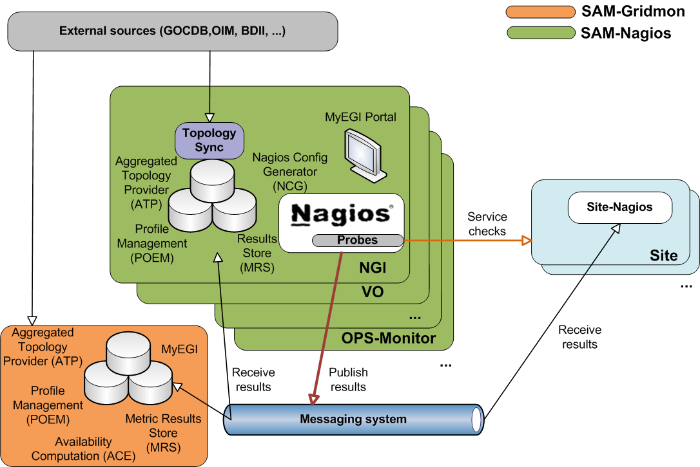
Architecture

Slide 6
Deployment
Each NGI deploys NGI-Nagios
32 instances
32 NGIs/ROCs/EIROs and 3 external regions (Canada, IGALC and LA)
List of instances
https://wiki.egi.eu/wiki/SAM_Instances

Slide 7
MyEGI
Visualization tool for monitoring the grid infrastructure
replaces the SAM Portal and programmatic interfaces (PI)s
Provides
status and history of services and sites
visualization of services & sites availabilities
gridmap style views
web services for data export in JSON/XML

Slide 8
Nagios Web Interface
Standard Nagios component
Provides
host and services status
scheduling service tests

Slide 9
Scheduling Service Tests
Who can schedule tests?
GOCDB contacts
site admins (get_site_list)
regional operators (get_roc_contacts)
All services on a host
Host Details page
Schedule a check of all services on this host

Slide 10
Scheduling Service Tests
Single metric
Service Details page
Re-schedule the next check of this service
Important!
don’t force check all services on host or remote metrics

Slide 11
External Links
Extra Notes
red folder image
links to metric documentation
Extra Actions
“bomb” image
links to performance data

Slide 12
SAM Internals

Slide 13
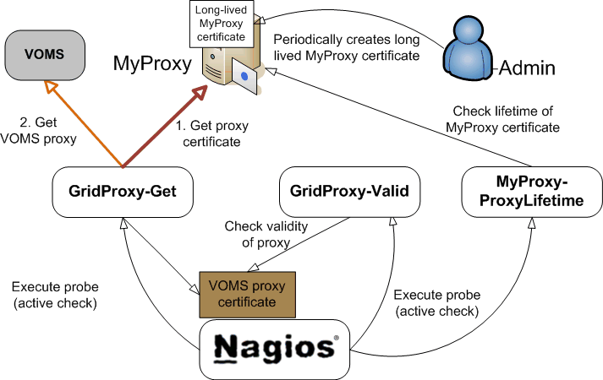
Credential Management

Slide 14
Credential Management
hr.srce.GridProxy-Get-*
regenerates VOMS proxy from MyProxy credential
hr.srce.GridProxy-Valid-*
checks validity of VOMS proxy on Nagios host
all metrics using proxy depend on this metric

Slide 15
Credential Management
hr.srce.MyProxy-ProxyLifetime-*
checks validity of stored MyProxy credential
warns admin that MyProxy should be refreshed

Slide 16
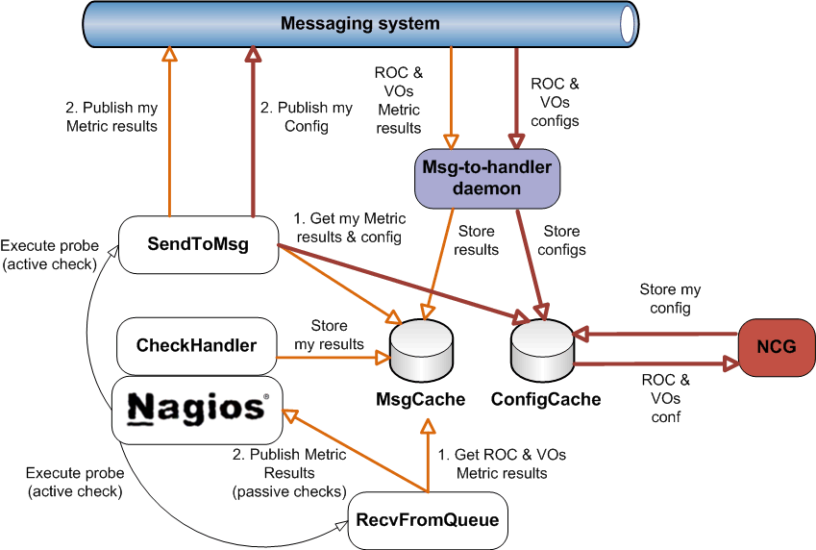
MSG Bridge

Slide 17
MSG Bridge
ConfigCache
SQLite database
/var/cache/msg/config-cache/config.db
configuration of local and remote SAM
MsgCache
DirQueue
/var/spool/msg-nagios-bridge/
results from metrics executed by local and remote SAM

Slide 18
MSG Bridge
msg-to-handler
daemon subscribed to list of topics and queues
modular implementation (handler per topic/queue)
stores configuration to ConfigCache
stores remote metric results to MsgCache

Slide 19
MSG Bridge
org.egee.SendToMsg
publishes configuration & metric results
org.egee.RecvFromQueue
imports results from local MsgCache to Nagios
results imported as passive checks
org.egee.ConfigCheck
checks if new remote configuration is available

Slide 20
MyEGI Bridge
org.egee.ATPSync
synchronizes the local ATP with the central ATP
log in /var/log/atp
org.egee.MDDBSync
synchronizes the local MDDB with the central MDDB
log in /var/log/mddb

Slide 21
MyEGI Bridge
org.egee.SendToMetricStore
publishes Nagios results to MRS
if critical no data in MyEGI
org.egee.MrsCheckMissingProbes
checks if the metric results are loaded to MRS
https://tomtools.cern.ch/confluence/display/SAM/Probes+testing+Nagios+instance

Slide 22
SAM CE Tests
org.sam.CE-JobStatus
associated with each CE service
submits SAM WN job via WMS & holds status of submitted job
WN probes communicate back via MSG
org.sam.CE-JobMonit
associated with Nagios server
updates status of all org.sam.CE-JobStatus probes on Nagios

Slide 23
SAM CE Tests
org.sam.CE-JobSubmit
associated with each CE service
holds the final state of SAM WN job
passive check updated by org.sam.CE-JobMonit
org.sam.WN-*
individual WN metrics (equivalent to old SAM)
passive checks updated via MSG

Slide 24
References
Main SAM documentation
https://tomtools.cern.ch/confluence/display/SAMDOC
EGI SAM documentation
https://wiki.egi.eu/wiki/SAM
SAM instances
https://wiki.egi.eu/wiki/SAM_Instances

Slide 25
Thank you!
Questions?

