Slide 1
EGI Central Accounting
John Gordon
EGI TF 2011, Lyon

Slide 2
Current Architecture
CLIENT
bash
Java
bash
perl
python
MySQL
MySQL
bash
Java
CLIENT
PORTAL
BROKER
MySQL
CLIENT
CONSUMER
Java
CLIENT
EXTERNAL CLIENTS
CLIENT
CLIENT
MySQL
RGMA REGISTRY
CLIENT
FLEXIBLE ARCHIVER
CLIENT
Closed on1st March

Slide 3
New System
APEL CLIENT
OTHER CLIENTS
SSM
SSM
CENTRAL SERVER
(MySQL, python)
MESSAGE BROKERS – located across Europe
(ActiveMQ)
APEL Monitoring
Job Records, Summary Job Records,
Sync Records
SSM
RECORD LOADER
PORTAL
SSM
SUMMARISER

Slide 4
New Accounting Infrastructure
Our redesign of the APEL infrastructure:-
A STOMP-based message publisher/consumer (SSM)
Multiple UR per message; signed and encrypted.
On the production AMQ bus.
Summary Record publisher/consumer
For regional and other repositories to publish to the central repository and to send to the accounting portal.

Slide 5
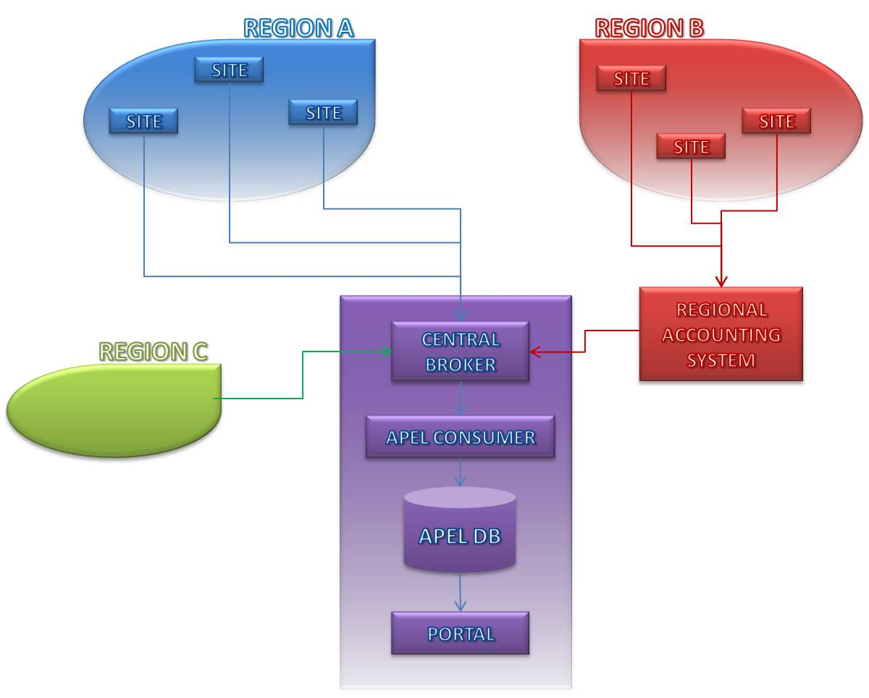
Regionalisation - Plan
All regions to publish via ActiveMQ
Provide regional accounting system
Allow regions to continue using central system
Collect records from other grids/tools via same interface

Slide 6
Regions
A. Continue publishing direct to the centre as now.
B. Use regional APEL repository
C. Use an alternative NGI repository
SGAS, DGAS, OSG(Gratia), D-Grid, Polish Unicore, CERN, GridSafe(IGE), France, NIKHEF, ARC
Any other alternatives?
Unicore sites could exist in all three regions types.

Slide 7
Migration
Migration to the new central repository requires all the existing alternatives to migrate to the new STOMP publishing before we can migrate the database and accept the new data in production.
Until then we will merge data from new publishers into the old database.
After migration, new database will continue to accept the old AMQ publishing (EMI-1) during migration
Distribution of Regional repository after it has proven itself centrally.
New client via EMI

Slide 8
Progress
A prototype SSM exists
Existing and potential Region C developers have been contacted.
Some have started testing.
Chasing the rest

