Slide 1
Operations Portal Grid Oversight September, 22th 2011
Cyril L’Orphelin – CCIN2P3/CNRS

Slide 2
Last and next Releases
Release 2.6.3 and 2.6.4
Interface to update operations tests (NGI or EGI scope)
Permalinks for the dashboard
For a given NGI
https://operations-portal.egi.eu/dahsboard/view/ngi/$yournginame
For a given Site
https://operations-portal.egi.eu/dahsboard/view/site/$yoursitename
Synchronization exchange between regional / central portals
CSI dashboard : candidate release without RT connection
Release 2.7 (October)
CSI dashboard : official release with RT connection

Slide 3
Synchronization Improvements
Synchronization with Nagios via AMQ
=> Problems encountered essentially due to network glitch
Use of 2 brokers
Nagios recoveries sent twice (6 h of delay)
Synchronization between regional and central portal
The regional portal is the authoritative source and the central portal is updated with its data .
The regional portal could work without the central one .
The information are encapsulated to avoid problems with special characters .

Slide 4
Security Dashboard (1/3)
Goal
Detect and inform sites about security incidents and vulnerabilities.
Propose an adapted display and workflow to open tickets against sites in the Operations Dashboard.
Achieved work
Authentication model : authorization is applied based on GOC DB and EGI SSO in order that security staff access only data in their own scope (EGI / NGI or site )
Summary of the current issues : Nagios and pakiti with historical details + Notepads and attached problems
Possibility to create / update notepads againt the site and attach problems to this notepad .
Possibility to generate dynamically metrics (table or charts)
Possibility to manage / declare events
Remaining work
Extension of the notepad to tickets into RT

Slide 5
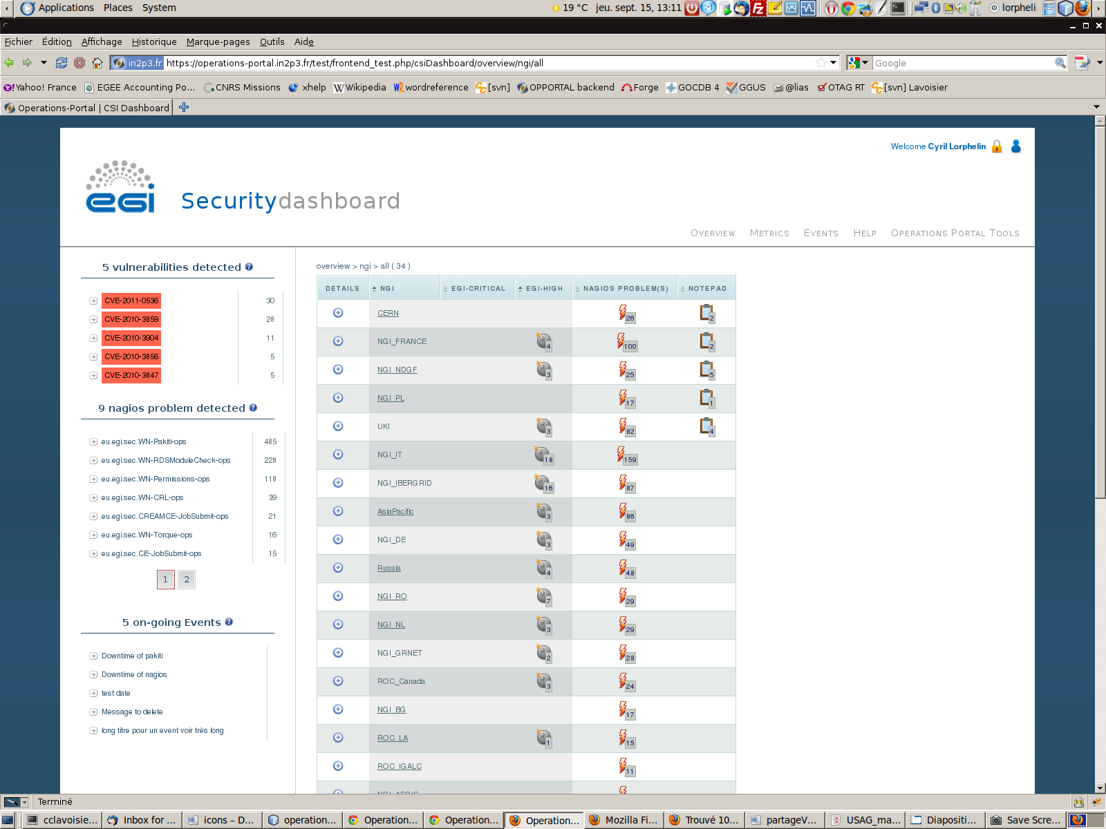
Security Dashboard (2/3)

Slide 6
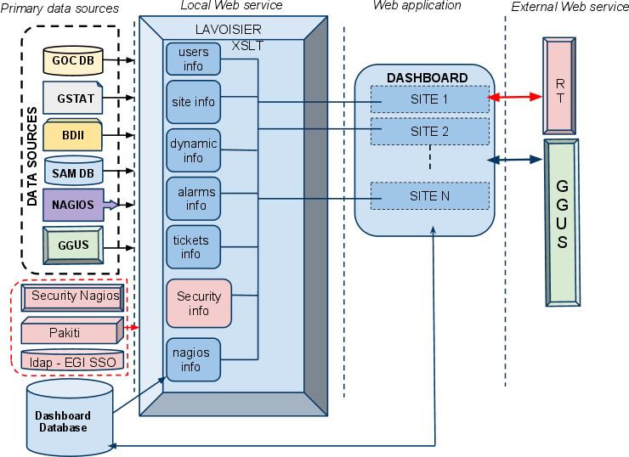
Security Dashboard (3/3)

Slide 7
VO oriented Dashboard
Basic functions
• Collecting results from Nagios
• The basic “unit” of the report will be a site, the Dashboard will be able to “construct” a VO view out of the relevant sites.
• Providing a view of a VO/NGI/site
• Proper access control must be applied : VO shifters either declared in the VO ID cards either based on a VOMS role
• Dispatching alerts when needed
• Operations functions – links to GOC DB, EGI RT , GGUS or Gstat
• Reporting functions – generation on demand and automatically on regular basis
• compute VO metrics based on the numbers gathered
• Possibility to declare a list of tests to take into account on a VO basis.
Different additional communication channels :
• notepad to send a note to the site
• handover to communicate between shifters

Slide 8
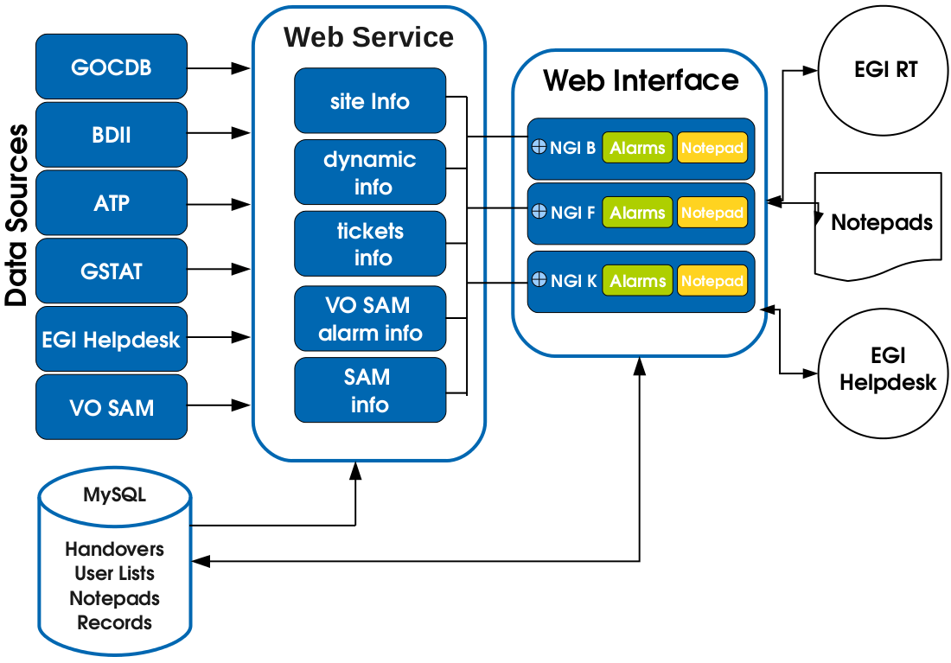
VO oriented Dashboard
Architecture

Slide 9
Operations Dashboard
The dashboard will use the different components developed for the Csi dashboard and the VO oriented dashboard with the possible evolutions :
Ajax use to load information only if needed – Load of page < 5 sec
Automatic load sites list / scope used
Automatic closure of alarm (Ok status)
No direct relation between alarm / ticket (only tickets will be closed )
Events manager – On duty shifts
Dynamic charts for metrics

