Slide 1
UMD distribution: experiences and feedback from sites
Mario David
TSA1.3

Slide 2
Outline
SW workflow: high level view.
Experience from EMI/UMD SW provisioning.
Some statistics.
Survey EMI/UMD in production
Issues and comments
Conclusions/summary

Slide 3
SW provisioning Workflow
Technology
Provider
EMI
EGI – JRA1
IGE
StatusLab
EGI-InSPIRE
TSA2.3
Verification
TSA1.3
StagedRollout
SA1
Production
TSA2.3 and TSA1.3
Release preparation

Slide 4
UMD SW provisioning
UMD release:
EGI takes SW products from the technology providers (EMI and IGE at the moment).
Produce a provisional list of products that are “candidates” for the UMD release.
Put’s them through the SW provisioning workflow:
Verification: verifies generic and specific quality criteria.
Staged rollout: deploys and configures the product in production instances.
Staged rollout relies on Early Adopter sites that are the first ones to deploy the new versions in production, before general availability.
The products passing successfully the SW provisioning will be included into the UMD release.
Notes:
OK DONE
This slide is probably too much detailed about the process, we can skip this one
Instead you should have 1 slide explaining what UMD is

Slide 5
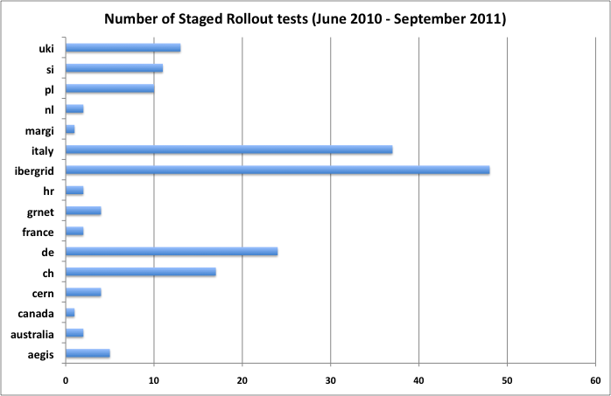
Some statistics I
# of EAs = 39
# of Staged Rollouts = 183
# of Products = 141
(most products more than 1 version)
# of Products rejected = 12
Includes products from:
gLite 3.1
gLite 3.2
EMI 1
IGE 1
Ops tools (SAM/Nagios)
CA (trustanchors)
Notes:
OK DONE
I don’t quite understand the different between this slide and the following one

Slide 6
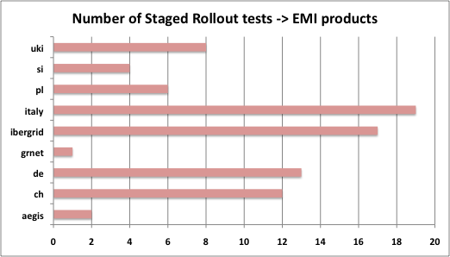
Some statistics II: as of UMD1.2
# of EAs = 22
# of Staged Rollouts = 82
# of Products = 47
(some products more than 1 version)
# of Products rejected = 3
Products no EA coverage:
AMGA
FTS
HYDRA (not yet released)
LFC Oracle (may have 1 EA)
VOMS Oracle
MyPROXY (1 Unofficial EA)
# NGIs in GOCDB = 34
# EGI sites = 225
# EMI products: 38
# EMI products in UMD: 32
Notes:
OK DONE
I don’t understand the message of this slide
What does “EMI/UMD product may NOT be a EMI component)
*_Oracle and *_mysql are treated as different products” mean?
Check spelling

Slide 7
Survey EMI/UMD in production I
Survey about the level of deployment of UMD and EMI released services into the
production infrastructure.
Question 1: List here which services (if any) did you deploy from the UMD repositories
(http://repository.egi.eu), please include the service version.
Question 2: List here which services (if any) did you deploy from the EMI repositories
(http://emisoft.web.cern.ch/emisoft/), please include the service version.
Total | Q1 (UMD repos) | Q2 (EMI repos)
63 | 6 | 9 (5 are early adopters)
~24% of the sites responding have deployed products from EMI or UMD
Notes:
OK DONE
Can we skip question 1 in this report?
As to question 1 do we want to bring the message that EMI is more used than UMD? Can we safely conclude this from the number of answers received?

Slide 8
Survey EMI/UMD in production II
Survey about the level of deployment of UMD and EMI released services into the
production infrastructure.
Additional comments and answers
Mostly upgrade plans in the coming months.
Sites should be aware that UMD contains products that underwent the verification and staged rollout procedures, thus subject to production environment/load.
Notes:
OK DONE
I think this slide is fairly irrelevant, do you agree? I wouldn’t quote anyway the comments as is (too much text into this slide)

Slide 9
Issues and comments: “Facts of Life” I
Huge load: large number of EMI products to be verified and staged rollout:
1st Major release.
Several updates: more than 1 version of a product in the SW provisioning almost in parallel or close in time.
dCache is taken by sites from dcache.org:
Release in EMI/UMD has somewhat outdated versions.
2 sites did the staged rollout based on versions they had in the past or presently in production.
ARC is taken by most sites from nordugrid.org. Similar reasons to dCache. Also, ARC sites deploy some variety of Linux flavours (not just SL5).
Sites strive for stability and as low as possible upgrade rate.
Sites will “jump” for new versions if they have real and annoying issues.
Notes:
I hope I can handle that, it’s facts of life, and goes directly to EMI
We UMD are inline (latest version) with EMI ones
So do we want to give the message that staged rollout of dcache and arc are useless??? Dangerous message in a room with directors of large computing centres

Slide 10
Issues and comments: “Facts of Life” II
EMI release rate is set around every 3 weeks:
Major release (12 May) and 6 updates (until 1st September) ➔ ~ 1 release every 3 weeks
UMD release rate is planned to be quarterly after UMD 1.3:
Major release 11th July, 1st update after 3 weeks, 2nd update after 1.5 month (from the update 1).
3rd update (UMD 1.3) planned for the end of October (but see later on).
Except for urgent updates or security vulnerabilities.
Verification and staged rollout have detected and open a quite large number of GGUS tickets: 40+ GGUS tickets:
Some of those issues appeared only in the production environment (i.e. staged rollout)
Some have to do with documentation
…

Slide 11
Issues and comments: “Facts of Life” III
Staged rollout has been done in production instances in some cases, but also in test instances that are included in production:
Comments please “Need to be involved earlier (much earlier) in beta testing, so that any issues that are discovered can be solved before the actual certification in EMI, and thus make it the next round of updates”.
We still need more EA teams even for already covered products:
Although ~ 100% of sites expect to have stable, robust, etc. MW products, there is a “price” to get there.
Notes:
OK DONE
This slide is overall ok but you should remove the amount of text

Slide 12
Conclusions/Summary
UMD1.3 by the end of October.
Both ARC and dCache should strive to have their latest production versions in EMI and then UMD:
This will give them more visibility to be adopted by more/newer sites.
The “price” of being early adopter (EA) will compensate later in more stable and robust SW.
In staged rollout, issues maybe found by 1 EA and not by others:
More EA teams for each product gives “redundancy”, “failover”, “backup”.
Notes:
OK DONE
SO what are the conclusions? We need a conclusion, and possibly have a slide with questions if you want to have a controlled discussion on some key (few) points

