Slide 1
EGI Cloud Roadmap
Steven Newhouse, EGI.eu
EGI-InSPIRE Project Director

Slide 2
Session Overview
EGI Virtualisation Roadmap
Goals and direction
EGI Federated Cloud Taskforce
Goals and activities
EGI Cloud Profile
Interfaces to support federated clouds

Slide 3
Alignment to the Cloud
Virtual Research Communities
(Users)
Key
Ecosystem
Partners
NGIs + EIRO EGI.eu
Software
Central Services
Domain Services
Community Services
Services
Planning & Coordination
Platforms
gLite
UNICORE
dCache
ARC
Globus
Infrastructure
Support
NGI
NGI
EIRO
NGI
NGI

Slide 4
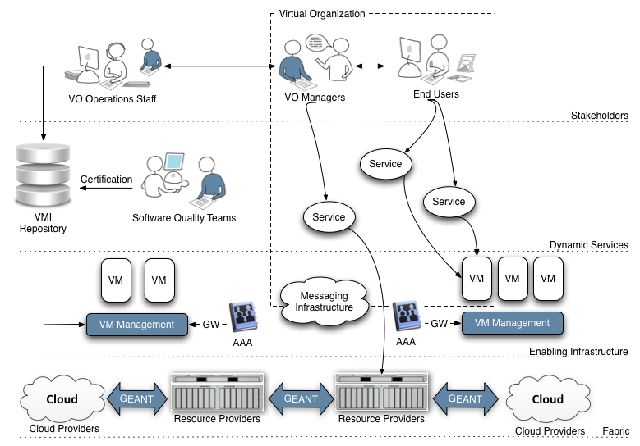
A Virtualised Future?
Experts
(Communicating between users & providers)
VO Specific Operations Staff
End-Users
(National, European & Global Collaborations)
End-User Technology Experts
(National, European & Global Collaborations)
Virtual Research Community
Infrastructure
Providers
Infrastructure Providers
(Research & Commerical – National, European & Global)

Slide 5
A Virtualised Ecosystem
EMI & IGE
VO Specific Operations Staff
EGI-InSPIRE
StratusLab
VENUS-C

Slide 6
The EGI Cloud
Individual communities get the environments they require
Community Services
Community Services
Virtual Machines
EGI.eu Coordination
Globus
Core Software & Support
gLite
ARC
Globus
UNICORE
Community Platform
dCache
Federated Virtual Machine Managers
NGI
NGI
NGI
EIRO
Amazon
Microsoft

Slide 7
Core Technical Issues
Federated pool of VMM
Re-use grid technologies to federate
Integrate ACL to VMM with VO model
Centrally provided VM Images
Policy around VMI accreditation underway
StratusLab has a VMI meta-data repository
Engagement with user community
Mechanism to engage with new users

Slide 8
Commercial Cloud Use?
EGI: Focused on the needs of researchers
Our stakeholders provide research computing
Use a range of resources to deliver this goal
Commercial Clouds: Profit focused
Do core things really well & at low cost
But can meet the needs of some workloads
How to make the best of both worlds?

Slide 9
A Federated EGI Cloud
No ‘big-bang’ migration
Gradual change transparent to the end-user
Clearly identifies the role of the expert
Allows experts to deploy & configure services
Experts already residing in the NGIs and VRCs
Increases the flexibility of the infrastructure
Meet the different needs of current users
Increases accessibility for other communities

Slide 10
The long term goal
An integrated service for all researchers
Any resources: commercial, academic, …
Transparent access: environment portability
Data Oriented: shift computation to the data
Federation through grid technologies
Grid crosses administrative & trust boundaries
Federated Cloud → Grid of virtualised resources

Slide 11
Next Steps
Identification of 6 simple use cases
Issues around federation
Issues around integration into EGI
Build a prototype federated cloud
Define a blueprint to help others
Provide feedback to technology providers
Attract new users to EGI
Report back through EGI blog
Managed by the TCB

Slide 12
Summary
Federated Cloud Task Force
Validate use cases
Identify working technologies
Integrate into EGI
Reporting:
Technical: EGI Blog
Managerial: TCB
Community: EGI CF 2012

