Slide 1
Cyberinfrastructure for the 21st Century (CIF21)
NSF Data Strategy and
EarthCube
9th e-Infrastructure Concertation Meeting
Sept 23, 2011
Rob Pennington
Office of Cyberinfrastructure (OCI)
National Science Foundation
rpenning@nsf.gov
1

Slide 2
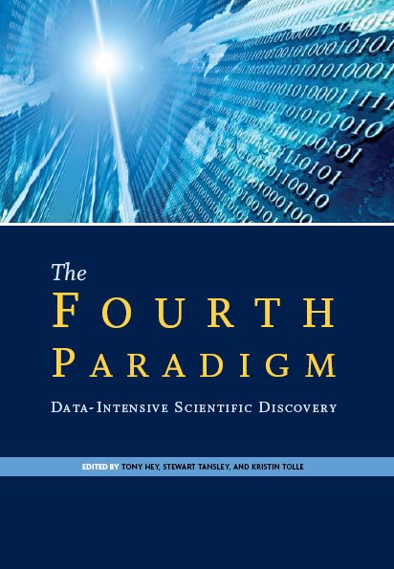
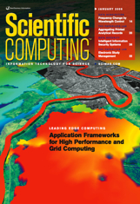
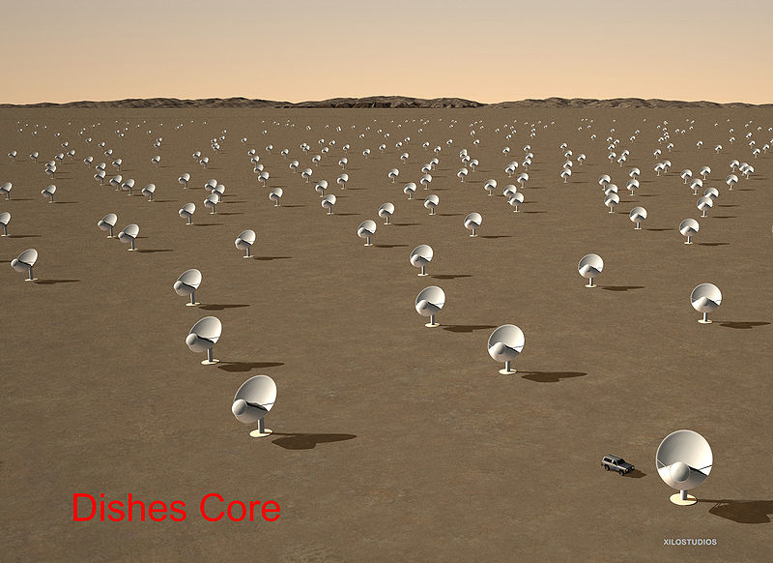
Framing the Challenge: Science and Society Transformed by Data
Modern science
Data- and compute-intensive
Integrative, multiscale
Multi-disciplinary Collaborations for Complexity
Individuals, groups, teams, communities
Sea of Data
Age of Observation
Distributed, central repositories, sensor- driven, diverse, etc

Slide 3
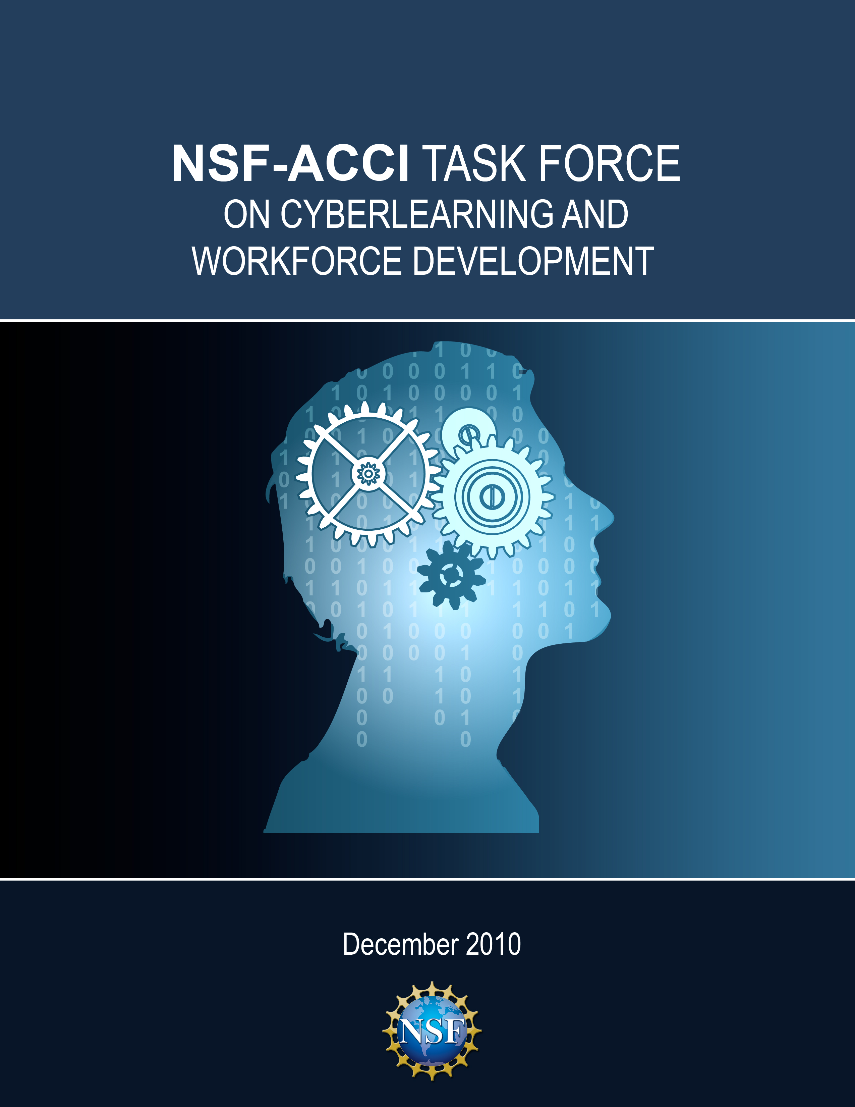
Advisory Committee for Cyberinfrastructure Task Force Reports
More than 25 workshops and Birds of a Feather sessions and more than 1300 people involved
Final recommendations presented to the NSF Advisory Committee on Cyberinfrastructure (ACCI) Dec 2010
Final reports on-line at: http://www.nsf.gov/od/oci/taskforces/
Campus
Bridging
Data and Viz
HPC
_{HIGH P ERFORMANCE COMPUTING}
Grand
Challenges
Cyberlearning
Software

Slide 4
Broad Principles to Lead CIF21
Builds national infrastructure for S&E
Leverages common methods, approaches, and applications – focus on interoperability
Catalyzes other CI investments across NSF
Provides focus and is a vehicle for coordinating efforts and programs
Acts as a “research multiplier” across NSF
Based upon a shared governance model involving every directorate and office
Managed as a coherent program

Slide 5
New Computational Infrastructure
Computational and Data-enabled resources
HPC, Clouds, Clusters, Data Centers
Computation capabilities
Modeling, simulation, visualization
Long-term software for science and engineering
Sustained software development and support
Discipline-specific activities
Services, tools, compute, simulation environments that serve specific research efforts and communities

Slide 6
Creating Scalable Software Development Environments
Scientific Software Elements:
Small groups, individuals
Scientific Software Integration:
Research Communities
Scientific Software Innovation Institutes:
Large Multidisciplinary Groups
Multi-year
Create a software ecosystem that scales from individual or small groups of software innovators to large hubs of software excellence
Focus on innovation Focus on sustainability

Slide 7
Evolution of Cyberinfrastructure for the 21st Century (CIF21) and Data
National Science Board (NSB)
On-going input
Science &
Engineering
Research
+
Cyberinfrastructure
ACCI
Data Task
Force
NSF
CIF21
Data
Programs
DataNet
Program
Community
Input

Slide 8
Data Task Force Recommendations
Infrastructure:
Recognize data infrastructure and services (including visualization) as essential long term research assets fundamental to today’s science
Economic sustainability:
Develop realistic cost models to underpin institutional/national business plans for research repositories/data services
Culture Change:
Emphasize expectations for data sharing; support the establishment of new citation models in which data and software tool providers and developers are recognized and credited with their contributions
Data Management Guidelines:
Identify and share best-practices for the critical areas of data management
Ethics and IP:
Train researchers in privacy-preserving data access

Slide 9
Scientific Data Challenges
Climate,
Environment
Square
Kilometer
Array
Exa
Bytes
Peta
Bytes
Tera
Bytes
Giga
Bytes
Volume
Genomics
Bytes per day
Useful Lifetime
Climate,
Environment
XSEDE, HPC
LHC
LHC
LSST
DataNet
Distribution
Genomics
Many smaller datasets…
2012 2020
Data Access

Slide 10
DataNet: A Multi-tiered and Multi-Disciplinary Landscape
Modeling and Simulation Communities
Population, Climate,
Environment Communities
Data-enabled Science
Genomics
Communities
Data Curation
Data Storage
DataNet supported

Slide 11
Data-Enabled Science
Data Services Program (data)
Provide reliable digital preservation, access, integration, and analysis capabilities for science and/or engineering data over a decades-long timeline
Data Analysis and Tools Program (information)
Data mining, manipulation, modeling, visualization, decision-making systems
Data-intensive Science Program (knowledge)
Intensive disciplinary efforts
Simulation, modeling
Multi-disciplinary S&E

Slide 12
Cross Cutting Challenges
Balancing research into next generations of infrastructure with operation & maintenance of current capacity.
Stimulate innovation and manage transitions
Sustainable, long term programs
Technical design, development of sustainability models, and integration with the research cycle.
Integration
Vertical – Linking low-level bit storage infrastructure to data collections, and finally to applications
Horizontal– Achieving connectivity and interoperability between activities that vary in scale, disciplinarity, and funding source.

Slide 13
DataNet Program Management
Life cycle perspective covering the use of the data
Research, development, implementation, operations, sustainability, close-out
Incorporate project management methodologies
Work breakdown structure, risk management, change control, schedule, milestones, deliverables
Standardized process:
Evaluate science merit, conceptual design
Develop initial project plans, design and reporting metrics
Finalize baseline, prototype, evaluate
Implementation & operations
Operational evaluations and continuance

Slide 14
What is EarthCube?

Slide 15
A Call to Action
Over the next decade, the geosciences community commits to developing a framework to understand and predict responses of the Earth as a system—from the space-atmosphere boundary to the Earth’s core, including the influences of humans and ecosystems
Transitions and Tipping Points in Complex Environmental Systems, NSF AC for Environmental Research and Education, 2009
Earth Science and Applications from Space: National Imperatives for the Next Decade and Beyond, 2007
High-Performance Computing Requirements for the Computational Solid Earth Sciences, 2005

Slide 16
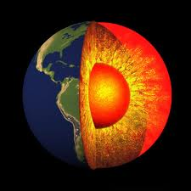
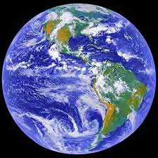
Goal of EarthCube
To transform the conduct of research in geosciences by supporting community-based cyberinfrastructure to integrate data and information for knowledge management across the Geosciences.

Slide 17
What Needs To Be Done?
Integrate data, tools and communities through cyberinfrastructure
Establish a governance mechanism that is inclusive and adopted by the community
Utilize current and emerging technologies to create transparent infrastructure for the geosciences community

Slide 18
Convergence to a Unifying Architecture
Modes of Support
Loosely or Not Connected
Well-Connected through
EarthCube
Notes:
This is an iterative process

Slide 19
EarthCube: Assumptions
The geosciences community is ready to take on the EarthCube challenge
Community will start self-organizing prior to EarthCube activities, such as the Nov 1-4 Charrette
Current and emerging technology will help achieve the convergence envisioned for EarthCube
A broad range of expertise and resources must be engaged to shape EarthCube

Slide 20
Framework Should
Create infrastructure of integrated and interactive services
transcend fields and accelerate discovery of a complex, multi-scale Earth System
Create an interoperable digital access infrastructure
Provide a network that is open, extensible and sustainable
Include Observations, Simulations, Collaborations, and Sharing of information
Facilitate data and metadata transfer from the field into data systems and applications
Integrate research and education
Build a knowledgeable and broadly engaged workforce
Notes:
EVA
A successful framework will necessarily address the following components, among others.
Because the earth system is complex and multi-scale, the framework will need need to build interactive and integrative services that transcend fields
Access to data will need to be open, interoperable and sustainable. But in addition, we must consider that access access to data requires access to simulation and visualization resources as well to community networks
What is almost uniformly important across the geosciences, is observational data gathered from the field. Facilitating data and metadata transfer from observation systems to data systemes and applications is integral to the way we do business.
And of course education is an essential component to the sustainability of this framework. Creating a research workforce that can use this system will require new educational methods and efforts.
These are some broad points that can span the geosciences. They will require the scientific community to find commonalities between diverse data types and community practices. A governance structure that allows this framework to be inclusive and responsive to the needs of all of those that study the Earth System is one of the most important challenges of this process.
So I will hand it off to Rob will describe how we hope to facilitate this community activity.

Slide 21
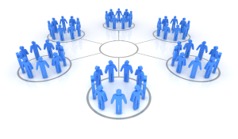
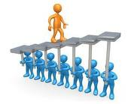
Proposed
Framework
Approaches
Developed through EAGERs
DCL
Released
Two
WebEx
events
Charrette
Sandpit/ IdeasLab
to determine
18 mo.
prototype
award(s)
Jun 2011
Nov 1-4 2011
May 2012
Jul-Sept 2011
Nov/11-Apr/12

Slide 22
Questions?

