Slide 1
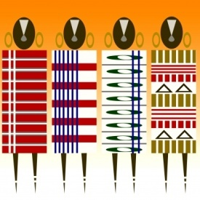
Digital Object Identifiers and Unique Authors Identifiers to enable services for data quality assessment, provenance, access
http://www.digoiduna.eu/
Paolo Bouquet
University of Trento (Italy)

Slide 2
Objectives of the study
Supporting policy makers at European and member state level to understand the opportunities and challenges of adopting solutions for managing identifiers in the context of establishing scientific data e-infrastructures (SDIs)
Providing instruments that will support decision making on solutions that will have a long-lasting impact on scientific research and on the long term access, preservation and integration of valuable data and knowledge assets

Slide 3
The context
“The focus is on building a pan-European and worldwide network of research infrastructures to increase the potential of innovation and the advancement of the research”
“[...] Increasing the efficiency and effectiveness of European research and reinforcing the research community”
From the EC Work Program 2012 on research infrastructures

Slide 4
Identifiers: a tool for creating value
DIs are an essential building block for enabling effective and efficient technical solutions the creation of value-added services like:
Data and information Access, Search and Navigation
Fast, large-scale and decentralized Data Sharing & Reuse
Effective Linkage of data and information across repositories
Impact and ROI assessment (reliable research outputs beyond the scope of published literature)
Fine-grained Access Control
Data and information Quality assessment
Reputation assessment & Citation indexes
Ownership management for data and scholarly content
…
on top of scientific data and contents

Slide 5
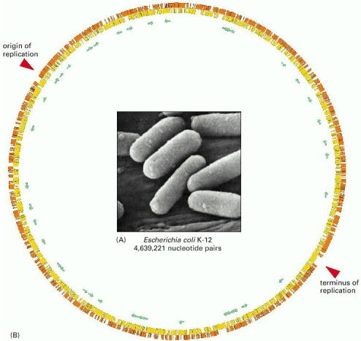
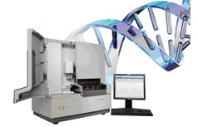
Example I: speeding up data sharing
Authorship and intellectual property
Citability before publication
Dataset ID
Genomic data
Research collaboration and collective benefit
Source: interview with Jan Brase (Datacite.org)

Slide 6
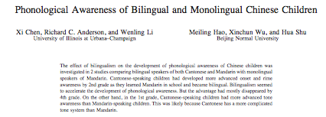
Example II: building the network of e-Science
Scientific publications
Biographical information
Research collaborations
& projects
Related / subsidiary info on the web
DI for Author
Citation metrics
Rich measures and impact assessment
Related institutions
Papers on the same research topic

Slide 7
The problem of digital identifiers in scientific data e-infrastructure

Slide 8
Data deluge and e-Science

Slide 9
Digital Identifiers (DIs) in a networked world
DIs
Digital Identifiers (DIs) are the keys for accessing and managing digital information in computer-based systems
But what if we need to deal with data & information created and managed across
national
organizational
disciplinary
cultural
technological
…
boundaries?

Slide 10
A multi-dimensional challenge
Moving from a local (closed) view to cross-boundary interconnected solutions
Defining general policies and governance models for coordinating the needs of stakeholders
Creating funding and business models, incentives for adoption and use

Slide 11
Where are we today?

Slide 12
A snapshot of the current situation
It is widely recognized that a systematic means to manage identifiers for a variety of digital objects and for non-digital objects is an essential component of present and future SDIs.
The main stakeholders of the e-Science community are in fact converging toward a restricted number of systems and initiatives for managing persistent identifiers for scientific publications and scholarly records (including DOI, Handle, URN-NBN), around which many value-added services are being built (for example, DataCite or CrossRef).
There is a different level of maturity between more mature solutions for digital objects and the gradually emerging solutions for authors (e.g. ResearcherID, ScopusID, the ORCID initiative).
There is a clear feeling that trusted institutions should support the definition of agreements between the relevant stakeholders and users, especially when there are potentially conflicting interests.

Slide 13
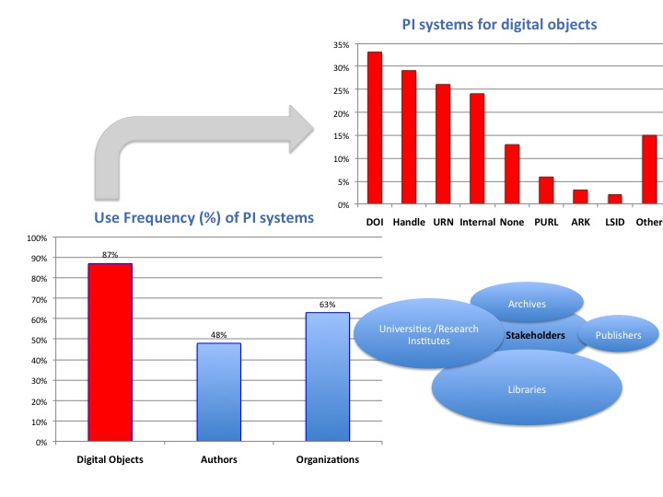
Adoption of systems for Digital Objects
Source: elaboration from APARSEN questionnaire (2011)

Slide 14
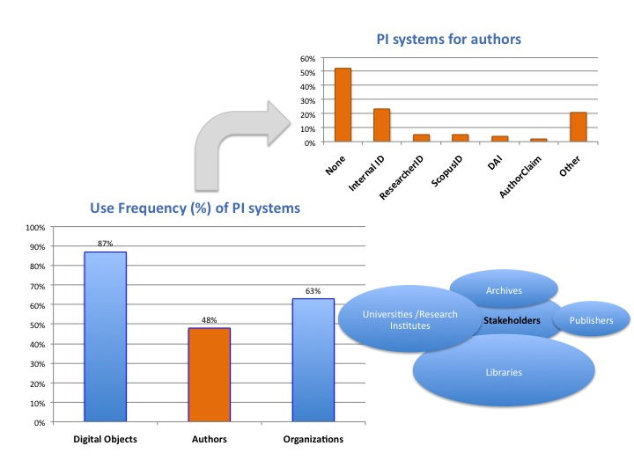
Adoption of systems for Authors
Source: elaboration from APARSEN questionnaire (2011)

Slide 15
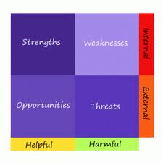
SWOT analysis
Policy-related
Economical
Social
Technical
Challenges & Recommendations

Slide 16
SWOT Analysis
S
W
Europe is already investing in the creation of e-infrastructures
The necessary know-how is available
Success of pioneering efforts in restricted contexts
Ultimate consensus and coordination among stakeholders
Lack of clear business & sustainability models
Scarce awareness beyond (and even within) direct players
Political priorities
Institutional consensus
Cultural reluctance to adopting more effective evaluation metrics
Resistance to change in scientific communities
Information Society consolidation/e-Science
Demand for Science based innovation
Expectations for “ROI” of public interventions
Technical solutions are available and relatively mature
O
T

Slide 17
Boosting the value of e-Infrastructure outputs
(securing long term growth of DI-supported management of e-infrastructure/e-science “production”)
POTENTIAL MEASURES
AREAS FOR INTERVENTION
Aiming at:
Building-up coordination mechanisms among e-infrastructure stakeholders
Creating business models to guarantee sustainability
Contribute to promote wider demand for usage/exploitation of e-science results
Secure Interoperability of DI approaches/solutions
Awareness
Social support
Demand
Fostering
Governance
DI
Growth
DI business
RTD/Standarisation
Support

Slide 18
Recommendations
Measures aiming at creating a critical mass of coordinated DI systems
Reinforce /promote/secure EU wide institutional coordination among vertical and regional clusters of e-infrastructure stakeholders (common policies on the governance of identifiers for digital objects and authors)
Institutional stakeholders should encourage the development of ID management systems consistent with the legitimate interests of the key stakeholders
Promote awareness and skills development to enable different stakeholders to participate effectively on DI initiatives and infrastructures
Work towards systematic implementation of technical and organisational factors that underpin trust in identifiers, their reliability as a key component of SDIs - secure their operational management

Slide 19
Recommendations
Measure aiming at securing sustainability /long term viability of DI initiatives
Stakeholders need to develop business models where the costs of developing and sustaining identifier infrastructures and the responsibility in granting the long term sustainability of these infrastructures are distributed among the beneficiaries
The flexibility of funding sources should be enhanced, allowing the reallocation of funds in the portfolio to enable the rapid scaling of promising solutions that embed or promote the value (usage) of identifiers
Funding bodies must support the development of collaborative models and actions to create synergies and exchange opportunities between the private/commercial sector and scientific sector (“DI-related PPPs”)

Slide 20
Recommendations
Measures aiming at wider demand for usage/exploitation of e-science results
Provide innovative incentives for data producers in publicly funded projects to either adopt one of the commonly-recognised methods for identifying digital objects and authors where they exist, or directly feed into solutions that overcome the obstacles
Funding agencies and the other e-infra stakeholders should promote the development of value-added services based on identifiers for digital objects and authors in e-Science infrastructures (raising awareness about benefits of DI based management and knowledge dissemination on DI systems implementation )

Slide 21
Recommendations
Aiming at Creating critical mass of demand (mainstream markets)
Standarization/RTD related , aiming at securing interoperability
Stakeholders, and especially funding agencies, should foster interoperability based on consolidation of established DI systems (where possible) more than on proliferation of ad-hoc systems
EC should promote research in deepening an understanding of needs of stakeholders in order to favour development of systems addressing social, organizational and technical complexities
Stakeholders should require systems compatible with the open web standards and practices for identifying entities on the web. In particular, encourage stakeholder convergence on practices serving to maximise connectivity on the emergent web of data

Slide 22
Conclusions
The benefits of using DI are recognised and largely shared by SDI stakeholders
DIGOIDUNA has collected quality information allowing to draw recommendations on DI growth
Now the time has come to renew commitments, to reinforce efforts and to coordinate our actions leading to maximizing the multidimensional value of scientific production

