Slide 1
Operations Portal OTAG September, 21th 2011
Cyril L’Orphelin – CCIN2P3/CNRS

Slide 2
Last and next Releases
Release 2.6.3 and 2.6.4
Interface to update operations tests
Permalinks for the dashboard and the VO
Synchronization exchange between regional / central portals
CSI dashboard : candidate release without RT connection
Release 2.7 (October)
CSI dashboard : official release with RT connection

Slide 3
Security Dashboard (1/3)
Goal
Detect and inform sites about security incidents and vulnerabilities.
Propose an adapted display and workflow to open tickets against sites in the Operations Dashboard.
Achieved work
Authentication model : authorization is applied based on GOC DB and EGI SSO in order that security staff access only data in their own scope (EGI / NGI or site )
Summary of the current issues : Nagios and pakiti with historical details + Notepads and attached problems
Possibility to create / update notepads againt the site and attach problems to this notepad .
Possibility to generate dynamically metrics (table or charts)
Possibility to manage / declare events
Remaining work
Extension of the notepad to tickets into RT

Slide 4
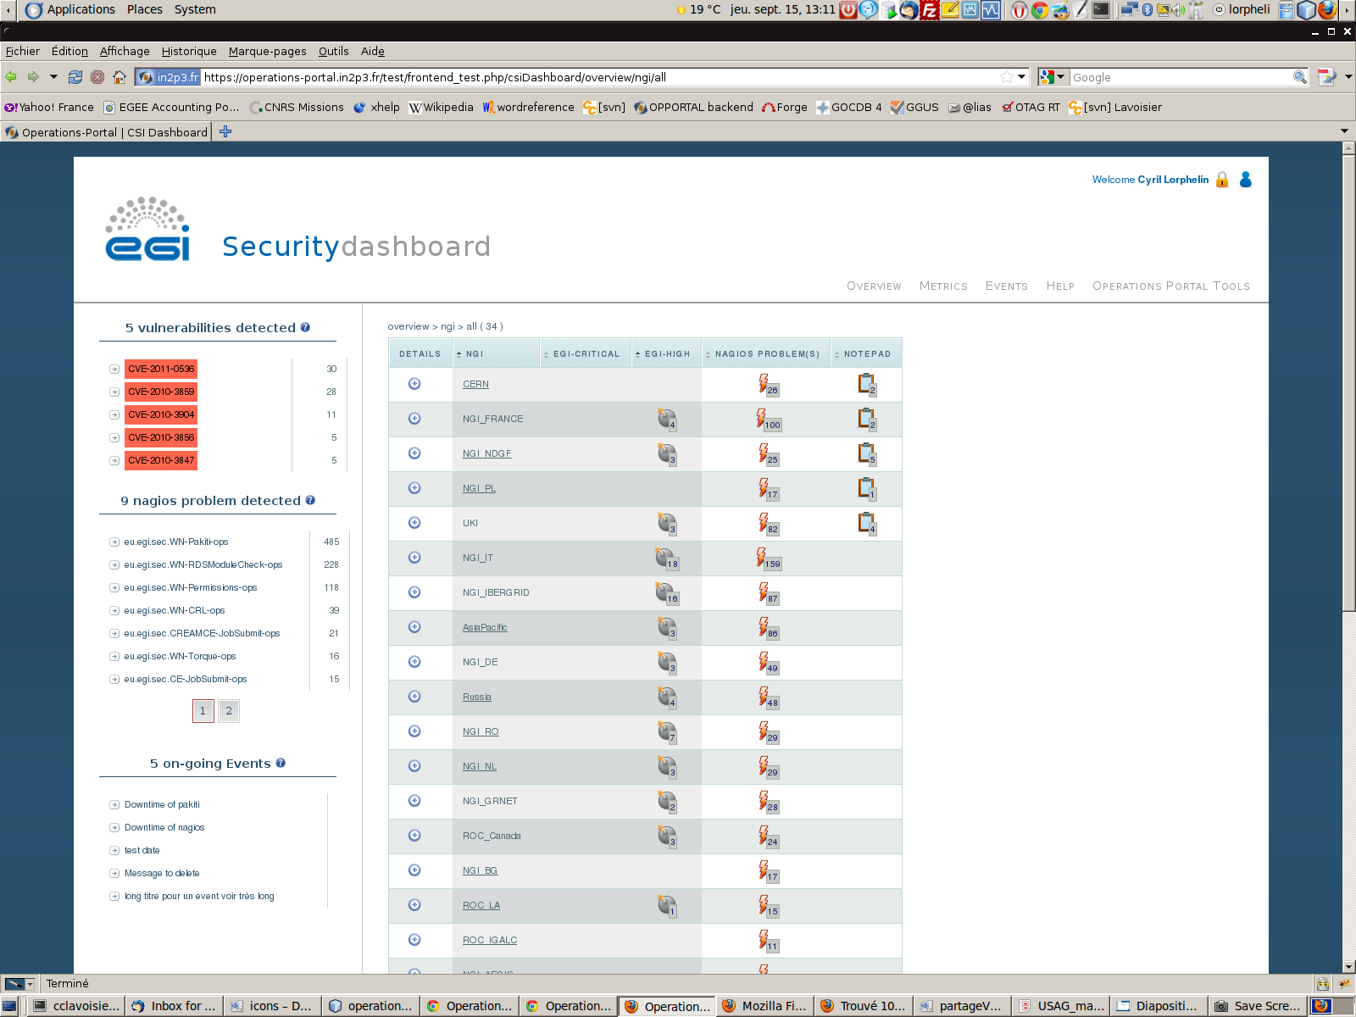
Security Dashboard (2/3)

Slide 5
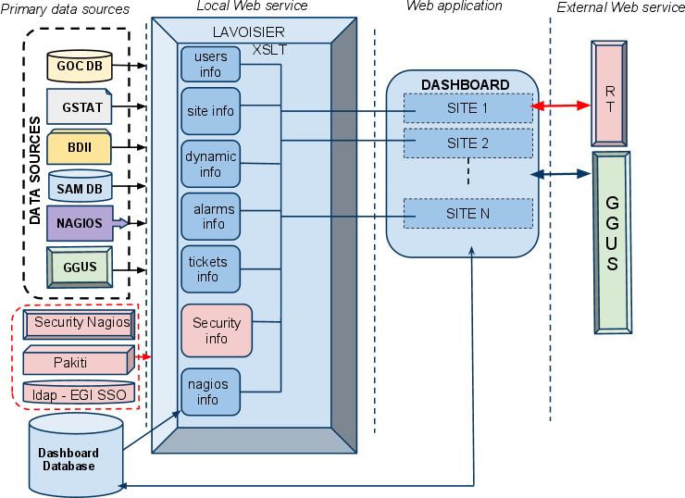
Security Dashboard (3/3)

Slide 6
Requirements List
VO Module – Improvements and minor requirements
GGUS 74120 - info in ops portal is not synchronized with voms
RT 1970 - VO Management: pending modifications interface should show only last VO ID Card update
RT 2190 - VO Information: counting real users within a VO
RT 2241 - VO Registration Form: validate new vo name against chosen VOMS server
RT 2318 - VO Management: VO supervizor should be able edit VO details
Developements will be done before the end of the year
VO Module – Big requirement
RT 2317 - VO Information:browse resources/information by a specific VO, « find all resources available for a VO » .
Work to be evaluated . Could be integrated into the VO oriented dashboard
VO Oriented Dashboard – Detailled in the next slides
Regionalization
RT 2796 - Regional Ops Portal: Manage alarms for non EGI sites in the dashboard
=> depending from GOC DB and SAM
RT 2797 - Regional Ops Portal: Use regional helpdesk directly
will be initiated in the last development phase of the CSI dashboard with a generic access to RT.

Slide 7
VO oriented Dashboard
Initial requirements
Need
Several communities representatives (GISELA, BIOMED, We-NMR) have requested the possibility for the project to provide a tool allowing a quick and easy identification of resources failing automatic VO SAM tests. VO experts could then access to this tool to validate results and alert infrastructure providers about how to mitigate the issues. The benefit of the such tool is straightforward since it optimizes the work of VO experts allowing them to pro-actively supervise the infrastructure, easily identify problems and push for their resolution before those issues are experienced by the end users.
Tickets RT / Status
RT Ticket 1135 - Dashboard VO View Request
RT Ticket 1800 - Proposal for a VO Operational Dashboard
Demand approved by UCST (S. Brewer)
Complete documentation written with Gonçalo Borges.

Slide 8
VO oriented Dashboard
Basic functions
• Collecting results from Nagios
• The basic “unit” of the report will be a site, the Dashboard will be able to “construct” a VO view out of the relevant sites.
• Providing a view of a VO/NGI/site
• Proper access control must be applied : VO shifters either declared in the VO ID cards either based on a VOMS role
• Dispatching alerts when needed
• Operations functions – links to GOC DB, EGI RT , GGUS or Gstat
• Reporting functions – generation on demand and automatically on regular basis
• compute VO metrics based on the numbers gathered
• Possibility to declare a list of tests to take into account on a VO basis.
Different additional communication channels :
• notepad to send a note to the site
• handover to communicate between shifters

Slide 9
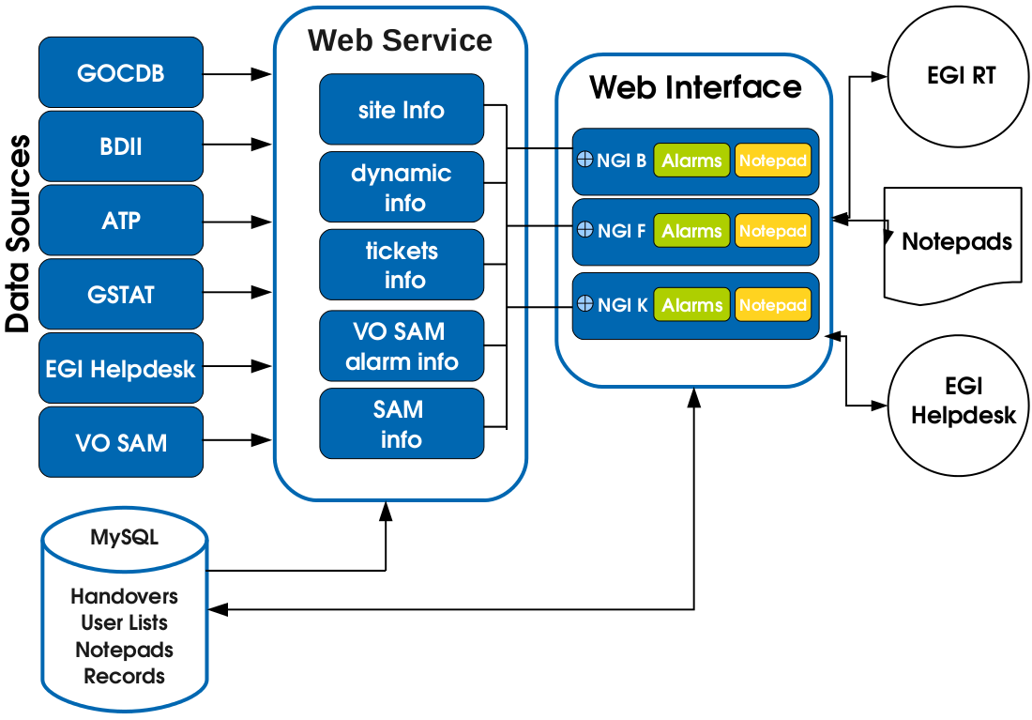
VO oriented Dashboard
Architecture

Slide 10
VO oriented Dashboard
Roadmap
Tasks for phase Development I | Estimated required effort (personweek)
Data connection and treatment | 1
Interface developments | 4
Overview part (dashboard) | 2
Metrics part | 1
Handover Part | 1
Authentication and control access | 1
Notepad and tickets creation | 2
TOTAL EFFORT | 8

