Slide 1
Improved X.509 Management Using PKCS11
Daniel Kouřil, Michal Procházka
CESNET
EGI TF 2011

Slide 2
PKCS11
Widely accepted standard to access security devices
A general API hiding implementation details of the actual token
HW (smart cards), SW (soft token)
Usually configured at run time
Supported by wide range of applications

Slide 3
Use-cases to Address
Single credentials repository on a desktop
A remotely available credentials
Management of IGTF anchors

Slide 4
Desktop credentials locations
Users are often required to handle files with certs
One repository for all applications
A single place to secure and manage
Mozilla‘s NSS
soft token PKCS11 available with every Firefox/Thunderbird installation
We’re on grid though

Slide 5
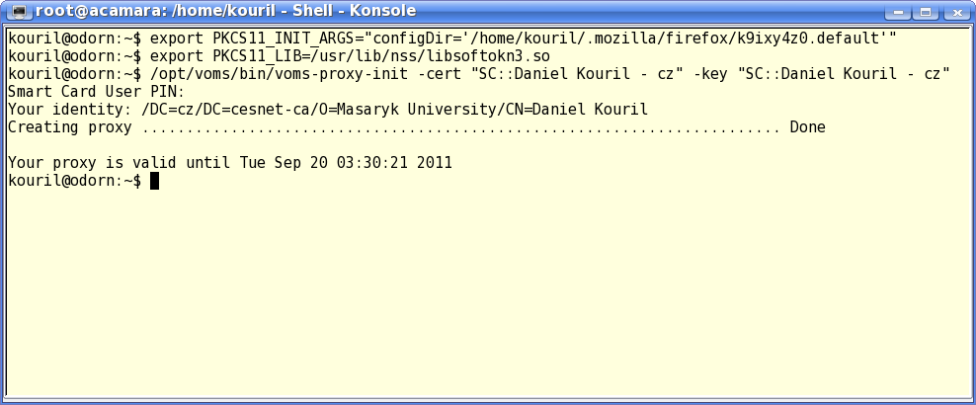
NSS for VOMS
Voms with PKCS11 support should be part of EMI2
Seamless access to browser credentials
for users with e.g. TCS credentials
Creds do not need to be stored in files

Slide 6
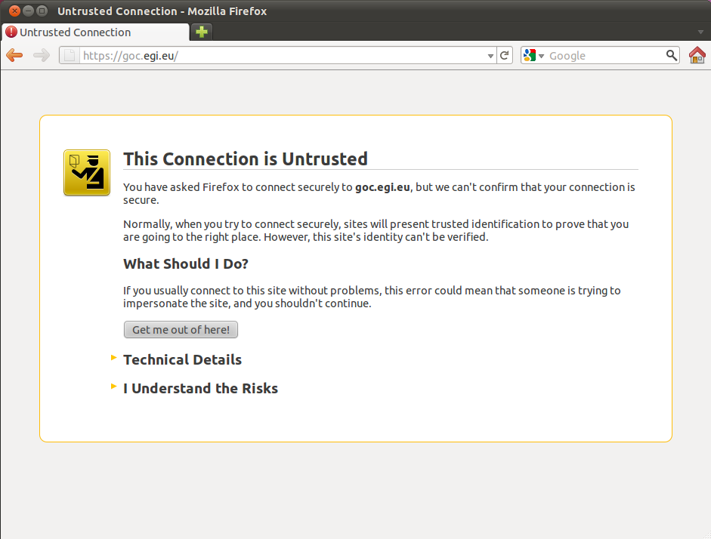
IGTF Anchors

Slide 7
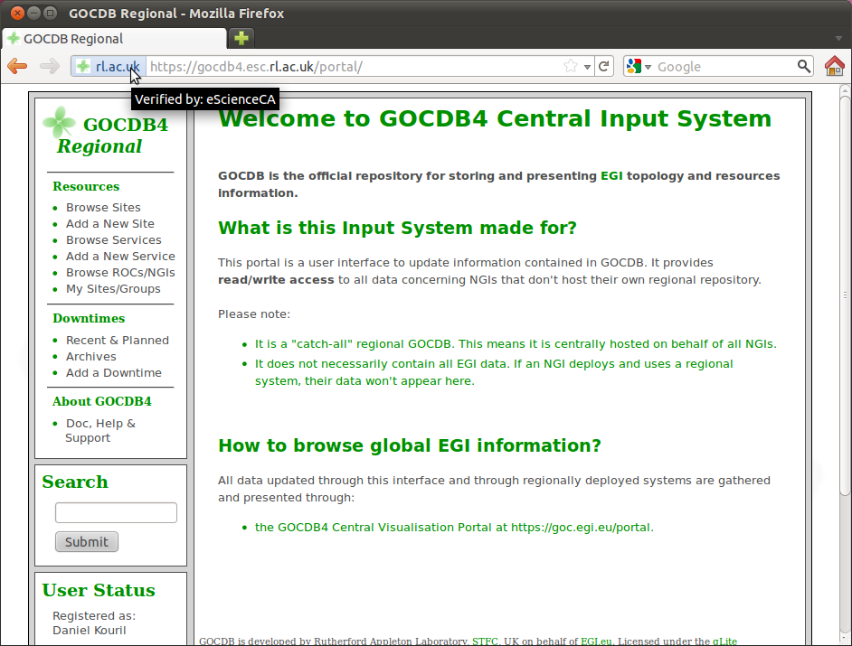
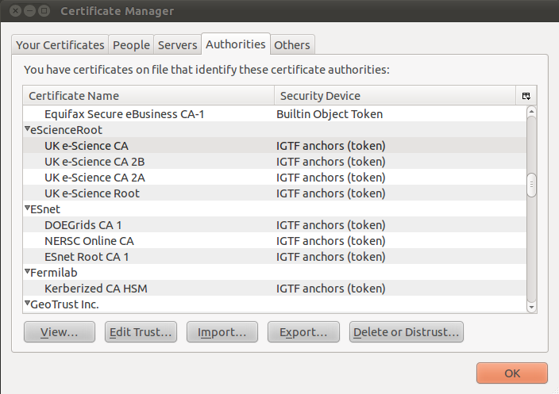

Slide 8
IGTF Anchors
PKCS11 token providing a list of CAs and describing they trust level
Interface to local ca directory
/etc/grid-security/certificates
Populated and maintained either manually or by a package (Debian, Ubuntu, …)

Slide 9
MyProxy PKCS11
Access to credentials in Myproxy server
Credentials must be loaded before
Usable by any PKCS11-enabled application
Thunderbird, browsers, VPN clients
voms-proxy-init
Creds aren’t stored in the application

Slide 10
Remote Smart Card
Two modes possible
Smart card
Full support of PKCS11 abstraction
Requires changes on the MyProxy server
Repository
Simpler, less secure (creds are transmitted to the client)
No server modifications

Slide 11
Conclusions
PKCS11 modules to improve users‘ experience
Support in any PKCS11 applications
Not grid specific
Available from http://www.metacentrum.cz/en/about/devel/

