Slide 1
EGI Policy Development Workshop
Sergio Andreozzi
Policy Development Manager, EGI.eu
sergio.andreozzi@egi.eu

Slide 2
Outline
Updates on EGI Policy Development
Strategic Policies
Operational Policies
Technical Policies
Communication Channels

Slide 3
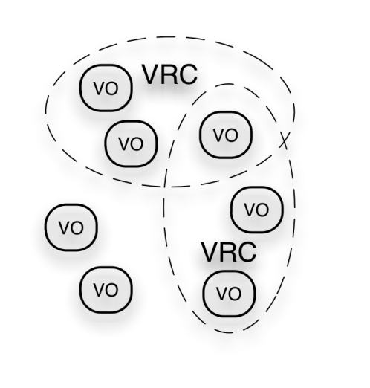
EGI Ecosystem
User Community
Policies + Funding
Requirements + Feedback
Services + Support
Service & Resource Providers
Requirements + Feedback
Public Funding Bodies
Policies + Funding
Requirements + Feedback
European Commission
EGI.eu
Technology Providers
Open Source Providers
National Research Councils
Resource Infrastructure Providers
Strategic Feedback
Technology + Support
Commercial Providers
Policies + Funding

Slide 4
Policy Development
Strategic
Strategic Policies
Operational
Operational policies/procedures
Technical
Open standards

Slide 5
Strategic Policies
Establishing collaborations
MoUs, LoIs
Tracking EU policies, align, inform
Europe 2020 (Digital Agenda, Innovation Union), Horizon 2020, Structural Funds
Sustainability Plan
Analyze ERIC for EGI.eu
Support the development of EGI Sustainability plan and Business Models

Slide 6
Collaborations: MoU Negotiation Status
+ Letter of Intent with
CLARIN and DARIAH
http://www.egi.eu/collaoboration/
Technology Provider
RIP
VRC
Project
more to come
…

Slide 7
Collaborations: MoU Advancement
The progress of MoUs execution is supervised by a member of the Policy Development Team
https://wiki.egi.eu/wiki/PDT:Agreements
Each MoU workplan defines milestones, the progress is recorded in this page:
https://wiki.egi.eu/wiki/PDT:MOU_advancement

Slide 8
EU Policies: Track, Align, Inform
Europe 2020 Strategy
Digital Agenda and Innovation Union:
tracking actions relevant to EGI
https://wiki.egi.eu/wiki/PDT:DA
https://wiki.egi.eu/wiki/PDT:IU
Horizon 2020 (see next talk)
Structural Funds (see next talk)
Answered various online consulations
e.g. Cloud Computing, Green Paper on CSF

Slide 9
ERIC Legal Framework
ERIC:
analysis and survey to NGIs presented at the EGI UF 2011
Prepared questions for ERIC Team
Exploring policy limitations on running economic activitites (e.g., from R&E networks)
"An ERIC shall pursue its principal task on a non-economic basis. However, it may carry out limited economic activities, provided that they are closely related to its principal task and that they do not jeopardise the achievement thereof”
limited = max 25% of annual activities

Slide 10
EGI Sustainability
EGI Sustainability Plan
First version, D2.7 (Mar11)
https://documents.egi.eu/document/313
Second version, D2.13 planned for Feb12
Proposal to move to Apr12, to also include strategic goals and plans endorsed by the EGI Council
do not miss the EGI Sustainability Workshop
http://go.egi.eu/egitf11-sustainability-workshop

Slide 11
Operational Policies
Set-up EGI Technical Governance
Support the EGI Policy Groups
Common Glossary

Slide 12
EGI Technical Governance
EGI Council
EGI.eu Executive Board
Technology
TCB
Security
OMB
OTAG
Users
UCB
USAG
OAT
SCG
SPG
SVG/RAT
CSIRT
Operations
Terms of
Reference
(ToR)
Policy
Development
Process
(PDP)
Common
Glossary
(GCG)
SVG/RAT
CSIRT
http://www.egi.eu/policy/groups/
http://go.egi.eu/policies_and_procedures

Slide 13
Common EGI Glossary
a shared set of terms and definitions across all the functional areas of EGI in order to enable a consistent understanding and improve consistency of documents
https://wiki.egi.eu/wiki/Glossary
Version 1 will be soon after the EGI TF 2011

Slide 14
Technical Policies
EGI Standards Roadmap
First Edition, D2.5 (nov 2010)
https://documents.egi.eu/document/206
Second Edition, D2.12 (in ext. review)
https://documents.egi.eu/document/
Main changes:
Alignment with Digital Agenda and European Interoperability Framework (EIF) 2.0
Implementation plans by technology providers
Adoption plans by EGI
Gap Analysis

Slide 15
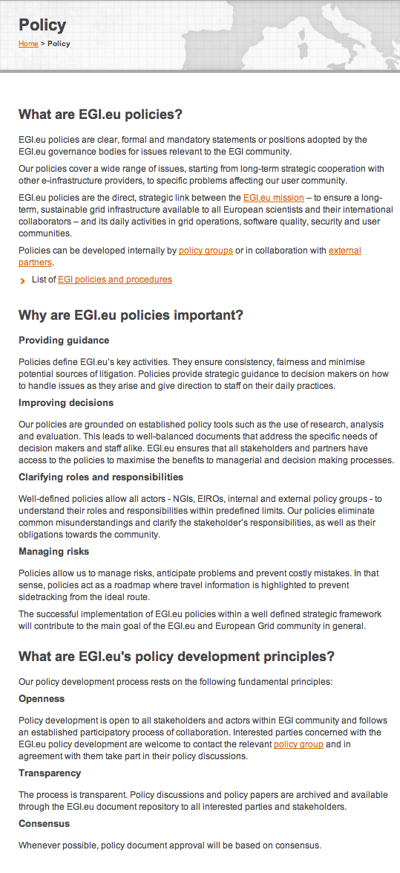
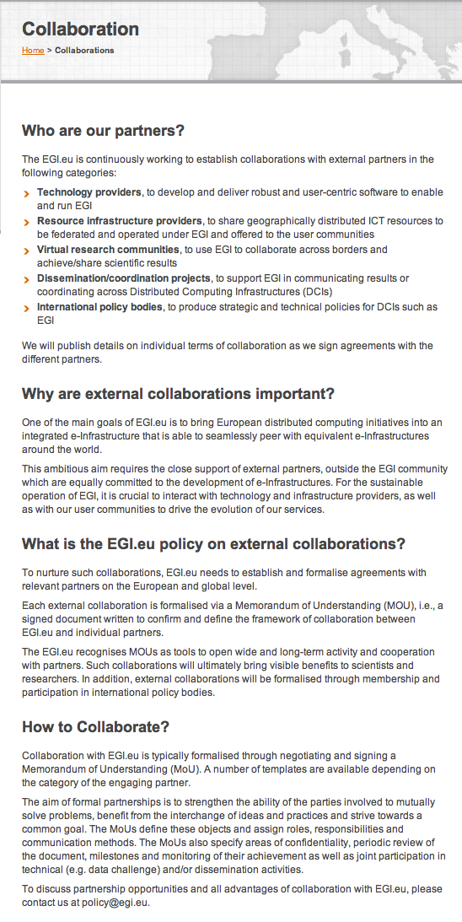
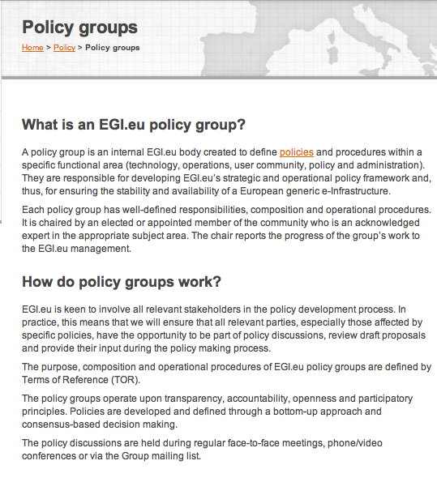
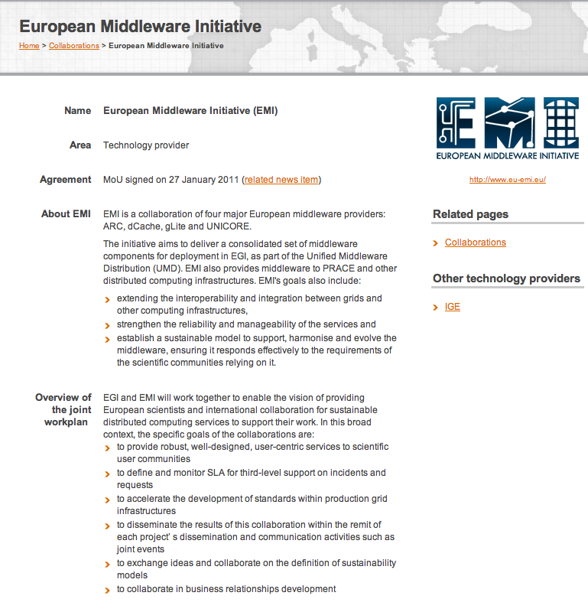
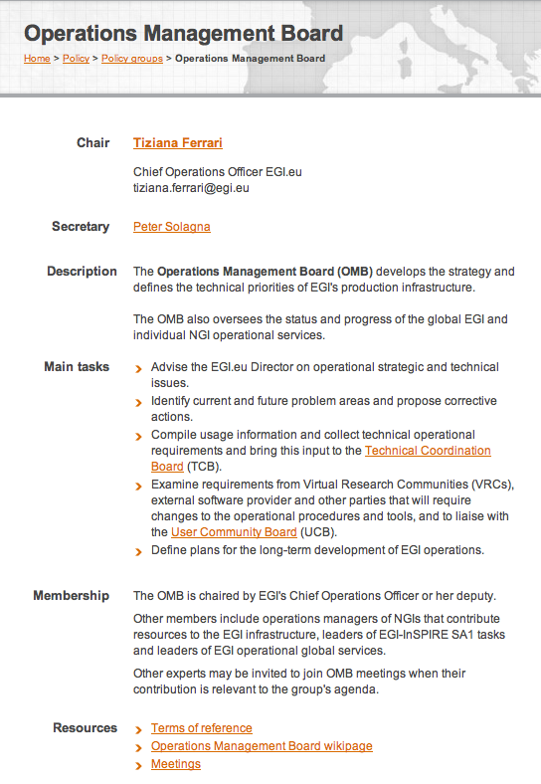
Communication Channels: Policy Area of the Website

Slide 16
Communication Channels: Blog Posts
http://www.egi.eu/blog/categories/policy/

Slide 17
Communication Channels: Mailing List
policy-discuss@mailman.egi.eu
Send an e-mail to policy@egi.eu to be subscribed
mention your EGI SSO

Slide 18
Communication Channels: NGI Coordinator (TBD)
NGI
NGI
SPP
SPP
EGI.eu
M
M
NGI Coordinator
NGI Coordinator
CO
CO
TO
TO
Strategic Policy & Plans
Marketing
Community Outreach
Technical Outreach
Notes:
Business coordination? Plaaning and coordinsation?

Slide 19
Communication Channels: Policy Workshops @ EGI Events
Next Event: EGI Community Forum http://cf2012.egi.eu/
What about an NGIs Policy Development Workshop?

Slide 20
Interesting Sessions for Policy Makers at EGI TF 2011
Sustainability and Business Models
20/09 14:00-15:30 + 16:00-17:30
e-Fiscal Project Workshop
21/09 11:00-12:30
Towards an effective e-Infrastructures impact assessment
21/09 14:00-15:30 + 16:00-17:30
Tutorial: Towards better managed Grids. IT Service Management best practices based on ITIL V3
-22/09 11:00-12:30

Slide 21
Thank you!
Policy Development Team @ EGI.eu
Sergio Andreozzi
Sy Holsinger
Damir Marinovic
contact: sergio.andreozzi@egi.eu
policy@egi.eu

