Slide 1
IPv6 activities in EGI
Mario Reale / GARR
EGI Network Support Coordination
mario.reale@garr.it
Lyon, September 19, 2011 EGI Technical Forum
Network Support Workshop

Slide 2
Goals for this talk and discussion
Shortly present results from work in EGEE II and EGEE II
Present the current results from the IPv6 survey
Discuss how to address the issue of IPv6 within EGI Network Support and beyond
Spotlight is on the middleware stack and the IPv4-IPv6 transition scenario

Slide 3
Outline
IPv6 activities in EGEE II & III (SA2)
  Porting of gLite to IPv6 and summary on its compliance
  Mention of ARC & UNICORE vs. IPv6
  Available tools for analysis of middleware compliance
IPv6 in EGI
  Current stand
    Outcome of the IPv6 Survey
  The IPv4-IPv6 transition scenario
  Issues
  Collaboration with HEPiX IPv6

Slide 4
Part I: IPv6 in the EGEE era
Porting gLite to IPv6 and
summary on gLite IPv6 compliance

Slide 5


gLite: a complex architecture
Logging &Bookkeeping System (LB)
Several levels of complexity:
  Various types of nodes
  Nodes are distributed at various sites
  And, running in each node…
File Transfer Service (FTS)
LB
FTS
User Interface
Workload Management System (WMS)
Worker Nodes (WN)
  Various processes
WN
WN
WN
WN
WMS
WN
Computing Element (CE)
Storage Element (SE)
CE
SE
Proper operation of gLite using IPv6 requires:
  IPv6 compliance of all these processes
  IPv6 connectivity between all of them.
BDIIServer
Logical File Catalog (LFC)
BDII
LFC

Slide 6
IPv6 tutorials for the gLite community
EGEE III SA2 organized tutorials on IPv6 for the community of gLite developers (JRA1) and the testing & certification team (SA3)
  Rome on Jan 18, 2008 – IPv6 tutorial
    https://agenda.euchinagrid.org/conferenceDisplay.py?confId=58
  Prague Nov 6, 2008 IPv6 Programming and Testing tutorial at the JRA1/SA3 All Hands
Covered topics:
  Introduction to IPv6
  IPv6 Programming (C/C++, JAVA, Perl, Python)
  IPv6 Testing
  Hands-on session

Slide 7
SA2 developed or improved tools
Static source code checker
  A bash script looking from non compliant function calls and address data structures
    Typical examples: - gethostbyname()
    ( instead of gateaddrinfo() )
    - 127.0.0.1
    113 IPv6-related bugs on source code have been posted after systematic analysis of source code
Dynamic Code Checker → IPV6 CARE tool
  A tool based on the LD_PRELOAD mechanism to intercept calls to non compliant functions in the dynamically linked libraries

Slide 8
Tested components in IPv6
DPM-SE
LFC File Catalog
WMS/Wmproxy
CREAM Computing Element
BDII
globus-url-copy / gridFTP

Slide 9



First IPv6 compliant production components: LFC and DPM-SE
First production gLite components ported to IPv6 :
  DPM
  LFC David Smith / CERN Dec 2007
Reported on 19 Feb 2008 at CERN
    http://indico.cern.ch/conferenceDisplay.py?confId=28208

Slide 10

gLite components ported to IPv6
BDII
LFC
DPM
CREAM CE
LCG-utils
GFAL lib
Probably still incompliant: AMGA
( Latest IPv6 bug update: Date: 2011-07-06 08:18 By: Maria Alandes Pradillo <malandes> I close this bug since AMGA is no longer supported in gLite. Please, reopen if it is valid for EMI - http://savannah.cern.ch/bugs/?41196 )
GridSite
WMS/WMProxy
BLAH
APEL
LB
VOMS
FTS

Slide 11
Test of IPv6 compliance of external packages
Directly tested packages
  GridFTP
  Axis/Java, Axis2/Java
  Axis2/C
  Boost:ASIO
  gSOAP
  Python::ZSI
  Perl::SOAPLite

Slide 12
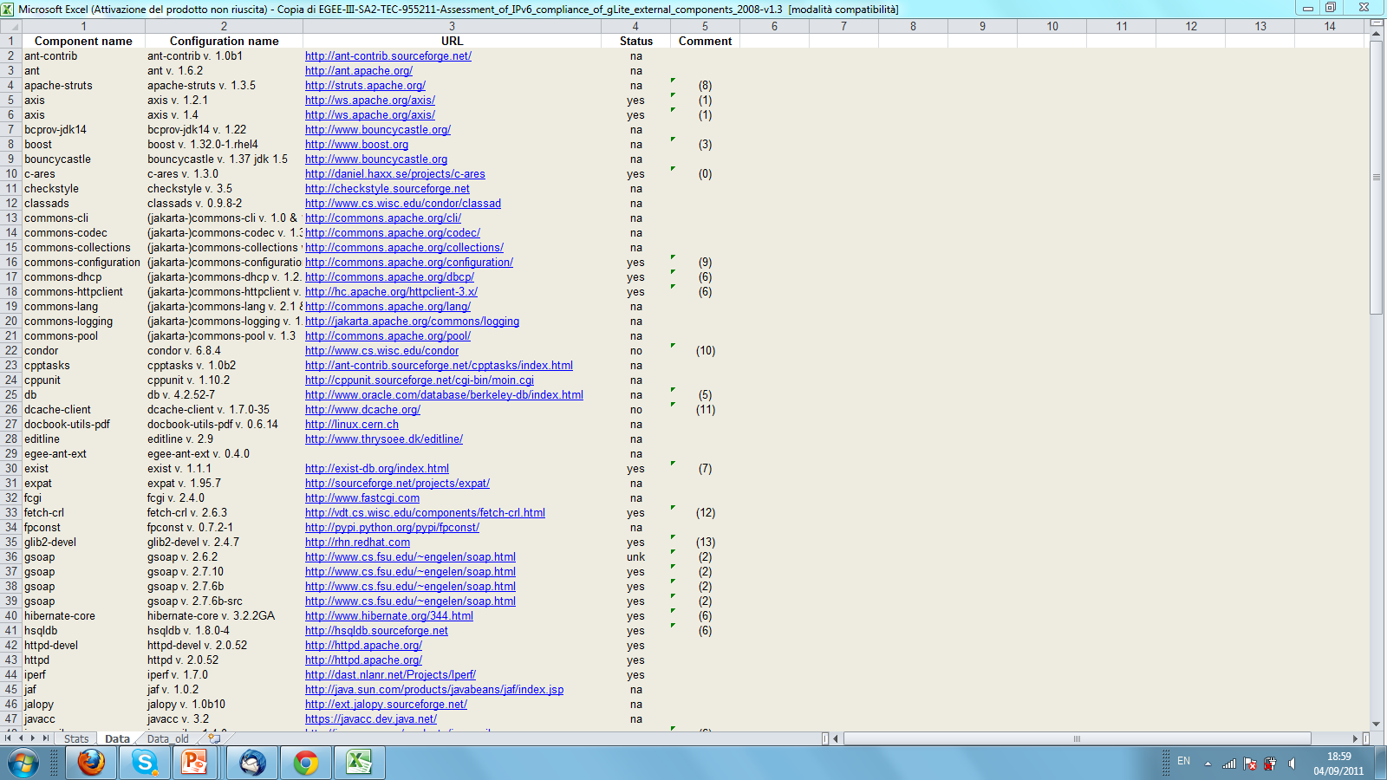
Assessment of all gLite external components
https://twiki.cern.ch/twiki/bin/view/EGEE/EGEEGliteExternalDependencies

Slide 13
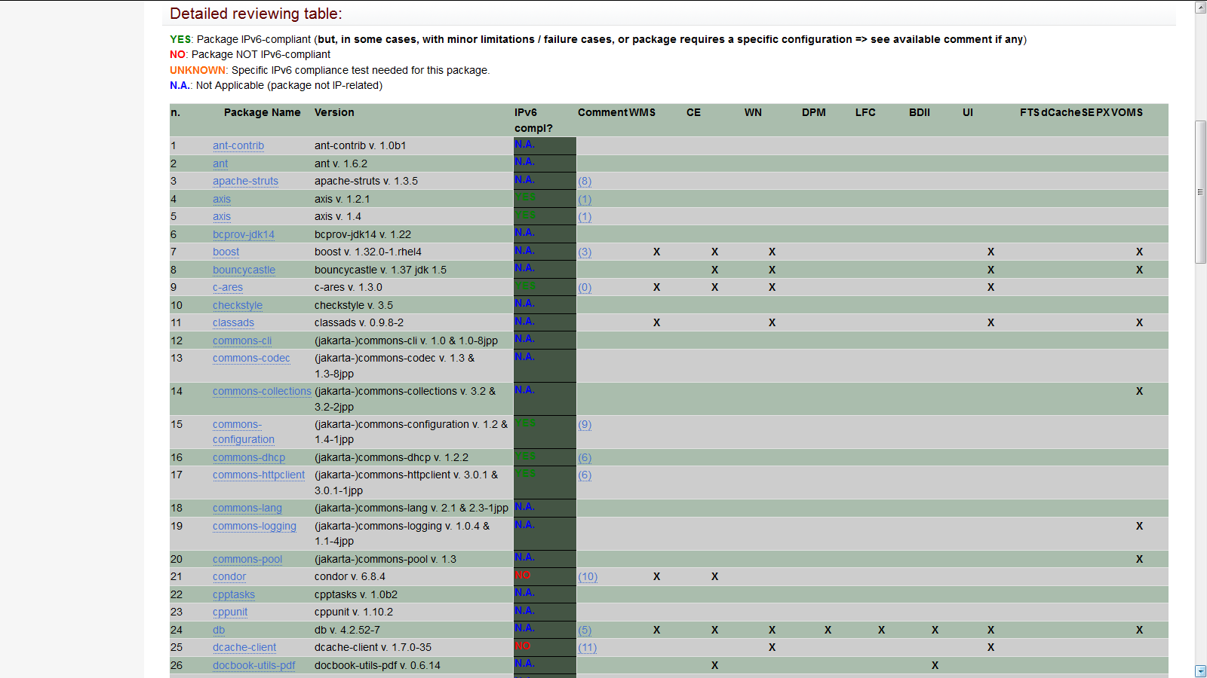
Assessment of all gLite external components

Slide 14
Issues with IPv6 and gLite
No systematic IPv6 testing and certification in place
No IPv6 maintained YUM repository available
No real testing of configuration tools (YAIM) using IPv6
Probable non compliance in many operations related tools
  SAM/NAGIOS, GOCDB, GSTAT,…

Slide 15
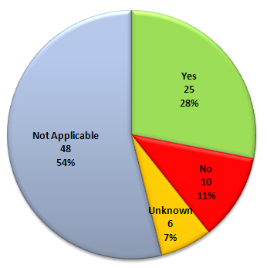
Final status of gLite and IPv6 as reported at the project final review
Analysis of the gLite source code
  Using the IPv6 metric (IPv6 code checker) in ETICS to point out 75 parts of the code where there are indications of possible of non-compliant function calls:
    111 bugs declared only 3 bugs left
  This analysis effectively helped developers to work on IPv6
IPv6 compliance
of external
dependencies
15

Slide 16
Status of gLite IPv6 compliance at the end of EGEE III (march 2010)
Level of IPv6 compliance: number of IPv6 compliant components w.r.t. total number of components
Level of IPv6 compliance | a) optimized tags for each component w.r.t. IPv6 | b) single overall gLite release tag
Upper value (excluding component test modules, examples, gSOAP built with wrong plug in) | 99.5% | 96,2%
Lower value (including all reported faults) | 96,1% | 92,8%

Slide 17
Trend with time
Trend with time for
(#compliant components) / (total # of comp.) components

Slide 18
Summary on IPv6 compliance of gLite
By the end of EGEEIII gLite was almost fully compliant(~95 %)
Some components have been ported to IPv6 but not included in the official release – an IPv6 compliant CVS tag exists
Proper, systematic certification of the middleware has never been put in place
  A full-fledged, distributed IPv6 infrastructure has never been exploited at this purpose
In deep analysis of IPv6 compliance of many installation and configuration tools (OS, m/w, applications) was not performed
  PXE, Quattor, yum, YAIM,…
Same problem for many Operations-related tools (SAM/Nagios, Dashboard, GSTAT, GOCDB,….)

Slide 19
And then ? Open questions
Reasonable assumption is that gLite is still essentially 100 % IPv6 compliant but no proof of it
  All IPv6 bug fixing changes should have been kept
What happened then ?
  What is EMI doing w.r.t. IPv6 ?
  What is the gLite Open Collaboration doing w.r.t. IPv6 ?
EMI recently stated their interest in resuming IPv6 activities
  HEPiX Meeting at CERN
  http://indico.cern.ch/conferenceDisplay.py?confId=152775

Slide 20
ARC and UNICORE vs IPv6
UNICORE mostly JAVA based and its networking libraries
  Should be well off w.r.t IPv6
ARC is IPv6 compliant
  Minor changed for IPv6 already done
Session on IPv6 compliance of m/w @OFG 25:
  http://www.ogf.org/gf/event_schedule/index.php?id=1503&tentative

Slide 21
Summary of SA2 provided tools and documents to deal with gLite and IPv6

Slide 22
What EGEE III SA2 provided around IPv6
Guides for
  IPv6 programming in C/C++, Java, Perl, Python
  Test the IPv6 compliance of a socket server
A general IPv6 introduction tutorial including exercises
A distributed IPv6 capable testbed, including NATPT (protocol translator) at GARR(Rome) and UREC(Paris)
IPv6 resources included in
  The SA3 certification testbed
  The ETICS metronome pool
Both a static (source code) and a dynamic IPv6 checker
  IPv6 metric of ETICS (static source code checker)
  IPv6 CARE Framework (dynamic code checker based on LD_PRELOAD)
A set of specific IPv6 compliance test reports for
  Selected external components
  gLite deployment modules and their services
An ETICS test project on IPv6 (ETICS provided):gLite_ipv6

Slide 23
EGEE III SA2 provided documents
Reference documents on IPv6 for gLite developers: (all on SA2 EDMS or Wiki page at https://twiki.cern.ch/twiki/bin/view/EGEE/IPv6FollowUp )
  IPv6 Programming methods:
    Guide to IPv6 compliant programming in C/C++, Java, Python and Perl:
      Provides a sample TCP client and server for each programming language
      Explains advantages/drawbacks/limitations of each lang.w.r.t.IPv6
  IPv6 Testing methods:
    How to make sure the IPv6 behavior of your application is as expected
  IPv6 Tests reports:
    Assessment of the status of the gLite external packages overall
    Selected IPv6 compliance studies for specific packages: gSOAP, Axis / Axis2, Boost:asio, gridFTP, PythonZSI, PerlSOAPLite
    Assessment of the IPv6 compliance of gLite components: DPM, LFC,CREAM
Provisioning of specific IPv6 introductory tutorials for gLite developers
23
23

Slide 24
The IPv6 static code checker
What is it?
  A bash script seeking for evident non IPv6 compliant patterns in the source code
    Available from http://ui2-4.dir.garr.it/GRID/ipv6.tar.gz
How to use it?
  Using ETICS build system:
    You can check the IPv6 metric on the ETICS UI (see next slides)
    You can submit an IPv6 check job, for example on the org.glite.data.transfer-fts gLite component:
etics-submit build -p ipv6check="True“ \
org.glite.data.transfer-fts
  Optionally the code checker can also be used by hand
24

Slide 25
Checking IPv6 compliance with the source code checker via ETICS
etics-get-project org.glite
etics-checkout -p default.profile=ipv6 --continueonerror --config glite_branch_3_2_0_dev --ignorelocking --noask org.glite
etics-build -p default.profile=ipv6 --config glite_branch_3_2_0_dev --continueonerror org.glite

Slide 26
Using the IPv6 code checker by hand
cvs check out directory tree of all code
place the script on the top directory of all checked out code
run it by hand:
ipv6-code-checker.sh <root directory>

Slide 27
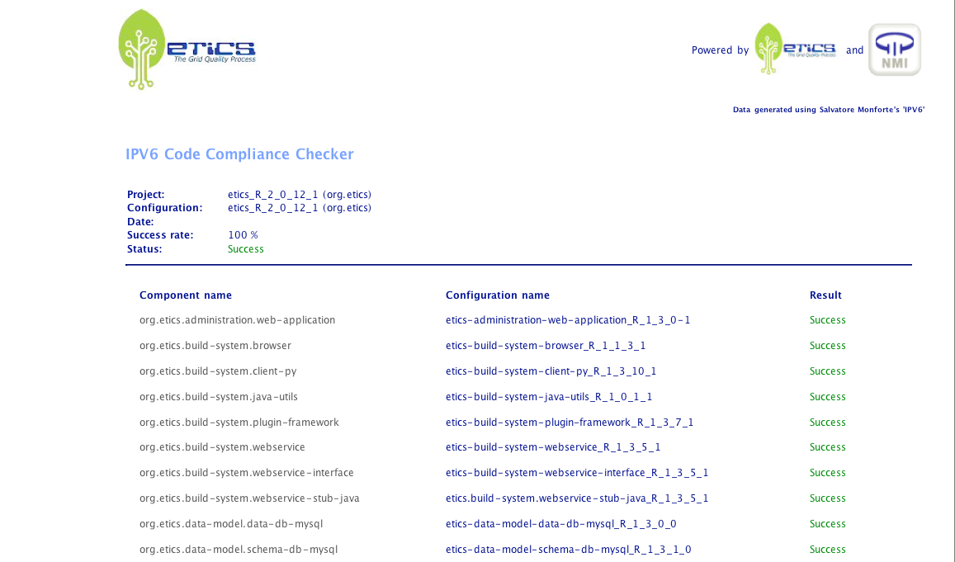

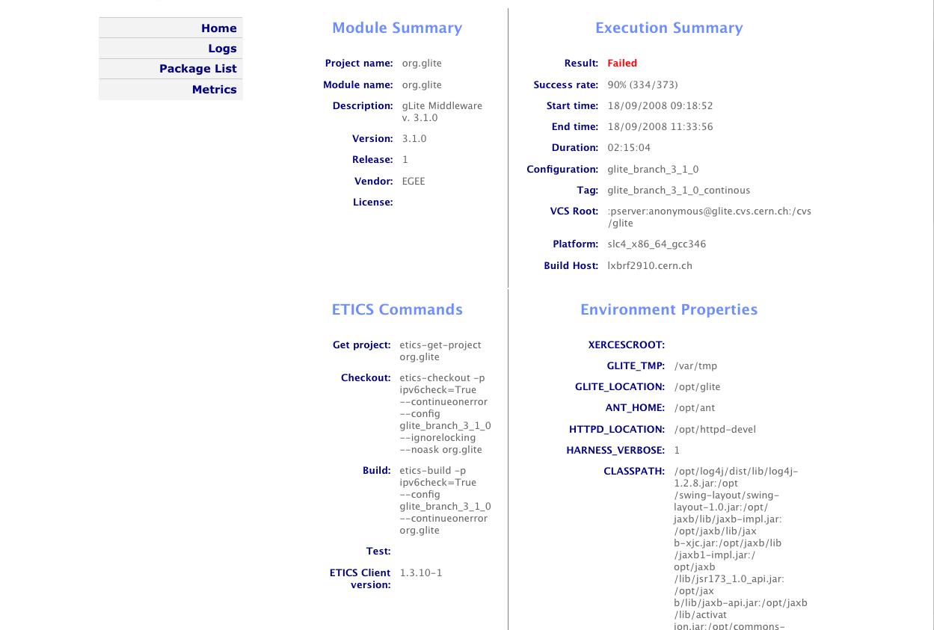
IPv6 code checker usage example
Click Here
…
Click Here
27

Slide 28
IPV6 CARE (Dynamic Checker)
The basic idea is to use the LD_PRELOAD mechanism to let the system pre-load a specific library (the IPv6 care one – including functions with the same name of the non compliant ones)
In this way each time a non compliant function would be called by a given loaded dynamic library, the IPv6 care one will actually be loaded instead
That function would rise an alarm and file a report (this is the check mode of the tool)

Slide 29
IPv6 CARE
Linux toolbox about IPv6 compliance of applications
  « Checking » mode: diagnose IPv6 compliance of an application
  « Patching » mode: correct non-IPv6 compliant behavior of an application on-the-fly, in order to make it compliant
The tool works by detecting and analyzing / replacing the networking function calls performed by your program
➔ no need to have the source code of the program being checked / patched
Notes:
29
29

Slide 30
IPv6 CARE mechanism
LD_PRELOAD=/path/to/libipv6_care.so
Program <name>
-------------------------
Main()
{ …
gethostbyname(…)
…}
Preloaded libipv6_care.so library
-----------------------------------------------
gethostbyname(…)
{
Diagnose problem in /tmp/ipv6_diagnosis/<name>/…
Call RTLD_NEXT gethostbyname()
}
...
<other_non_ipv6_compliant
functions>
C Standard Shared Library
----------------------
gethostbyname()
{…
}
…
C Standard Shared Library
----------------------
gethostbyname()
{…
}
…

Slide 31
Advantages / Drawbacks
Advantages:
  It works with all non-static programs
  It does not affect the standard behavior of the program
  It does not warn about parts of code which are actually not executed
Drawbacks:
  IPv6 CARE only detects non-IPv6-compliant function calls. There may be other (less common) kinds of non-IPv6 compliance problems which will not be detected.

Slide 32
IPv6 CARE: Checking mode
Example: test of an old version of “telnet”
  One must prefix the command with “ipv6_care check [-v]”:
  The output messages allow to diagnose IPv6 compliance
  If needed the whole diagnosis is available in the reported directory
$ ipv6_care check -v telnet localhost 9876
Notes:
32
32

Slide 33
IPv6 CARE: Checking mode
Example: test of an old version of “telnet”
  One must prefix the command with “ipv6_care check [-v]”:
  The output messages allow to diagnose IPv6 compliance
  If needed the whole diagnosis is available in the reported directory
$ ipv6_care check -v telnet localhost 9876
IPV6 CARE detected: inet_addr() with [ cp=localhost ]
IPV6 CARE detected: gethostbyname() with [ name=localhost ]
IPV6 CARE detected: inet_ntoa() with [ in=127.0.0.1 ]
Trying 127.0.0.1...
IPV6 CARE detected: socket() with [ domain=AF_INET type=SOCK_STREAM protocol=ip ]
IPV6 CARE detected: connect() with [ socket=3 address.ip=127.0.0.1 address.port=9876 ]
telnet: Unable to connect to remote host: Connection refused
------------------------------------------------------------------------------
IPv6 diagnosis for 'telnet localhost 9876' was generated in: /tmp/ipv6_diagnosis/telnet/by_pid/pid_6541
------------------------------------------------------------------------------
$
Notes:
33
33

Slide 34
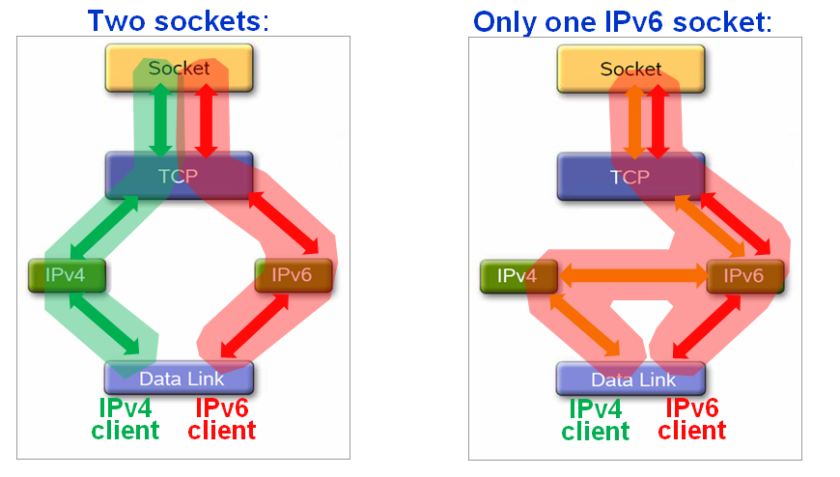
IPv6 CARE: how does the patching mode work ?
IPv6 CARE in patch mode changes the behavior of program P in 3 different ways:
  When P calls accept() on an IPv4 socket (server case)
  When P calls connect() to reach a dual stack node using and IPv4 socket (client case)
  When P calls an IPv4-only name resolving routine (for example gethostbyname() ) but the remote node is IPv6-only (i.e. it has only an IPv6 address)

Slide 35
1) Server case: P calls accept() in an IPv4 socket
IPv6 CARE changes the behavior of program P in order to accept IPv6 clients as well:
  opens an IPv6 socket
  calls select() to wait for a connection on any of these 2 sockets
  calls accept() on the socket that received the connection

Slide 36
2) Client case: P calls connect() to reach a dual stack host using an IPv4 socket
IPv6 CARE changes the behavior of P to enable it to be able to connect to any of the remote addresses of the remote dual stack host
  Calls connect() as requested (no change)
  Checks if the connection succeded
  If not, creates an IPv6 socket and tries to connect using the IPv6 address of the remote host

Slide 37
3) IPv4-only name resolving used in the case of IPv6-only hosts
The remote host has only an IPv6 address (A6) and no IPv4 address. Program P calls an IPv4-only name resolving function (i.e. gethostbyname() );
IPv6 CARE cannot return address A6, so it changes the behavior of P such that
  It returns an IPv4 address (A4) taken from a pool of available IPv4 addresses
  Record this mapping A6 ← → A4
  When P will perform further network functions calls referring to A4, IPv6 CARE will know that P was actually referring to A6, and act accordingly

Slide 38
IPv6 CARE: Patching mode
Example of mysqld:
[root@quarks ~]# /etc/init.d/mysqld start
Notes:
38

Slide 39
IPv6 CARE: Patching mode
Example of mysqld:
[root@quarks ~]# /etc/init.d/mysqld start Starting MySQL: [ OK ] [root@quarks ~]#
Notes:
39

Slide 40
IPv6 CARE: Patching mode
Example of mysqld:
[root@quarks ~]# /etc/init.d/mysqld start Starting MySQL: [ OK ] [root@quarks ~]# netstat -lnpt | grep mysqld
Notes:
40

Slide 41
IPv6 CARE: Patching mode
Example of mysqld:
[root@quarks ~]# /etc/init.d/mysqld start Starting MySQL: [ OK ] [root@quarks ~]# netstat -lnpt | grep mysqld tcp 0 0 0.0.0.0:3306 0.0.0.0:* LISTEN 21591/mysqld [root@quarks ~]#
Notes:
41

Slide 42
IPv6 CARE: Patching mode
Example of mysqld:
[root@quarks ~]# /etc/init.d/mysqld start Starting MySQL: [ OK ] [root@quarks ~]# netstat -lnpt | grep mysqld tcp 0 0 0.0.0.0:3306 0.0.0.0:* LISTEN 21591/mysqld [root@quarks ~]# /etc/init.d/mysqld stop
Notes:
42

Slide 43
IPv6 CARE: Patching mode
Example of mysqld:
[root@quarks ~]# /etc/init.d/mysqld start Starting MySQL: [ OK ] [root@quarks ~]# netstat -lnpt | grep mysqld tcp 0 0 0.0.0.0:3306 0.0.0.0:* LISTEN 21591/mysqld [root@quarks ~]# /etc/init.d/mysqld stop Stopping MySQL: [ OK ] [root@quarks ~]#
Notes:
43

Slide 44
IPv6 CARE: Patching mode
Example of mysqld:
[root@quarks ~]# /etc/init.d/mysqld start Starting MySQL: [ OK ] [root@quarks ~]# netstat -lnpt | grep mysqld tcp 0 0 0.0.0.0:3306 0.0.0.0:* LISTEN 21591/mysqld [root@quarks ~]# /etc/init.d/mysqld stop Stopping MySQL: [ OK ] [root@quarks ~]# ipv6_care patch /etc/init.d/mysqld start
Notes:
44

Slide 45
IPv6 CARE: Patching mode
Example of mysqld:
[root@quarks ~]# /etc/init.d/mysqld start Starting MySQL: [ OK ] [root@quarks ~]# netstat -lnpt | grep mysqld tcp 0 0 0.0.0.0:3306 0.0.0.0:* LISTEN 21591/mysqld [root@quarks ~]# /etc/init.d/mysqld stop Stopping MySQL: [ OK ] [root@quarks ~]# ipv6_care patch /etc/init.d/mysqld start Starting MySQL: [ OK ] [root@quarks ~]#
Notes:
45

Slide 46
IPv6 CARE: Patching mode
Example of mysqld:
[root@quarks ~]# /etc/init.d/mysqld start Starting MySQL: [ OK ] [root@quarks ~]# netstat -lnpt | grep mysqld tcp 0 0 0.0.0.0:3306 0.0.0.0:* LISTEN 21591/mysqld [root@quarks ~]# /etc/init.d/mysqld stop Stopping MySQL: [ OK ] [root@quarks ~]# ipv6_care patch /etc/init.d/mysqld start Starting MySQL: [ OK ] [root@quarks ~]# netstat -lnpt | grep mysqld
Notes:
46

Slide 47
IPv6 CARE: Patching mode
Example of mysqld:
[root@quarks ~]# /etc/init.d/mysqld start Starting MySQL: [ OK ] [root@quarks ~]# netstat -lnpt | grep mysqld tcp 0 0 0.0.0.0:3306 0.0.0.0:* LISTEN 21591/mysqld [root@quarks ~]# /etc/init.d/mysqld stop Stopping MySQL: [ OK ] [root@quarks ~]# ipv6_care patch /etc/init.d/mysqld start Starting MySQL: [ OK ] [root@quarks ~]# netstat -lnpt | grep mysqld tcp 0 0 0.0.0.0:3306 0.0.0.0:* LISTEN 21736/mysqld tcp 0 0 :::3306 :::* LISTEN 21736/mysqld [root@quarks ~]#
Notes:
47

Slide 48
Patching mode: system patch
An option allows to apply the patching-mode to
all processes started on the system:
ipv6_care system patch
This could for example make a whole gLite node IPv6 compliant
    IPv6 CARE code available at: http://sourceforge.net/projects/ipv6-care/files/
    Any other info:
    http://sourceforge.net/projects/ipv6-care
    etienne.duble@urec.cnrs.fr
Notes:
48

Slide 49
IPv6 CARE: known issues and limitations
Both modes:
  Secure Environments ( SELinux, AppArmor)
    Require some configuration
  sudo
  RPC based programs
Patch Mode specific:
  No UDP support
  Requires a pool of IPv4 addresses
Check Mode specific:
  Interpreted or Virtual Machine-based languages ( Python, Perl, JAVA…) introduce additional layers in the execution thread stack → more difficult to interpret the outcome of the IPv6 CARE check mode analysis

Slide 50
Part Two: EGI and IPv6
IPv6 activities in EGI:
Current stand

Slide 51
Current stand of EGI IPv6 activities
The IPv6 task has been silent for a while in EGI : we should keep an eye on the IPv6 middleware compliance
We should get ready to
  provide dual stack central services
  include IPv6-only sites
Should we start a task force on IPv6 ?
  Requires exact mandate and ToRs
MoU with Technology Providers about IPv6 ?

Slide 52
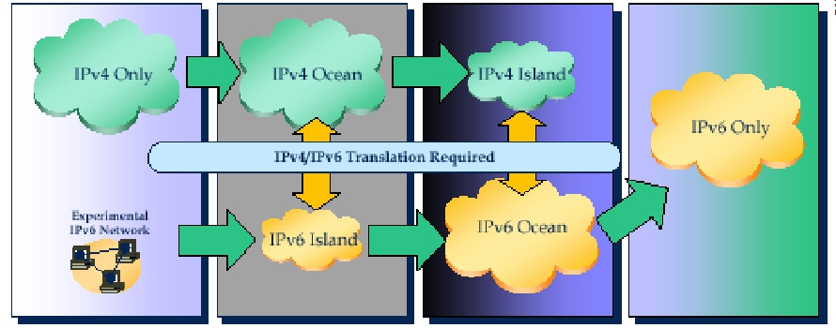
The scenario: transition from IPv4 to IPv6

Slide 53
The topology of transition mechanisms
Dual Stack
  IPv4/IPv6 coexistence on one device
Tunnels
  For tunneling IPv6 across IPv4 clouds
  Later, for tunneling IPv4 across IPv6 clouds
  IPv6 ←→ IPv6 and IPv4 ←→ IPv4
Translators
  IPv6 ←→ IPv4

Slide 54
IPv6 Survey for NGIs
About the current IPv6 deployment level and know-how on IPv6 by NGIs
Within your NGIs, are you aware of any site (or planned future site) providing resources accessible only in IPv6 (IPv6- only internet stack configuration) [Y/N]?
Do you have any site TODAY implementing IPv6 stack connected to the IPv6 Internet [Y/N]?
Do you have sites which are planning to implement the IPv6 stack and, if yes, on which time scale?
How many sites in your NGI have IPv6 network connectivity available?
Is your NREN providing IPv6 connectivity [YES or NO]?
In case you are deploying IPv6, what is the main motivation for you to use it? (lack of IPv4 addresses, will to take advantage of IPv6 protocol specific features, …) – [please specify ]
Do you think organizing tutorials on IPv6 in general for site admins would be useful [Y/N]?
Do you think organizing tutorials on IPv6 security for site adminis would be useful [Y/N]?
About the desired involvement of NGIs in IPv6-related activities and tasks
Are you available to participate to a global IPv6 testbed for testing the IPv6 readiness of the operations related tools and the deployed Grid Middleware [YES or NO]?
Are you available to directly participate to an IPv6 task force aimed at identifying the EGI priorities for IPv6, write an IPv6-action plan, and report to the OMB about the results by means of a written report [YES or NO]?

Slide 55
Results of IPv6 survey so far
# NGIs who answered so far: 19 (45% of total # NGIs/EIROs)
# NGI available to join distributed IPv6 testbed:11 (58%)
# NGIs available to join Task Force on IPv6: 1 (5.3 %)
# NGIs which do/will deploy an IPv6-only site: 1( NGI_BA)
# NGI in favour of IPv6 tutorials : 17 (89%)
# NGIs in favour of IPv6 security tutorials: 16 (84 %)
Various answers on reasons for IPv6 adoption given
Full listing of answers available at
https://wiki.egi.eu/wiki/IPv6

Slide 56
Issues in EGI about IPv6
Strategy for including IPv6-only resources to be defined
  At least until we won’t have a fully IPv6 compliant middleware
  Gateway ?
Get ready to provide IPv6-compliant central services
Evaluate protocol translation mechanisms w.r.t. the Grid middleware
Is IPv6 a requirement for the User Community ?
Should IPv6 compliance be asked for to the Technology Providers ?
Should IPv6 be endorsed more completely by EGI ?
ToR for an IPv6 task force

Slide 57
Issues for EGI-HEPiX IPv6 collaboration
HEPiX started a Working Group on IPv6
https://w3.hepix.org/ipv6-bis/doku.php?id=ipv6:introduction
Next milestone for them is write an initial assessment/report and bootstrap an IPv6 testbed
Some possible points for future collaboration are:
  Grid Middleware testing over IPv6
  Analysis of IPv6 compliance and behavior of specific packages
  Testing of HEP applications
  Support on the existing tools developed by EGEE SA2
  Defining a strategy for integrating IPv6-only sites
    Protocol translation
    Set up of Dual Stack central Grid services
  Jointly push at all levels to get IPv6 enabled (network-agnostic) middleware and applications ☺

Slide 58
Protocol Translation Mechanisms
To include pilot IPv6 sites in an IPv4-based infrastructure
Host level:
  Bump in the Stack
  Bump in the API
  IPV6 CARE (LD_PRELOAD)
IP level:
  NAT-PT ( DNS App Level Gateway)
    But the Grid “hates” NATs
  SIIT (Stateless IP/ICMP Translation Algorithm)
  IVI
    Does not break bidirectional e2e connectivity

Slide 59
NAT-PT factsheet
Advantages:
  Transparent for the nodes using it
Drawbacks:
  Same problems of IPv4 NAT
    Fragile
    Requires specific ALGs to handle all protocols beyond pure basic client server one connection, since it breaks every protocol including IP addresses in the payload
    It does not allow direct e2e connectivity from on end to the other
    “The Grid hates NAT”
  Of course, nevertheless NAT is widely used and many applications do support it.
RFC4947 decleared NAT-PT “historic” given the constraints it imposes to IPv6

Slide 60
IVI factsheet
No need to modify the end systems (IPv4 e IPv6)
Support for communication started from both sides (IPv4 and IPv6)
Support for dual stack hosts
Standard IPv4 NAT can be easily integrated
Standard DNS (changes the way you get the addresses…)
Does not modify IPv4 nor IPv6 routing
TCP, UDP, ICMP support
Handles fragmentation
Can foresee gradual deployment
Supports Multicast

Slide 61
Towards a strategy to include
IPv6-only resources
At a first glance, two scenarios:
  Including IPv6-only resources in an IPv4 Global Grid
    Global public IPv4 interfaces required by “IPv6 only” sites
    IPv4 ← → IPv6 translation at the site level
  Enabling the provisioning of whole IPv6-only sites and IPv6-only services
    Full-fledged partitioning of the Grid into its IPv4 and its IPv6 branches
    EGI spawns an IPv6 branch, connected to its IPv4 one
      To include new IPv6-only resources for the IPv4 world users
      To make its IPv4 resources and service accessible to the IPv6-only world (users and resources)

Slide 62
Gateways (draft)
If the whole set of middleware components and external packages would be IPv6 compliant ( network agnostic) we would not need any gateway
  we would simply not feel the network stack
Before this happens, we could go for a gateway approach building a global IPv6 Gateway for IPv4 users: You access all IPv6 computing resources from a given IPv4 Computing Element which takes care of the IPv4 ← → IPv6 translation
  Protocol Translation happens in 1 place, once (how does it scale?)
  Once you reached with your job sent from an IPv4 UI an IPv6-only worker node, what happens next ? ☺
    Which Catalog do you query ? Which Storage Element do you use ?
All this is at the draft level right now → Needs further thinking, designing → might imply some development

Slide 63
What we could start doing now
Start working on the detailed design of a strategy for including IPv6-only resources
  Task Force on IPv6 ?
Include information on the IP protocol stack of a service (site) Glue / InfoSys
  Might be useful in close future
Start assessing /understanding what is missing for the provisioning of Dual Stack Central Grid services
Perform an analysis of the IPv6 compliance of EMI / UMD

Slide 64
A decision to take
Personal point of view:
  Dual Stack is the way to go. At all levels.
We need network agnostic (IPv6 compliant) middleware and dual stack servers.
How much shall we deal with transition mechanisms - namely protocol translation –(and in which context) – and how much shall we push for getting network-agnostic middleware and applications (IPv6 & IPv4 enabled) ?
Protocol translation might work for a while to include pilot IPv6 resources and sites
  But it is definitely not the long-term answer

Slide 65
References and Contacts
https://wiki.egi.eu/wiki/Network_Support
https://twiki.cern.ch/twiki/bin/view/EGEE/IPv6FollowUp
mario.reale@garr.it

