Slide 1
ACE Status Update
Pedro Andrade
pedro.andrade@cern.ch

Slide 2
Outline
Brief History
Overview
Status Computation
Availability Computation
Operation Status

Slide 3
Brief History
The development of ACE is part of a co-operation agreement between CERN and the Department of Atomic Energy (DAE) of the Government of India for the WLCG project
ACE is an external product designed and developed by the Bhabha Atomic Research Centre (BARC) based in Mumbai
ACE is released by the SAM team and made available in the central grid-monitoring service

Slide 4
Overview
ACE main task is to compute availability and reliability statistics for grid services and sites:
Status is the status of service instances, overall service flavours, and sites at a given point in time
Availability is the fraction of time a service was up during the period the service was known
Reliability is the fraction of time a service was up during the period the service was scheduled to be up

Slide 5
Overview
ACE Profiles are a collection of metrics/services defined for VOs (multiple profiles per VO). Each profile defines its computation algorithm.
Service
s₁
s_{n}
s₁
s_{n}
s₁
s_{n}
Flavour
CREAM-CE
SRMv2
sBDII
Profile 1
Profile 2
t₁
t_{n’’}
t_{1’}
t_{n’}
t_{1’’}
t_{n’’}
Metric

Slide 6
Overview
Metric Results
Status Computation
Calculated per Hour, Day, Week, and Month
Calculated continuously
Availability Computation
Based on Service Instances, Service Flavours, Sites
Based on Service Instances, Service Flavours, Sites
Visualization
Retrieved from Messaging Broker and stored in DB
Monthly Reports
Web Interface

Slide 7
Status Computation
ACE computes status for services, service flavours, and sites based on metric results
ORing
At least one service up → up
ANDing
All services up → up
Metric
Results
Service
Status
Service Flavour
Status
Site
Status
ORing
At least one flavours up → up
ANDing
All flavours up → up
ANDing
All metrics in OK state → up

Slide 8
Availability Computation
Based on the concepts of hourly up fraction, scheduled down fraction, and unknown fraction
From the status and downtimes information ACE computes hourly availability and reliability for services, overall service flavours, and sites
From the hourly availability and reliability information ACE computes daily, weekly, monthly availabilities and reliabilities for services, overall service flavours, sites, and federations

Slide 9
Visualization
Monthly Reports:
http://gvdev.cern.ch/GRIDVIEW/downloads/Reports/
PDFs reporting monthly availability and reliability numbers
Created once per month and distributed to WLCG/EGI
Created using iReport, OpenReports, and JasperReports
Web Interface:
https://grid-monitoring.cern.ch/myegi/sa
Online tool showing availability and reliability graphs
Queries can be based on: profiles, groups, sites, dates

Slide 10
Operation Status
Management of OPS VO profile and algorithm:
(OR CEs) AND (OR of SEs) AND sBDII
Operation of the service availability web interface provided by the central grid-monitoring MyEGI portal
Generation of monthly availability and reliability reports for OPS VO. Including the maintenance of templates used to generate the reports

Slide 11
Thanks!
For more information please visit the
SAM Documentation website
https://tomtools.cern.ch/confluence/display/SAMDOC/Home

Slide 12
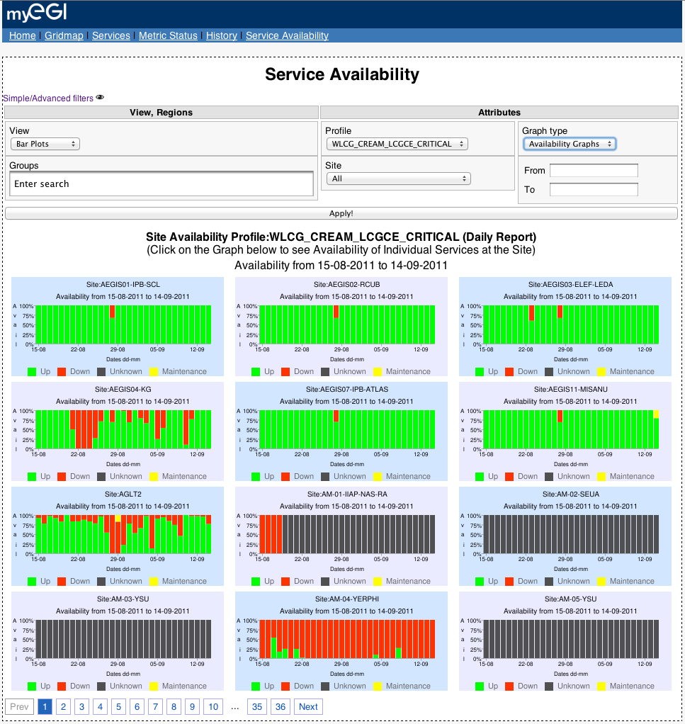
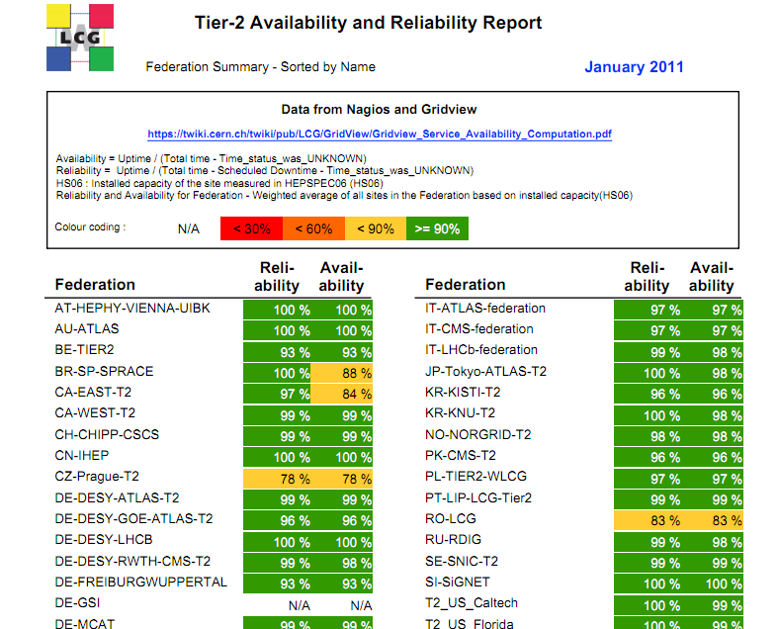
Visualization
Monthly Reports
Web Interface
iReport
OpenReports
JasperReports

