Slide 1
NGI Operational Tools Marketplace NGI_AEGIS Operational Tools: WatG Browser, gFinger, DWARF
Vladimir Slavnic
SCL, Institute of Physics Belgrade, Serbia
slavnic@ipb.ac.rs

Slide 2
Overview
Motivation for development of operational tools
Some of operational tools developed at SCL
WatG Browser
gFinger
DWARF
Useful links

Slide 3
Motivation (1/2)
gLite represents one of the major middleware stacks used today
Installation, maintenance and everyday Grid operations of a successful gLite resource center (Grid site) is not an easy task
Site administrators are responsible for:
Maintaining Grid resources provided to user communities
Resolving all operational problems identified by the deployed monitoring tools or diagnosed by the users

Slide 4
Motivation (2/2)
Administrators of resource centers are usually deploying customized or home-made tools for different purposes:
Monitoring of resources
Automatization of maintenance tasks that have to be performed regularly on many nodes
The good collaborative practice is to make such custom tools available to other interested site administrators

Slide 6
Overview and Motivation
Web-based Grid Information System visualization application
Detailed overview of the status and availability of various Grid resources
Queries and presents data obtained from gLite-based e-Infrastructure at different layers
Local resource information system (GRIS)
Grid site information system (site BDII)
Top-level information system (top-level BDII)
Deployed by the AEGIS Grid e-Infrastructure

Slide 7
WatG Browser features (1/2)
Highly responsive tool
Partial refreshes of a web page
When an interaction event fires - click on plus icon of LDAP tree - the server processes the information and returns a limited response specific to the data it receives – only LDAP's subtree that requires given condition
Application is driven by events and data, whereas conventional web applications are driven by pages

Slide 8
WatG Browser features (2/2)
Asynchronization of a web page
Client can continue processing while the server does its processing in the background
User can continue interacting with the client without noticing a lag in the response
Simple and advanced search
Browse large directories
Access multiple directories
View all available attributes
Works across all major browsers

Slide 9
WatG Browser implementation (1/2)
Java programming language
Google Web Toolkit (GWT) cross-compiles into optimized JavaScript
GWT Remote Procedure Call (RPC) mechanism for interacting with a server across a network
Java Naming and Directory Interface (JNDI) LDAP extensions for Grid Information System interaction

Slide 10
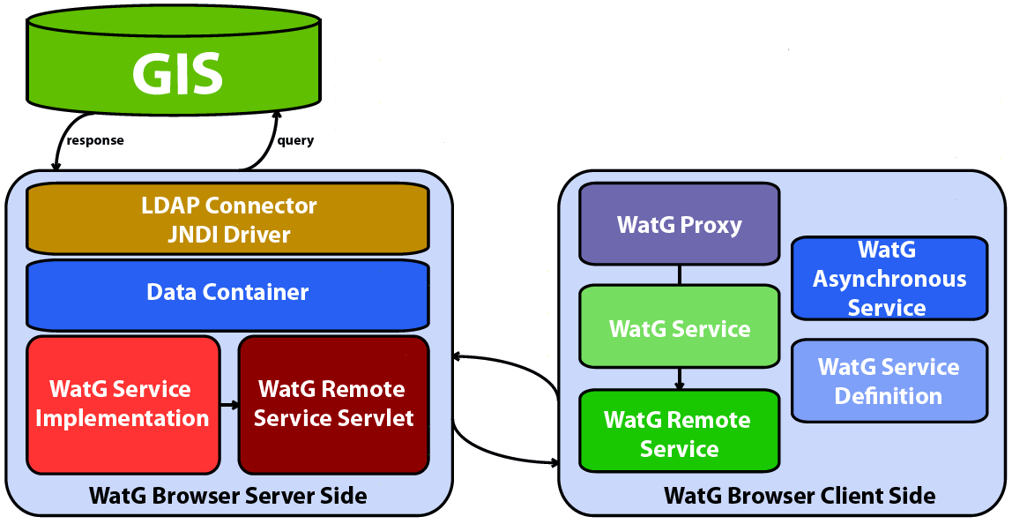
WatG Browser implementation (2/2)

Slide 11
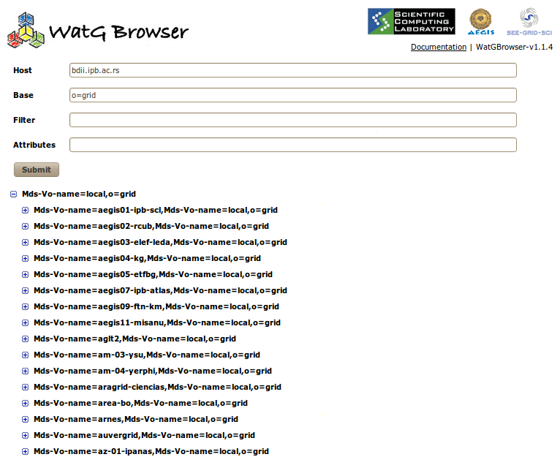
WatG Browser screenshoots (1/3)

Slide 12
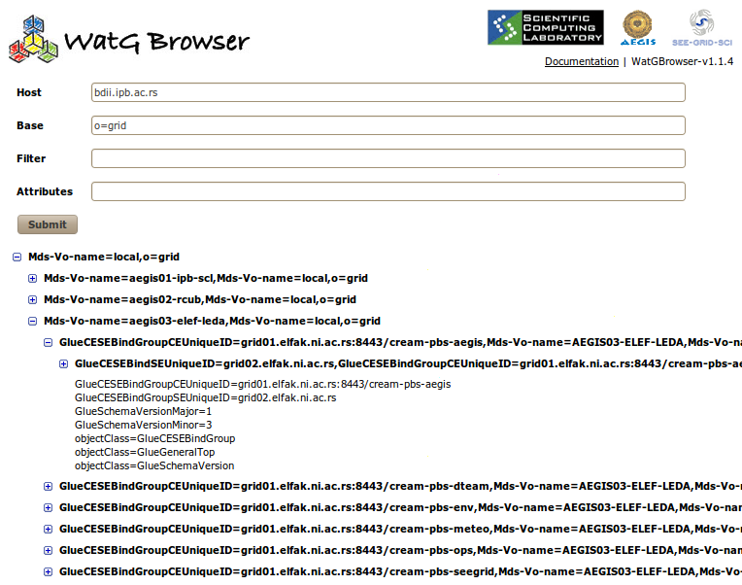
WatG Browser screenshoots (2/3)

Slide 13
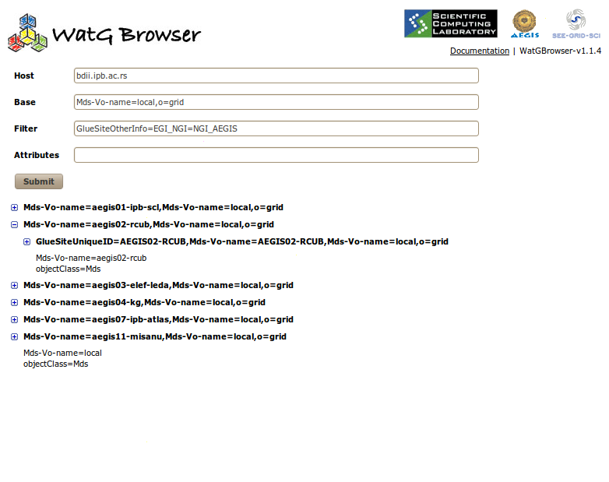
WatG Browser screenshoots (3/3)

Slide 14
gFinger

Slide 15
Account mapping (1/2)
The authorisation of a user on a specific Grid resource can be done in different ways:
grid-mapfile mechanism
LCAS/LCMAPS
ARGUS
…
After authorisation process is completed, information on account mapping is stored in /etc/grid-security/gridmapdir directory of a particular Grid service

Slide 16
Account mapping (2/2)
For each Unix username in the pool, an empty file named after a username exists in this directory
When a certain Unix account is mapped to a Grid user, a hard link with the same name as the certificate subject is created in /etc/grid-security/gridmapdir directory, and points to the appropriate file according to the Unix username to which the subject is mapped

Slide 17
gFinger overview (1/2)
gFinger is a command-line tool
It provides information on local VOMS mapping of users authenticated by digital certificates on various Grid services such as Computing Element (CE), CREAM CE, Workload Management System (WMS), Storage Element (SE), etc.

Slide 18
gFinger overview (2/2)
To find which username corresponds to which digital certificate subject and vice versa, gFinger searches /etc/gridsecurity/gridmapdir directory for links pointing to the same inode
Useful when individual user has to be tracked, e.g. when resolving operational or user-reported problems, or when investigating a security related issue

Slide 19
Example of usage
[root@wms ~]# gfinger seevo002
DN: /c=rs/o=aegis/ou=institute of physics belgrade/cn=aleksandar bogojevic:seevo
Login: seevo002 Name: mapped user for group ID seevo
Directory: /home/seevo002 Shell: /bin/bash
User ID: 23002 Group ID: 2300
or
[root@wms ~]# gfinger vudragovic
DN: /c=rs/o=aegis/ou=institute of physics belgrade/cn=dusan vudragovic:atlas:atlas
Login: atlas001 Name: mapped user for group ID atlas
Directory: /home/atlas001 Shell: /bin/bash
User ID: 20001 Group ID: 2000
DN: /c=rs/o=aegis/ou=institute of physics belgrade/cn=dusan vudragovic:aegis:aegis
Login: aegis002 Name: mapped user for group ID aegis
Directory: /home/aegis002 Shell: /bin/bash
User ID: 26002 Group ID: 2600

Slide 21
DWARF motivation
In user/development communities where large number of partners/collaborators from different institutions jointly contribute to applications and RPMs built from applications' sources, it is useful to create a unique software repository that collects all such RPMs
For security, scalability and reliability reasons, authentication and authorization of submitters should be established and closely checked

Slide 22
DWARF description (1/2)
DWARF is a framework used for management of Advanced Packaging Tool (APT) and Yellow dog Updater Modified (YUM) repositories
DWARF allows uploading of RPM packages and creation of APT and YUM repositories
It provides authentication and authorization based on digital certificates using Public Key Infrastructure (PKI)

Slide 23
DWARF description (2/2)
From the DWARF web portal authenticated and authorized user can:
Create and change repository structure
Perform package uploading
Build repository
Deployed within AEGIS e-Infrastructure

Slide 24
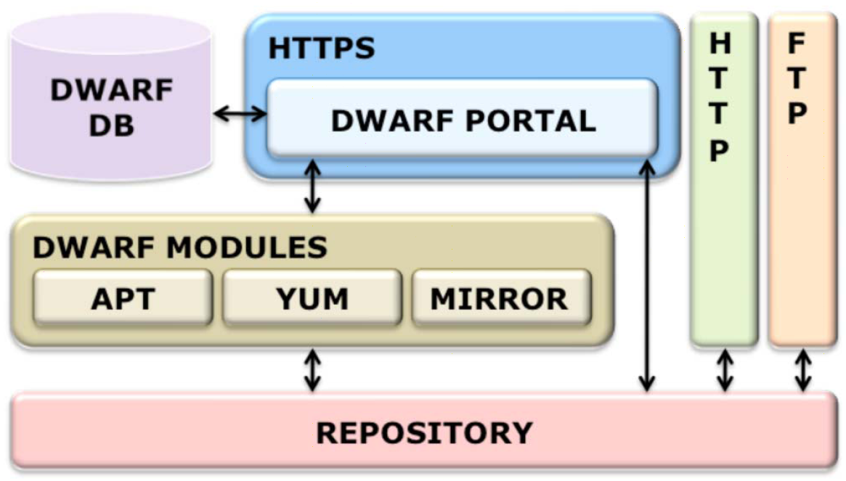
DWARF implementation (1/3)

Slide 25
DWARF implementation (2/3)
DWARF modules are implemented as bash scripts that handle build action on repositories
APT DWARF and YUM DWARF module
Analyzes RPM packages in a directory tree and builds information files so that that directory tree can be used as an APT or YUM repository
MIRROR DWARF module
Responsible for mirroring some existing software repository locally (Scientific Linux, gLite software, Ubuntu, community repositories (dag)…)

Slide 26
DWARF implementation (3/3)
The DWARF database
Realized using MySQL database technology
Contains information on:
Security
Repositories type
Repositories metadata
Mirrored repositories
Logging information

Slide 27
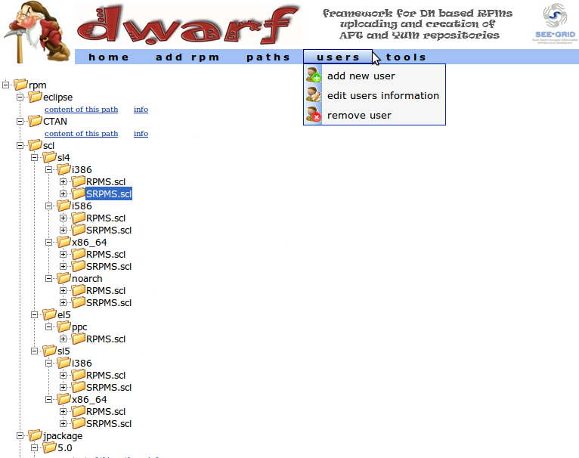
DWARF screenshoot

Slide 28
Useful links
WatG browser
https://http.ipb.ac.rs/tools/watg_browser/
Soon to be available for download as a JAR file that will be easily deployed under the Tomcat server
gFinger
https://http.ipb.ac.rs/tools/gfinger/
Source code and RPMs available for download
DWARF @ SCL: https://dwarf.scl.rs/
RPM @ SCL: http://rpm.scl.rs/

