Slide 1
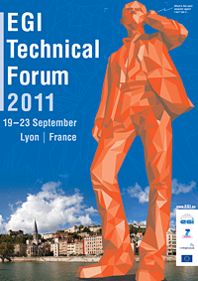
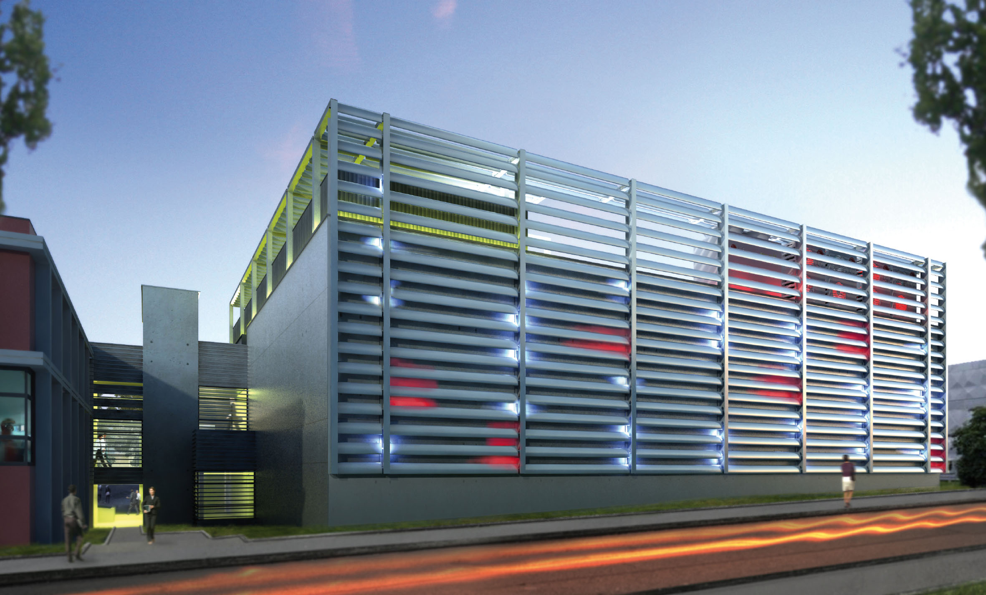
Grid Activity in France …
… from Grid to Clouds
Dominique Boutigny
September 20th 2011
Credits : Vincent Breton
Hélène Cordier

Slide 2
France Grilles brief history
2007
August: Creation of CNRS “Institut des grilles” (IdG) under Guy Wormser leadership
2008
National steering board: CNRS, CEA, INRIA, INRA, INSERM, Universities, RENATER and Ministry of Research
Goal: develop a sustainable French production grid organization integrated in the European framework
2009
Production grids are labelled TGIR (Very Large Research Infrastructure)
2010
End of EGEE-III project and EGI-Inspire Kick-off
September: France Grilles Scientific Interest Group Kick-off
2011
“Institut des Grilles” becomes “Institut des Grilles et du Cloud”

Slide 3
Resources of production grids in France
Users:
75% French
25% Outside France
Operations: 64 engineers in 23 sites
6
Lille
431
Strasbourg
1
Île de France (GRIF)
61
Brest
4
2
20
1
Nantes
54
70
130
Annecy
Clermont-Fd
(AuverGrid)
Lyon (TIDRA)
Number of cores
Storage (Toctets)
Grenoble
(CIGri)
4
40
Credit: Anne-Laure Derepas
Bordeaux
<100
<100
100-1000
100-1000
3
1000 - 10000
1000-10000
Toulouse
79
26
6
14
Montpellier
Marseille
> 10 000
> 10000
1
22.000 cores
15 PB storage
2
3
10
Nombre de certificats émis
En 2009
Notes:
Présenter Hélène Cordier et Gilles Matthieu

Slide 4
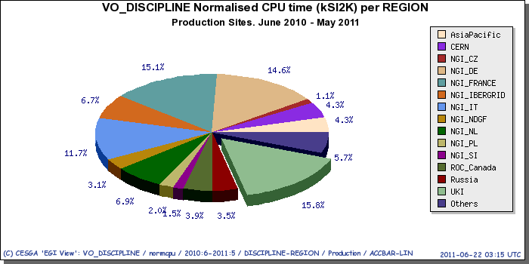
Usage of the Grid infrastructure in France
From June to May 2011 : 215 millions
of CPU hours (kSI2k) have been used
The second largest contributor to the European Grid Infrastructure (15%)
¾ of French grid resources are used by French researchers
A major contribution to the Data Processing and Analysis of the 4 LHC experiments
Grid is now becoming a major scientific instrument in several disciplines:
Life Sciences, Astrophysics, Complex systems, Earth sciences…
Still need to develop activity in
Chemistry
Theoretical physics
LHC analysis
Other fields

Slide 5
France Grille Management
Scientific Committee
Management Board
International Advisory Committee
High level
Executive Board:
F. Desprez (INRIA)
JP Meyer (CEA)
J. Montagnat (CNRS)
Director
V. Breton
Strong relationship with IT research
Applications supervisor
Technical Direction
Communication – training
Administrative manager
Quality manager
Security manager
Technical Committee

Slide 6
From Grids to Clouds
Virtualization technologies and Cloud model are now changing the landscape of intensive and distributed computing
The boundary between Grid and Clouds is fuzzy, both can be seen as complementary approaches which will coexist for some time
The grid model is extremely powerful for well structured collaborations (LHC Computing is a very big success)
Out of reach of other communities
Complex middleware – Difficulty to port applications to the Grid – Rigid hardware and software …
The Cloud model is a chance to overcome (at least partly) some of these difficulties
Grid → Virtualization → Elasticity → Cloud specific software services → …
Natural hierarchy : IaaS → PaaS → SaaS

Slide 7
The CAPRI project (1)
Call for proposals from the French Government for large scientific equipments : “Equipex”
1st call : 340 M€
2nd call : ~140 M€ for investments ⬅
Total 1 B€ for investment + operation cost
CAPRI is a proposal to build an academic cloud for scientific research and opened to Small and Medium Enterprises
7.6 M€ investment
CAPRI is strongly oriented toward Data Processing : DataScope(*) as proposed by Jim Gray and Alex Szalay (see Alex’s talk tomorrow)
New discovery and innovation emerge from analysis of large amounts of complex data generated by high-throughput instruments and observational systems
CAPRI is multidisciplinary
(*) http://research.microsoft.com/en-us/collaboration/fourthparadigm/4th_paradigm_book_complete_lr.pdf

Slide 8
The CAPRI project (2)
CAPRI is a distributed Cloud :
CC-IN2P3 – GRIF (Orsay + Saclay) – IPGP (earth science)
10 partners :
Production sites
Use cases community
Grid Institute
IT research
2 industrial partners working in software development
StratusLab
User-centric approach in close collaboration with data-intensive domain specialists
Work with specific communities ➔ build use cases
Open the platform to other communities as soon as we have working solutions
Biomedical applications (with a federation of Lyon research teams)
High Energy Physics
Seismology (VERCE project)
HPC medium size computing center

Slide 9
The CAPRI Project (3)
CAPRI will leverage on well established resource managers
Nimbus – Eucalyptus – OpenNebula …
and complete Cloud solutions like StratusLab – Contrail …
Strong link to IT Research (Grid’5000)
Most innovative approaches
CAPRI as a full scale production platform will provide metrics of interest for the IT research
CAPRI will implement standards and will contribute to their evolution
Platform built over a 4 year period:
15 000 cores
5.5 PBytes
High speed LAN
Rely on the high bandwidth RENATER network connecting the 4 sites

Slide 10
CAPRI in the global framework
Even if CAPRI is a French project it should articulate with other initiatives
➔ Session on EGI Virtualization roadmap after the coffee break
EGI federated cloud task force
WLCG is also making a shift toward virtualisation / Cloud
➔ CAPRI will be in phase with this
CAPRI will also consider middlewares developed within the industrial world ➔ Strong link between CC-IN2P3 and IBM (Montpellier – Haifa) ➔ Storage Cloud
If CAPRI is accepted ➔ Strong impact on CC-IN2P3 & GRIF focus, from almost pure HEP to a more multidisciplinary + SME target
This future change of focus seems to be seen in several large HEP centers ➔ opportunity to coordinate the efforts.

Slide 11
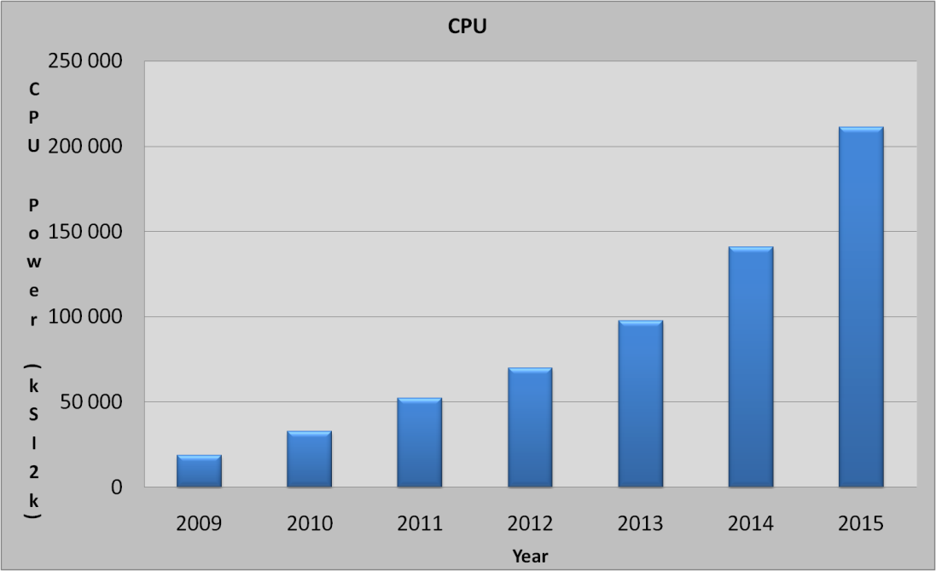
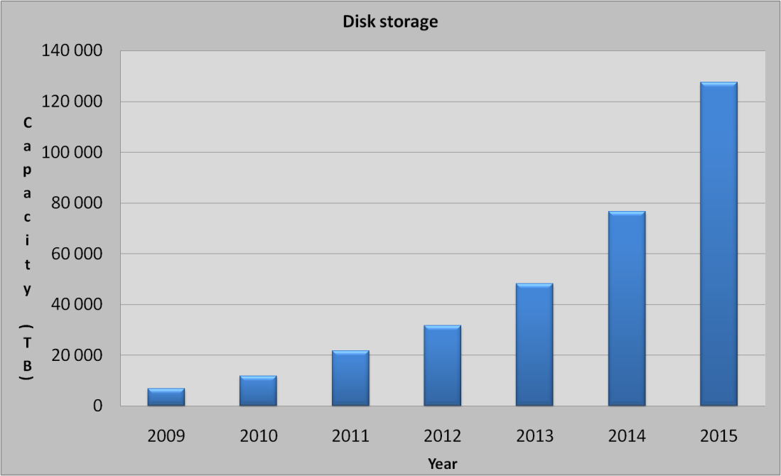
CC-IN2P3 New Computer Room
Next week we inaugurate our new datacenter
Modern and modular design in order to accommodate the data processing infrastructure for future experiments
sLHC – Astroparticle big projects (LSST – EUCLID)
Master piece for CAPRI
2011
50 racks
600 kW
2015
125 racks
1.5 MW
2019
220 racks
3.2 MW
On top of the existing 1 MW computer room
~ 80 000 today’s cores

Slide 12
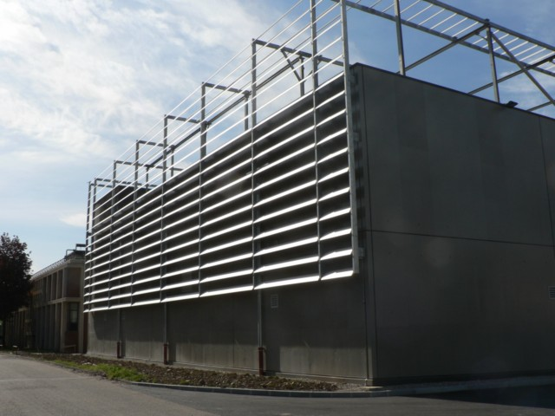
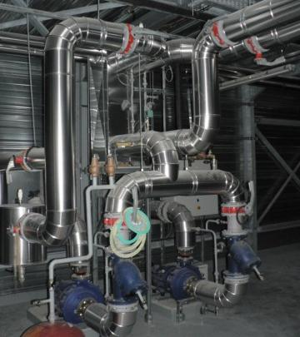
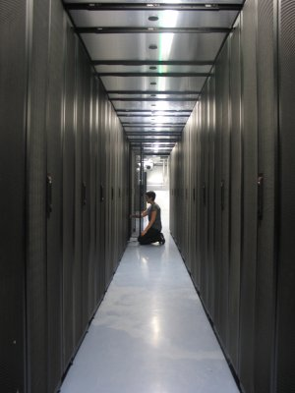
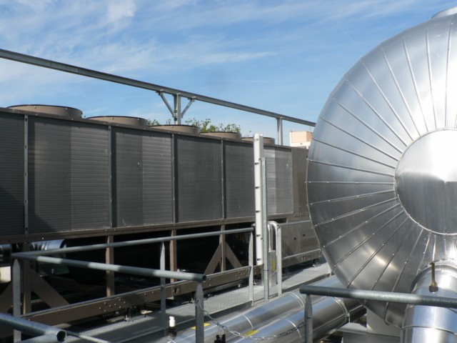
Visits of the new CC-IN2P3 datacenter are possible during the EGI-TF week

