Slide 1
StratusLab project
Update on service development and operations
Vangelis Floros, GRNET
EGI Technical Forum 2011
19-22 September 2011, Lyon, France
Notes:
Needs update

Slide 2
Presentation Outline
Project overview and status update
Advanced Grid service management – Site elasticity
Other use cases – MapReduce with Hadoop
Future work

Slide 3






StratusLab Project
Goal
  Create comprehensive, open-source,
  IaaS cloud distribution
  Support a wide range of use cases
Information
  1 June 2010—31 May 2012 (2 years)
  6 partners from 5 countries
  Budget : 3.3 M€ (2.3 M€ EC)
Contacts
  Site web: http://stratuslab.eu/
  Twitter: @StratusLab
  Support: support@stratuslab.eu
CNRS (FR)
UCM (ES)
GRNET (GR)
SIXSQ (CH)
TID (ES)
TCD (IE)

Slide 4
So far, so good…
Series of public/preview releases of StratusLab distribution
  Latest release: v1.1 (16 Sept. 2011)
  RPMs available from the StratusLab repo: http://yum.stratuslab.eu
  OpenNebula 2.2 virtual machine manager
  Claudia Service Manager
Public reference cloud service
  9 months of operation
  External users from various projects
  >3700 VMs instantiated
StratusLab Marketplace
  Searchable metadata of available VM appliances and base images: http://marketplace.stratuslab.eu
  Actual images stored and fetched from appliance repository: http://appliances.stratuslab.eu
1st Year Review
Successfully passed

Slide 5
StratusLab Architecture

Slide 6
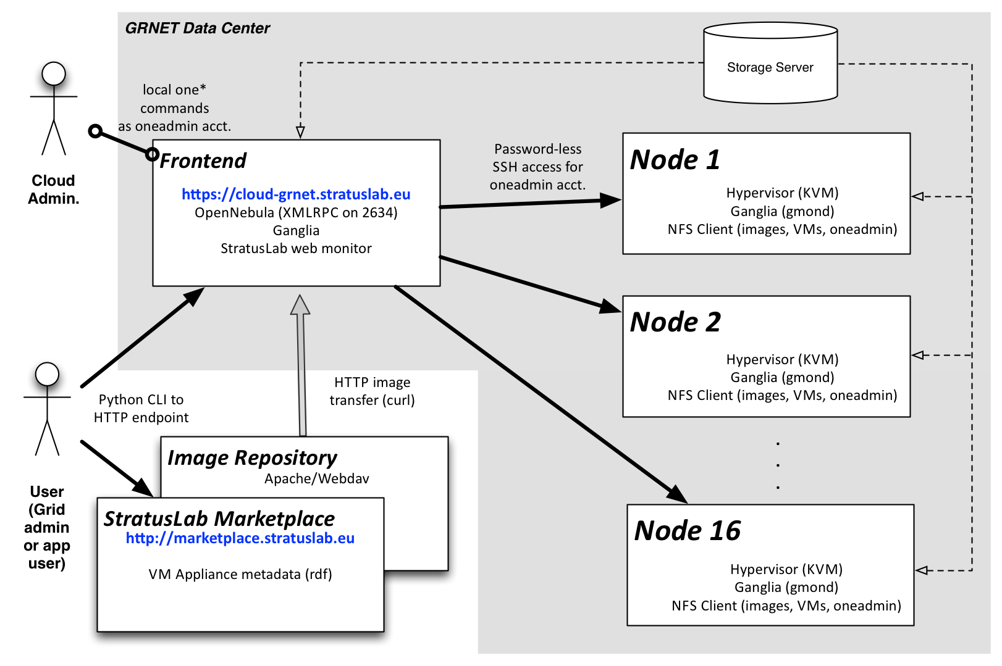
Reference deployment
Trinity College Dublin

Slide 7
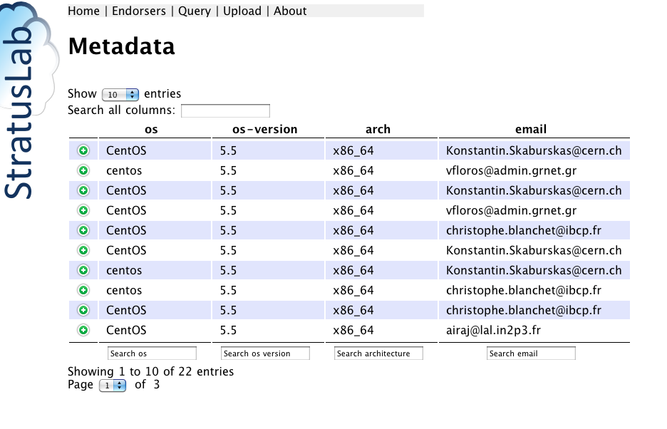
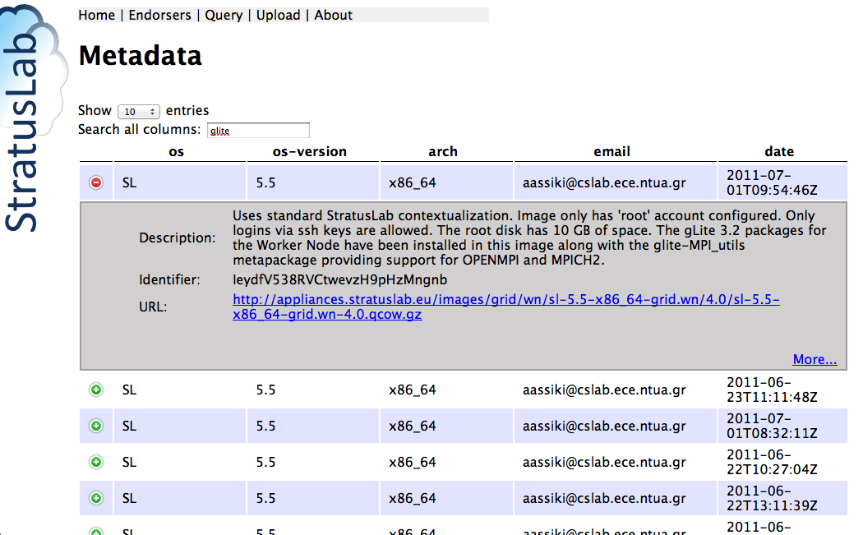
Marketplace and Appliance Repositories
  Developed by TCD and CNRS/LAL. Operated by TCD
  Integral part of the public cloud service
  Marketplace: Metadata for image appliances
  Repository: Online storage for VM images and appliances
  (referenced from the Marketplace metadata). Can be any any web accessible on-line storage.

Slide 8

Deploying a gLite grid site
Marketplace
Query metadata
CE image
WN image
SE image
UI image
APEL image
stratus-* cli commands
stratus-run-instance,
stratus-describe-instance,
stratus-kill-instance
VM Instantiation
SSH root access
IaaS Cloud Service running StratusLab distribution
CE instance
SE instance
Cloud Storage
WN instance
WN instance
WN instance
…
WN instance

Slide 9
Production grid site
HG-07-StratusLab: Virtualized production grid site running on StratusLab reference cloud service
Certified in Greek NGI, officially part of the national grid infrastructure
GStat details: http://gstat-prod.cern.ch/gstat/site/HG-07-StratusLab/
Resource allocation and support (Updated July 2011)
Doubled the provided processing capacity: 1 CE, 16 dual-core WNs, 1 SE (3TB of storage), 1 gLite-APEL monitoring node, 1 UI
Support added for 21 VOs including atlas, alice, biomed, compchem, esr etc.
13,960 jobs – 26,202 norm. CPU time. (Jul – Aug 2011)
Experience
Exhibited high availability (91%) and reliability (92%) numbers
Downtimes of cloud services impacting the grid site ➔Need a better way to manage cloud service upgrades

Slide 10
Grid site elasticity
What? Resize cluster capacity based on current workload
Add WNs when queues are getting full
Remove WNs when utilization drops below a certain threshold
Why? Exploit the elastic nature of the cloud
Reduce costs
Optimize utilization
Increase grid service availability
How? Exploit Service Manager and OVF
Prepare OVF file describing grid site/services and elasticity rules
Service Manager uses OVF to instantiate a complete site, monitor a set of user defined KPIs and dynamically adjusts the site size
Grid site uses OVF to extract yaim configuration information

Slide 11
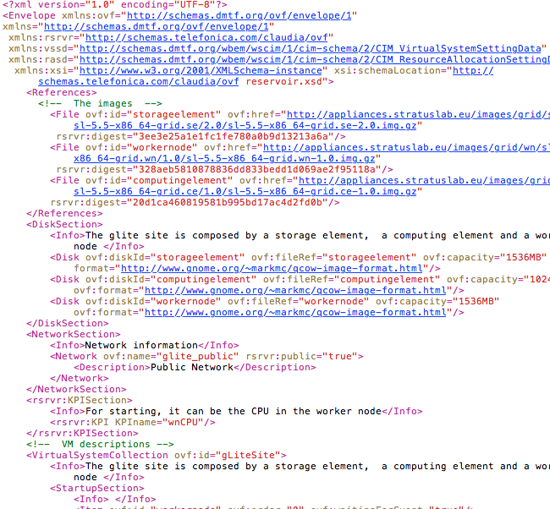
Deploying a gLite grid site with OVF and Claudia
OVF description
Marketplace
Query metadata
CE image
WN image
SE image
UI image
APEL image
VM Instantiation
Claudia Service Manager
IaaS Cloud Service running StratusLab distribution
CE instance
SE instance
Cloud Storage
WN instance
WN instance
WN instance
…
WN instance

Slide 12
Service manager and KPIs
Key Performance Indicator (KPI)
(Running_Jobs/Available_CPU_Slots) * 100
Elasticity rules:
Scale-up: If KPI > 80 % increase the size of the site by 20%
Scale-down: If KPI < 20 % decrease the size of the site by 20%
Lazy scale-down: Apply the scale-down rule with a delay in order to give time for new jobs to arrive and avoid useless resizing.

Slide 13
Service Manager/CE integration
Cloud Frontend
Cloud Backend (Hosting Node)
Service
Manager
Computing Element (VM)
OVF File
OVF Parser
Site definition/configuration
(e.g. yaim configuration files)
wnMonitor
KPI monitoring
Torque Master
probe
REST API
Scalability actions
lbserver
Job Queues
OpenNebula

Slide 14
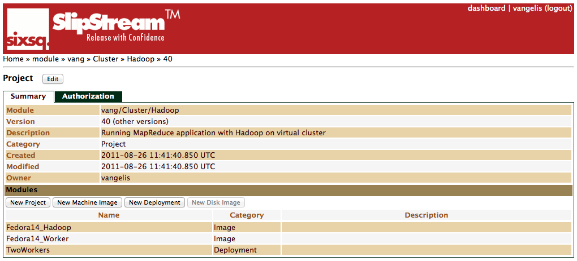
Other use cases – Hadoop Cluster
Marketplace
Created appliance with Hadoop and JDK installed
Pre-configured for 1 master - N worker setup
User only defines the list of workers (file prepared when using stratus-run-cluster command)
Stratus-run-cluster configures the site for password-less ssh logins
Also implemented with SlipStream
Hadoop Appliance
stratus-run-cluster
Master (JobTracker. NameNode
Worker (TaskTracker, DataNode)
Worker (TaskTracker, DataNode)
Worker (TaskTracker, DataNode)
Worker (TaskTracker, DataNode)
Worker (TaskTracker, DataNode)
Cloud service
Image transfer
& VM Instantiation
Tutorial: http://stratuslab.eu/doku.php/tutorial:mapreduce

Slide 15
Conclusions
StratusLab 1.1 released.
Reference cloud service – stable production environment for cloud applications
Production grid site fully functional on reference cloud
Beta-testing elastic grid site functionality. Planning to move it to the production grid site in the coming months.
Targeting more use-cases, platforms and applications (e.g. MapReduce)

Slide 16
Credits
Stuart Kenny, David O'Callaghan, TCD
  Marketplace design, programming and operation
Henar Munoz Frutos, Diego Perez Fabado, TID
  Claudia integration. OVF support and development
Nassia Assiki, Christina Mpoumpouka,
  Grid elasticity services development
Cal Loomis, LAL/CNRS
  Marketplace design
  … and all the developers and administrators of the StratusLab project!!!

Slide 17
For more information…
StratusLab wiki: http://www.stratuslab.eu
Support mailing list: support@stratuslab.eu (also for requesting access to the reference cloud service)
Marketplace: http://marketplace.stratuslab.eu
Appliance Repository: http://appliances.stratuslab.eu
Git (source code): http://code.stratuslab.eu/public/git/
Package repository: http://yum.stratuslab.eu

