Slide 1


Clouds in grids using CLEVER
University of Messina
Andronico Giuseppe, Monforte Salvatore, Puliafito Antonio
and
Massimo Villari
Dr. Massimo Villari
mvillari@unime.it

Slide 2
Outline
Briefly about Cloud
Introduction, Challenge and Opportunities
Cloud Middleware: details on CLEVER
CLEVER and GRID: motivations, the design and implementation
CLEVER deplyment on GRID
Conclusions and Future Work

Slide 3
Why Cloud Computing?
IT resources on demand just like public facilities
New business models and market opportunities.
Pay-per-use model.
The major trends are:
  IT Efficiency. Companies are minimizing costs, converting them from capital expenses to operating expenses through technologies such as virtualization Business Agility. Companies can maximize their return using IT as a competitive weapon through the rapid time to market, by mean of integrated application stacks, instant machine image deployment, and parallel programming
Real Benefits to get
Cost reduction-optimization
  Server consolidation, resources reuse
  Time to market optimization
  Green computing
Business Models
  Pay per use
  Pay as you go
  Subscription
High Flexibility

Slide 4
Different subsequent stages for Cloud Computing market
1) Monolithic: (now !!!!), cloud services are based on proprietary architectures - islands of cloud services delivered by megaproviders (this is what Amazon, Google, Salesforce and Microsoft look like today).
2) Vertical Supply Chain: some cloud providers will leverage cloud services from other providers.
The clouds will be proprietary islands yet, but the ecosystem building will start.
3) Horizontal Federation: smaller, medium, and large providers will federate horizontally themselves to gain: economies of scale, an efficient use of their assets, and an enlargement of their capabilities.
T. Bittman, The evolution of the cloud computing market, Gartner Blog Network,
http://blogs.gartner.com/thomas bittman/2008/11/03/the- evolution-of-the-cloud-computing-market/, November 2008.
Notes:
http://blogs.gartner.com/thomas bittman/2008/11/03/the- evolution-of-the-cloud-computing-market/, November 2008

Slide 5
The pillars of CC
Separation
  Cloud computing providers lease resources on pay-per-use basis but do not expose infrastructure details to customers or partners
  Cloud computing consumers use leased resources without exposing details of their applications to providers
Isolation
  Given the hosting nature of cloud computing providers, consumers need mechanisms and warranties that their application are isolated from others that are being hosted in the same infrastructure
Elasticity
  Cloud computing providers should automatically adjust the resources allocated to a particular application according to “elasticity rules” provided by cloud computing consumer
Federation
  To overcome the finite amount of resources available locally, cloud computing providers should be able to collaborate among themselves and share their resources

Slide 6
goals to be addressed
Easy Management
  Low level of configuration (ZeroConf)
  Easy deployment: large scale datacenters
  Extendibility
Scalability
  Strong distributed approach
Elasticity
  Live Migration
Federation
  Site discovery
  Dynamic aggregation
Security
  Authentication and Authorization of overall modules compounding the system
System logs
  Monitoring of all phases: start-up, stop, migration etc.

Slide 7
Cloud Federation
We characterizes three types of Clouds
  Open (free contribution)
  Commercial (by charge)
  Hybrid (open/commercial)
The clouds can interoperate
A federation is composed of two or more Clouds that interoperate according to specific rules
A Cloud federation has different access points for users interaction

Slide 8
A Cloud Middleware Model: the stack
Public
Cloud
Partner
Cloud
Cloud Manager
Virtual Infrastructure Manager (VIM)
Virtual Machine Manager
B. Sotomayor, R. Montero, I. Llorente, and I. Foster,
“Virtual infrastructure management in private and hybrid clouds,” Internet Computing, IEEE, vol. 13, pp. 14–22, September 2009.
Notes:
B. Sotomayor, R. Montero, I. Llorente, and I. Foster,
“Virtual infrastructure management in private and hybrid clouds,” Internet Computing, IEEE, vol. 13, pp. 14–22, September 2009.

Slide 9
Virtual Infrastructure managers
They are appearing in literature, some of them can be listed as follows:
  OpenNebula.
  OpenQRM.
  Nimbus.
  Eucalyptus.
  …
Two main philosophies:
Apply the virtualization model to simplify the management of proprietary datacenters.
Reorganize the previous distributed computation middleware for accomplishing an easy management of virtualization capabilities.

Slide 10
Openstack initiative
The goal of OpenStack is to allow any organization to create and offer cloud computing capabilities using open source software running on standard hardware. OpenStack Compute is software for automatically creating and managing large groups of virtual private servers. OpenStack Storage is software for creating redundant, scalable object storage using clusters of commodity servers to store terabytes or even petabytes of data. It uses the shared nothing (SN) philosophy in which the architecture is fully distributed where each node is independent and selfsufficient, and there is no single point of contention across the system.
Canonical has recently announced:
For Ubuntu, OpenStack, and not Eucalyptus will make up the
core of the Ubuntu Cloud.

Slide 11
Design of a new vim: clever
CLEVER: A CLoud-Enabled Virtual EnviRonment:
To simplify the access management of private/hybrid clouds
To provide simple and easily accessible interfaces to interact with different “interconnected” clouds, deploy Virtual Machines and perform load balancing through migration.

Slide 12
Design of a new vim: clever
The pluggable design:
  integrating security,
  contextualization,
  VM disk image management
  federation functionalities
It is able to grant:
  high scalability,
  Modularity
  flexibility in the middleware architecture,
  fault tolerance requirements are also satisfied.

Slide 13
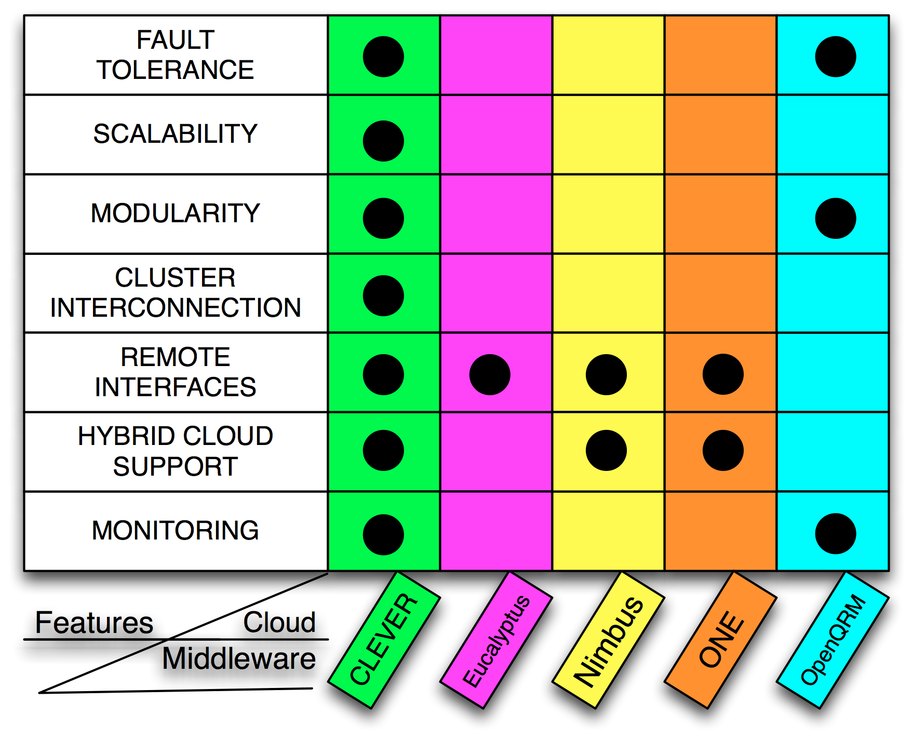
Vim: Summary comparison

Slide 14
Inter-host Communication and Security
HM-CM Communication Protocol over XMPP, main features:
Open Source Communication Protocol
peer2peer approach
Auto setup through the DHCP discovery
Inband Registration
Firewall pass-through

Slide 15
XMPP
The base protocol used for XMPP is RFC 2779 (Instant Messaging /Presence Protocol Requirements).
Presence and Instant Messaging
Presence – Presence is a means for finding, retrieving, and subscribing to changes in the presence information (e.g. "online" or "offline") of other users.
Instant Messaging – It is a means for sending small, simple messages that are delivered immediately to online users.

Slide 16
Requirements of RFC 2779
Scalability
Access Control
Message Encryption & Authentication
Presence Lookup & Notification
Presence Caching & Replication
Reliability
Performance
XMPP Overview
XMPP is an open protocol for streaming XML elements in order to exchange messages and presence information in close to real time.
XMPP has been implemented via a typical client-server architecture, wherein a client utilizing XMPP accesses a server over a TCP socket.
Notes:
Scalability - The protocol must be able to meet its functionality and performance reqs even if there are millions of entities in a domain and there are millions of such domains.
Access Control - Who can watch an entity presence info and who can subscribe to that entity etc.
Message Encryption & Authentication - Ensure confidence that a received message has not been corrupted or tampered.
Presence Lookup & Notification – Even when the entity is offline, the fetcher shld be able to fetch the enity’s presence info.
Presence Caching & Replication - Presence info to be cached and be updated when the master copy changes.
Reliability - Sender shld be informed of successful delivery or reasons of failure.
Performance - Transport of the message shld be instant.

Slide 17
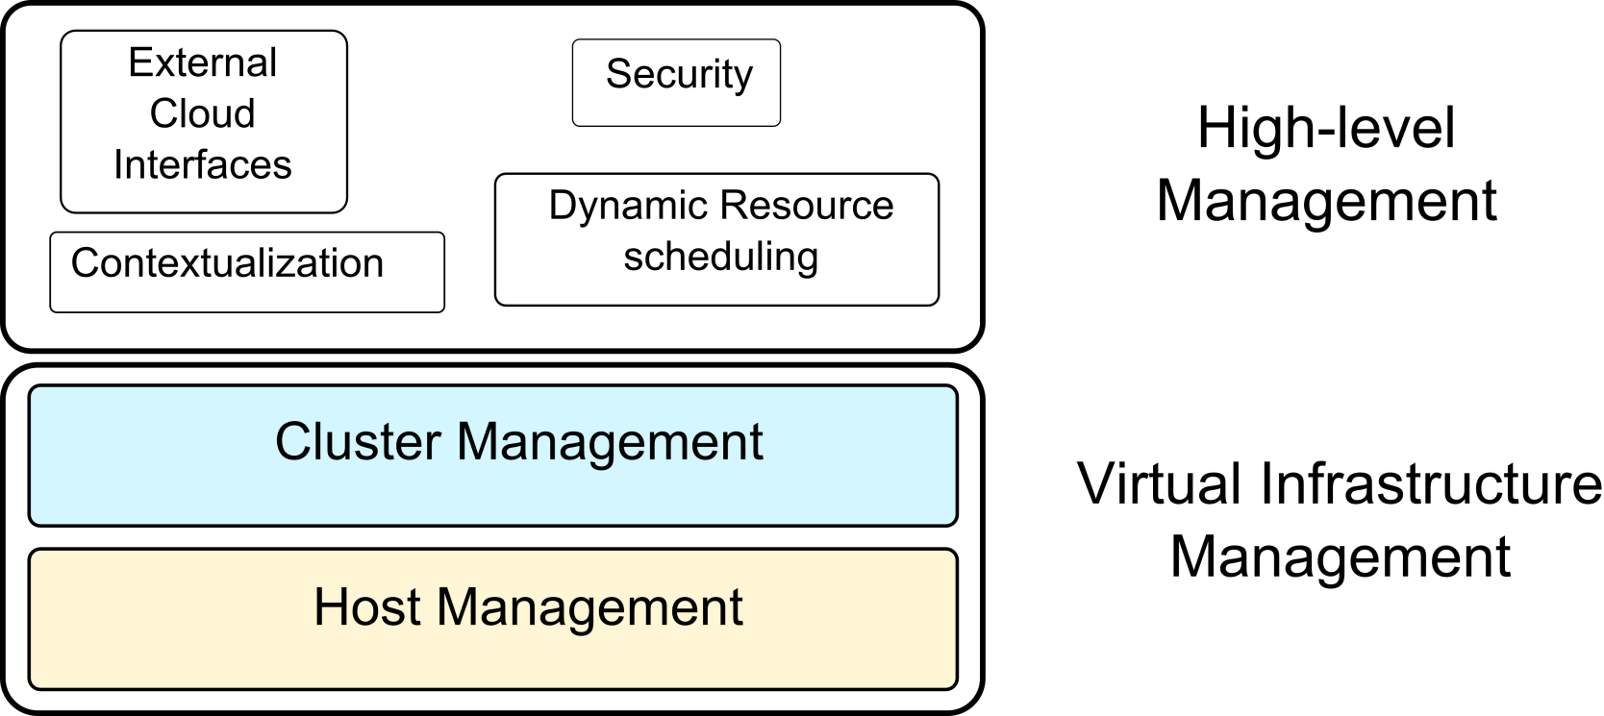
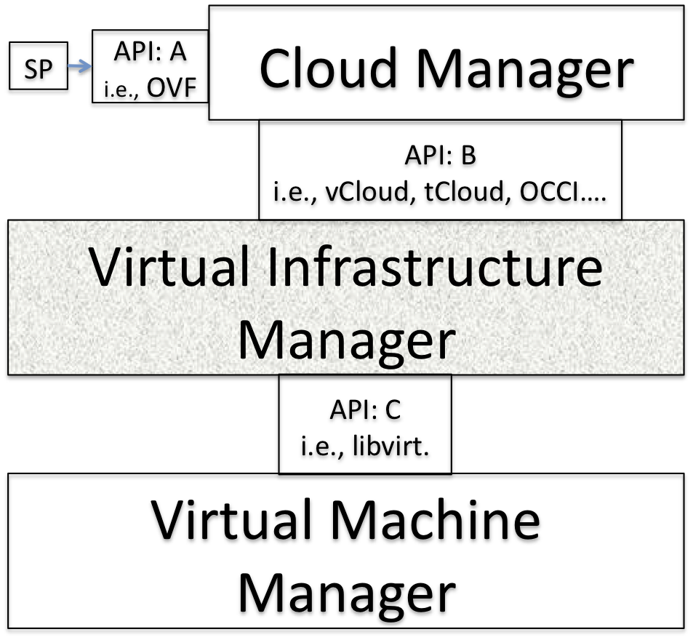
Virtual execution environment: CLEVER
Clever stack
CLEVER aims at the design of a VI management layer.
CLEVER provides accessible interfaces exploitable from higher levels.
The high level management layer could include interfaces for enabling Cloud Management interaction (i.e.,Cloud Orchestrator)
17

Slide 18
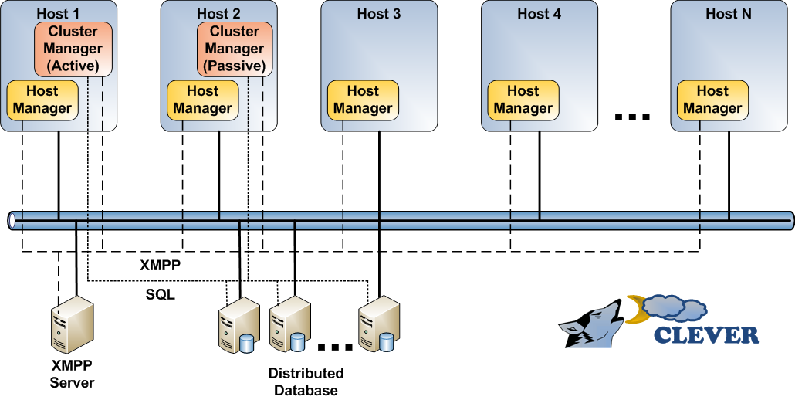
Virtual execution environment: CLEVER
Host Management Layer: Host Manager
  Performs physical resources monitoring and VEs allocation
Cluster Management Layer: Cluster Manager
  Monitoring the overall state of the cluster, “coordinates” HMs
External components: XMPP Server and Distributed Database
XMPP advantages: host presence, open standard
Central failure point does not exist: fault tolerance mechanism with multiple CM instances

Slide 19
Clever architecture: the added values
Inter host (inter cluster) Communication: p2p
Zero configuration: ZeroConf
Monitoring
Security
Fault Tolerance
System Logs: Apache Log4J
Distributed Database: Sedna (XML-based)
Storage: Virtual Distributed Technology
Communication XMPP:
  Fault Tolerance: pool of JABBERDs
  Networking: Firewall Crossing
  Logging of overall communication and actions
  Open Protocol
  Protocol Intrinsic Security

Slide 20
Clever architecture: the added values
Zero configuration: ZeroConf
  Wizard Installation: common steps
  Minimal requirements: S.O. and environment (Java)
    All in a JAR file.
  XMPP InBand Self Registration:
    User name
    Email address
    Certificates
  Pluggable approach:
    Module auto loading at bootstrap phase
    Runt-time module loading
    Inter process communication: JMS, D-BUS

Slide 21
Clever architecture: Scenario and..
HOW IT
WORKS

Slide 22
CLEVER on GRID: motivations
Grid technology continues to dominate public sector and scientific computing environments.
New interests have raised in deploying cloud technology on grid-enabled resources to improve the management and reliability of those resources via the virtualization layer.
Integrating a Cloud in a Grid adopts the Cloud paradigm to strengthen its security with the robust federated identity and access management architecture of Grids.

Slide 23
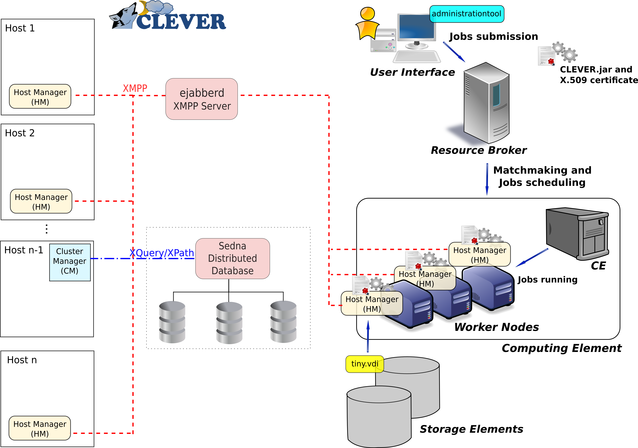
CLEVER on GRID

Slide 24
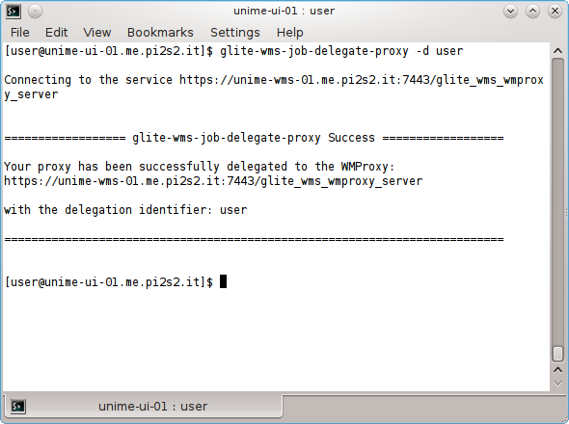
Clever: the deployment
authentication phase:
the voms-proxy-certificate has been created

Slide 25
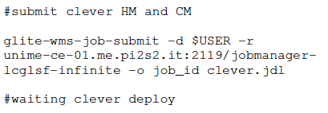
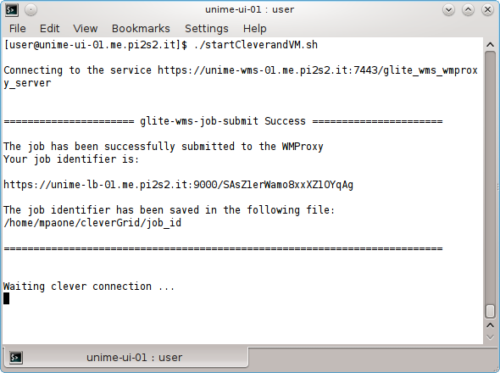

Clever: the deployment
CLEVER
Main JAR file
Clever.jar

Slide 26
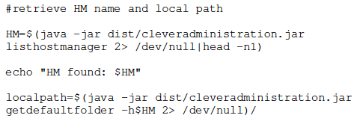

Clever: the deployment
CLEVER
SHELL
Cleveraministration.jar

Slide 27
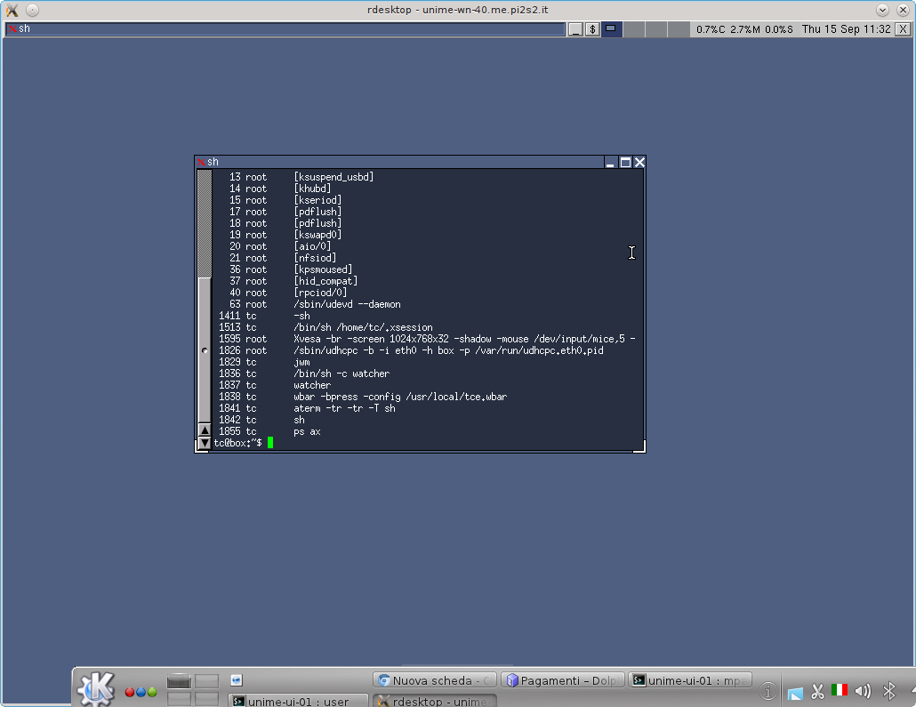
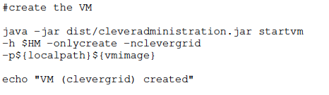
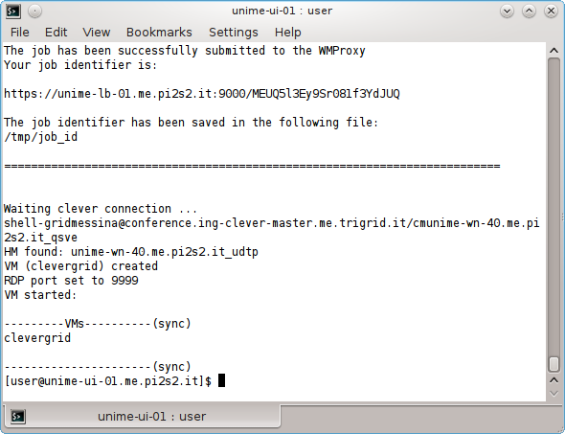
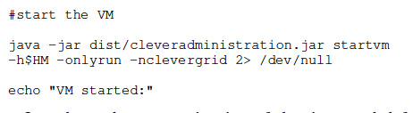
Clever: the deployment

Slide 28
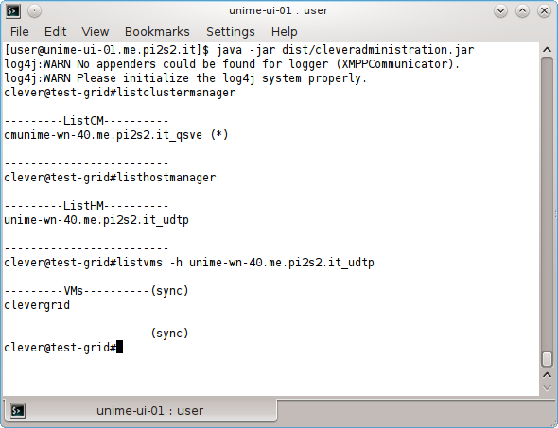
Clever: the deployment
CLEVER
SHELL
Cleveraministration.jar
i.e.: listclustermanager

Slide 29
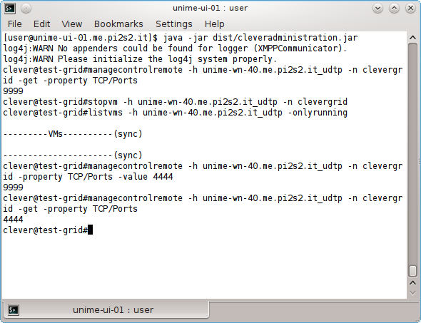
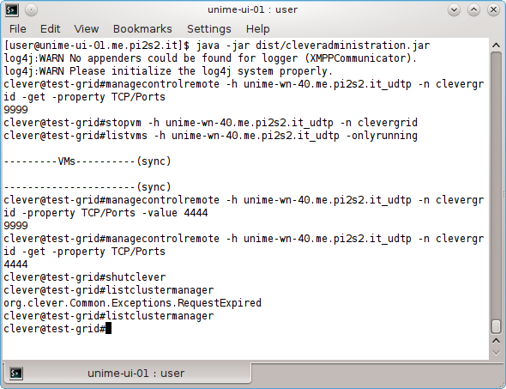
Clever: the deployment

Slide 30
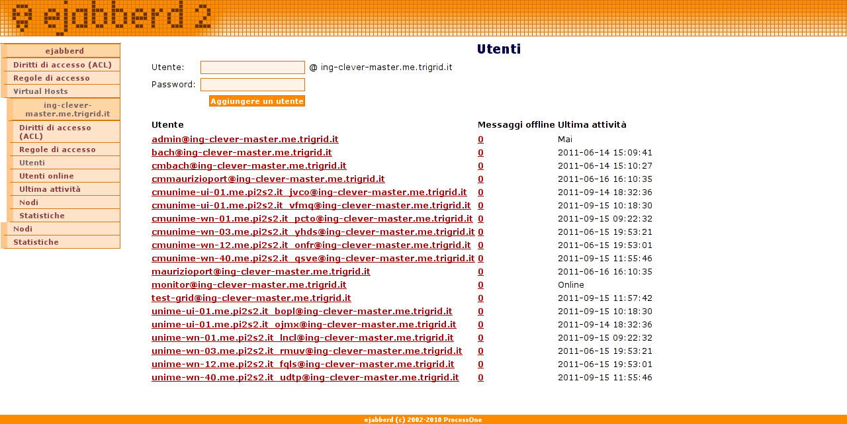
XMPP server: ejabberd2

Slide 31
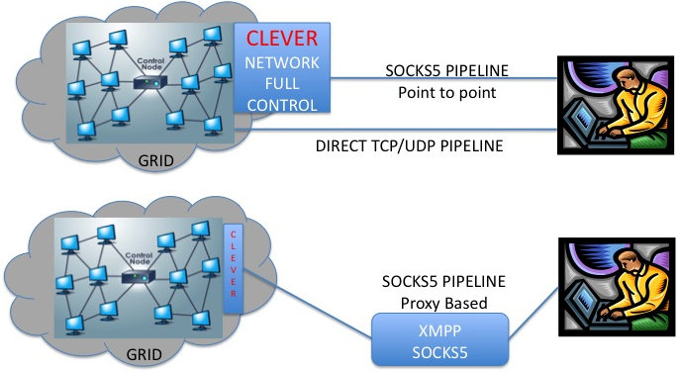
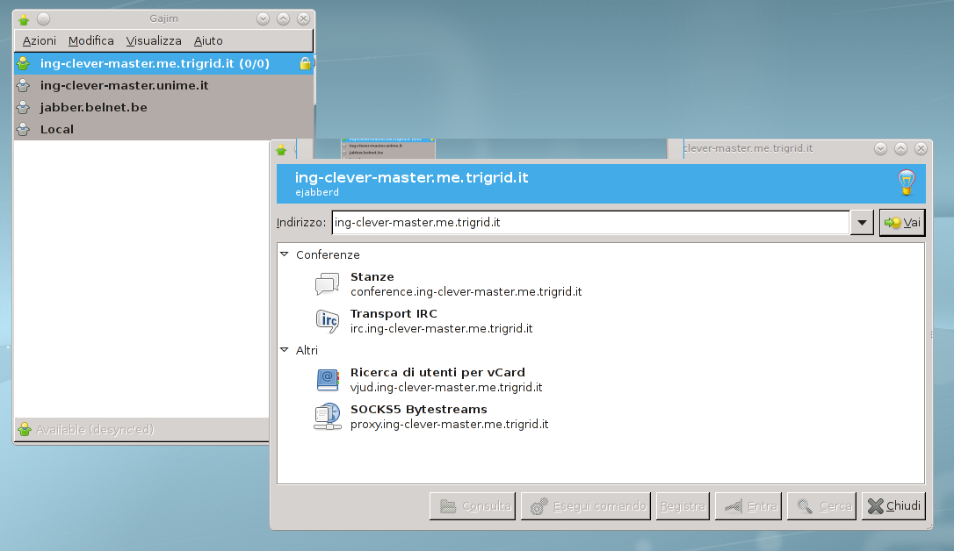
XMPP client

Slide 32
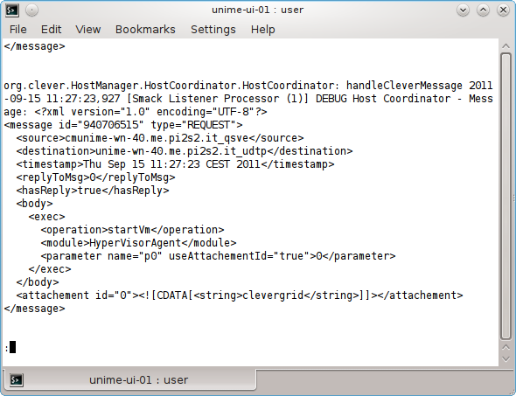
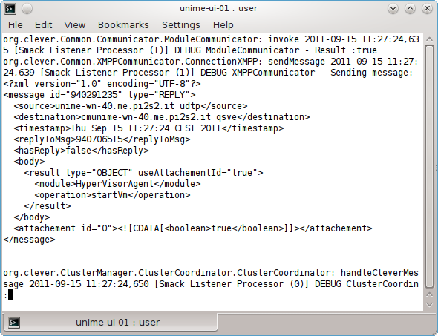
XMPP communication: logs

Slide 33
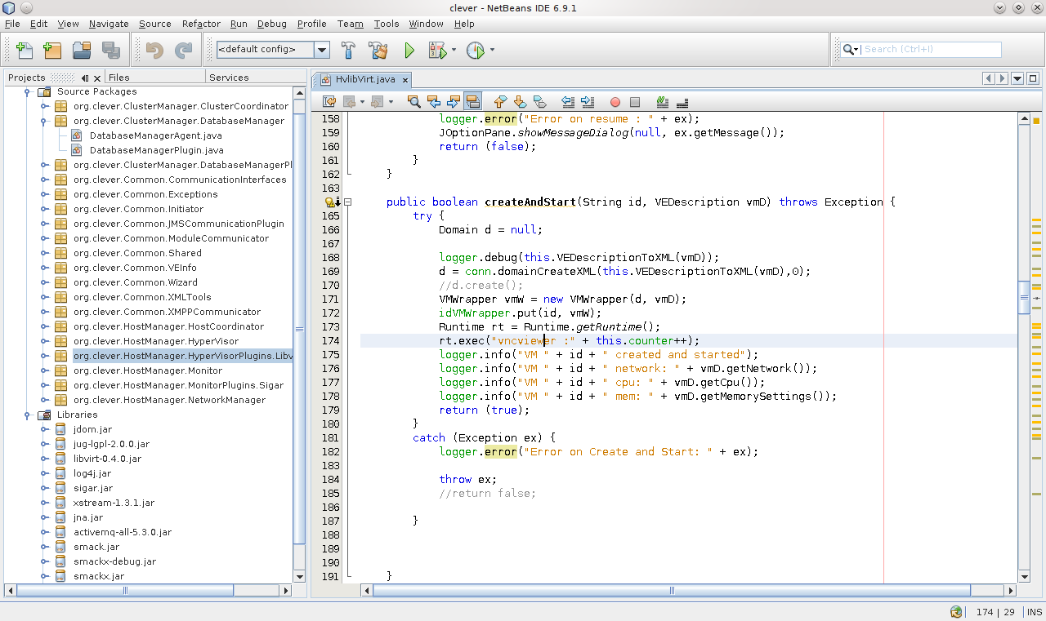
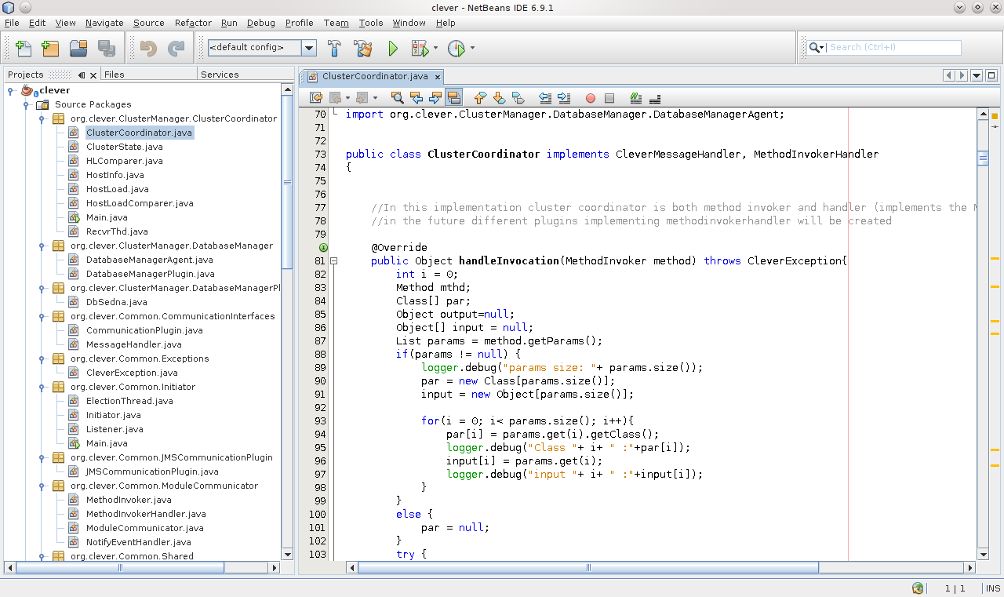
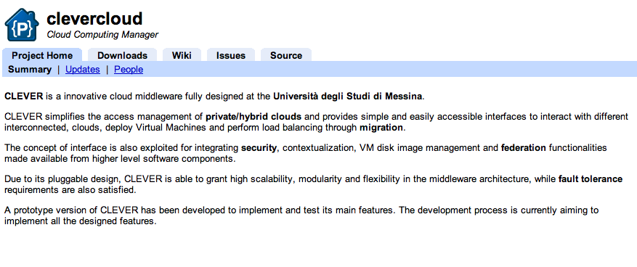
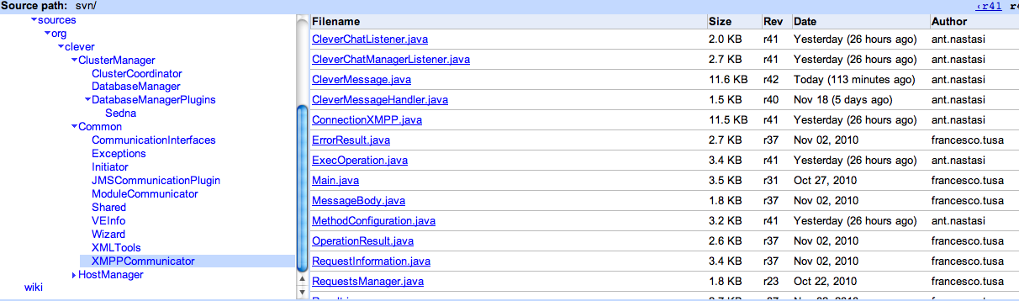
Clever architecture: the IMPLEMENTATION http://cclab.unime.it/
http://code.google.com/p/clevercloud/

Slide 34
Conclusions and Future Works
Development of more modules of CLEVER
Using Certificates X509 of GSI (in-band registr.)
Adding new features: i.e. SOCKS5 - firewall crossing for end-users
Evaluating the performance on GRID of communication modules, database and monitoring parts

Slide 35
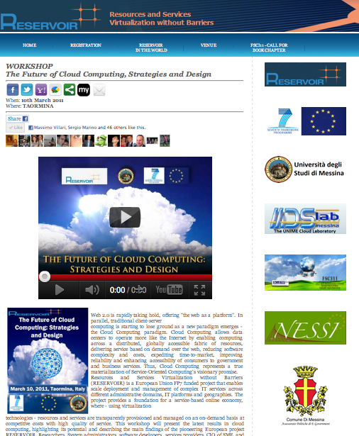
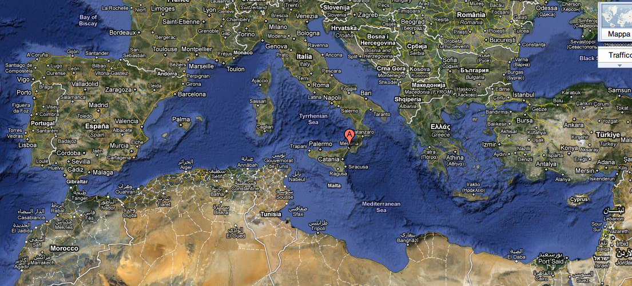
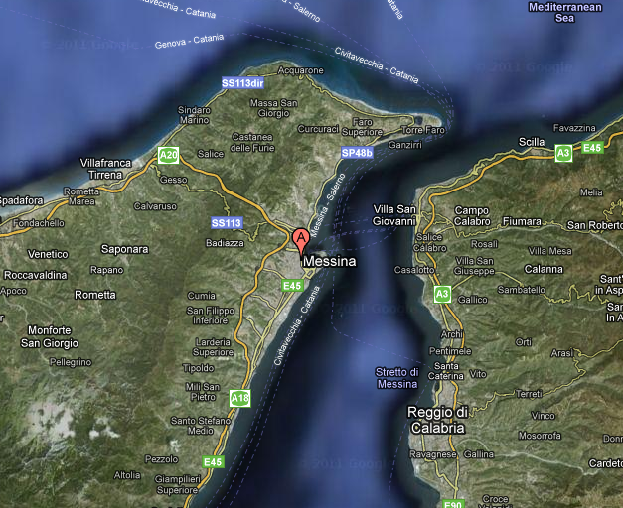
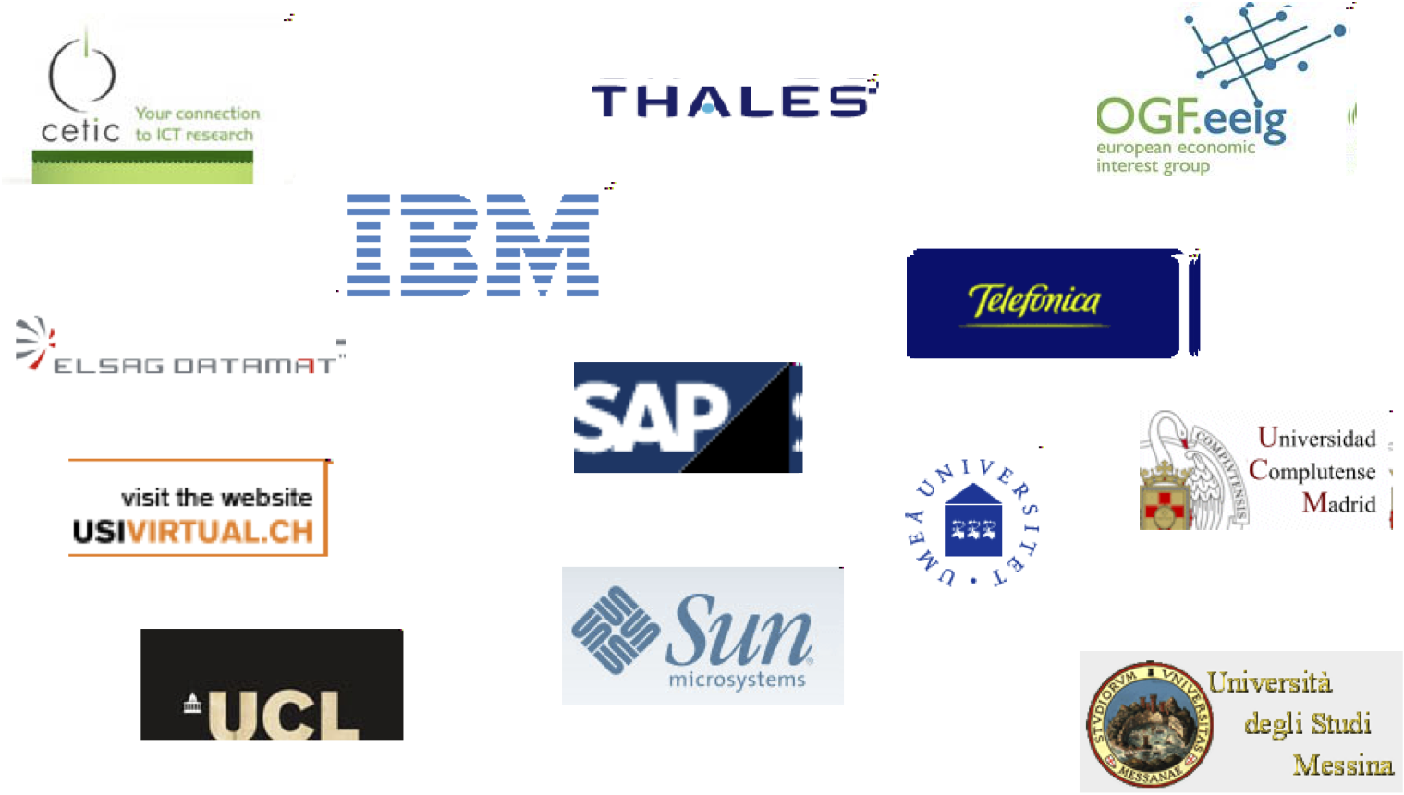
Why cloud In UNIME? (University of messina)
RESERVOIR
7fp: cloud (2008-2011)

Slide 36
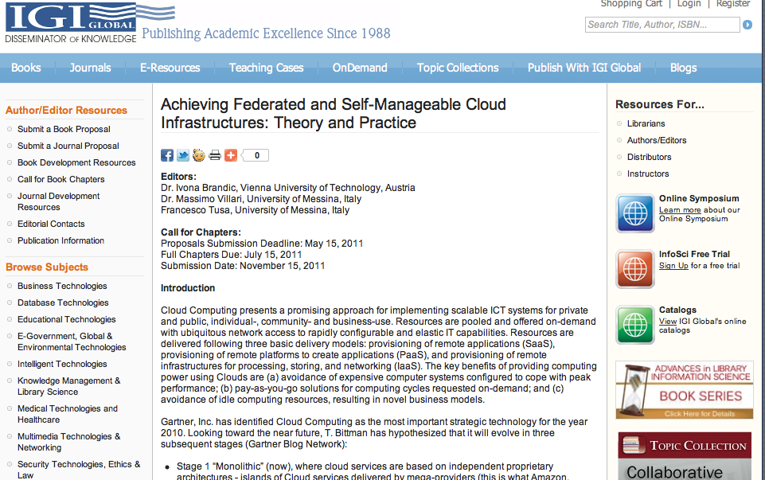
Why cloud In UNIME? (University of messina)
VISION-CLOUD
7fp: cloud storage
Participant no. * | Participant organisation name | Part. short name | Country
1 (Coordinator) | IBM Israel - Science and Technology LTD | IBM | ISRAEL
2 | SAP Research | SAP | Germany
3 | Telefónica Investigación y Desarrollo | TID | Spain
4 | Siemens AG | SAG | Germany
5 | Engineering | ENG | Italy
6 | National Technical University of Athens | ICCS/NTUA | Greece
7 | Deutsche Welle | DW | Germany
8 | RAI-Radiotelevisione italiana Spa | RAI | Italy
9 | Umeå University | UMU | Sweden
10 | SNIA Europe | SNIA | UK
11 | Telenor | TN | Norway
12 | France Telecom | FT | France
13 | Swedish Institute of Computer Science | SICS | Sweden
14 | University of Messina | UniMe | Italy
15 | iTricity B.V. | iTricity | Netherlands

Slide 37

?
Prof. Massimo Villari (mvillari@unime.it)
University of Messina, Italy
Thank you

