Slide 1
EMI Interoperability Activities
Alberto Di Meglio
Project Director
EGI Technical Forum 2011
Lyon, 19-23 September 2011

Slide 2
Interoperability Challenges
Interoperability among different grid infrastructure is affected by:
Differences in interfaces and semantics of the grid services and clients
Differences in tools and policies for AAA
Different job description and submission methods
Different data access protocols and mechanisms
EMI is working on addressing some of these issues

Slide 3
Security and Resource Access
Main issues:
The use of certificates by end-users is not trivial and is considered a duplication wrt existing commonly used AA methods like Shibboleth or Kerberos
Different grids use different ways of describing the authorization assertions and managing the communication between PEPs and PDPs

Slide 4
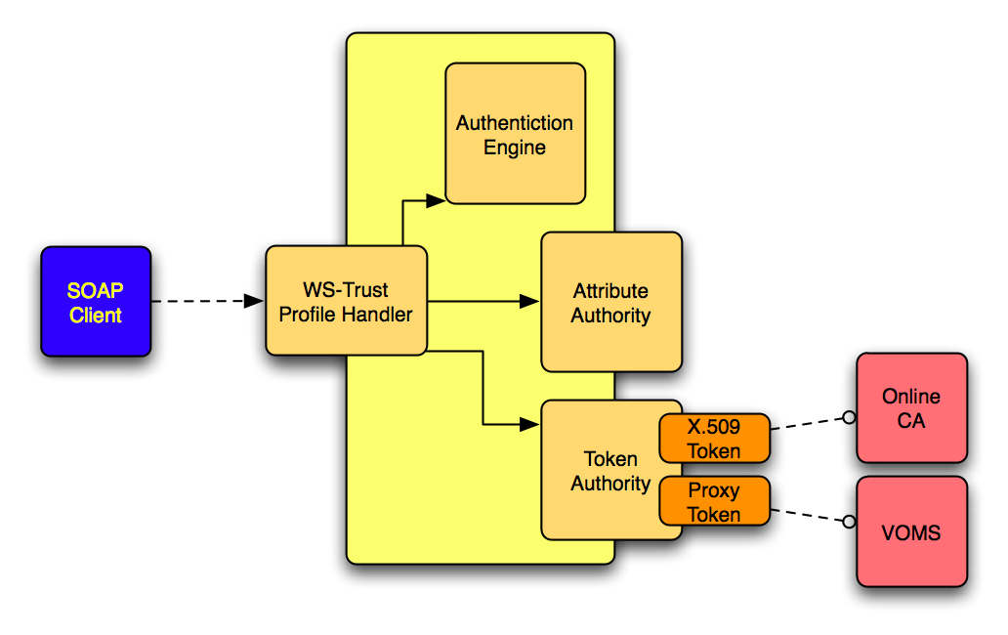
Security Tokens Service (STS)

Slide 5
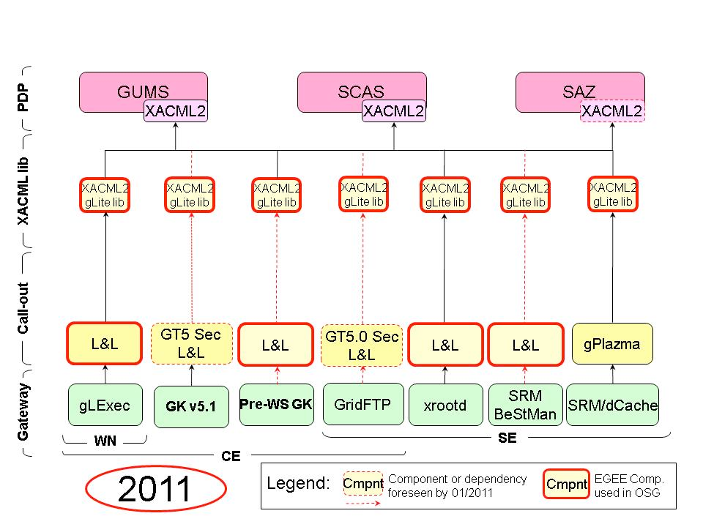
SAML-XACML
Argus

Slide 6
Computing Job Management
Main issues:
Different descriptions of a “job”
Different submission mechanisms
Different workflows definitions and management

Slide 7
Job Management Interop
OGF OGSA-BES (2004-2008)
Implemented by UNICORE, ARC, gLite CREAM and Globus and others, often incomplete, extended or non-compliant
Limited features compared to proprietary interfaces
JSDL (Job Submission Description Language) (2005)
More used, but considered limited, improvements needed
OGF PGI WG (2008-today)
Tasked to improve on BES, work still in progress, EMI long term goal to adopt the proposed standard interfaces
EMI Execution Services (2010-today)
Not a standard, but defined and being implemented by ARC, gLite and UNICORE together, potential to be proposed to OGF PGI for open standardization

Slide 8
Harmonised Clients and Libraries
The MW collaborations within EMI are working on a set of common clients and libraries for the main grid functions
During the course of next year the following products will be released:
security (EMIAuthlib)
data access libraries (EMIDataLib)
computing (EMI ES compliant clients)
standardized accounting records

Slide 9
User Support
Grid interoperability requires also user support systems interoperability
EMI is fully integrated in the GGUS system for all its services
Single access point
measurable performance based on SLAs

Slide 10
Grid and Cloud
Two major contributions to the ongoing grid/ cloud integration activities
Investigation of how existing EMI services can be used in support of the federated cloud infrastructure (authentication, authorization, service registration and discovery , dynamic configuration)
Creation of appliances for the major EMI services

Slide 11
Model 4: Virtual grid services
Grid services
Users
Site admins
Grid Appliances
CEs
Virtualization Managers
Grid nodes

Slide 12
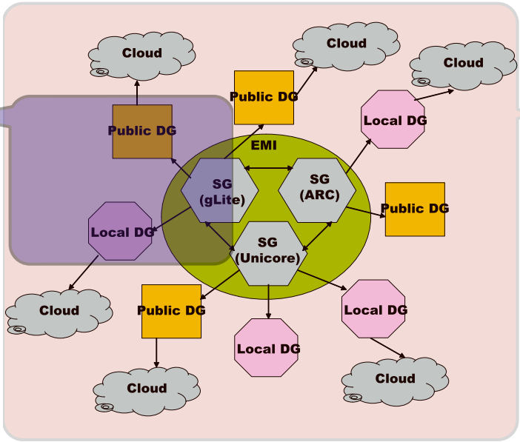
Grid and Volunteer Computing
Bridge
Bridge
Bridge
Bridge

Slide 13
Thank you
EMI is partially funded by the European Commission under Grant Agreement INFSO-RI-261611

