Slide 1
Security Monitoring
Daniel Kouřil
EGI-TF 2011

Slide 2
Overview
Nagios
Pakiti
Security dashboard
Plans

Slide 3
Pakiti
Pakiti v3 prototype deployed for evaluation purposes
Mainly data collection
Scalable enough so far (over 11 000 reports)
History kept
OVAL-based evaluation under development

Slide 4
Nagios
Probe changes
CRL
Fixed compatibility with 2 hashes in CA distribution
Fixed timestamp substitution algorithm
Pakiti-client
Updated to version 3
Torque
Added more checks to avoid reporting “UNKNOWN”
Migration from org.sam.sec to eu.egi.sec
The probes are no longer gLite specific
Added support for ARC sites

Slide 5
Current coverage support
Computing Element capability
Monitored (681 endpoints)
CE (gLite) (304 endpoints)
CREAM-CE (gLite) (356 endpoints)
ARC-CE (ARC) (21 endpoints)
Not monitored (8 endpoints)
gLite-CE (dead?) (5 endpoints)
GRAM5 (globus) (1 endpoint)
unicore6.TargetSystemFactory (unicore) (2 endpoints)
Actual monitored entities
573 hosts
4552 services

Slide 6
Nagios - plans
Support for other middleware
Unicore
Globus
Probe other capabilities (?)
SE, LFC
VOMS
….

Slide 7
Security dashboard
A pilot produced and updated according to feedback
Collects results from Nagios and Pakiti and provides their visualations
Further discussions planned this week

Slide 8
Security dashboard - functions
Access control
Aauthorization based on GOC DB and EGI SSO in order that security staff access only data in their own scope (EGI / NGI or site )
Overview
Visualize security problems
Summarized by ngi or site
Summarized also by tests
With historical details provided within a chart
permalinks to access directly to the desired information
Possibility to create /update notepads :
with a mail to Site Security Officer
with a template adapted to the current problems on the site
Pith the possibility to visualize the status of the related problems

Slide 9
Metrics - Generate dynamically metrics with the choice of :
format : table or charts
ngi or site
testname
type of metrics : number of issues or sites
possibility to save charts (csv, pdf , jpg )
Events
Possibility to declare / delete events : rotation declaration , monitoring downtimes …
Remaining work
Extension of the notepad to tickets into RT

Slide 10
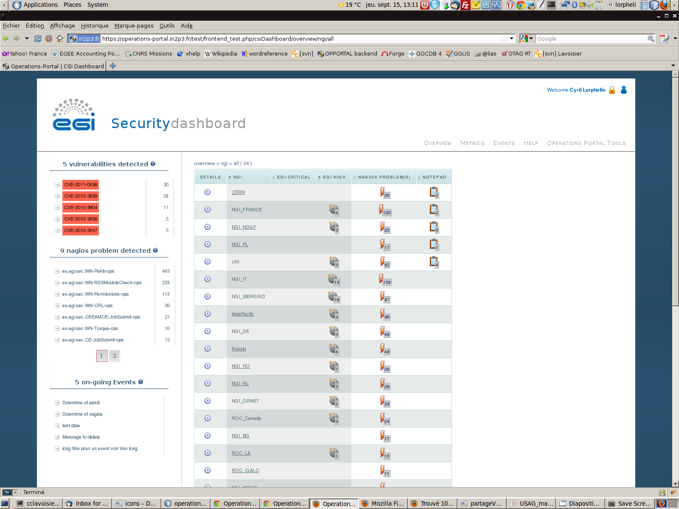
Overview

Slide 11
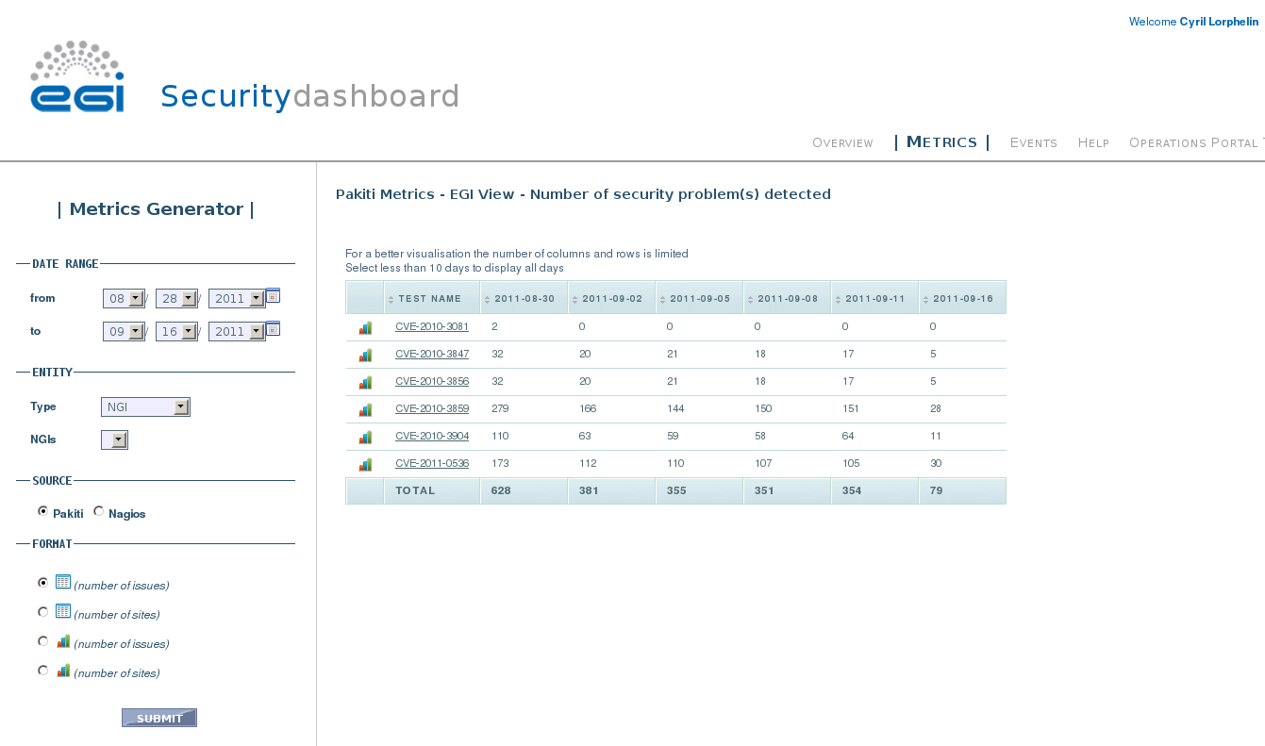
Metrics

Slide 12
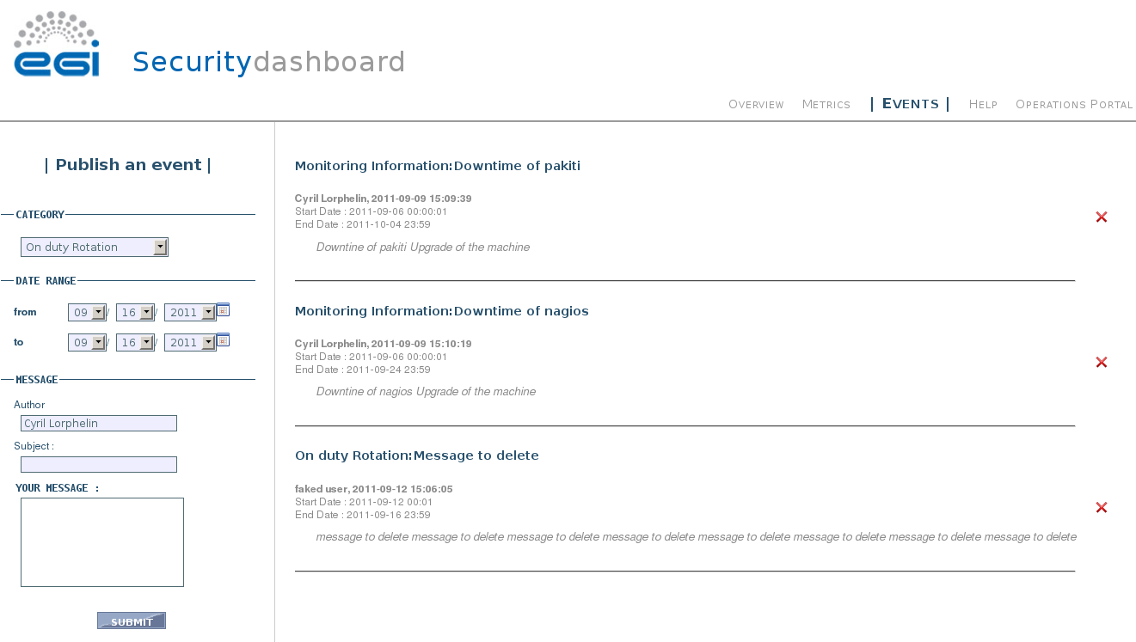
Events

Slide 13
Security dashboard utilization
All NGI security contact to check issues in the NGI and follow up
Several goals:
Cleaning up the dashboard
Testing the operations procedures
Defining crucial alarms
Spotting false alarms, problems in probes, etc.
A wiki page with pointers will be published shortly

Slide 14
Discussions
Site-wide monitoring
SWAT – a meeting scheduled
Explanation – draft at the wiki
Nrpe ?
Integration with operations procedures
Meeting (?)
GGUS access control

