Slide 1
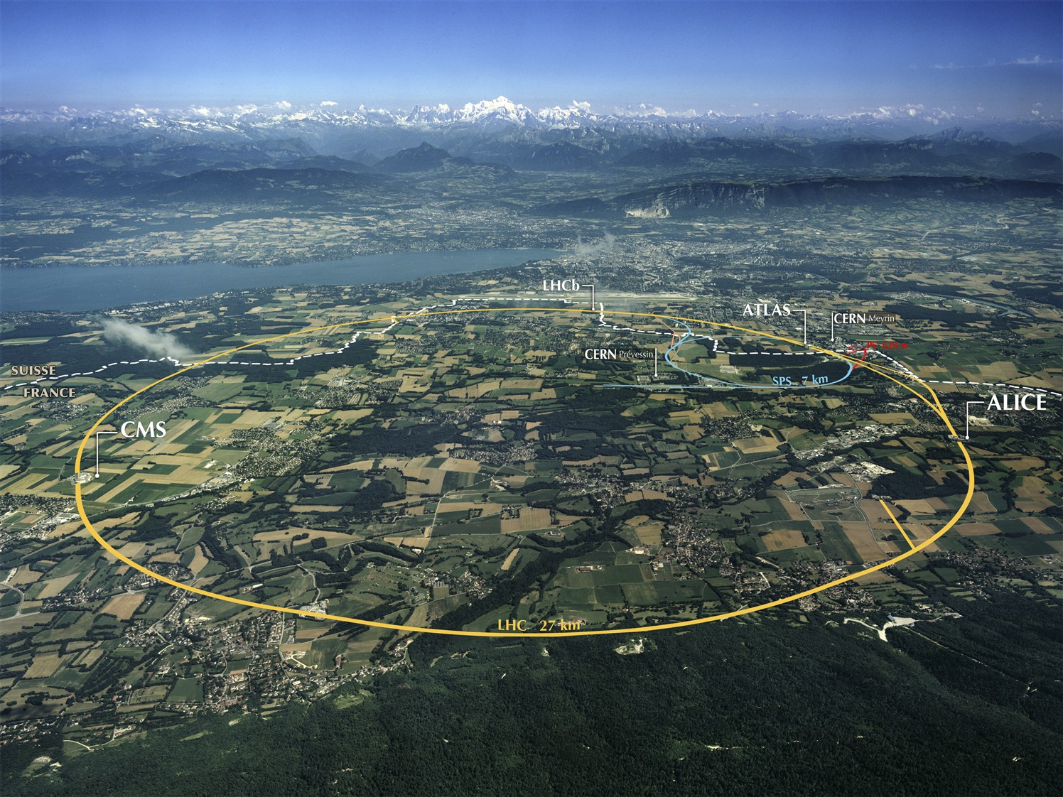
WLCG:
Input on Sustainability
presented by Bob Jones, IT dept, CERN
based on material provided by
Ian Bird, CERN
WLCG Project Leader
Accelerating Science and Innovation
Notes:
1

Slide 2
Introduction
LHC Computing has a sustainability plan: this is called “WLCG”
The collaboration was explicitly constructed as the long term organization to manage and evolve LHC computing
Expected to last at least the lifetime of LHC (>20 years)
Collaboration through an MoU between CERN (LCG project and experiments) and 50 funding agencies
Current MoU runs until end 2012, then renewed automatically in 5-year slots
Collaboration is world-wide – Europe is only one (large) part
Resources are pledged to experiments as part of the MoU

Slide 3
WLCG User Community
The WLCG user community is large (> 10,000)
BUT:
EGI (and OSG, etc) are mostly invisible to them: the users interact with experiment computing frameworks which then use grid services
Main concerns of the users are: reliability and availability (of services and resources)
The WLCG & EGI relationship is complex
Long standing (goes back 10 years)
Heavy User Community / Resource Provider / Service Development & Support

Slide 4
EGI-Inspire and sustainability
WLCG regards the EGI-Inspire project as a transition from project funding (EGEE-like) to a long term model
Recognises, today many sites rely on some level of project funding
Agree that the NGIs and EIROs need to be more engaged in non-technical activities
Would like to see a self-sustaining European e-infrastructure that can be relied upon to provide key operational services
Injections of EC (or other) funding to allow specific targeted developments or evolutions

Slide 5
WLCG and NGIs
Many Tier 1 and Tier 2 sites depend on the national organisations for services and support
In many cases WLCG sites provide NGI services
Strong and successful national infrastructures will help ensure a sustainable grid service for WLCG sites
WLCG works with funding agencies and grid sites
Sites may coordinate via their NGI
WLCG should use EGI to talk to all NGIs (rather than individually)
EGI.eu should provide the central coordination of the national infrastructure providers

Slide 6
Role of EGI.eu
EGI must have a global view
Resources pledged to WLCG by funding agencies, in Europe are (mostly) operated as part of the EGI grid
NB. Other grids have similar roles – e.g. OSG in US
Interoperability and cooperation are essential
EGI provides services to WLCG
GGUS, Monitoring, Accounting, Security coordination, and other operations activities
WLCG willing to work with EGI on dissemination tasks

Slide 7
Technology providers
WLCG will define how it needs to evolve, in consultation with experiments, sites, infrastructure providers (EGI, OSG, etc.) & technology providers
Will discuss needs for technology with providers
Should not be limited to a particular provider, should be able to mix and match:
Who can deliver to a specific requirement
Issues of support and sustainability should be part of evaluation
Open source licensed sw should have an open approach – anyone can contribute

Slide 8
Billing & Charging
Not appropriate for large communities such as WLCG that bring resources to EGI (funding agencies pay for resources to the LHC experiments) – thus charging for their use is not possible
EGI vision/mission is to federate resource contributed by user communities.
The most common commercial cloud use case involves procuring resources – not contributing them.
These are two fundamentally different approaches. But in the end the user community has to commit – resources or cash or both

Slide 9
Suggestions
Stay technically relevant
Branch-out from a niche market
Virtualisation and cloud services need to be incorporated into the infrastructure – Task Force is a good starting point
Adopt not invent!
New user communities are more likely to embrace clouds than grids
They have not made the investment in grid mware and will want to use other means of accessing resources
Allow integration of academic/public sites with commercial service providers
Give users the choice
Support interoperability

