Slide 1
Business Models & EGI Sustainability
EGI.eu Policy Development Team

Slide 2
Evolving IT Landscape
Innovative business models are emerging
e.g. for cloud computing
New industries are replacing old
e.g. New media (online, smart phones) vs. traditional (newspapers)
Upstarts are challenging the old guard
e.g. Facebook vs. MySpace; Apple vs. Microsoft

Slide 3
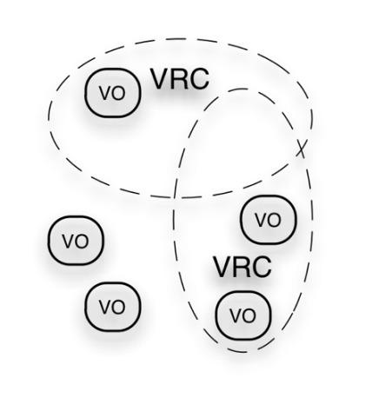
EGI Ecosystem
User Community
Policies + Funding
Requirements + Feedback
Services + Support
Service & Resource Providers
Requirements + Feedback
Public Funding Bodies
Policies + Funding
Requirements + Feedback
European Commission
EGI.eu
Technology Providers
Open Source Providers
National Research Councils
Resource Infrastructure Providers
Strategic Feedback
Technology + Support
Commercial Providers
Policies + Funding

Slide 4
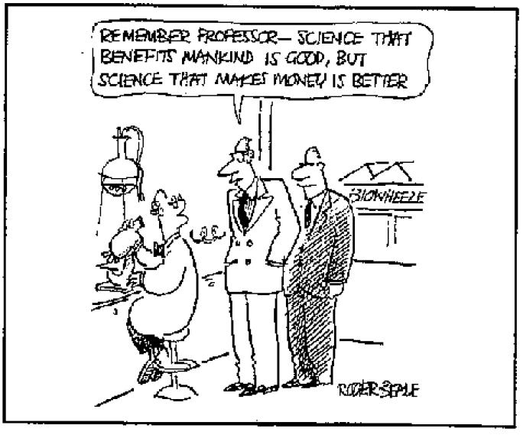
What is a Business Model?
The rationale of how an organisation creates, delivers, and captures value sustainably
Value Propositions
Newness: Researchers conduct their analysis in more effective ways.
Performance: Optimises IT infrastructure utilisation.
Cost Reduction: Maximise utilisation through multi-tenancy.
Convenience: Improves collaboration by sharing applications, best practices, training material, etc.
Source: Business Model Generation
(used also in Wikipedia) http://www.businessmodelgeneration.com/

Slide 5
Routes to Sustainability
Broaden usage by offering new services
Expand market
Deliver a unique service to the customer
Niche market
Provide cost effectiveness services
Mass market
Provide value to national/European funders
Direct public funds

Slide 6
The Way Ahead…
Moving out of our comfort zones
Changing for services previously free?
Examining what needs to be sustained
How can a service be sustained and by who?
Sustaining the EGI ecosystem
We are as strong as our weakest part!
Across EGI as a whole:
Strategy → Plan → Implementation
Check back at the Community Forum 2012

