Slide 1
Intro to Business Models &
EGI Sustainability
Sy Holsinger
Policy Development Officer, EGI.eu
sy.holsinger@egi.eu

Slide 2
Content
Objectives
Context
EGI Sustainability Plans
What is a Business Model?
EGI in the Business Model Canvas
Summary

Slide 3
Objectives
Introduce the components of a business model
Provide a context for how business models apply to EGI and have direct impact on sustainability
Encourage NGIs/EIROs to develop their own business model for providing grid services
  Through outlining a model by which to follow and related information

Slide 4
Evolving IT Landscape
Today, countless innovative business models are emerging
  e.g. cloud computing
Entirely new industries are forming as old ones fade
  e.g. New media (online, smart phones) vs. traditional (newspapers)
Upstarts are challenging the old guard, some of who are struggling feverishly to reinvest themselves
  e.g. Facebook vs. MySpace; Apple vs. Microsoft
So ask yourself:
  How do you imagine your organisation’s structure around distributing computing might look two, five or ten years from now?
  Will you/it still be here?
  What would you need to change to ensure your relevancy?
EGI / NGI Sustainability

Slide 5
Sustainability
Bottom line = Coordinating and maintaining a world-class infrastructure costs time and money
Time to:
  Increase the flexibility of the infrastructure to broaden user communities
    Integration of clouds and virtualisation, HPC infrastructures
  Continue to move from a project-based model
    Funding to focus on research and innovation
    Prepare application for ERIC Organisational Model
    Define business models for long-term financial sustainability of EGI
  Ensure sustainability of NGIs
    Directly engage ministries and national research councils
    Be better positioned with a detailed strategy

Slide 6
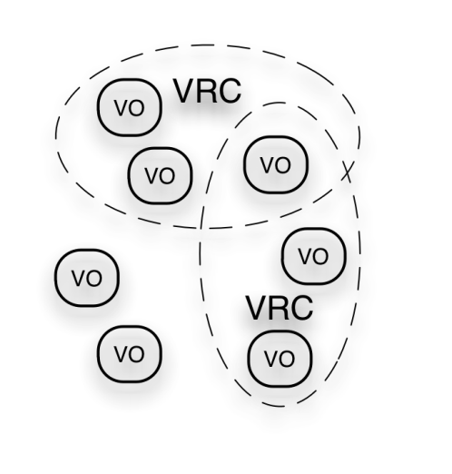
EGI Ecosystem
User Community
Policies + Funding
Requirements + Feedback
Services + Support
Service & Resource Providers
Requirements + Feedback
Public Funding Bodies
Policies + Funding
Requirements + Feedback
European Commission
EGI.eu
Technology Providers
Open Source Providers
National Research Councils
Resource Infrastructure Providers
Strategic Feedback
Technology + Support
Commercial Providers
Policies + Funding

Slide 7
Provider to Consumer
What are the relevant provider to consumer relationships in the EGI ecosystem?
Tech. Provider to User Communities
Tech. Provider to EGI Collaboration
EGI.eu to NGIs/EIROs
EGI.eu to User Communities
NGIs to User Communities
NGIs to Resource Centres
Resource Centres to User Communities
EGI Collaboration to User Communities
For each of these provider-consumer relationships, one or more business models should be defined

Slide 8
Who/What needs to be sustained?
Who
  The EGI Collaboration/Partnership
    NGIs/EIROs
    Resource Centres
    EGI.eu
  User Communities
  Technology Providers
What
  EGI Service Portfolio
How?

Slide 9
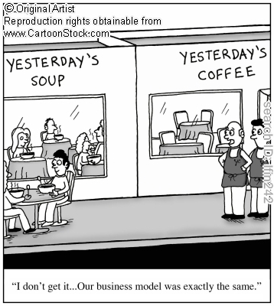
What is a Business Model?
Every organisation has a business model, including non-profits.
To survive, every organisation that creates and delivers value must generate enough revenue to cover its expenses.
Definition:
The rationale of how an organisation creates, delivers, and captures value sustainably
    Source: Business Model Generation
    (used also in Wikipedia) http://www.businessmodelgeneration.com/

Slide 10
How do we describe a Business Model?

Slide 11
Where to start?
Customer Segments – Who do you serve?
Value Propositions – What do you solve or satisfy?
Channels – How is it delivered and communicated?
Customer Relationships – Interactions?
Key Resources – What is needed to provide X?
Key Activities – Performing what / Must dos?
Key Partnerships – Suppliers / External expertise?
Cost Structure – All costs incurred equal what, where?
Revenue Streams – Pricing / Collection mechanisms?

Slide 12
1. Customer Segments
Who do you serve?
  Mass Market (e.g. consumer electronics)
  Niche Market (e.g. car part manufactures)
  Segmented – branch/arm of industry (e.g. precision instruments – medical, military, watches, tools)
  Diversified – 1 company two different sectors (e.g. Amazon.com / AWS)
  Multi-side Platforms - joins two different customer groups (e.g. Visa, Newspapers, Google – card holders/merchants; consumers/advertisers)
EGI Collaboration: Niche Market
(computing needs for science and research)

Slide 13
2. Value Propositions
What do you solve or satisfy?
  Newness, Performance, Customisation, Design, Brand, Price, Cost /Risk Reduction, Convenience, Accessibility, Usability
EGI (just a few examples)
  Newness: Researchers conduct their analysis and run computations in new and more effective ways
  Performance: Optimises IT infrastructure utilisation for both responsiveness to dynamic workloads and economy of scale
  Cost Reduction:
    Shares the cost of expensive resources while obtaining more compute power
    Reduces costs as a result of improved efficiency and smarter capacity planning
  Convenience: Improves collaboration with other researchers by sharing applications, best practices, training material, etc.

Slide 14
3. Channels
How is it delivered and communicated?
  Direct: e.g. in-house sales/marketing
  Indirect: e.g. website, promotional material
  Partner: e.g. using network for expanded reach
 | Awareness | Evaluation | Purchase | Delivery | After Sales
Direct Indirect Partner | How do we raise awareness about our products and services? | How do we help customers evaluate our Value Proposition? | How do we allow customers to purchase specific products and services? | How do we deliver value to customers? | How do we provide post-purchase customer support?
EGI | Dissemination (Articles, press releases, events, social media) Outreach Events UCST | Surveys Monitoring (helpdesk tickets) Metrics (user satisfaction, impact, performance) | Public Funding In-kind effort Free Access | Portals/Client API Collaboration Tools | Helpdesk support UCB UCST

Slide 15
4. Customer Relationships
How do you interact with customers?
  Personal Assistance – Human interaction
  Dedicated Personal Assistance – a representative specific to an individual customer/client
  Self-Service – no direct relationship; org. provides all the necessary means for client to help themselves
  Automated Services – automated process for client interaction (e.g. online profiles, info orders/usage)
  Communities – user communities to create personal networks, knowledge exchange, solutions to problems
  Co-creation – vendor/developer and customers working together for increased value creation

Slide 16
5. Key Resources
What are the key assets to provide your value?
  Physical (e.g. IT infrastructure)
  Intellectual (e.g. expertise for dedicated consultancy)
  Human (e.g. site administrator, user support)
  Financial (e.g. grants/project funding)
Business Models & Sustainability – EGI TF Lyon - Sept 2011
Notes:
‘Human Services’ for coordination and community building;
‘Infrastructure Services’ for properly running and monitoring the infrastructure;
‘Technical Services’ for supporting the collaboration and interaction of the user, operations and technology communities.

Slide 17
6. Key Activities
What activities must you do or be performed in order to deliver the expected value?
  Production
  Problem Solving (e.g. consultancy on how to solve problems using the grid)
  Platform/Network (e.g. platform management, promotion)
Business Models & Sustainability – EGI TF Lyon - Sept 2011
Notes:
‘Human Services’ for coordination and community building;
‘Infrastructure Services’ for properly running and monitoring the infrastructure;
‘Technical Services’ for supporting the collaboration and interaction of the user, operations and technology communities.

Slide 18
7. Key Partnerships
Who are your partners? Suppliers?
  NGIs / EIROs
  Technology Providers
  Resource Infrastructure Providers
  Virtual Research Communities
  Commercial Organisations
  European Commission
Business Models & Sustainability – EGI TF Lyon - Sept 2011
Notes:
‘Human Services’ for coordination and community building;
‘Infrastructure Services’ for properly running and monitoring the infrastructure;
‘Technical Services’ for supporting the collaboration and interaction of the user, operations and technology communities.

Slide 19
8. Cost Structure
All costs incurred to operate the business model
  2 broad classes of cost structures
    Cost-driven: focus on minimising costs
    Value-driven: focus on value
  As for many business models, EGI falls in between
  Specific costs to be evaluated through the e-Fiscal project
Business Models & Sustainability – EGI TF Lyon - Sept 2011
Notes:
‘Human Services’ for coordination and community building;
‘Infrastructure Services’ for properly running and monitoring the infrastructure;
‘Technical Services’ for supporting the collaboration and interaction of the user, operations and technology communities.

Slide 20
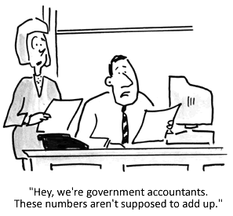
9. Revenue Streams
Subscription Fee
  Monthly or yearly fees (e.g. membership)
Usage-based
  Billing according to usage of services or resources that can be quantified numerically
Professional Services
  Dedicated or special services upon request
Free Access: Zero cost services that are supported by other income streams (e.g. paid premium services)
In-kind Effort Sources: collaborative efforts
Public Funding
  Project: submit project proposals for specific activities
  Recurrent: become a budget line item
Each revenue stream may have different associated pricing mechanisms (e.g. such as fixed list prices, volume dependent)
Notes:
There are others: brokerage, advertising, lending/renting/leasing, licensing

Slide 21
Summary
Overview
  Covered the components of a business model
  Provided a high-level overview on how it relates to EGI
  Emphasized the impact on EGI’s sustainability
Next Steps
  NGIs to work on defining their individual business models
  Continue the discussion on the best way forward in defining a strategy, a vision, for where we see ourselves in the future
  Please complete the questionnaire before you leave
Business Models & Sustainability – EGI TF Lyon - Sept 2011

Slide 22
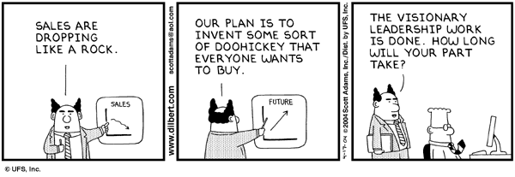
Thank you!
policy@egi.eu
References
EGI TF Sustainability and Business Model Session - http://go.egi.eu/yaqzs
Session Material - https://documents.egi.eu/document/798
EGI Sustainability Plan (D2.7) - https://documents.egi.eu/document/313
Business Model Canvas - http://en.wikipedia.org/wiki/Business_Model_Canvas
Business Models & Sustainability – EGI TF Lyon - Sept 2011

