Slide 1
The NGS on the Road Gillian Sinclair NGS Liaison Officer

Slide 2
What is the NGS?
NGS is the UK National Grid Service ww.ngs.ac.uk
NGS is the UK NGI in partnership with GridPP
NGS staff based at several UK institutions
University of Leeds
University of Manchester
University of Oxford
STFC Rutherford Appleton Laboratory

Slide 3
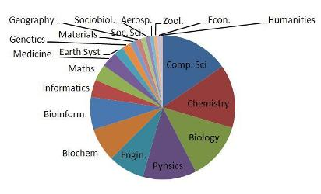
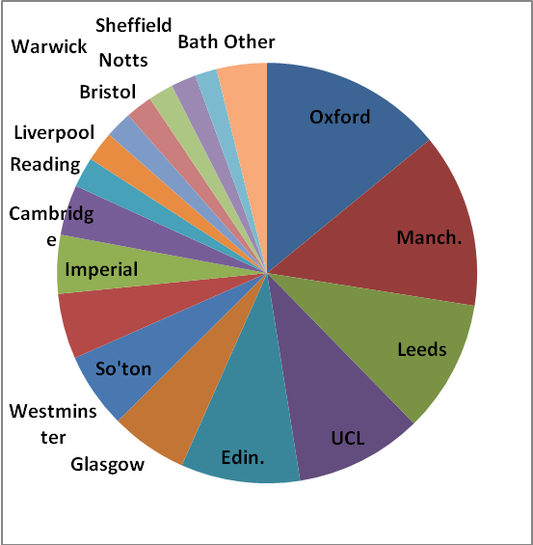
Our users
Currently have over 340 active users, 1,200 over the lifetime of the NGS
Users from a wide range of backgrounds from humanities to computer science.
Users from a wide range of universities – the traditional universities to the new universities

Slide 4
NGS Roadshows
12 roadshow events held so far at a mix of universities and research institutes, some of which are members of the NGS
Various formats
½ day roadshow event
½ day roadshow followed by ½ day “hands on” training
½ day roadshow followed by full day “hands on” training
Flexible format – up to the hosting institution and content can be adapted to fit specific requirements

Slide 5
Aim of the roadshows
Explain to people what e-infrastructure is – DON’T assume everyone knows what this is!
Tell people about the NGS, what it is, what it offers
Explain how it fits into the bigger picture, most importantly with what they already use i.e. local resources
Give them relevant practical examples of what they can do with e-infrastructure, preferably from someone within their own community
Give them the opportunity to use the NGS under the supervision of a trainer

Slide 6
What we do (well I do!)
Event page on the NGS website
Registration done online – www.regonline.com
Write advertising blurb for distribution to departments, produce posters etc
Organise external speakers
Pay for catering and external speakers travel expenses
Chair the event
No cost to the institution

Slide 7
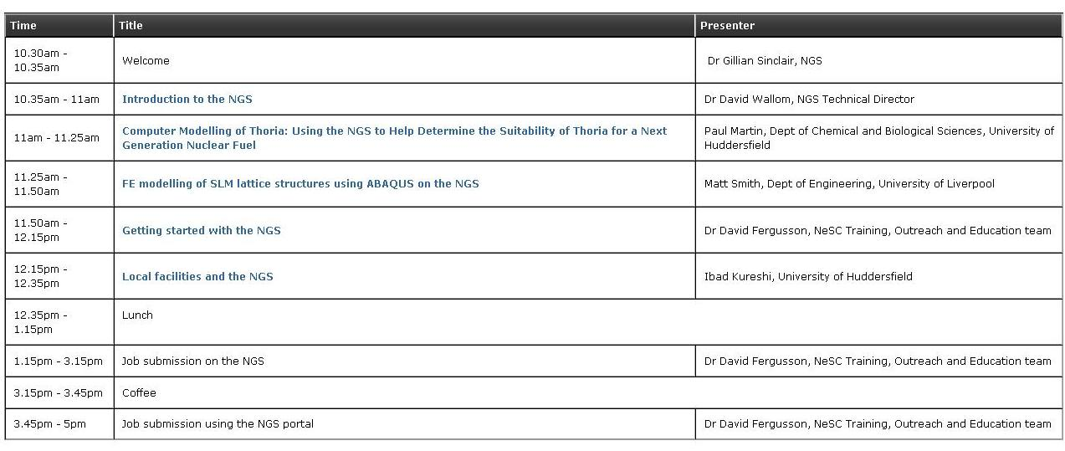
A typical roadshow

Slide 8
Feedback

Slide 9
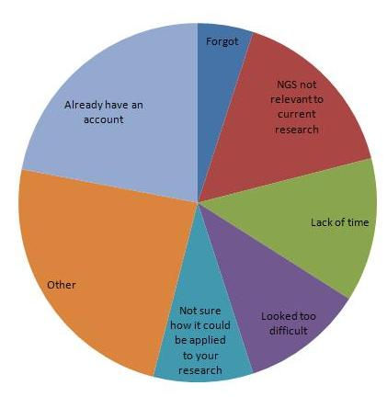
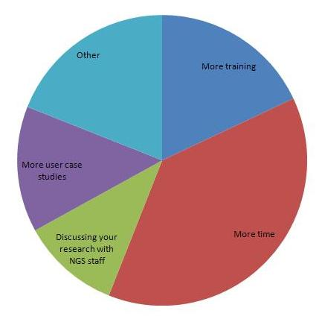
Future follow up
If you have not yet applied for a NGS account , why not?
What would help you to start using the NGS?

Slide 10
Further information
www.ngs.ac.uk
http://www.ngs.ac.uk/ngs-roadshows
Gillian Sinclair
Gillian.sinclair@manchester.ac.uk

