Slide 1
EGI - NGI Roadshows Technical Forum 21 September 2011
Steve Brewer - Chief Community Officer
&
Richard McLennan - User Community Support Officer
Technical Forum - Lyon, Sep 11

Slide 2
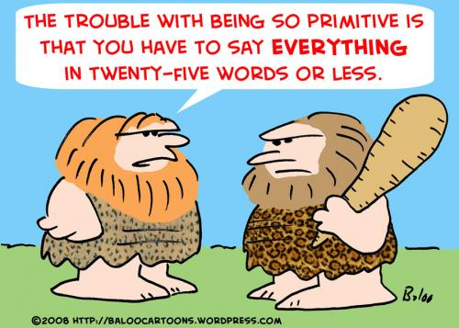
Communication
It is all about opening communication channels

Slide 3
EGI - NGI Roadshows
Session Structure:
EGI Roadshow
- the Model for Discussion
Introduction
Elements of EGI Model
Case Study - UK NGS
Discussion
Customisable
Roadshow
Package
Templates
Presentation Material
Case Studies
Checklists

Slide 4
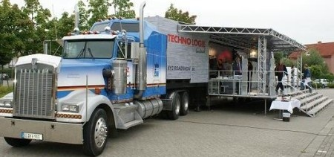
What is a Roadshow?
Get out of the office and ‘Spread the Word’

Slide 5
Aims
Aim of conducting Roadshows:
Messages to more users
Educate & Train
Feedback
Gain more users
Aim of today:
Present the EGI Roadshow Model
Listen to your needs, gain feedback and ideas
Fine tune our model
Technical Forum - Lyon, Sep 11

Slide 6
EGI Users
Who and Where are the EGI Users?
Who and where is our potential audience?
Technical Forum - Lyon, Sep 11

Slide 7
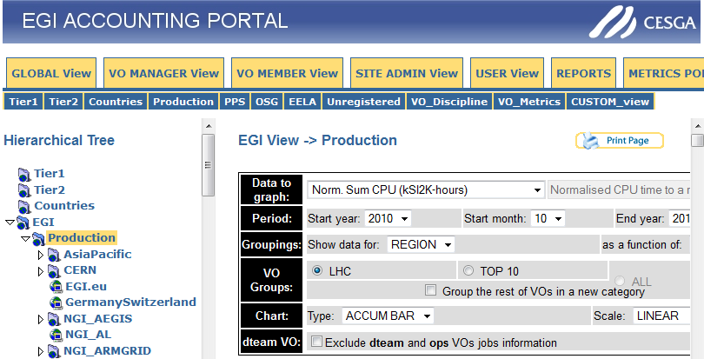
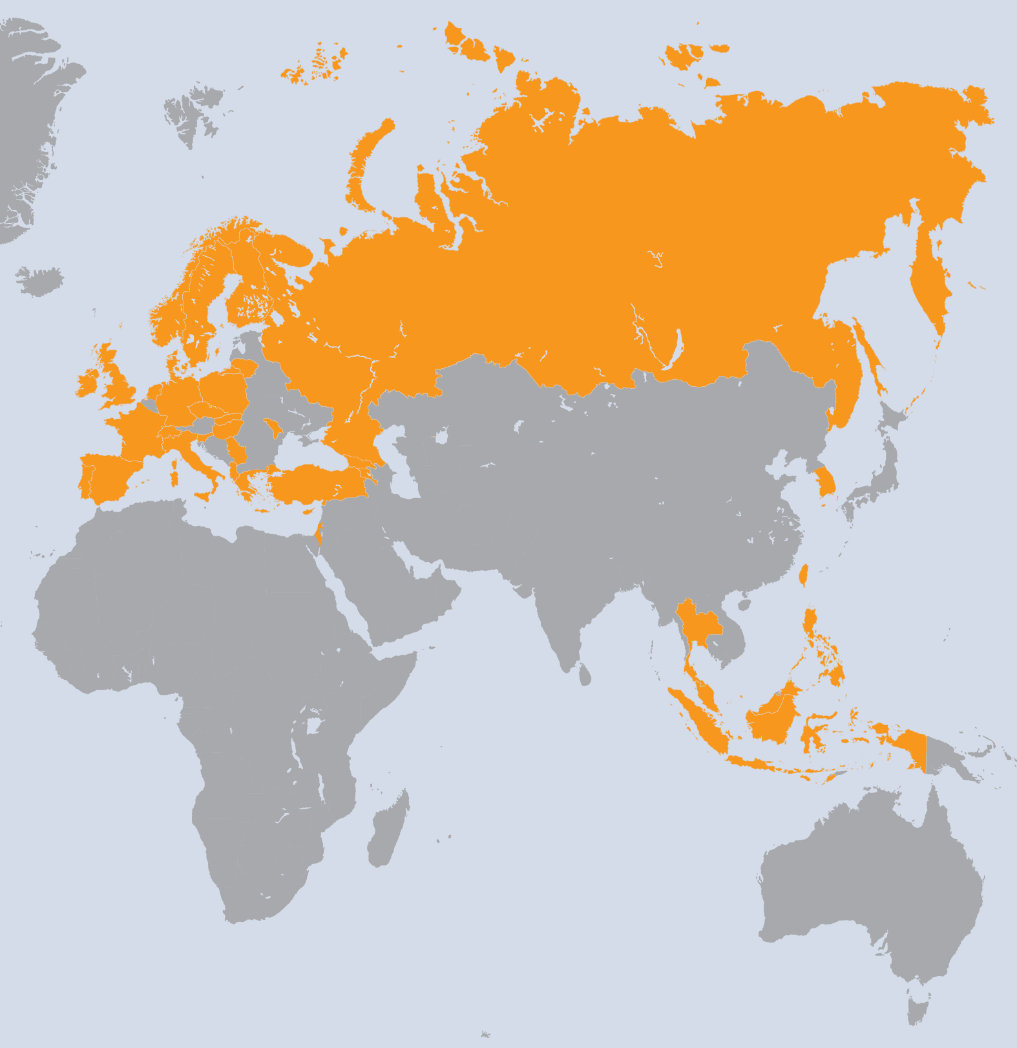
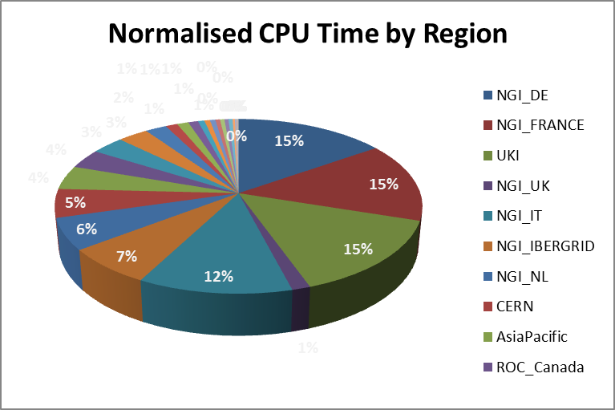
EGI Users
Source: EGI accounting portal for the period 10/2010 to 9/2011

Slide 8
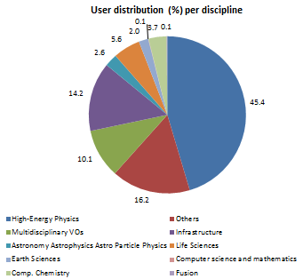
EGI Usage (April 2011)
Average usage 2010-2011 vs 2009-2010
27.8M jobs/month, 914,000 jobs/day (+82%)
74.8M CPU wall clock hours/month (+35%)
2.8M jobs/month for non-HEP users (+47%)
Year to Year Increase
18,271 End-users (+47%)
219 VOs (+17.7%)
~30 high activity VOs (no change)
User Communities
Archeology
Astronomy
Astrophysics
Civil Protection
Comp. Chemistry
Earth Sciences
Finance
Fusion
Geophysics
High Energy Physics
Life Sciences
Multimedia
Material Sciences
…

Slide 9
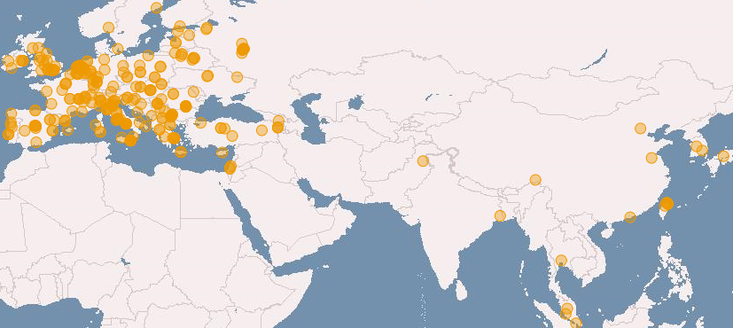
EGI Users (April 2011 and yearly increase)
Logical CPUs (cores)
239,840 EGI (+24.9%)
338,895 All
Resource Centres
338 EGI
345 All (+6.8 %)
96 supporting MPI (+6.8%)
Countries (+11.5%)
51 EGI
57 All (+18.75)
38 NGIs providing resources
22 National Operations Centres
16 NGIs in 5 Federated Operations Centres
1 EIRO providing resources
18 countries in 4 non-European Operations Centres

Slide 10
EGI Users
Diversity of User and User Needs
Undergraduate Students
Post-graduates
Post-doctoral researchers
Academic research coordinators
IT managers
IT System Administrators
Dissemination officers
Technical Forum - Lyon, Sep 11

Slide 11
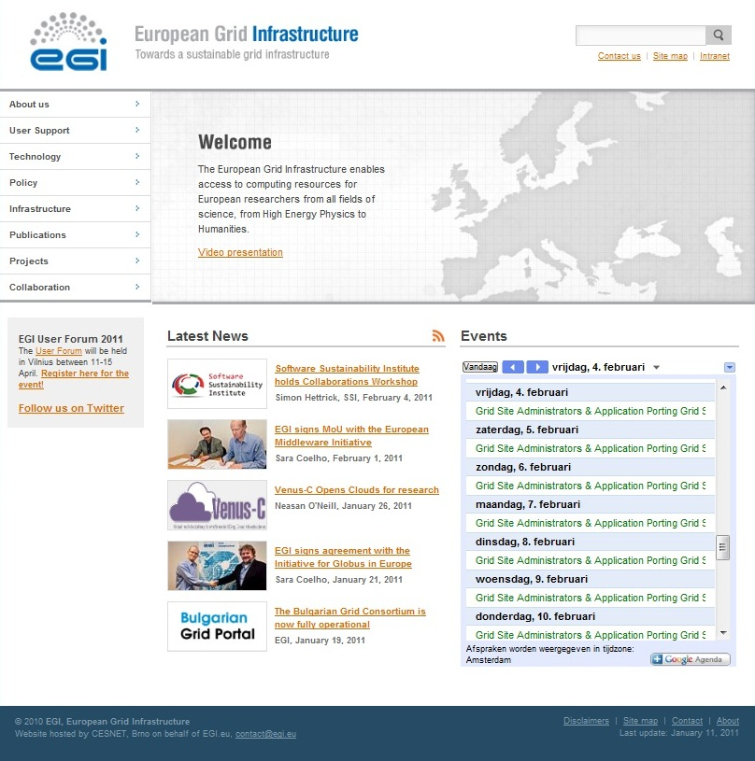
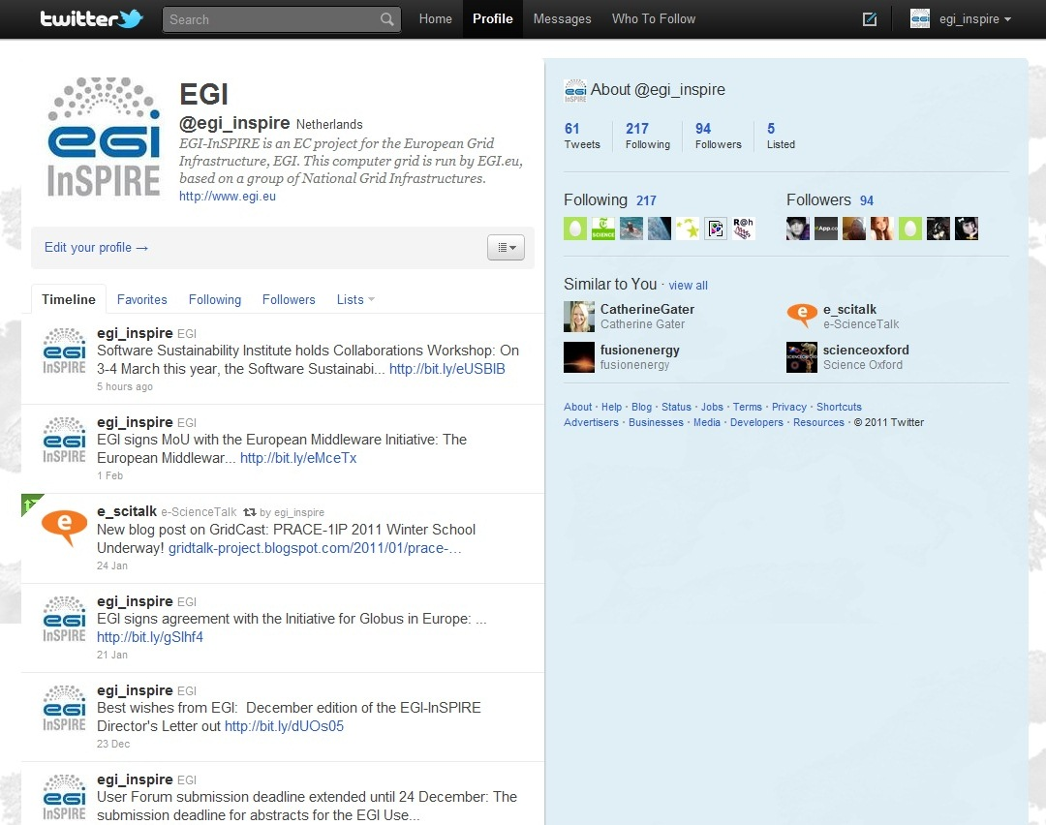
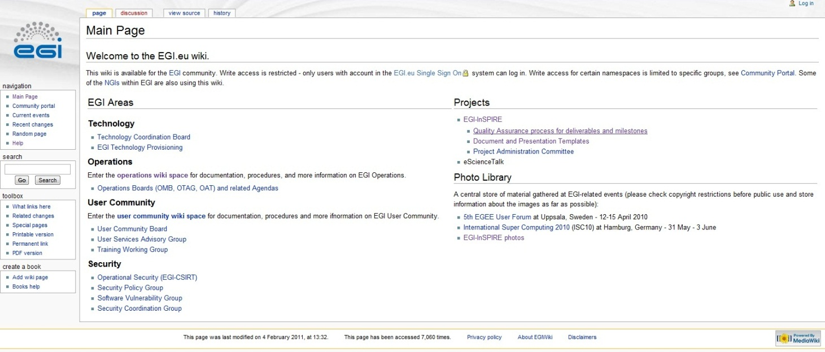
How to Spread the Word?
Website
Quarterly Newsletters
Wiki
Monthly Letters
e-mail
30,000 visitors
365,000 page views

Slide 12
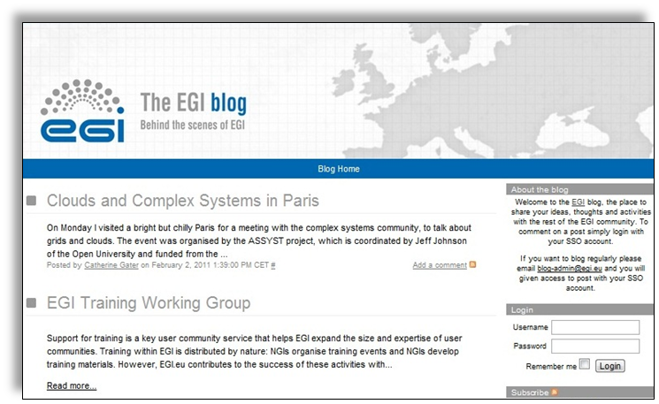
How to Spread the Word?
Blogging
RSS feeds
Social Media
Technical Forum - Lyon, Sep 11

Slide 13
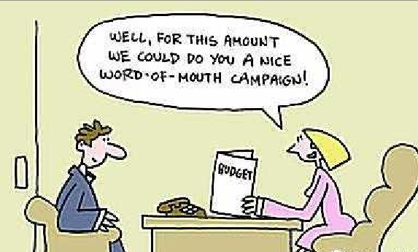
How to Spread the Word?
It is all about opening communication channels - Talk with Users
Technical Forum - Lyon, Sep 11

Slide 14
Who Spreads the Word?
NGI User Support Teams
Consultancy
Training
Porting apps.
Provide access to grid and software services
Dev. and operate software services
Collecting Feedback
Document
Processes & apps.
Helpdesk
NGI User Support Teams provide:
Consultancy & training
Access to grid services
Application porting
Developing and operating software services
Collecting feedback
Documentation & helpdesk
NGIs receive:
Web & wiki resources
Requirements process
Applications and services
VRC coordination support
Support teams are available across 50 partners – they are all different… as are their support skills.

Slide 15
Roadshow Format
Diversity of Users - Flexible format
½ day event
Full day event
All presentation - “hands off”
“Hands on” training
Combination of briefing and “hands on”
“Face to Face” time
Work with hosting institution to provide combined day of interactive briefings
Opportunity to interact - Meet friends new & old

Slide 16
Building the Event
Meet friends & Share
Registration
Feedback - Have your say
Coffee
What is NGI/EGI
Core Message
Case studies - guest speakers
Getting the best out your resources
Coffee
Coffee
Lunch
Gadgets Demonstration
Other Issues - guest speakers

Slide 17
EGI Roadshow “Bank”
Presentations, Hand-outs and distributable material
EGI Overview Slides
Demo slides
Briefing slides
NGI Overview Slides
Posters
News Sheets
Brochures
Postcards
Case Studies
Create once, Use many

Slide 18
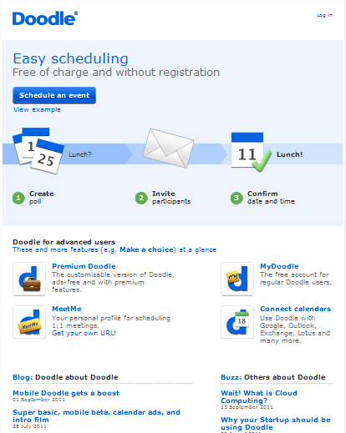
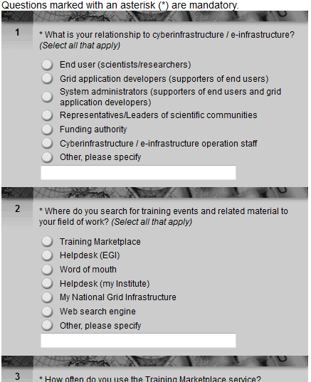
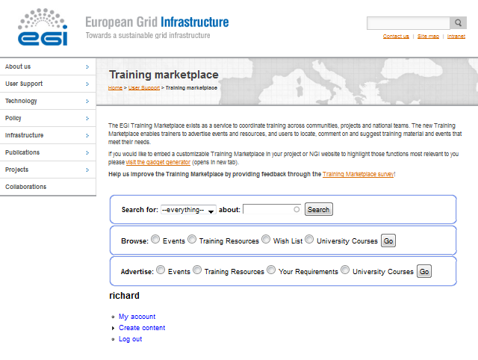
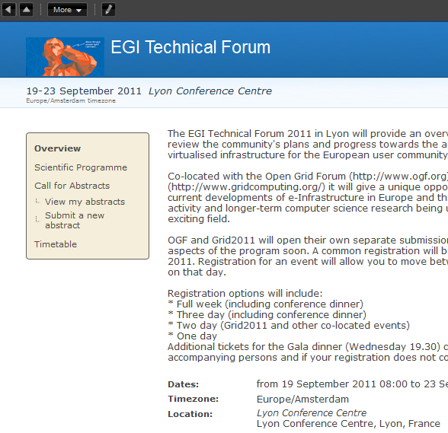
EGI Roadshow “Bank”
Logistical Material & Templates for Events
Dates
Surveys
Announcement
Registration
Check lists
Templates for signs
Templates for posters
Repository for material
Create once, Use many

Slide 19
EGI Roadshow “Bank”
Guidance and support for organisers and presenters:
Planning checklist - clear delegation
FAQs from audiences - use & add
Relevant Points of Contact
grid certificates, creating VOs/VRCs, running applications
Suggested timetables - what to cover, when, how long.
Suggested/proven planning - what to do and when.
Suggested/current training & workshop material.
What is available in Training Marketplace.
Lessons Learned (from previous NGI/EGI events)
Create once, Improve many

Slide 20
Supporting Material
Existing material for re-use .....there is no shortage of it.

Slide 21
Case Study
Gillian Sinclair
Liaison Officer
UK National Grid Service

Slide 22
Further Information
www.egi.eu/user-support/
Steve Brewer
steve.brewer@egi.eu
Richard McLennan
richard.mclennan@egi.eu

