Slide 1
Implementing Accounting within an IaaS Cloud
Dr David Wallom,
Associate Director - Innovation (Oxford e-Research Centre)
Technical Director (UK NGS)
VP-Community (OGF)

Slide 2
Develop our Pilot case studies
Eduserv
STFC/NGS Accounting Database
Oxford
Reading
eZEEL Management
eZEEL Management
Software Development Framework
Storage Manager
Software Development Framework
Storage Manager

Slide 3
Accounting the Cloud – Requirements & Implementation
Requirements
No modification of Eucalyptus code base;
Accounting based on local accounts with VM, EBS, Snapshot usage for each registered user;
Non-destructive treatment and permanent recording of accounting data;
Open standard publishing allowing for multiple types of consumption.
Implementation
Data sources: Eucalyptus logs (cc.log, output-cloud.log, debug-cloud.log);
4 stage design:
Aggregation: logs are parsed. Records are date and time stamped, checked for duplication and saved in daily archive files;
Parsing, records are parsed and stored into an accounting database (MySql 5.1);
Mining, database is mined to create OGF standard usage records;
Uploading, Usage Records are uploaded to the RUS server.

Slide 4
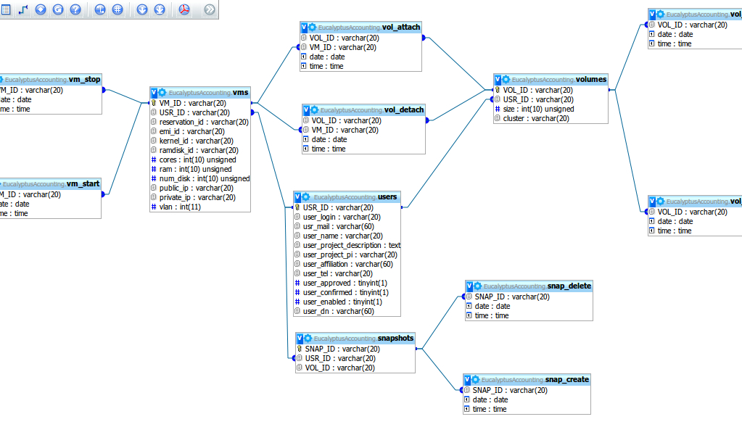
The not so simple Accounting Database Schema

Slide 5
Accounting the Cloud – Advantages & Challenges
Advantages:
Full regression chain from account record to original Eucalyptus logs;
Agnostic storage and representation of the accounting records (SQL);
Multiple, concurrent access of accounting records from different types of accounting clients: RUS + local web interface;
Multiple representation of the accounting logs (SQL DB + aggregated files) allows for consistency tests embedded in the parser;
Challenges:
High volume of daily logs: up to 500Mb daily for just 3 file types;
Highly redundant log information -> expensive duplicates checking;
Non uniform formatting of log records, lack or date stamping for 2/3 of them.

