Slide 1
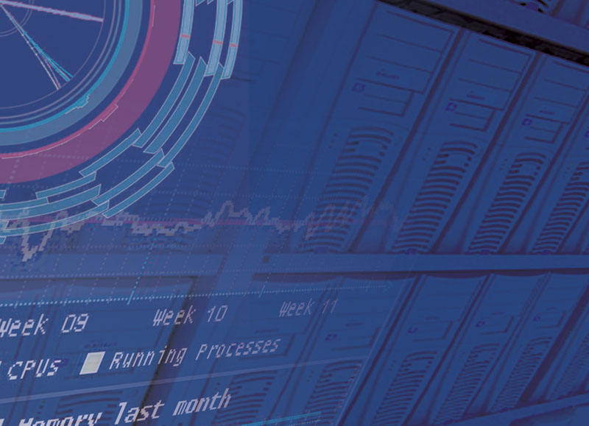
EGI Resource Forum
UK Input
EGI Technical Forum
21st Sep 2011
Prof. David Britton GridPP Project leader
University of Glasgow

Slide 2
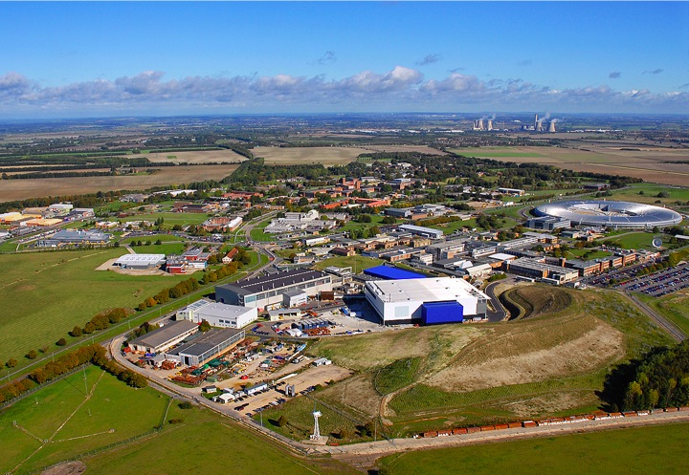
RAL
STFC Facilities:
Neutron and Muon Source
Synchrotron Radiation Source
Lasers
Space Science
Particle Physics
Information Technology and Data Storage
Wind Energy Research
Microstructures
Nuclear Physics
Radio Communications
User communities
Particle Physics (LHCB, CMS, ATLAS, others)
ISIS (Neutron & muon source)
Diamond Light Source
British Atmospheric Data Centre
EISCAT (Radar research)
National Earth Observation Data Centre
World Data Centre
Central Laser Facility
National Crystallography Service
Hinode (Solar-B)
BBSRC (BITS)
…
User communities
Particle Physics (LHCB, CMS, ATLAS, others)
ISIS (Neutron & muon source)
Diamond Light Source
British Atmospheric Data Centre
EISCAT (Radar research)
National Earth Observation Data Centre
World Data Centre
Central Laser Facility
National Crystallography Service
Hinode (Solar-B)
BBSRC (BITS)
…
STFC Facilities:
Neutron and Muon Source
Synchrotron Radiation Source
Lasers
Space Science
Particle Physics
Information Technology and Data Storage
Wind Energy Research
Microstructures
Nuclear Physics
Radio Communications
Key point: There are RAL communities who are engaged with ‘the Grid’ but not with EGI. E.g. neutrons and photon sources through PaNData, EU-DAT, etc. EGI could engage with them, possibly through us.

Slide 3
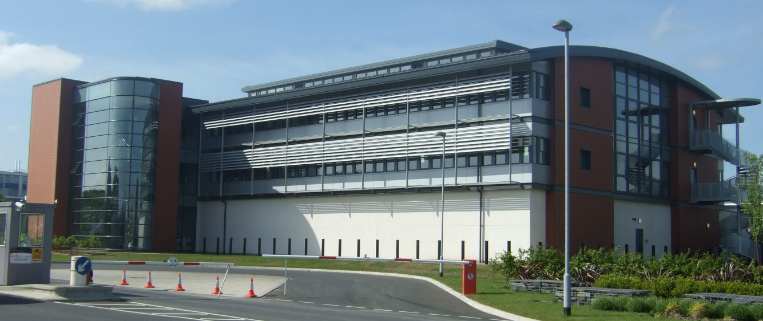
STFC e-Science Centre
Mission: “Develops and supports an integrated research computing infrastructure throughout STFC programmes, the research communities they support and the national science and engineering base.”
Operates compute clusters and storage systems for diverse communities including:
STFC Facilities such as ISIS Neutron facility and Lasers
Diamond Light Source
The LHC and other particle physics projects
Space Science
Other national research communities

Slide 4
RAL Compute Facilities
Tier-1
Service for:
GRIDPP
WLCG
EGI
Grid Access
EGI Middleware
High throughput
6000 cores
SCARF
Service for
STFC
Facilities
Local users
Classic access
Commercial S/W
Low latency MPI
4000 cores
NGS
Service for:
National UK e-Science
Many VOs
Grid Access
VDT
Low Latency MPI
Licensed S/W
288 cores
NSCCS
Service for:
UK Computational Chemistry
Classic access
Commercial S/W
Community shared licences
Community specific software
UK -NGI

Slide 5
National Grid Service
The NGS provides the base services (such as CA and VOMs) on which different communities (e.g. GridPP/wLCG) can then build discipline-specific infrastructures.
Through the NGS, the UK is actively engaging with other communities through the ESFRI projects with UK involvement. Clarin, Elixir, LifeWatch, SKA, DARIAH, ESRF upgrade and hyper. These are UK involvements, but do not involve the UK Tier-1 or Tier-2s.
In parallel, NGS supports national and local activities (at both the project and institutional level), e.g. DIRAC and Digital Social Research.
The NGS already has a business model but this is tailored to individual communities.

Slide 6
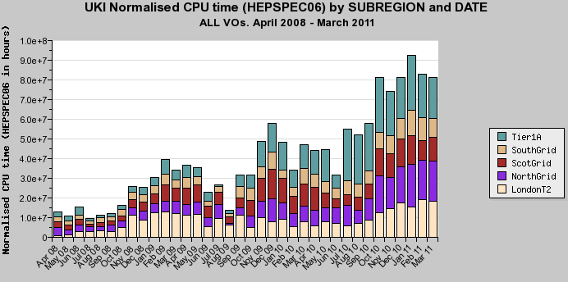
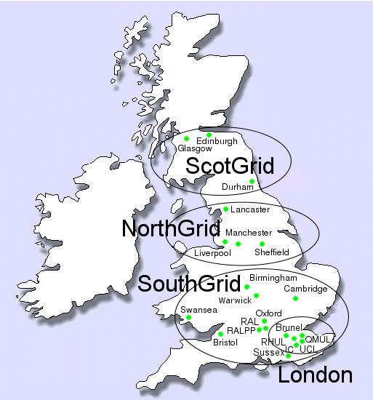
The Bigger UK Picture
The Tier-2s are organisational units.
About 19 sites.
Some sites provide a share of a central service; most sites are dedicated facilities.
Some sites focus on one VO; others on several.

Slide 7
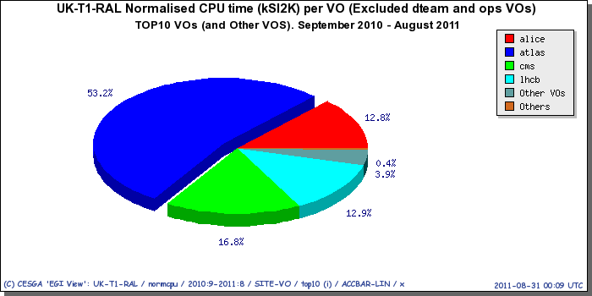
RAL Tier-1 Usage
Dominated by LHC experiments
Only 4% non-LHC use from number of small VOs
Non-LHC use not reaching target fair-share (10%)
Low demand (usability a deterrent?)

Slide 8
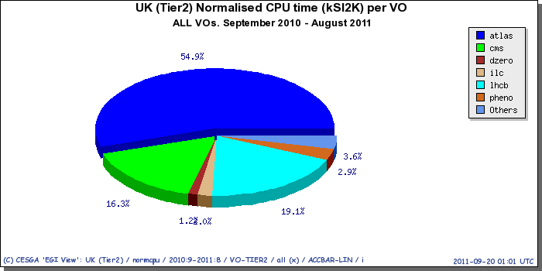
UK Tier-2 Usage
Dominated by LHC experiments
But non-LHC users reach 10% fair-share.

Slide 9
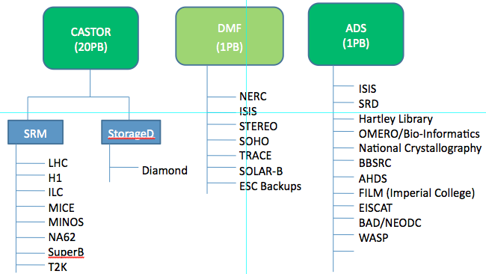
Types of New Users – (1)
Mature collaborations are hard to attract because they already have funding and their own infrastructure which we could not replace without substantial new resources (manpower and/or hardware). E.g. at RAL there are other (mature and/or large groups) who use different infrastructure(s).
RAL Storage Services Users

Slide 10
Types of New Users – (2)
New collaborations, often without (much) funding. Typically they are keen to engage to make opportunistic use of spare resources.
e.g. ILC in the UK, via GridPP, did enormous amounts of simulation work for their L.O.I. without any explicit funding.
The GridPP model is that 10% of our resources are for these “other” VOs but the expectation is that, as they mature, they ask for explicit funding to bring resources to the Grid.
But the important point is that much of the engagement with new groups is via the Tier-2 sites, not the Tier-1.

Slide 11
Example: Glasgow
Optics VO: We negotiated the donation of licences for the Lumerical Commercial software for optical engineering.
Solid State VO: Perform medium scale MPI, CASTEP
PaleoDB VO: Data mining fossil database
EarthSci VO: Medium scale MPI, Developmental geology.
It is key to demonstrate to them that the Grid will work for their domain/application without them needing to risk too much.
Local experts support during the learning period is essential and this is why the Tier-2 sites at universities are a natural entry point for new VOs (the 19 universities cover a lot more fields than the Tier-1).

Slide 12
Observations: Support
Formal support structures less effective than local contact during formative stages of setting up a new VO. Tier-2 sites in the UK can provide this help to local users.
GridPP has 0.5 FTE of effort that we embed in new collaborations for a period of 3-6-9? months to provide a single-contact and dedicated help. This can be an alternative to local help.
Management and support workload scales:
Very weakly with capacity (eg # worker nodes)
Weakly with number of similar service nodes (eg # of CEs)
Strongly with number of VOs as each VO brings own unique set of:
requirements, workflows, software products, contact procedures,
education needs and prejudices.
Very strongly with middleware stack/Management structures

Slide 13
Observations: Technical Challenges
No single solution meets all community requirements
e.g. “High throughput” v “Low-latency” CPU
Large files v small files
Data processing v Data mining
Requirements for commercial licensed products
Global project choices drive need for locally compatible solutions
Existing products often unsatisfactory (hence drive push for
alternatives)
Adoption date fixes choices and forces lock in. Hard to move 10PB of
data to new storage solution etc etc
User Interface / Job management (also recommending DIRAC)
VO management – hard to move later; new users need VO but no tools.
Data management – hard for new users.
Software Reliability – improving but still an issue.
Job Reliability – new users expect better.

Slide 14
Requirements
Requirements of better Reliability, Availability, Serviceability, and Usability of the Grid middleware to support multiple disciplines within the constraints of the existing manpower…
So faster, better and cheaper!
“Within the constraints of the existing manpower” we have optimised things for the LHC. Different disciplines will have different requirements that can only add to the load.

Slide 15
Business Models
Need to be careful about imposing a common model that may not work in some countries.
Business models may expose currently hidden costs with awkward consequences.
Need to be sure that business models don’t just invent a lot of additional work for little gain.
Business models may prevent new disciplines joining (how do they argue for funding if they don’t know if the Grid is the solution?)
Sustainability: The discussion should be about how we continue to do EGI Global and International tasks when EU funding goes away. Discussions of business models pre-supposes the answer to some extent.

Slide 16
Backup Slides

Slide 17
User Interface / Job Management
Except for (some) particle physicists most new user communities are not experienced in using the Grid
Many aspects of current Grid systems offer a set of facilities – and not an end to end product.
e.g Pilot jobs are not part of the default install of Grid middleware.
Recommending Dirac for new VO's.

Slide 18
VO management
It is much easier to have a dedicated 'small users' VO – the management overhead is smaller, and can be centralised
It is extremely difficult to move from one VO to another – essentially starting again plus additional work
So we find each project, even a small one, is probably better with it's own VO

Slide 19
Data management
For users with existing data, it often takes some time to work out how best to handle / distribute data
Not all data is organised along lines that fit well with SRM
Even with data that does, it's tricky for users to visualise why some ways of distribution are better than others
Initial import of data is often hand held by experts

Slide 20
Software Reliability
The operations guys were trying to think of the last week where we didn't have to do some (non-routine) maintenance, or other fix or diagnosis
They couldn't recall one
Some of these are hardware related, and more self-healing would help, others were pure software
Time spent fixing things is time not spent making things better
Notes:
Power cut's etc no doubt adding to the woes. We'll be taking note of this stat in future.
Note that no GGUS tickets is a nessecary, but not sufficent, condition for this – we monitor to spot problems before users do, and sometime things are reported informally.
This is not meant to be a presented as a problem – just a statement that this is where we are. These problems have been spread everywhere, roughly in proportion to there deployment (so it's not some spcific thing here, just the general trend).

Slide 21
Job Reliability
The larger LHC VO's expect a certain level of job failures
The smaller the VO, the greater the impact of any failed job
i.e. the human impact is roughly O(log(failures))
Pilot job frameworks eliminate some classes of problems
But there are too many failed jobs to fully investigate each one
Notes:
Can we put a number on the level of failures expected? Maybe generate an actual number from last month form Panda?
Graeme has mentiond 10-15% in the past?
O(log failures) is sorta from thin air, but fits with basic observations. After one failed job, 2 fails is not twice the problem, but roughly 10 is (in terms of human time to handle and recover).
Additional layers of automated retries can mask the problem, but without resolution then they waste resources (both CPU and developer time not spent eliminating problems).
Need to be able to delve into each failed job, before we can eliminate causes of failure.

