Slide 1
StratusLab: Marketplace & Image Metadata
EGI Technical Forum (Lyon, France)
22 September 2011

Slide 2
StratusLab Marketplace
Machine image creation is a barrier to cloud adoption
Creating virtual machine images is time-consuming
Ensuring that machines are secure and correct is difficult
Sharing existing machines lowers this barrier
Marketplace facilitates sharing of images
Registry of metadata for machine & disk images
Image contents are kept in cloud, grid, or web storage
Benefits
End-users: browse and use existing images for their analyses
Creators: publicize their work and attract larger user base
Cloud Admins.: Use metadata to evaluate trustworthiness of images

Slide 3
Interfaces
REST interface
Exposes a simple HTTP-based REST interface
Easy to program against in all languages
Web interface
REST interface also allows browsing via a web browser
Signed entries can also be uploaded via the browser
Endpoint:
In your ~/.stratuslab/stratuslab-user.cfg:
marketplace_endpoint = http://cloud-lal.stratuslab.eu:8081

Slide 4
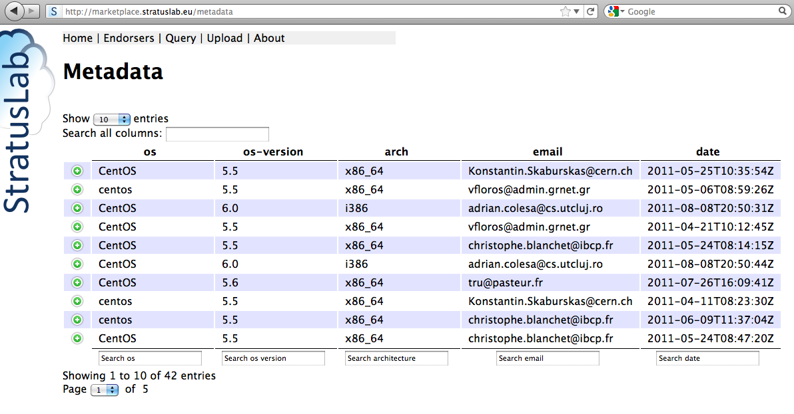
Web Portal

Slide 5
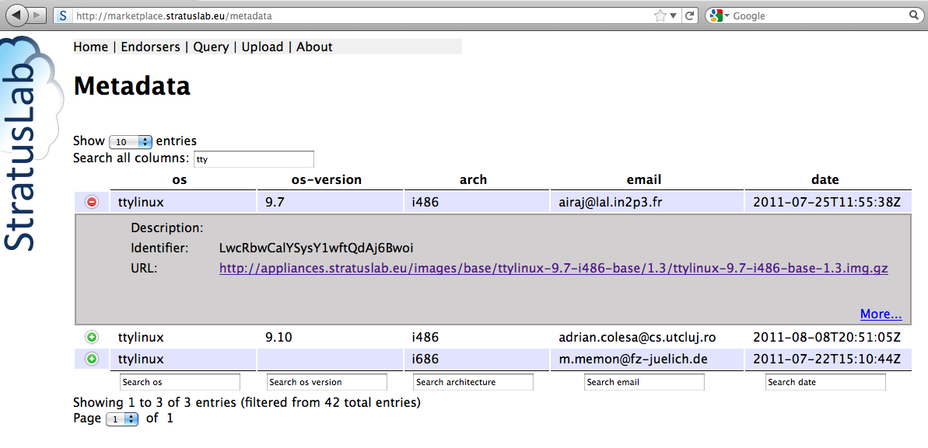
Metadata Entries Search

Slide 6
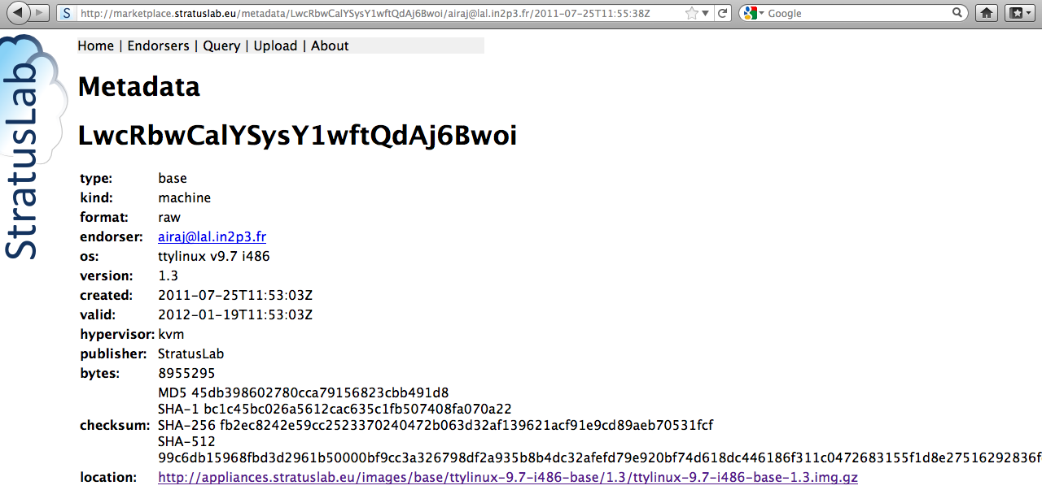
Metadata Entry details

Slide 7
Metadata
Image metadata
Must conform to a defined schema
Uses the RDF-XML format
Must be cryptographically signed with a (grid) certificate
Must contain image ID and checksums to make connection to image
May contain location elements with image content URL(s)

Slide 8
Workflow
Typical Marketplace workflow:
Create image from scratch or based on existing image
Upload the image to cloud, grid, or web storage area
Create the metadata for the image
Sign the metadata with your (grid) certificate
Upload the signed metadata to the Marketplace

Slide 9
Creating & Uploading Image
Creating an image is a time consuming process…
Cheat (!) and just copy ttylinux image from appliance repository:
See link on agenda page: https://www.egi.eu/indico/contributionDisplay.py?contribId=65&confId=452
Uploading of image
Skip this for now: image already exists in the appliance repository.
Normally, it would be transferred to cloud, grid, or web storage.
Images must be accessible via http(s) at the moment.
Location URL(s) would usually be part of the metadata.

Slide 10
Create Metadata Description
Use stratus-build-metadata for creating metadata:
Wait for the unknown state, then kill (remove) the instance:
Look at the contents of the file:
Identifier is based on SHA-1 checksum and looks like "LwcRbwCalYSysY1wftQdAj6Bwoi"
Checksums ensure that downloaded images match the metadata
Empty endorser element and no signature element
Normal file would have location elements(<slterms:location>…<slterms:location>);
Edit ttylinux-9.7-i486-base-1.3.xml to define image location
<dcterms:compression> element is empty, so fill it.
$ stratus-build-metadata \
--author='your name' \
--os=ttylinux \
--os-version=9.7 \
--os-arch=i486 \
--version=1.3 \
ttylinux-9.7-i486-base-1.3.img.gz

Slide 11
Create Metadata Description
Try to validate the unsigned metadata file:
There is no signature so the file should not be valid
Sign the contents of the file with a grid certificate:
ttylinux-9.7-i486-base-1.3.xml → ttylinux-9.7-i486-base-1.3.xml.orig
ttylinux-9.7-i486-base-1.3.xml contains endorser and signature elements
$ stratus-validate-metadata ttylinux-9.7-i486-base-1.3.xml
Invalid: ttylinux-9.7-i486-base-1.3.xml
no signature
$ stratus-sign-metadata \
--p12-cert grid.p12 \
--p12-password xxxxxx \
ttylinux-9.7-i486-base-1.3.xml
Manifest file successfully signed: ttylinux-9.7-i486-base-1.3.xml
$ stratus-validate-metadata ttylinux-9.7-i486-base-1.3.xml
Valid: ttylinux-9.7-i486-base-1.3.xml

Slide 12
Upload Metadata Description
File can be uploaded via the command line:
stratus-upload-metadata
Note: Depending on the configuration of the server, it may validate the email address in the metadata description before it is made visible.
$ stratus-upload-metadata \
ttylinux-9.7-i486-base-1.3.xml
http://cloud-lal.stratuslab.eu:8081/metadata/LwcRbwCalYSysY1wftQdAj6Bwoi/email address/2011-09-13T09:58:54Z

Slide 13
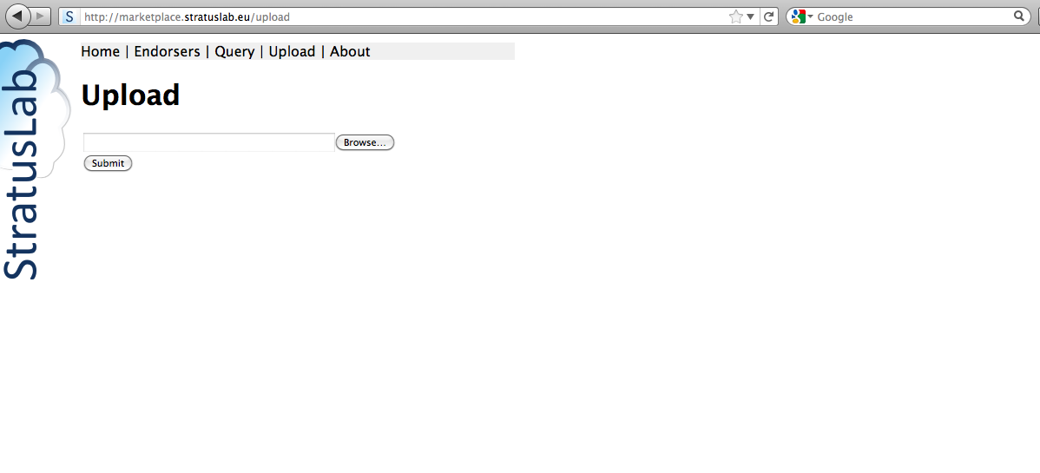
Web Upload of Metadata

Slide 14
Using an Image in the Marketplace
Pass the URL for metadata entry when starting instance.
stratus-run-instance LwcRbwCalYSysY1wftQdAj6Bwoi
Use normal machine lifecycle to control machine.
StratusLab cloud will validate image before running it:
stratus-policy-image: invokes site policy to determine if the referenced image can be used; includes endorser white lists, checksum black lists, etc.

Slide 15
Image deprecation
May want to invalidate an image:
stratus-deprecate-metadata
deprecates an image and gives a reason
Try running the image; what happens?
Put back standard Marketplace endpoint!
$ stratus-deprecate-metadata \
--reason=“JUST FOR FUN” \
--p12-cert=/Users/loomis/.globus/cert.p12 \
--p12-password=XXXXXX \
$TTYLINUX_ID
http://cloud-lal.stratuslab.eu:8081/metadata/LwcRbwCalYSysY1wftQdAj6Bwoi/loomis@lal.in2p3.fr/2011-09-21T14:52:43Z

