Slide 1
StratusLab: Storage Services
EGI Technical Forum (Lyon, France)
22 September 2011

Slide 2
StratusLab Storage Services
Disk-based abstraction
"More natural" abstraction for an IaaS cloud
Persistent, read-write disks for use within a cloud instance
Read-only disks shared between cloud instances
Available from v1.0 release
Will add CDMI interface in future version
File-based abstractions
"More natural" abstraction for scientific analyses
Clients still have access to traditional services (SRM, gsiftp, …)
StratusLab probably won’t provide file-based storage services

Slide 3
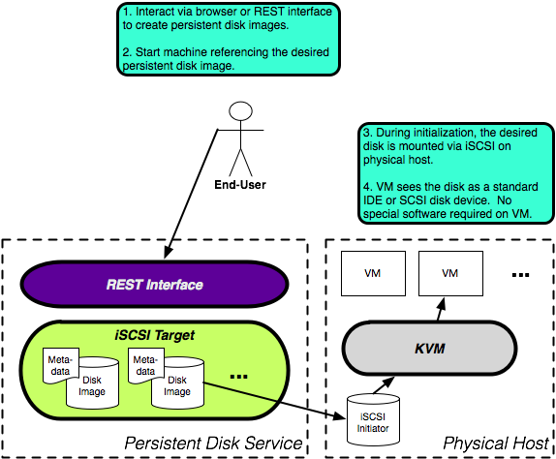
Persistent Storage Architecture

Slide 4
Using a Persistent Disk
Workflow
Create a disk with a given size via CLI/Web Portal.
Launch a machine instance referencing that image.
Partition (fdisk) and format (mkfs) the disk via the running VM
Store data to the disk as usual
Dismount the disk or halt the machine instance
Disk with persistent data is available for use by another VM

Slide 5
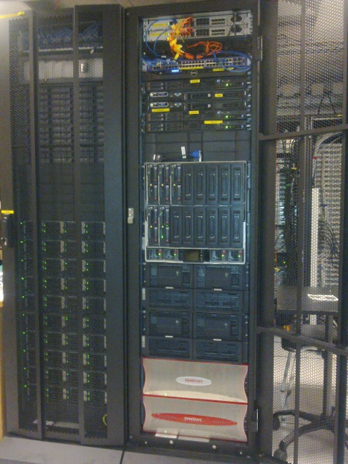
Using a Persistent Disk
Persistent disk endpoint
In $HOME/.stratuslab/stratuslab-user.cfg,
provide cloud-lal.stratuslab.eu
as persistent disk endpoint:
pdisk_endpoint = cloud-lal.stratuslab.eu

Slide 6
Create persistent disk: CLI
Create a persistent disk with the following properties:
size = 2GiB
tag = myprivate-disk
Run stratus-create-volume command to create your persistent disk.
Your persistent disk had been created with the UUID: 1ceeff5e-a0f7-4eb5-9958-725036a6e611
$ stratus-create-volume --size=2 --tag=myprivate-disk
DISK 1ceeff5e-a0f7-4eb5-9958-725036a6e611
NB:
By default all the persistent disks are private: could be read, written and deleted
only by their owner.
If you want other users have access (read and write only) to your persistent disks,
set it to be public.
To create public persistent disk, pass --public argument to stratus-create-volume.

Slide 7
List Persistent Disks: CLI
Stratus-describe-volumes allow you to:
List of all your public and private persistent disks,
List of all users public persistent disks
Run stratus-describe-volumes command:
$ stratus-describe-volumes
:: DISK 5bc1c62e-af1b-439d-92da-a8fd1f99ec0b
created: 2011/09/16 09:58:40
visibility: PUBLIC
tag: test-public
owner: test
size: 1
users: 0
:: DISK 1ceeff5e-a0f7-4eb5-9958-725036a6e611
created: 2011/09/16 13:36:30
visibility: private
tag: myprivate-disk
owner: egitf
size: 2
users: 0

Slide 8
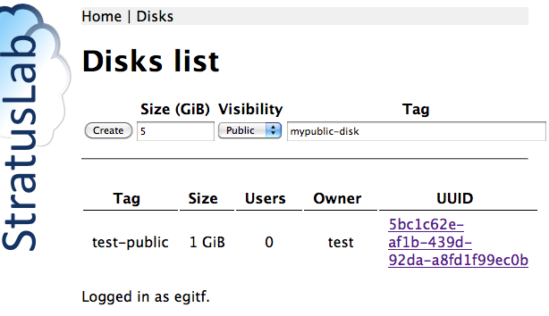
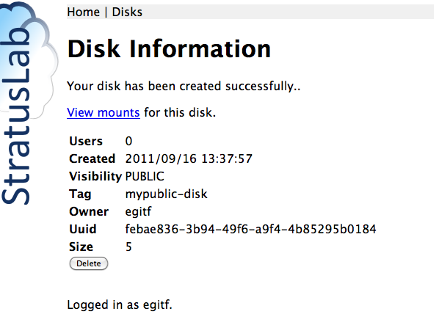
Create persistent disk : Web Portal
Create a public persistent disk with the following properties:
size = 1GiB
tag = mypublic-disk
Run stratus-create-volume command to create your persistent disk.
Log into https://cloud-lal.stratuslab.eu:8445/disks with your StratusLab username and password

Slide 9
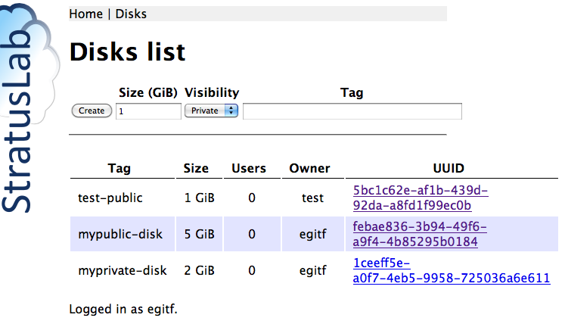
List Persistent Disks: Web Portal
Disks menu:

Slide 10
VM Instance with Persistent Disk
Use a ttylinux image Identifier from the Marketplace:
export TTYLINUX_ID=LwcRbwCalYSysY1wftQdAj6Bwoi
Deploy your virtual machine:
stratus-run-instance --persistent-disk=1ceeff5e-a0f7-4eb5-9958-725036a6e611 ${TTYLINUX_ID}
Response should give the VM ID and Public IP:
:::::::::::::::::::::::::
:: Starting machine(s) ::
:::::::::::::::::::::::::
:: Starting 1 machine
:: Machine 1 (vm ID: 18)
Public ip: 134.158.75.44
:: Done!

Slide 11
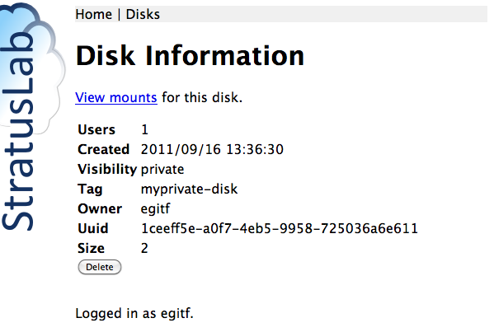
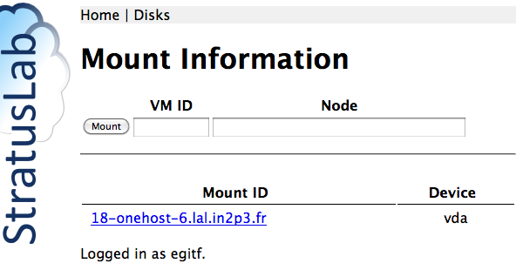
Mount Information on the Web Portal

Slide 12
Format the disk via the running VM
Partition (fdisk)? and format (mkfs) it via the running VM
In your VM, the persistent disk will be referenced as /dev/hdc or /dev/sdc. In ttylinux9.7, it will be /dev/hdc.
Format your disk
$ ssh root@134.158.75.44
# fdisk –l
…
Disk /dev/hdc: 2147 MB, 2147483648 bytes
255 heads, 63 sectors/track, 261 cylinders
Units = cylinders of 16065 * 512 = 8225280 bytes
…
# mkfs.ext3 /dev/hdc

Slide 13
Mount & store data into your disk
Mount your disk, store data into, and dismount it
# mount /dev/hdc /mnt
# echo "Testing Persistent Disk" > /mnt/test_pdisk
# umount /mnt

Slide 14
Deploying a Virtual Machine with persistent disk
Now deploy another virtual machine with the same persistent disk:
stratus-run-instance --persistent-disk=1ceeff5e-a0f7-4eb5-9958-725036a6e611 ${TTYLINUX_ID}
Response should be:
[ERROR] Only 0/1 disk(s) can be attached. Aborting
Disk can only be attached to 1 Virtual Machine!

Slide 15
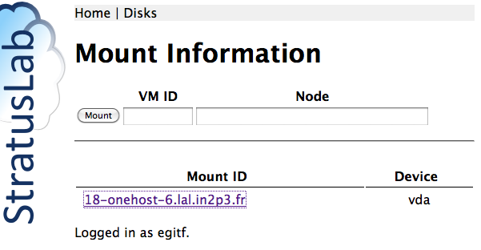
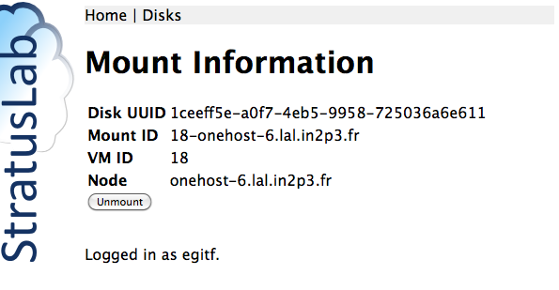
Unmount your disk via the Web Portal
Now deploy another virtual machine with the same persistent disk:
stratus-run-instance --persistent-disk=1ceeff5e-a0f7-4eb5-9958-725036a6e611 ${TTYLINUX_ID}

Slide 16
Verify disk contents via the running VM
Log into your VM using ssh, verify existence of your persistent disk
$ ssh root@134.158.75.45
# fdisk –l
…
Disk /dev/hdc: 2147 MB, 2147483648 bytes
255 heads, 63 sectors/track, 261 cylinders
Units = cylinders of 16065 * 512 = 8225280 bytes
…
Mount your persistent disk, verify its content
# mount /dev/hdc /mnt
# ls /mnt
lost+found test_pdisk
# cat /mnt/test_pdisk
Testing Persistent Disk

Slide 17
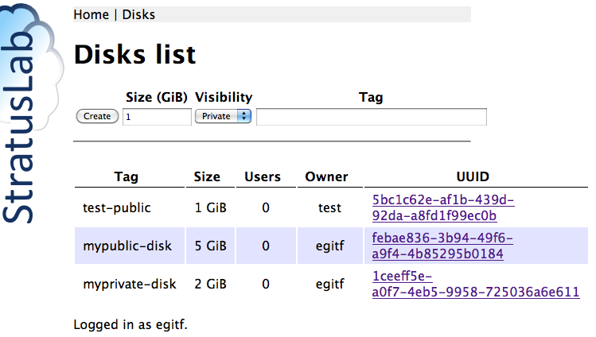
Kill you Virtual Machine
On the Web Portal: myprivate-disk nb. of users =0
$ stratus-kill-instance 19

Slide 18
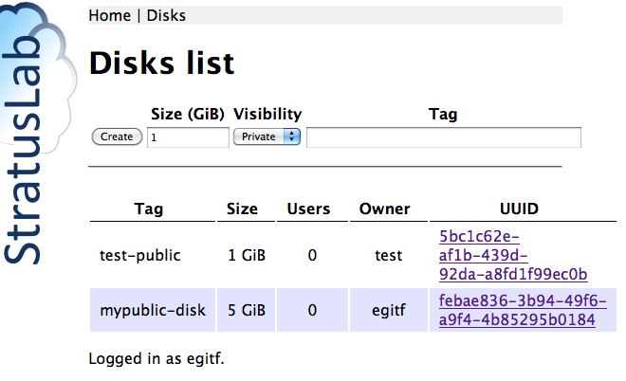
Persistent disk deletion
To delete your persistent disk: stratus-delete-volume <Disk UUID>
$ stratus-delete-volume 1ceeff5e-a0f7-4eb5-9958-725036a6e611
DELETED 1ceeff5e-a0f7-4eb5-9958-725036a6e611
List the existing persistent disks
$ stratus-describe-volumes
:: DISK 5bc1c62e-af1b-439d-92da-a8fd1f99ec0b
created: 2011/09/16 09:58:40
visibility: PUBLIC
tag: test-public
owner: test
size: 1
users: 0
:: DISK febae836-3b94-49f6-a9f4-4b85295b0184
created: 2011/09/16 13:37:57
visibility: PUBLIC
tag: mypublic-disk
owner: egitf
size: 5
users: 0

Slide 19
Hot-plug Persistent Disks
To use the hot-plug feature, the running instance needed to have acpiphp kernel module loaded.
ttylinux doesn’t have this feature, you have to use base image like Ubuntu, CentOS or Fedora.
In this part of tutorial, we will be using Ubuntu10.04 (OWojA0YDjya7Uhzf7fDRulB3pz3 from http://marketplace.stratuslab.eu)
Persistent disks could be attached/detached using CLI or from the Web Portal
To attach one or more volumes to a running machine using CLI:
To detach one or more volumes from a running machine using CLI:
$ stratus-attach-volume –i <VM ID> <disk1 UUID> <disk2 UUID> …<diskn UUID>
$ stratus-detach-volume –i <VM ID> <disk1 UUID> <disk2 UUID> …<diskn UUID>

Slide 20
Deploying Ubuntu Virtual Machine
Use a ubuntu image:
export UBUNTU_ID=OWojA0YDjya7Uhzf7fDRulB3pz3
Deploy your virtual machine:
stratus-run-instance $UBUNTU_ID
Response should give the VM ID and Public IP:
:::::::::::::::::::::::::
:: Starting machine(s) ::
:::::::::::::::::::::::::
:: Starting 1 machine
:: Machine 1 (vm ID: 19)
Public ip: 134.158.75.45
:: Done!

Slide 21
Hot-plug Persistent Disks
Before hot-plugin a disk, make sure acpiphp is loaded.
In your VM execute:
To attach one or more volumes to a running machine using CLI:
To detach one or more volumes from a running machine using CLI:
# modprobe acpiphp
$ stratus-attach-volume –i <VM ID> <disk1 UUID> <disk2 UUID> …<diskn UUID>
$ stratus-detach-volume –i <VM ID> <disk1 UUID> <disk2 UUID> …<diskn UUID>

Slide 22
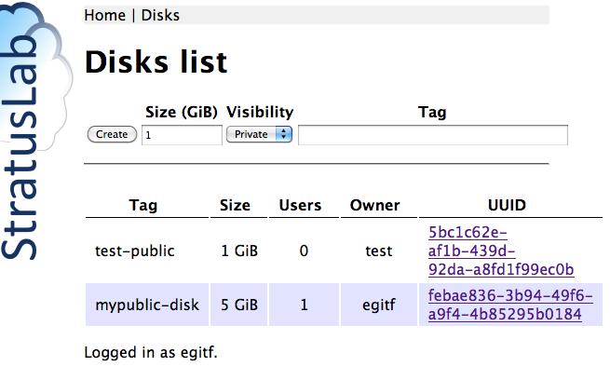
Hot-plug Persistent Disks
Attach mypublic-disk to your VM using CLI:
$ stratus-attach-volume -i 19 febae836-3b94-49f6-a9f4-4b85295b0184
ATTACHED febae836-3b94-49f6-a9f4-4b85295b0184 in VM 19 on /dev/vda

Slide 23
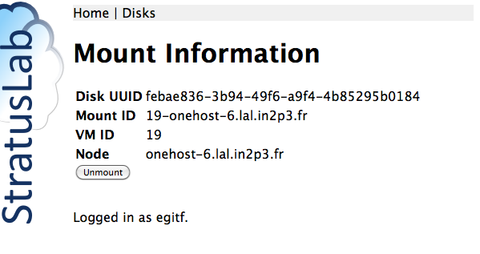
Hot-plug Persistent Disks

Slide 24
Hot-plug Persistent Disks
Detach mypublic-disk from your VM using Web portal
$ stratus-detach-volume -i 19 febae836-3b94-49f6-a9f4-4b85295b0184
DETACHED febae836-3b94-49f6-a9f4-4b85295b0184 from VM 19 on /dev/vda

Slide 25
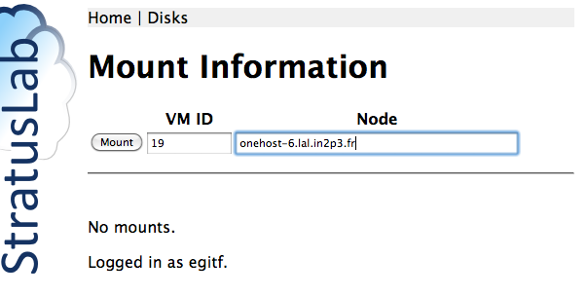
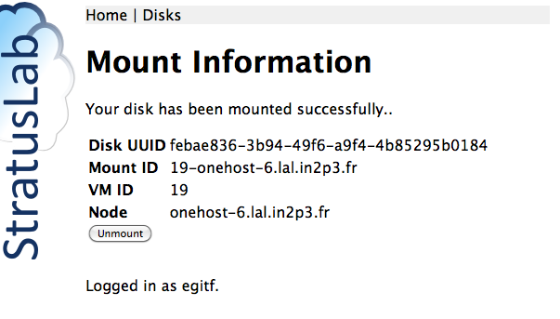
Hot-plug Persistent Disks
Attach mypublic-disk to your VM using Web Portal:

