Slide 1
User communities of NDGF: specifics and requirements
Oxana Smirnova EGI Technical Forum Lyon, September 21, 2011

Slide 2
NDGF users
NDGF was initiated by users – the LHC groups
Key VOs: ATLAS, ALICE, CMS
Hardware is contributed by these communities
Installed at different HPC centres
Frequent suggestion from funding bodies: involve researchers outside LHC
They are often (much) smaller communities without own hardware
join forces (also with LHC) in hardware bids
apply for time on national Grid-enabled HPC resources
NDGF is an international distributed facility by design
Each country/node has a great degree of autonomy w.r.t. allocating resources to users outside LHC

Slide 3
Existing user communities
LHC (ATLAS, ALICE, CMS)
Computer science
Astroparticle physics (ICECube)
Bioinformatics (BioGrid, ELIXIR)
Environmental sciences (CO2 sequestration)
Computational Chemistry
Material Sciences

Slide 4
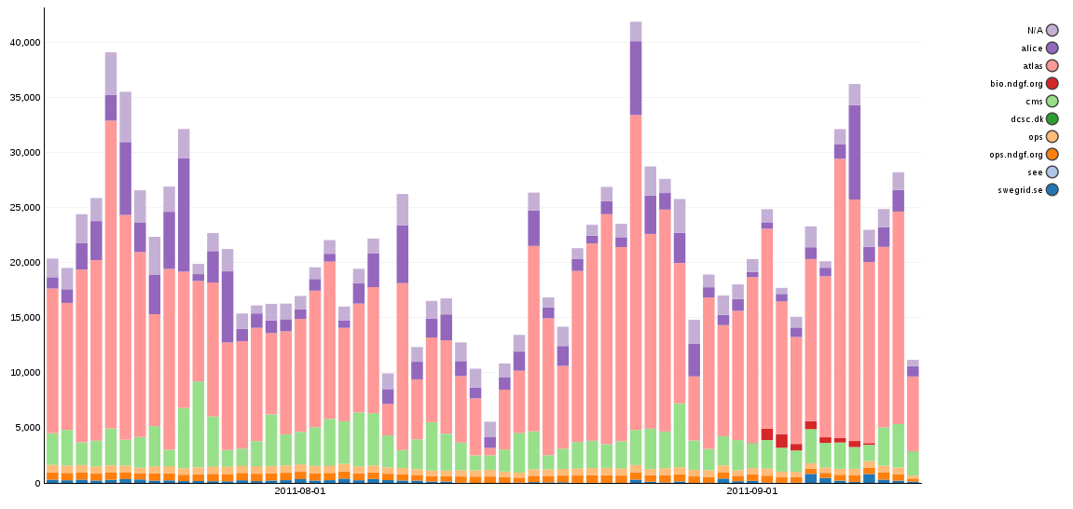
NDGF jobs per VO
Clearly dominated by LHC (specifically, ATLAS)

Slide 5
New users
NDGF is open to new users ever since it was created in 2006
Potential new communities:
More bioinformatics (also proteomics, genomics)
More material sciences
More computational chemistry
Radioastronomy? Many close contacts, but so far they prefer not to share resources
Challenges:
NDGF has no “free” resources to offer – only know-how
Non-LHC user communities often have no massive resources to contribute
After all, NDGF is LHC-tuned

Slide 6
Technical challenges
Each user community comes with own middleware
ALICE – AliEn, ATLAS – Panda, BIO – Taverna, etc
NDGF relies on ARC and dCache, but has also to deploy LFC, FTS, VOMS, site-BDII, VOBoxes etc to satisfy users
Difficult to streamline
Users and sysadmins alike do not like to change tools without an extremely good reason
In HPC, sites/queues are tailored for applications and other way around – on the Grid, all sites are different, and applications can not be tailored
Difficult to optimize load
LHC – nearly constant (though fluctuating) load
Most other communities – episodic activities

Slide 7
Middleware requirements
Generic middleware must not be tied to a single operating system
Generic middleware must not have “vendor locks” w.r.t. third party dependencies
Generic middleware must follow worldwide community practices and standards (FSH, licensing, packaging, monitoring, configuration, auditing etc)
Generic middleware must provide API and development libraries to build application-specific tools and utilities
Middleware shortcomings should not be getting solved by operational means
Documentation, documentation, documentation

Slide 8
Operations
Now
Operations team comprising of
Systems integrator – primarily general WLCG support
Dedicated ALICE/CMS/ATLAS support experts
Storage specialist – specific WLCG storage requirements
Operator on Duty (OoD) team, one country on a 4 week rotation basis
OoD handles EGI ROD duties and WLCG monitoring support
Future challenges
More user communities – more dedicated experts needed – more organisational complexity?
More people are trying ARC
operational procedures still are often gLite-specific (YAIM this, APEL that etc)
more ARC support specialists may be needed

Slide 9
Sustainability thoughts
NDGF is a strictly research facility
Much like NORDUnet or other NRENs
Very little EU-funded effort (below 10%)
Sustainability relies on ever increasing need for computing and storage capacities in academic research
Public funding
Business model: states invest as much as they can, researchers use as much as they need
Works as long as we are much cheaper than commercial providers
Cloud technologies look appealing
If we can offer services comparable to commercial providers for smaller costs
How?

Slide 10
Summary
LHC community is by far the largest user, and will remain such in foreseeable future
If we want to attract new communities, both middleware and operations must become less LHC-specific (obviously)
Reduce overhead for very small VOs
Learn how to share resources
Accommodate more different use cases and scenarios
Get rid of single-OS dependency and other in-house specifics
NDGF is an international effort by several HPC centres
Experience is good, as long as coupling is sufficiently loose
Key benefit: we share experts, we are a community

