Slide 1
Role and Challenges of the Resource Centre in the EGI Ecosystem
Tiziana Ferrari, EGI.eu
EGI Chief Operations Officer

Slide 2
Welcome to the 1st RC Forum
Themes
support of diverse user communities, and plans to extend to new communities and projects
the technical challenges faced to support multiple disciplines in various areas (operations, deployed middleware, existing capabilities and services, etc.)
requirements of better Reliability, Availability, Serviceability, and Usability of the Grid middleware to support multiple disciplines within the constraints of the existing manpower
new services, long-term sustainability, business models and cloud computing
interest in a coordinated action of large Resource Centres at the European level?

Slide 3
Outline
EGI resource infrastructure
  trends in resource usage
  support of new communities
Role of the RC in the EGI Ecosystem
RC Challenges

Slide 4
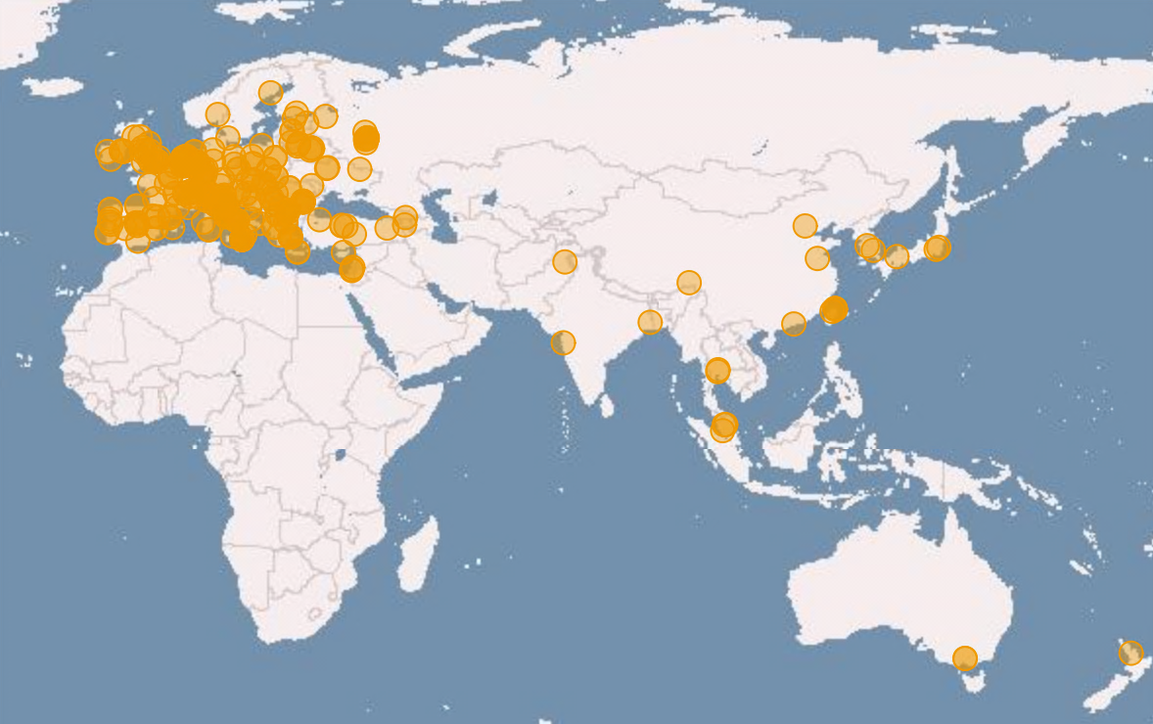
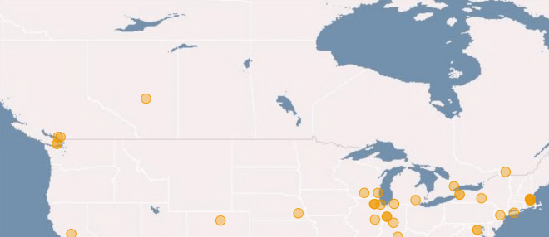
European Grid Infrastructure
(July 2011 and increase from Apr 2010)
Logical CPUs (cores)
248,424 EGI (+29.3%)
337,608 ALL
106.7 PB disk and 112.8 PB tape
Resource Centres
329 EGI
346 All (+6.8 %)
93 supporting MPI (+6.8%)
35% of logical cores provided by the 9
largest Resource Centres
Countries (+11.5%)
50 EGI
57 All (+18.75)
38 NGIs providing resources
1 EIRO providing resources (CERN)
19 countries in 4 non-European Operations Centres

Slide 5
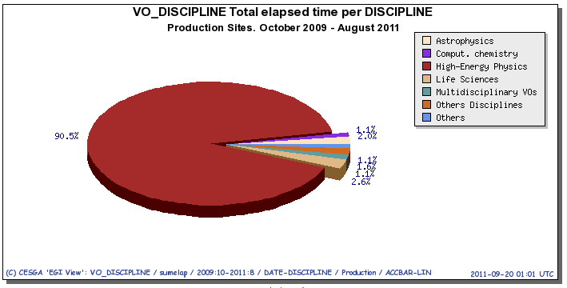
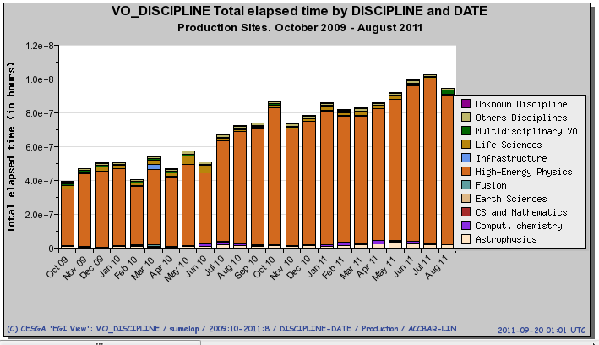
Usage – CPU wall time hours
(Oct 2009 – Aug 2011)

Slide 6
Usage statistics
Metric | Unit | Per month | Per day | 2011-2010 vs 2009-2010
Average Number Jobs | number | All VOs: 27.8 M Non HEP: 2.8 M (10% of total) | All VOs: 914,000 Non HEP: 100,000 | +82% +47%
CPU wall clock (all VOs) | hours | All VOs: 74.8 M Non HEP: 7.0 M | All VOs: 2.5 M Non HEP: 230,600 | +35% +28%
Normalised CPU wall clock | HEP-SPEC 06 hours | All VOs: 563.2 M Non HEP: 50.3 M | All VOs: 18.5 M Non HEP: 1.7 M | +101% +56%

Slide 7
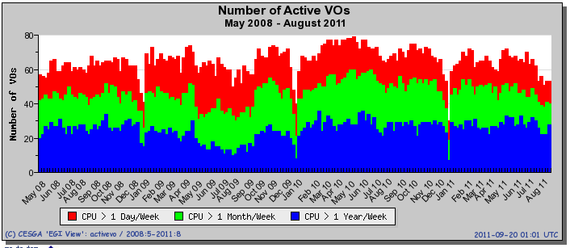
High activity VOs
(EGEE-III and EGI-InSPIRE to date)
High activity VO: All the jobs run by the VO during the week consumed more than 1 year of CPU time.

Slide 8
EGI Resource Infrastructure
EGI Participant: National Grid Initiatives (NGIs), European Intergovernmental Research Organisations (EIROs)
Layer II. Resource Infrastructure
The federation of Resource Centres, which are interconnected by the National Research and Education Networks (NRENs) and GÉANT.
Resource infrastructure Provider (RP)
The legal organisation responsible for any matter that concerns the respective Resource Infrastructure
Layer III.
EGI Resource Infrastructure
NGI/EIRO
Network
Resource Provider
Resource Infrastructure
EGI.eu
Resource Infrastructure
Resource Centres
MoUs
Resource Centres
Resource Provider
Resource Infrastructure
Resource Centres
Resource Centres
Peer infrastructures:
accessible to EGI users, but relying on own operational services, e.g. Open Science Grid (USA)
Layer I. Resource Centre (RC)
A localised or geographically distributed administration domain, where EGI resources (CPUs, data storage, instruments and digital libraries) are managed and operated to be accessed by end-users
Resource Centres
Integrated Infrastructures:
operated by a non-EGI-InSPIRE partner but relying on EGI operational services, e.g. Latin American and Caribbean
Resource Centres

Slide 9
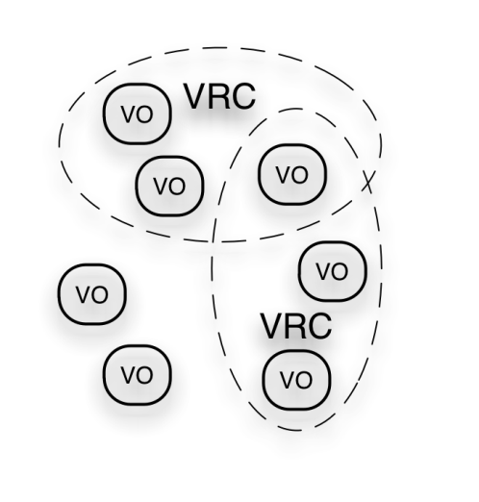
EGI Ecosystem
User Community
Policies + Funding
Requirements + Feedback
Services + Support
Service & Resource Providers
Requirements + Feedback
Public Funding Bodies
Policies + Funding
Requirements + Feedback
European Commission
Technology Providers
Resource Infrastructure Providers
Open Source Providers
National Research Councils
Strategic Feedback
Technology + Support
Commercial Providers
Policies + Funding

Slide 10
Roles of the RCs
RCs as consumers of
  operational services provided by EGI.eu and NGI
    Dependency on the sustainability of NGIs
      EC funding and short-term national funding streams
  NGI Grid technical services
    Dependency on Technology Providers and NGIs
RCs as providers of
  ☺Access services to customer-owned resources (Grid middleware services)
    Dependency on Technology Providers and NGIs
  ☺ user community services
  ☹ Resource capacity (to local communities/projects)

Slide 11
Governance
Currently Resource Centres (RCs) represented by the respective NGI within the EGI Operations Management Board (OMB) for
  Bring issues/requirements about deployed grid middleware to the Technology Providers and the operations tools
    RC → NGI → OMB → Technology Coordination Board → Technology Providers
  Discussion of operational issues that concern the RC
    Service level targets (availability, reliability, Operational Level Agreements)
    The operational services provided by the NGI/EGI.eu to the RC
  Coordination of
    Middleware staged rollout
    Middleware deployment
    ..

Slide 12
Requirements gathering from RCs
New process for requirements gathering (tools and deployed software) every 3 months
Gathering
Prioritisation
Discussion with
Technology Providers
EGI Request Tracker
User Community Board
Technology Coordination Board
and
EGI- JRA1
Virtual research communities
Virtual Organisation
Operations Tools Advisory Group
Resource Centres
Resource infrastructure Providers
Operations Management Board

Slide 13
Challenges 1/2
Technology and innovation
  RCs as sources of innovation → communication and sharing between RCs across multiple NGIs needs to be facilitated
Sustainability
  Common need for greater sustainability
    Dependency of NGI/EGI.eu operational services
Support of multiple di disciplines
  Reduction of operational expenditure for resource infrastructure and middleware while extending the user base

Slide 14
Challenges 2/2
Expansion of the current user base
  opportunistic usage of existing resources?
  capital expenditure may be needed to increase resource capacity to support new communities
    NGI as bridge to national communities
    EGI as mediator to international communities
Development of consistent business models across a subset of NGIs/RCs
  currently no coordinated capacity management and planning across NGIs

