Slide 1
IGE Globus Appliances
Dr. Ioan Lucian Muntean, Dr. Adrian Colesa
Technical University of Cluj-Napoca
Virtualisation & Cloud Computing Technology
EGI Technical Forum, Lyon, 21.09.2011

Slide 2
Outline
IGE Software
Appliances
Experiences with StratusLab

Slide 3
Initiative for Globus in Europe
FP7 DCI project, October 2010 – March 2013, 11 partners
Objectives
Coordinate Globus activities in Europe
Continuously support the European computing infrastructures
Serve as a central point of contact in Europe for Globus
Drive the Globus developments forward in accordance with the requirements of European users
Strengthen the influence of European developers in the Globus Alliance
Comprehensive service provider for the European e-infrastructures regarding the development, customization, provisioning, support, and maintenance of components of the Globus Toolkit
Initiative for Globus in Europe: http://www.ige-project.eu/

Slide 4
IGE Software
Packaged GT5 as RPM and deb
GT 5.0.3, GT 5.0.4, and GT 5.2 (in preparation)
Wide range of supported platforms
Redhat, Fedora, Scientific Linux, Ubuntu, Debian
Community software adaptations
Selected examples: GridWay, GridSAM, GSI-SSHTerm, GridSAFE
Coming up: LCAPS/LCMAPS, Adhoc etc.
Public releases
IGE 1.0.0 (GT 5.0.3)
Technology preview (GT 5.0.4 + software adaptations)
More info at: http://www.ige-project.eu/releases

Slide 5
IGE Software and the Cloud
IGE Software Repository
IGE Globus Appliances
Marketplaces
Beneficiaries
StratusLab
EGI
GridFTP
GridFTP
Communities
GRAM
GRAM+GridFTP
Amazon EC2
GSISSH
GridWay
Yet another Marketplace
GridWay
MyProxy
OGSA-DAI
GridSAFE
…
…

Slide 6
Types of IGE Appliances
Basic appliances
GT components and/or community adaptations installed
(-) no pre-installed certs, customization of service configs needed
Start-and-use appliances
GT components and/or community adaptations installed and configured, host certificates installed
Usage: ready to run services on clouds, testing GT components in a predefined environment (e.g., an internal GT-based Grid in StratusLab)
(+) no installation or compilation required
Usage: admins trying out different configurations, GT trainings etc.
(+) no configuration effort needed, functioning services
Project partners responsible UCM and UTCN

Slide 7
Current Status
Basic appliances
GT components and/or community adaptations installed
Start-and-use appliances
GT components and/or community adaptations installed and configured, host certificates installed
Coming soon: use of community tools for dynamic generation of VMIs and VMI-based grids (Globus Provisioning - UC, WMS-based solution – TU Dortmund)
VM Images in testing phase: full GT5 VM image, GridFTP VMI, GRAM VMI (for StratusLab and Amazon EC2)
Coming soon: release of the existing VMI, GridWay VMI
Problems: persistency of VMIs (StratusLab Persistent Disk Storage Service?)
Problems: dynamic contextualization, e.g., requesting host certificates
Not started yet, depends on Basic appliances
VMI Preparation
Local creation, configuration and testing with KVM
OS installation
GT5 component installation
Storage of VMI to a public location
VMI Metadata creation & signing
VMI metadata publication in the StratusLab Marketplace
Compliant to StratusLab procedures

Slide 8
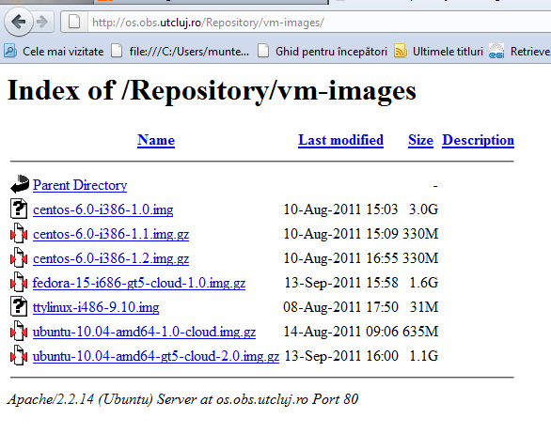
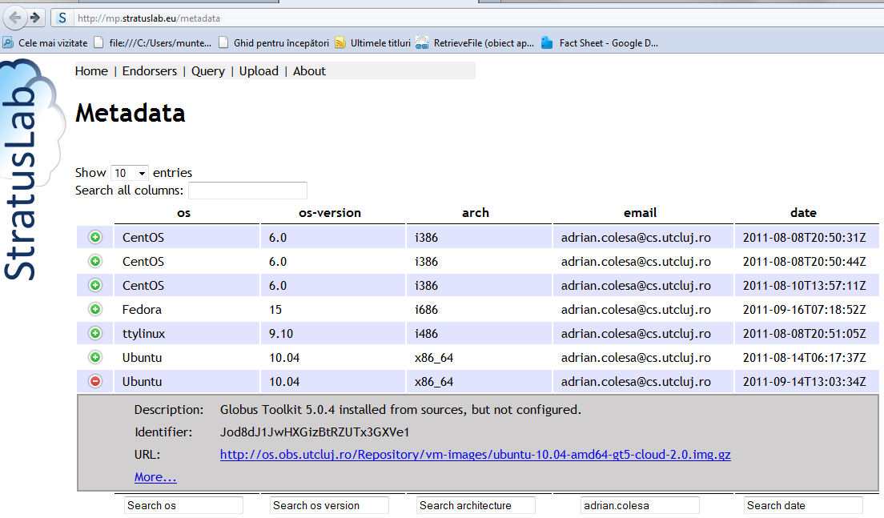
Current Status
StratusLab Appliance Repository
Metadata already published in the StratusLab Metadata Repository

Slide 9
Appliances in Action
DCI Summer School in Budapest, July 2011
Amazon EC2 VMIs (Basic & Start-and-Use appliances)
GridKa Summer School in Karlsruhe, September 2011
Amazon EC2 VMIs (Basic & Start-and-Use appliances)
Considering to deploy a StratusLab Cloud within the IGE Test Bed
Support software certification in IGE

Slide 10
Experiences with StratusLab
Good to have the StratusLab Reference Cloud
Prompt and clear support replies
Good tutorials for basic use-cases
Tutorials with deeper technical insights would be helpful
Good usability of the StratusLab software in general
No restart operation available for regular users so far
→available with the Persistent Disk Service
Have not investigated the performance and scaling of StratusLab yet
Looking forward to the new StratusLab release version 1.2!
… and to sign the MoU with the StratusLab

Slide 11
Next Steps
Automate deployment of GT components in various combinations to appliances
Globus Provisioning tool (UC)
Workflow approach (TU Dortmund)
Automate deployments of start-and-use Globus-based appliances
Packaged GT 5.2 and new adaptations
IGE appliances available soon for UC1, UC2 (GridFTP)
UC1
UC2
UC3
UC4
UC5
UC6
Pre-defined image
Data
Multiple resource providers
Accounting
Reliability & availability
Notifications

Slide 12
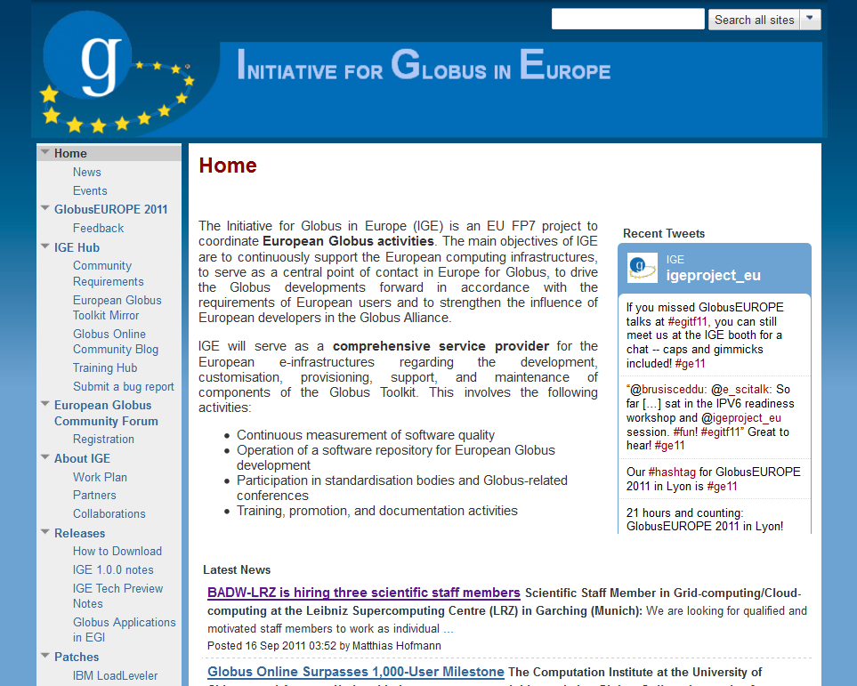
Thank You for Your Attention!
Initiative for Globus in Europe: http://www.ige-project.eu/

