Slide 1

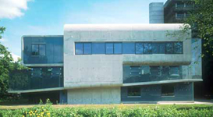
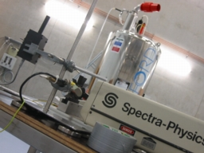
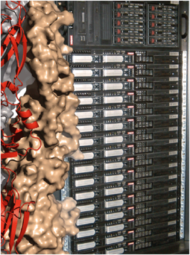

Structural Biology on the Grid
Christophe Schmitz
Bijvoet Center for Biomolecular Research
Faculty of Science, Utrecht University
The Netherlands
c.p.f.schmitz@uu.nl
Technical Forum 2011 - Lyon

Slide 2
The objectives
What is needed and why?

Slide 3
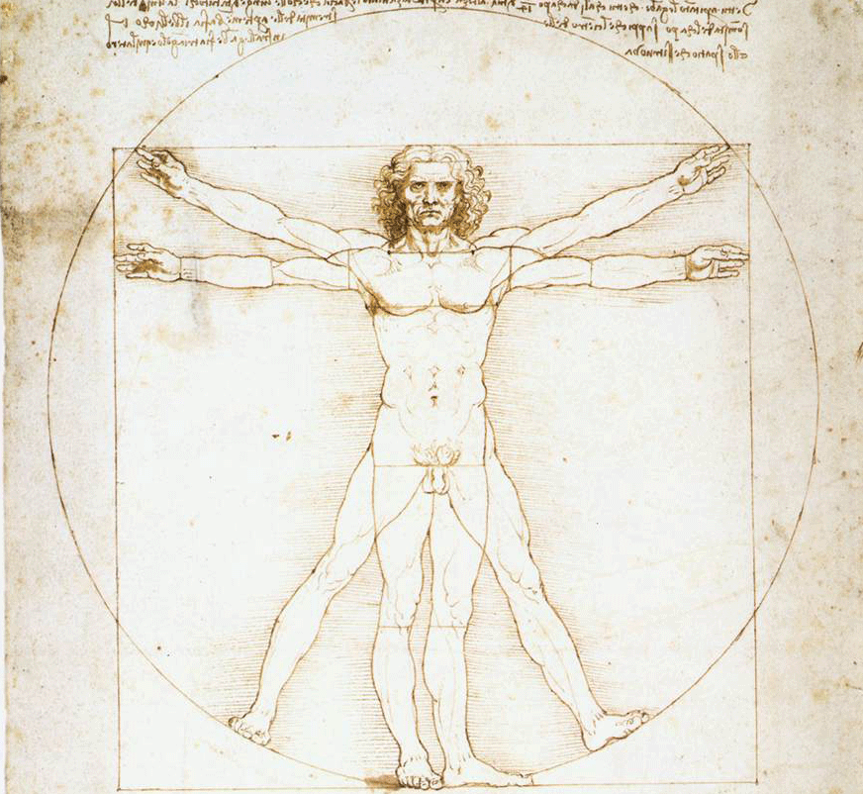
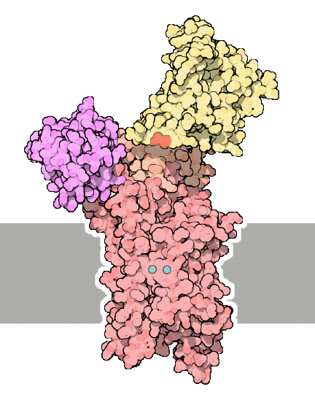

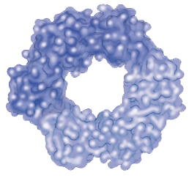
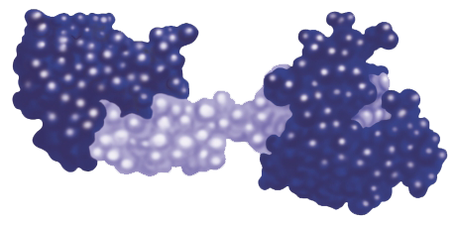
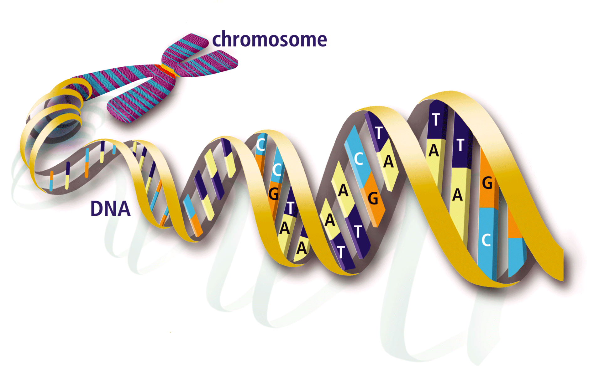


The molecular machines and network of life

Slide 4
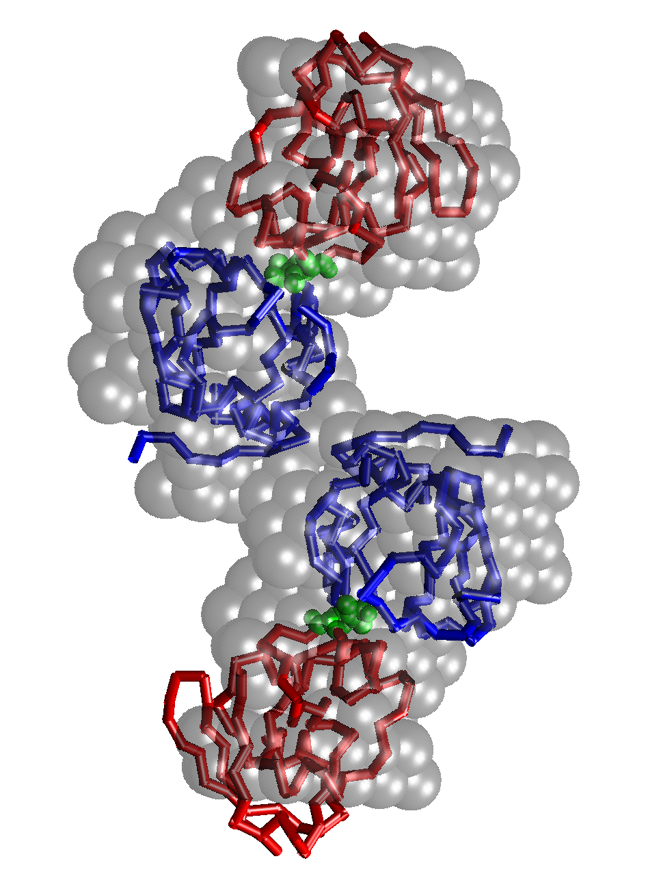
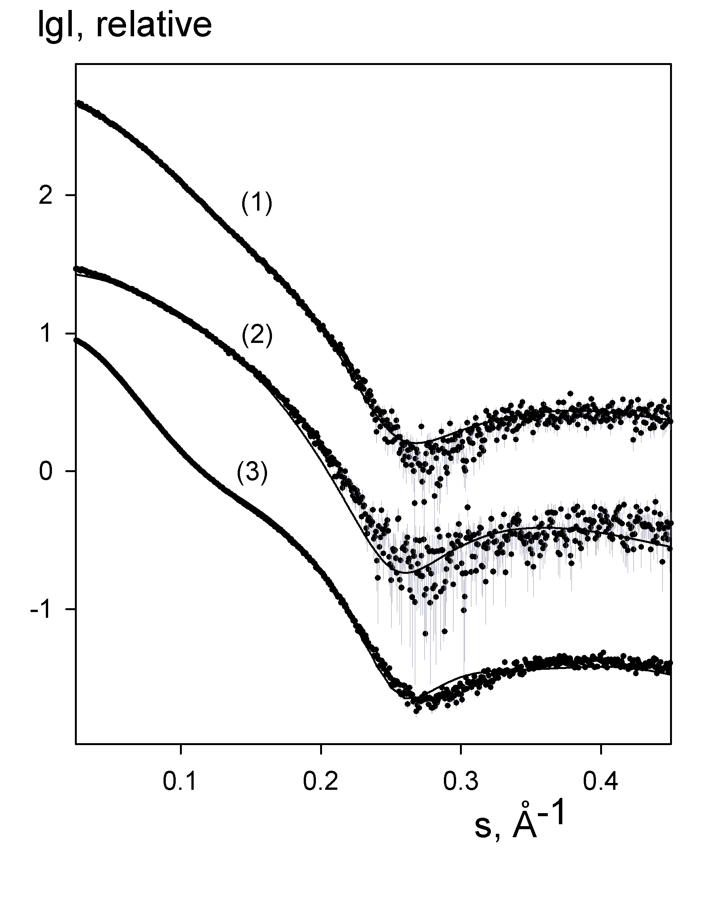

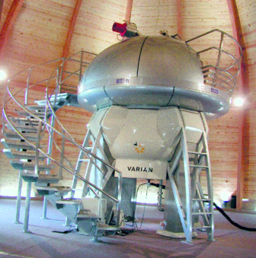
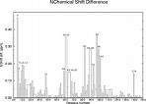
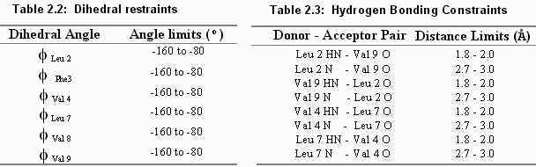
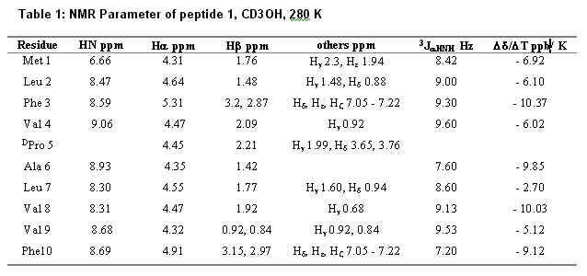


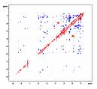
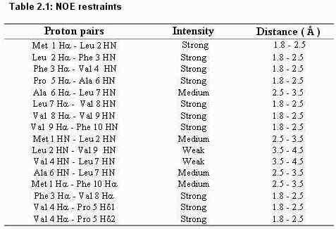
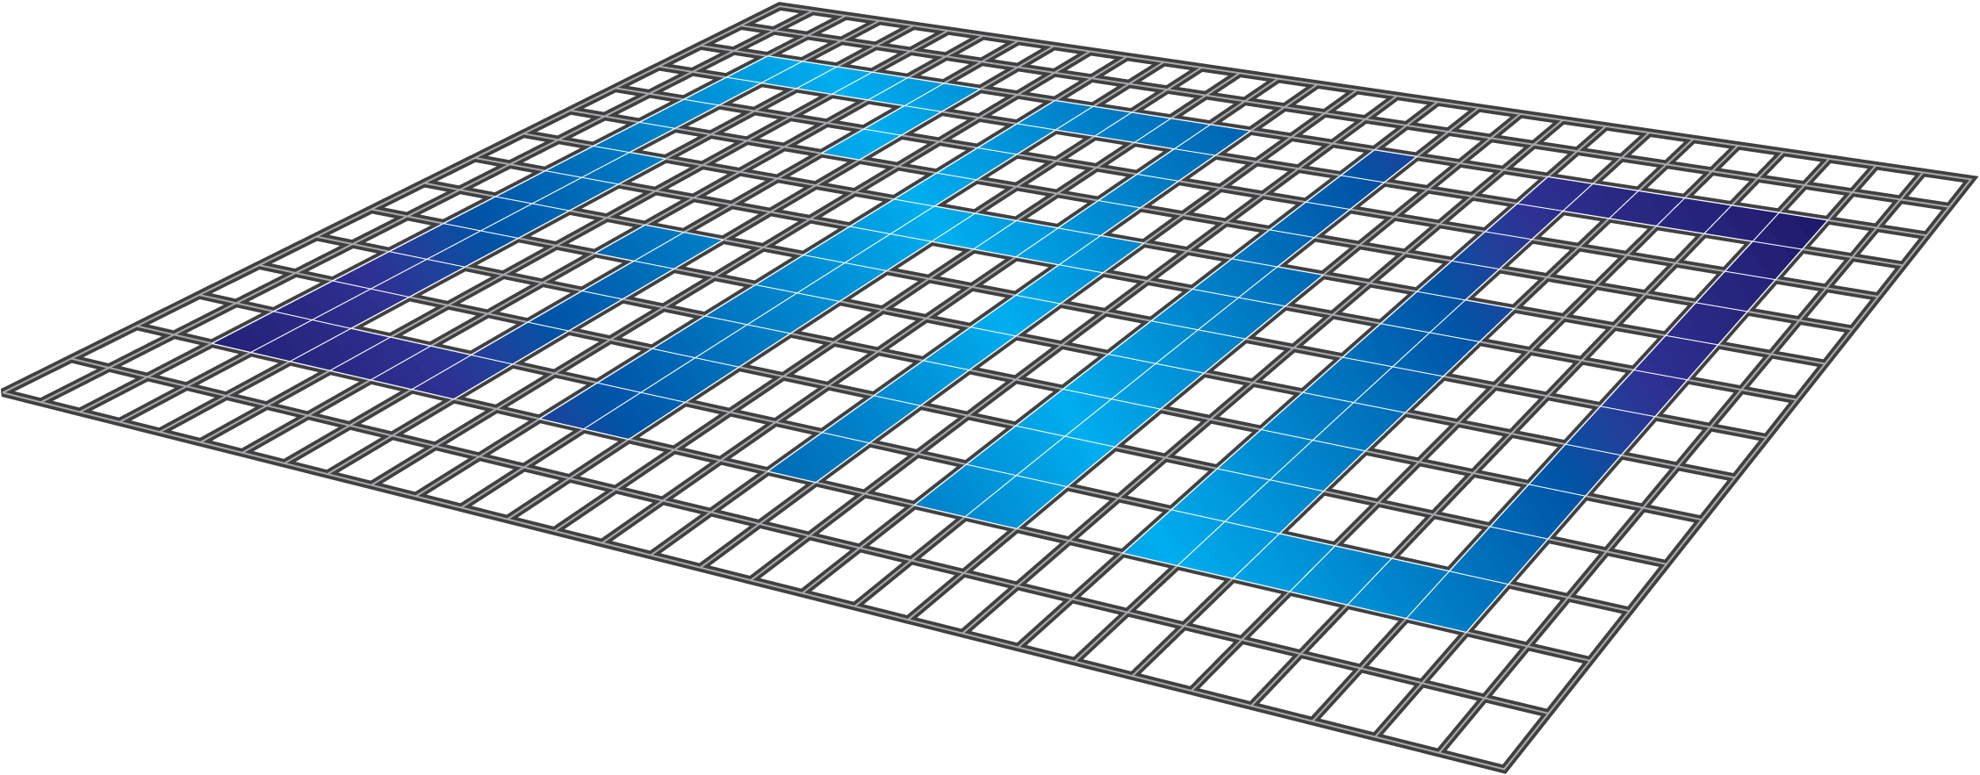

Exploiting Grid resources in structural biology
NMR data collection and processing SAXS data analysis
# Number of dimensions 2
# INAME 1 1H
# INAME 2 1H
12 2.137 2.387 1 T 0.000e+00 0.00e+00 - 0 2756 2760 0
14 2.387 4.140 1 T 0.000e+00 0.00e+00 - 0 2760 2752 0
32 1.849 4.432 1 T 0.000e+00 0.00e+00 - 0 2259 2257 0
36 1.849 3.143 1 T 0.000e+00 0.00e+00 - 0 2259 2587 0
39 1.760 4.432 1 T 0.000e+00 0.00e+00 - 0 2260 2257 0
40 1.760 1.849 1 T 0.000e+00 0.00e+00 - 0 2260 2259 0
43 1.760 3.143 1 T 0.000e+00 0.00e+00 - 0 2260 2587 0
46 1.649 4.432 1 T 1.035e+05 0.00e+00 r 0 2583 2257 0
47 1.649 1.849 1 T 0.000e+00 0.00e+00 - 0 2583 2259 0
Data
interpretation
assign ( resid 501 and name OO )
( resid 501 and name Z )
( resid 501 and name X )
( resid 501 and name Y )
( resid 2 and name CA ) -0.1400 0.15000
assign ( resid 501 and name OO )
( resid 501 and name Z )
( resid 501 and name X )
( resid 501 and name Y )
( resid 3 and name CA ) -0.0100 0.15000
Computations
Structure, dynamics & interactions
➔ impact on research and health:
  origin of disease
- design of new experiments
- drug design …

Slide 5
Web-portal related objectives
to provide integrated protocols for NMR data processing
to provide access to end users through user-friendly web interfaces
to exploit Grid technology for computationally demanding tasks in structural biology
to lower the barriers for access to Grid resources in life sciences, notably in structural biology
Details of requirement?

Slide 6
The web portals
The solution?

Slide 7
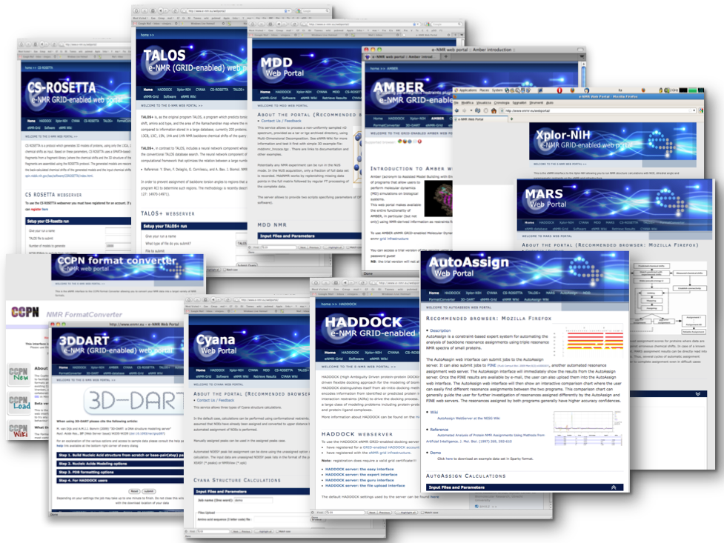
The web portals

Slide 8
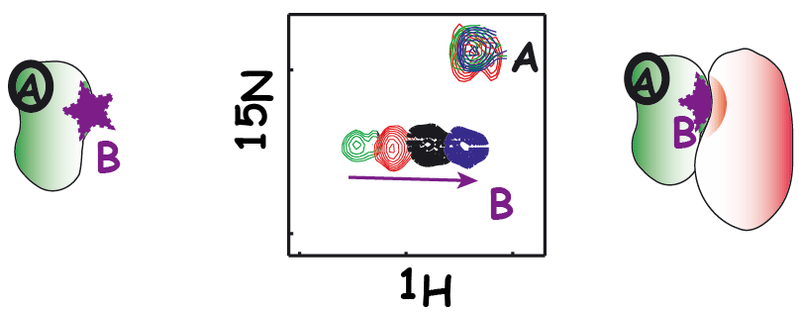
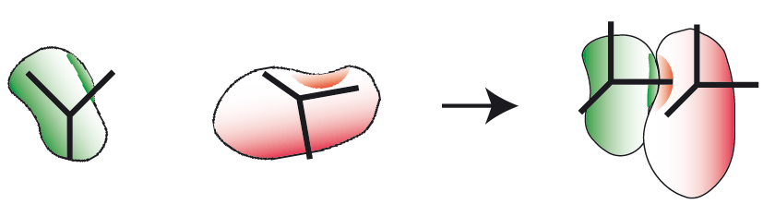
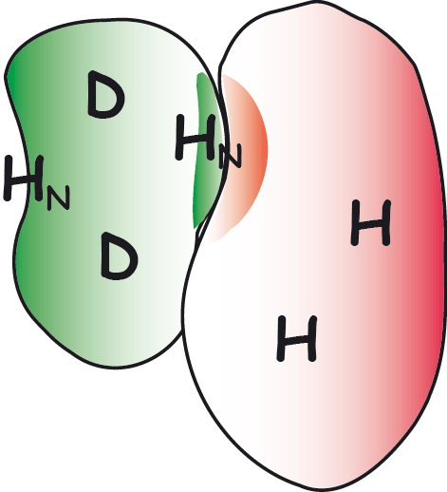
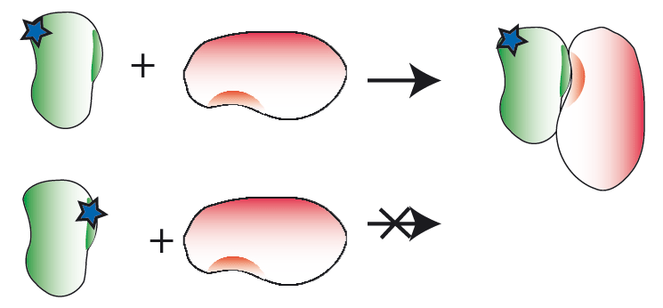
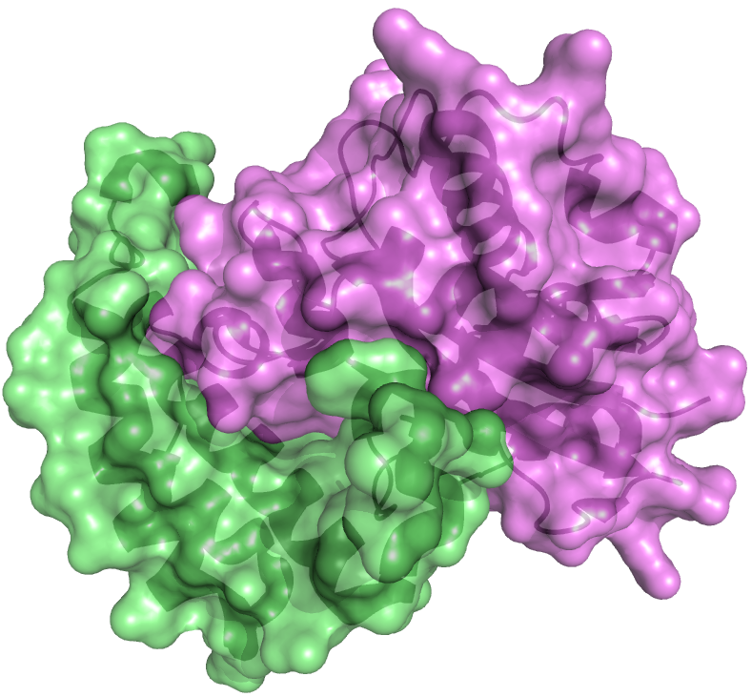
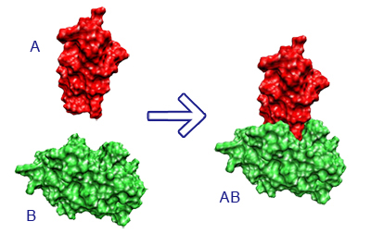
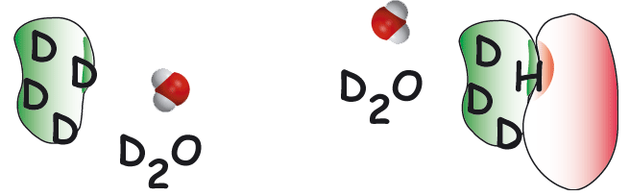
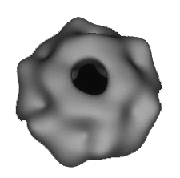
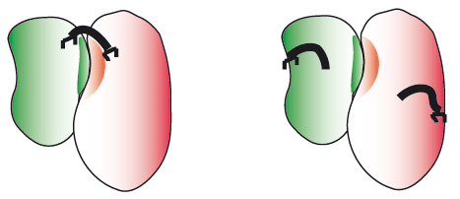
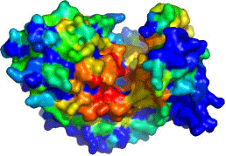
HADDOCK
NMR titrations
RDCs, PCSs, diffusion anisotropy
NMR cross saturation
PRE
H/D exchange
EFRGSFSHL
EFKGAFQHV
LFRLTWHHV
EFEPSYPHI
Other sources e.g.
SAXS, cryoEM
Mutagenesis
Cross-linking
Bioinformatic predictions

Slide 9
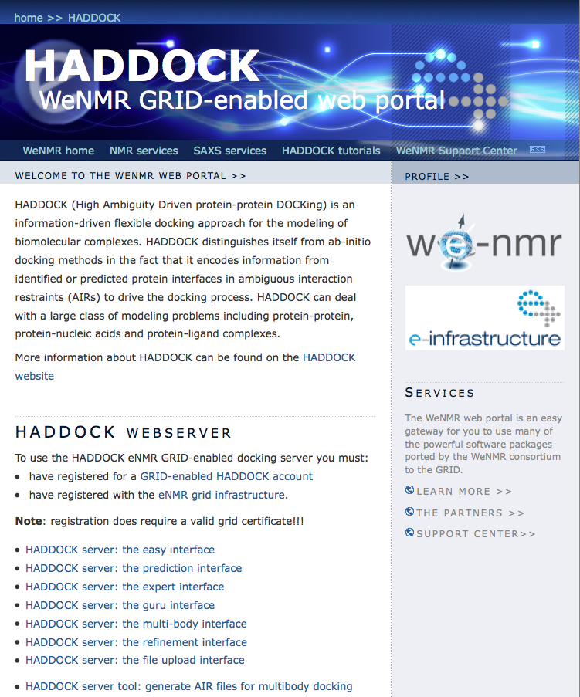
Haddock web portal

Slide 10
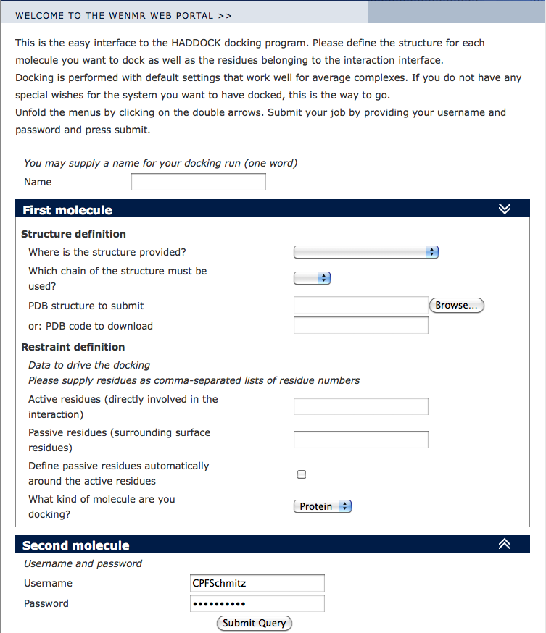
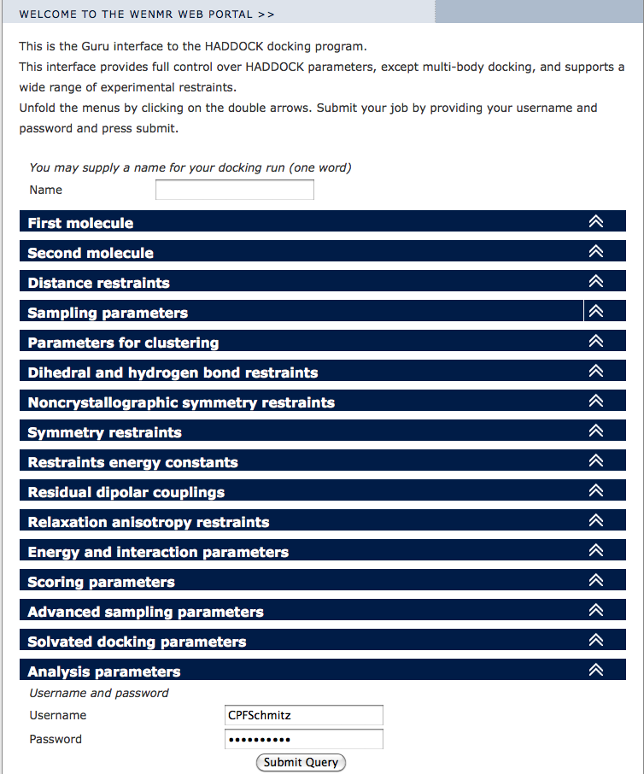
Haddock web portal

Slide 11
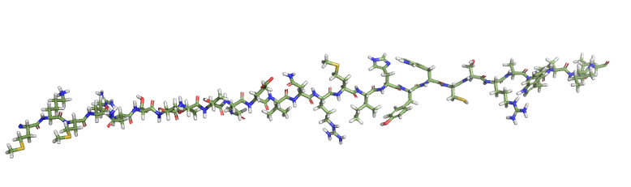
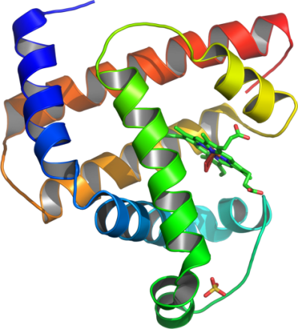
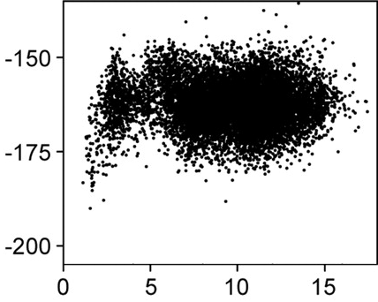
CS-ROSETTA
CS-Rosetta score
RMSD from native

Slide 12
CS-ROSETTA not web portal
/Volumes/Home/Users/christophe/minirosetta_svn/bin/minirosetta.macosgccrelease -abinitio::increase_cycles 1 -nstruct 10 -database /Volumes/Home/Users/christophe/minirosetta_database -frag3 Volumes/Home/Users/christophe/Dropbox/minirosetta_pcs_file/DATA/1NKU/FRAG_CS-ROSETTA/frag3.t000.rosetta.tab.gz -frag9 /Volumes/Home/Users/christophe/Dropbox/minirosetta_pcs_file/DATA/1NKU/FRAG_CS-ROSETTA/frag9.t000.rosetta.tab.gz -abinitio::stage1_patch /Volumes/Home/Users/christophe/Dropbox/minirosetta_pcs_file/SCORE/score0_pcs1.wts_patch -abinitio::stage2_patch /Volumes/Home/Users/christophe/Dropbox/minirosetta_pcs_file/SCORE/score1_pcs1.wts_patch -abinitio::stage3a_patch /Volumes/Home/Users/christophe/Dropbox/minirosetta_pcs_file/SCORE/score2_pcs1.wts_patch -abinitio::stage3b_patch /Volumes/Home/Users/christophe/Dropbox/minirosetta_pcs_file/SCORE/score5_pcs1.wts_patch -abinitio::stage4_patch /Volumes/Home/Users/christophe/Dropbox/minirosetta_pcs_file/SCORE/score3_pcs1.wts_patch -native /Volumes/Home/Users/christophe/Dropbox/minirosetta_pcs_file/DATA/1NKU/idealized_1NKU.pdb -out:file:silent /Volumes/Home/Users/christophe/PCS_ROSETTA_RESULT/ABINITIO//1NKU_exact_N1_PCS1.silent -out:file:scorefile /Volumes/Home/Users/christophe/PCS_ROSETTA_RESULT/ABINITIO//1NKU_exact_N1_PCS1.sc -abinitio::rg_reweight 0.5 -abinitio::rsd_wt_helix 0.5 -abinitio::rsd_wt_loop 0.5 -abinitio::use_filters false -broker::setup /Volumes/Home/Users/christophe/Dropbox/minirosetta_pcs_file/RUN/././1NKU_exact/setup_pcs1.txt -run:protocol broker -overwrite -PCS:normalization_id 1 -in::file::native_exclude_res 1 2 3 4 5 6 7 8 9 172 173 174 175 176 177 178 179 180 181 182 183 184 185 186 187 -mute core.scoring.methods.PCS.PcsEnergy -mute core.optimization.LineMinimizer

Slide 13
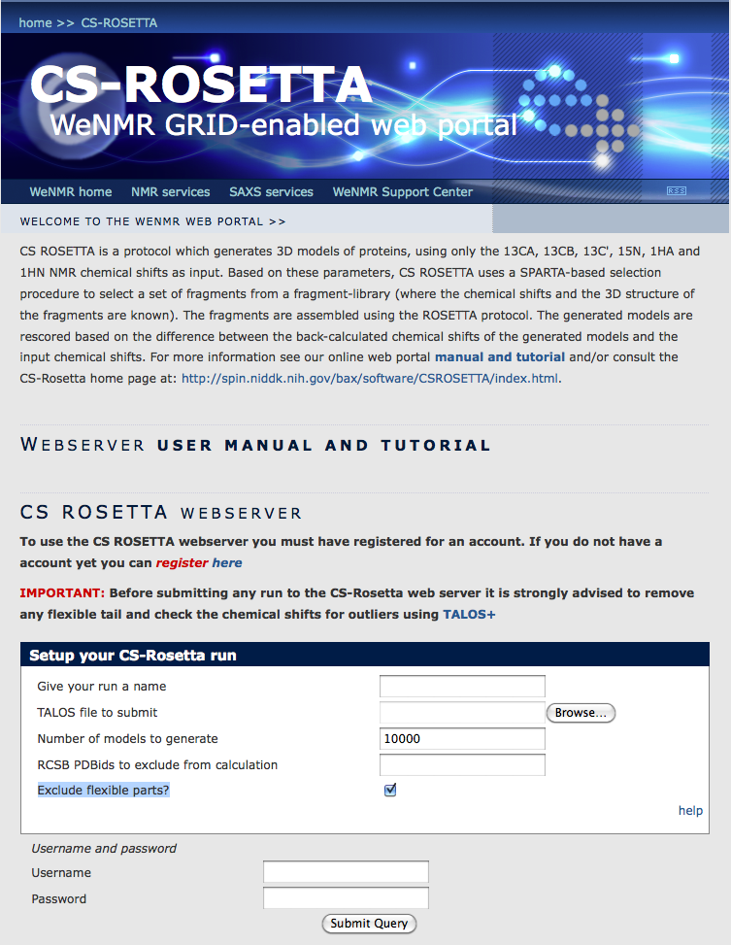
CS-ROSETTA web portal

Slide 14
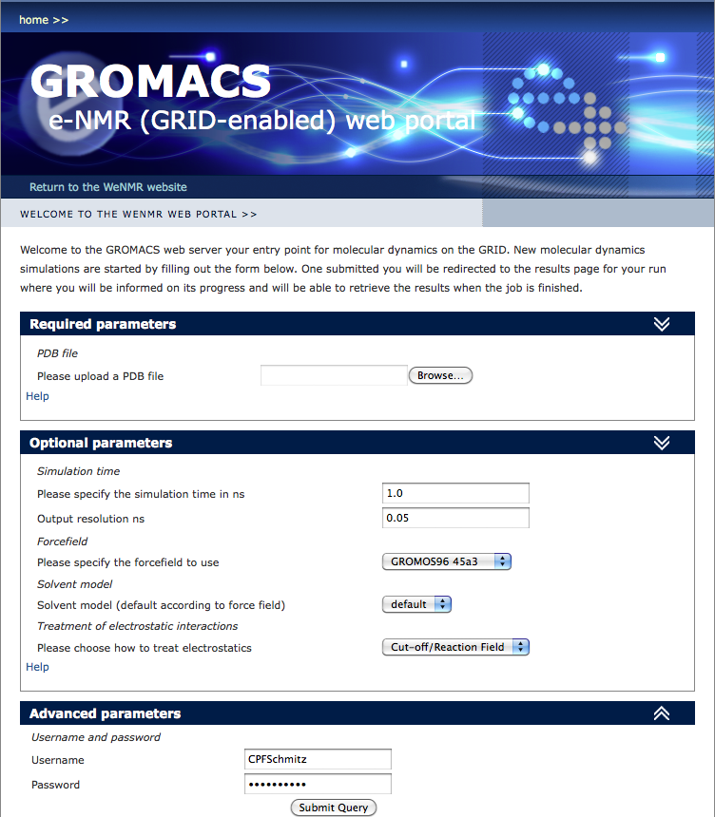
GROMACS web portal

Slide 15
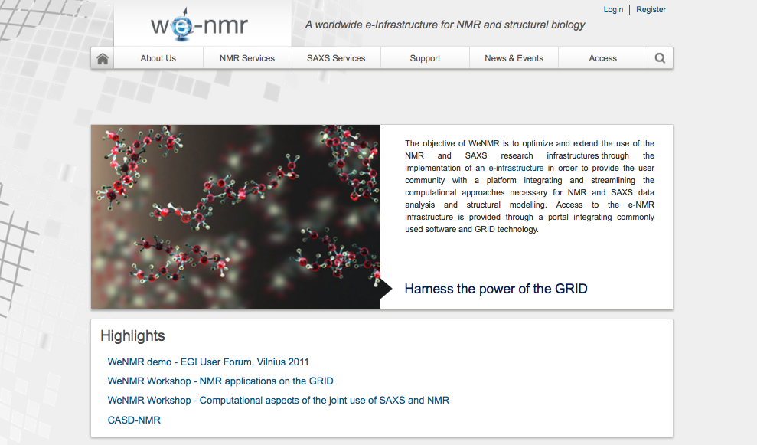
www.wenmr.eu

Slide 16
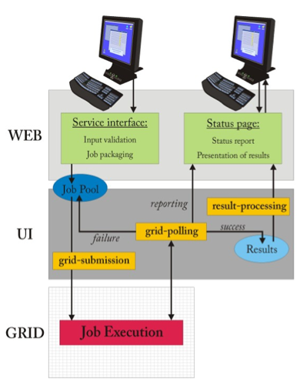
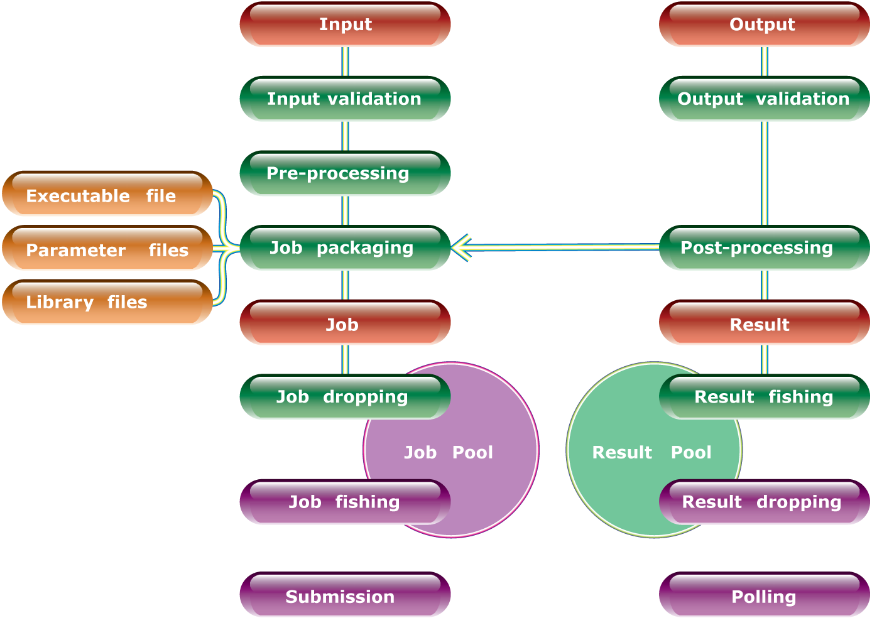
Behind the scene: the grid

Slide 17
Concluding statistics
Feedbacks

Slide 18
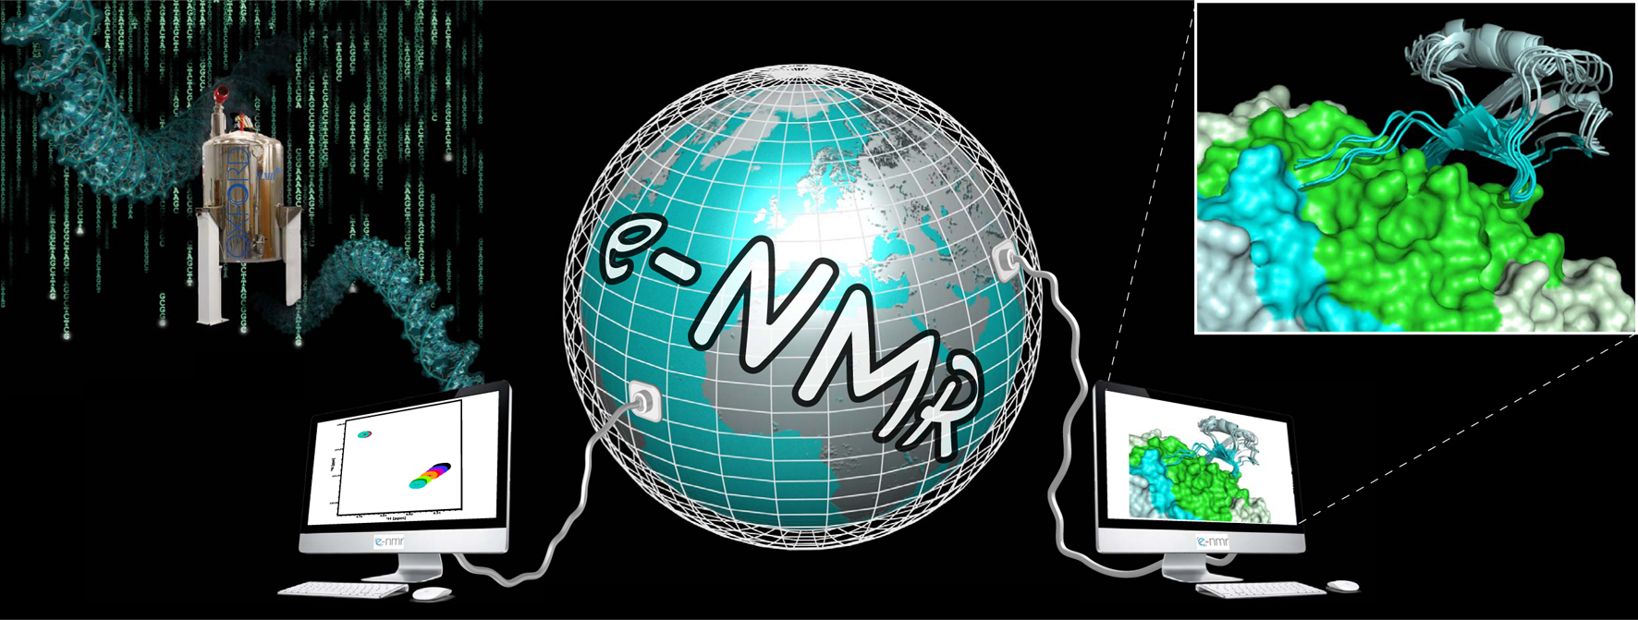
WeNMR platform operational and well used!
Largest global VO in the life sciences
Over 336 registered users from 38 nationalities, and growing
>33 000 CPUs
>700 (normalized) CPU years over the last 12 months
1.4 million jobs over the last 12 months
150Tb of storage space
~20% of Life Sciences on the Grid
User-friendly access to e-Infrastructure via web portals

Slide 19
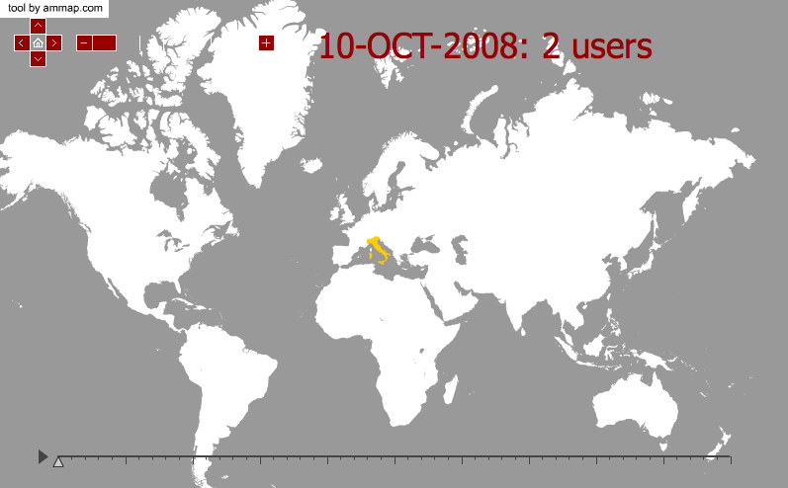
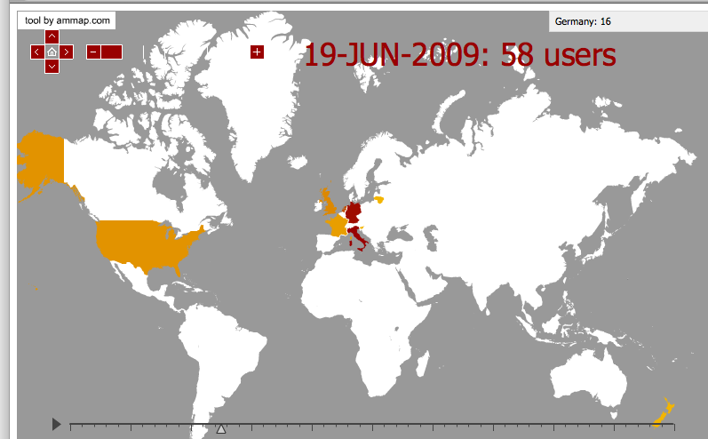
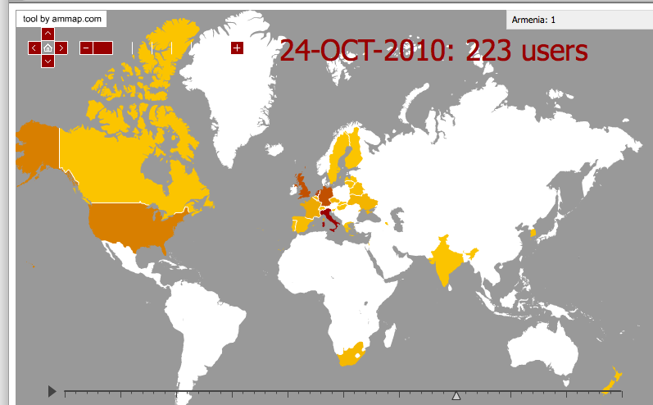
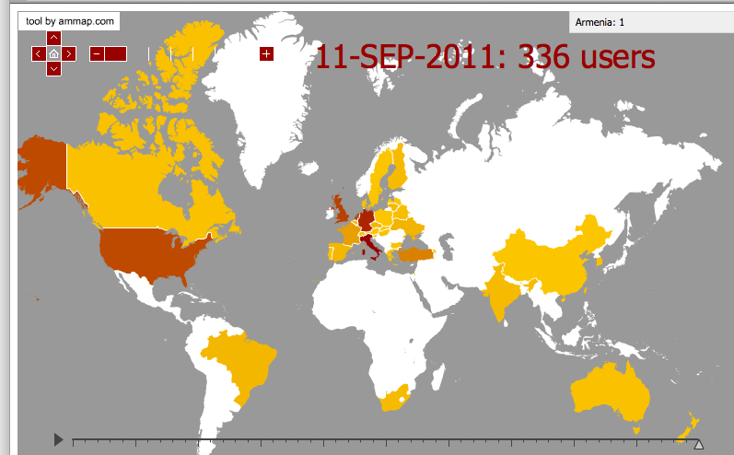
The user community over the last 3 years
Australia: 2
Brazil: 5
Canada: 2
China: 1
Germany: 48
France: 12
Italy: 59
Netherlands: 41
Turkey: 21
United Kingdom: 40
United States: 37
South Africa: 4

Slide 20
Jobs statistics
Software | % Jobs | % CPU time
CS-ROSETTA | 45.7 | 28.4%
HADDOCK | 16% | 1.5%
GROMACS | 0% | 0%
“enmr.eu” | 31.3% | 69.7%

Slide 21









Acknowledgment
The team
Alexandre M.J.J. Bonvin
Andrea Giachetti
Antonio Rosato
Anurag Bagaria
Christophe Schmitz
Gijs van der Schot
Harald Schwalbe
Hendrik R. A. Jonker
Ivano Bertini
Johan van der Zwan
Lucio Ferella
Marc van Dijk
Marco Verlato
Mirco Mazzucato
Nuno Loureiro-Ferreira
Peter Güntert
Rolf Boelens
Sjoerd J. de Vries
Stefano Dal Pra
Torsten Herrmann
Tsjerk A. Wassenaar
Victor Jaravine
Wim F. Vranken
The partners
Utrecht University, Bijvoet Center for Biomolecular Research, NL
Johann Wolfgang Goethe Universität Frankfurt a.M., Center for Biomolecular Magnetic Resonance DE
University of Florence, Magnetic Resonance Center, IT
Istituto Nazionale di Fisica Nucleare , Padova, IT
Raboud University, Nijmegen, NL
University of Cambridge UK
European Molecular Biology Laboratory, Hamburg, DE
Spronk NMR Consultancy, LT

