Slide 1
Simplifying Large-Scale Data Movement with Globus
Steve Tuecke
Deputy Director, Computation Institute
University of Chicago & Argonne National Laboratory
Notes:
Need slide with

Slide 2
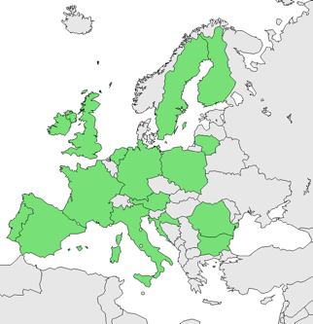
Initiative for Globus in Europe (IGE)
Help Scientists in the European Research Area
Coordination of widespread European Globus development and operation activities
Central point of contact in Europe for Globus
Add the European perspective to Globus
Globus service provider for European e-Infrastructures such as DEISA, EGI, PRACE
2
Notes:
Overarching goal: Help scientists in European Research Area!
Enable collaboration through interoperability.
Project created due to popular demand (grass roots movement). Then informal quick survey shows that 16 countries (green in map) actively use Globus already now. Globus is the second most important middleware in Europe (25 for gLite, 8 for Unicore, 8 for ARC, 1 for MOAB).
Map with GridFTP servers usage data shows strong clustering in the US and Europe, emphasizing the heavy Globus usage in Europe. This includes gLight sites, as gLight also uses GridFTP from Globus.
Scientists are already collaborating across all of Europe, but infrastructures are hindering this, because they are not interoperable....

Slide 3
Globus Toolkit
Globus Online
Build the Grid
Components for building custom grid solutions
globustoolkit.org
Use the Grid
Reliable file transfer Software-as-a-Service
globusonline.org
Notes:
This is something new. Not just more of the same Globus Toolkit stuff.
Globus Toolkit: hasn’t change. Been around 15 years. Still a toolkit for building custom Grids such as LHC and ESG.
Globus Online: Provides easy access for end users to use Globus GridFTP-based grids (e.g. TeraGrid, OSG, BIRN, EGEE, LIGO, etc.). If you don’t have GridFTP,

Slide 4
Globus Toolkit
Globus Online
Build the Grid
Components for building custom grid solutions
globustoolkit.org
Use the Grid
Reliable file transfer Software-as-a-Service
globusonline.org
Notes:
This is something new. Not just more of the same Globus Toolkit stuff.
Globus Toolkit: hasn’t change. Been around 15 years. Still a toolkit for building custom Grids such as LHC and ESG.
Globus Online: Provides easy access for end users to use Globus GridFTP-based grids (e.g. TeraGrid, OSG, BIRN, EGEE, LIGO, etc.). If you don’t have GridFTP,

Slide 5
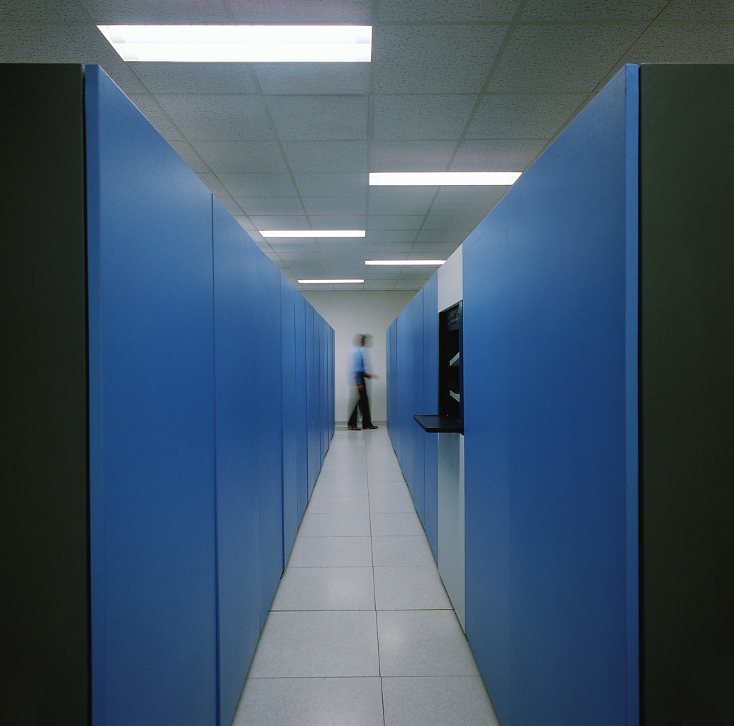
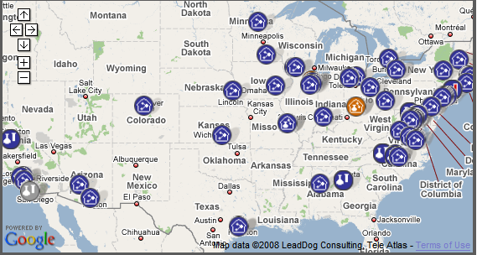
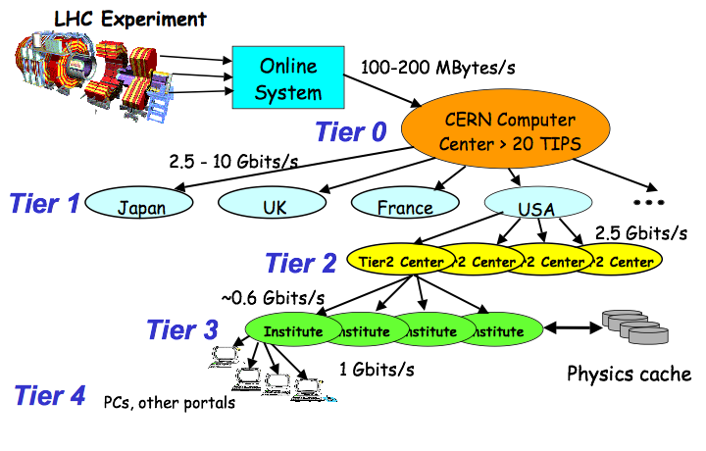
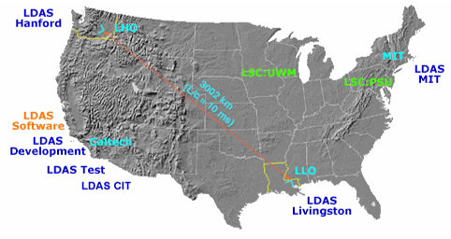
Big Science Built on Globus Toolkit
Cancer Biologiy Informatics Grid
LHC
Earth System Grid
LIGO data grid

Slide 6
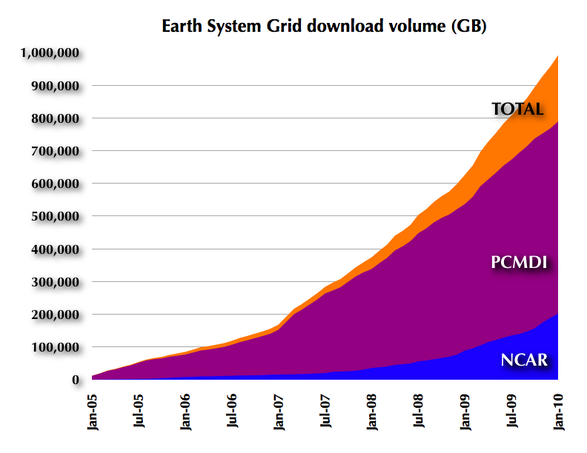
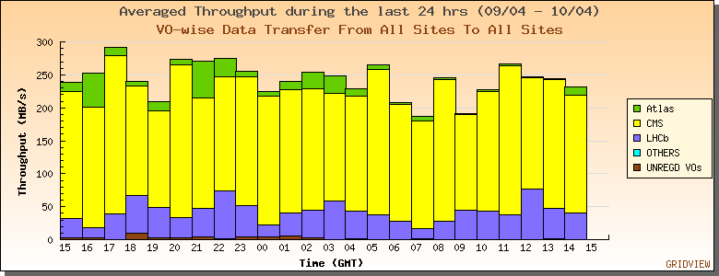
GT GridFTP: File transfer work horse
Extensions to FTP standard
High-performance, Security, Reliability, etc.
Used in XSEDE, LHC, ESG, OSG/VDT, LIGO, BIRN, …
>10M files, >½PB transferred per day

Slide 7
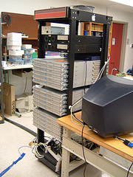
But small and medium science is suffering
Ad-hoc solutions
Inadequate software
Inadequate hardware
Data plan mandates

Slide 8
Globus Toolkit
Globus Online
Build the Grid
Components for building custom grid solutions
globustoolkit.org
Use the Grid
Reliable file transfer Software-as-a-Service
globusonline.org
Notes:
This is something new. Not just more of the same Globus Toolkit stuff.
Globus Toolkit: hasn’t change. Been around 15 years. Still a toolkit for building custom Grids such as LHC and ESG.
Globus Online: Provides easy access for end users to use Globus GridFTP-based grids (e.g. TeraGrid, OSG, BIRN, EGEE, LIGO, etc.). If you don’t have GridFTP,

Slide 9
Globus Online Vision
Goal: Accelerate discovery and innovation worldwide by providing research IT as a service
Leverage software-as-a-service to:
provide millions of researchers with unprecedented access to powerful tools
reduce research IT costs dramatically via economies of scale
“Civilization advances by extending the number of important operations which we can perform without thinking of them” --Alfred North Whitehead , 1911
Notes:
I will describe to you today an exciting opportunity to greatly accelerate discovery and innovation on a global scale—in the words of famous mathematician Alfred North Whitehead, to advance civilization, in this case by automating a set of demanding IT tasks that hinder research progress

Slide 10
The Challenge: Moving Big Data Easily
What should be trivial…
“I need my data over there – at my _____” ( supercomputing center, campus server, etc.)
Data Source
Data Destination
… can be painfully tedious and time-consuming
“GAAAH!%&@#&”
! Config issues
Data Source
! Firewall issues
Data Destination
! Unexpected failure = manual retry

Slide 11
What is Globus Online?
Reliable file transfer.
Easy “fire and forget” file transfers
Automatic fault recovery
High performance
Across multiple security domains
No IT required.
Software as a Service (SaaS)
No client software installation
New features automatically available
Consolidated support and troubleshooting
Works with existing GridFTP servers
Globus Connect solves “last mile problem”
“I moved 400 GB of files and didn’t even have to think about it.”
Lawrence Berkeley National Lab
“It’s just not a big deal to move big data anymore.”
Initiative for Biomedical Informatics
“Fantastic! I have started using globus connect to transfer data, and it only took me 5 minutes to set up. Thank you!”
NERSC user
Notes:
Point out the Globus Online picture with endpoints

Slide 12
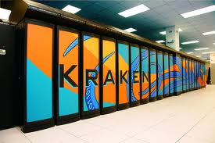
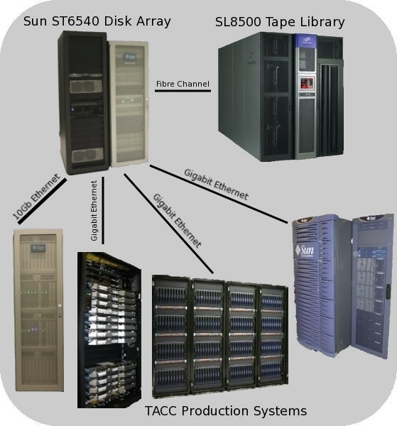
Case Study: Lattice QCD
Fast: Reduced transfer times
Easy: Fire-and-forget transfers
Automated retry
No file pre-staging
No complex infrastructure
Convenient CLI or GUI interfaces
Indiana University researcher moved ~6 TB from Oak Ridge to TACC in 2 days
“Globus Online frees up my time to do more creative work than typing scp commands or devising scripts to initiate and monitor progress to move many files.”
“I moved 100 7.3 GB files tonight in about 1.5 hours. I am very impressed. I also like the new commands and help system.”

Slide 13
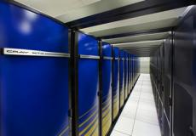
Case Study: Enabling Users @ NERSC
Challenge
“We need to provide web-based ways to accomplish computing tasks – it’s what our scientists expect. and it will make them more productive.”
Solution
Globus Online endpoints maintained by NERSC
GO = recommended transfer method
Benefits for NERSC users
Drag and drop archiving
Easy to use
Users can focus on their research (not on IT)
Benefits for NERSC
Operations and support outsourced to GO
Fast and easy to make endpoints available
Automated authentication
Reliable performance and support
“Fantastic! I have already started using Globus Connect to transfer data, and it only took me 5 minutes to set up. Thank you!” – NERSC user
Hopper, Franklin and HPSS are among the NERSC resources leveraged by Globus Online.
Notes:
Point out the Globus Online picture with endpoints

Slide 14
How It Works
How It Works
Data
Source
2
Globus Online moves files
Data
Destination
1
User initiates transfer request
Globus Online notifies user
3
Notes:
How are we going to help you?
October 2010
Image from: http://www.flickr.com/photos/argonne/4244642347/sizes/s/in/photostream/
Briefly describe 2-3 other use cases here

Slide 15
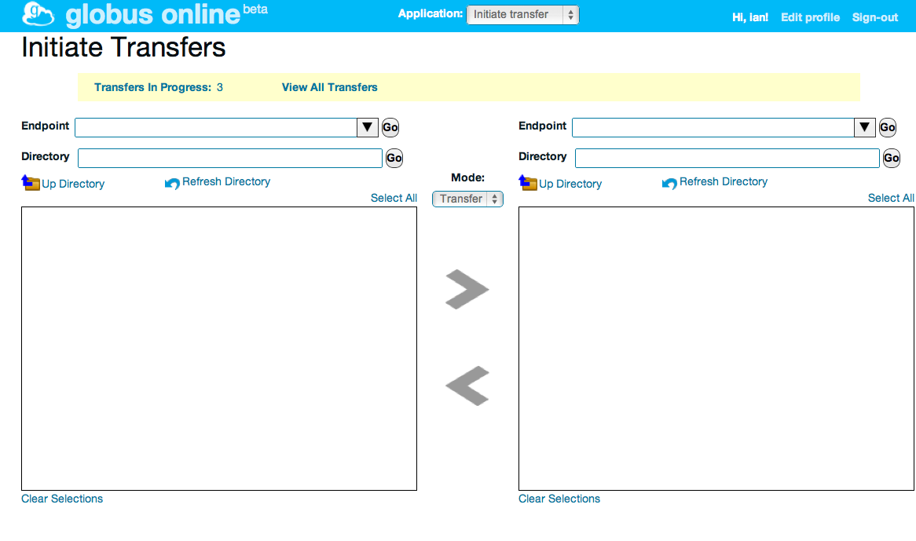
Globus Online Interface
HTTP REST interface
POST https://transfer.api. globusonline.org/ v0.10/ transfer <transfer-doc>
Command line interface
ls alcf#dtn:~
scp alcf#dtn:~/myfile \
nersc#dtn:~/myfile
Web interface
(Hosted on)
GridFTP servers
FTP servers
High-performance
data transfer nodes
Globus Connect
on local computers

Slide 16
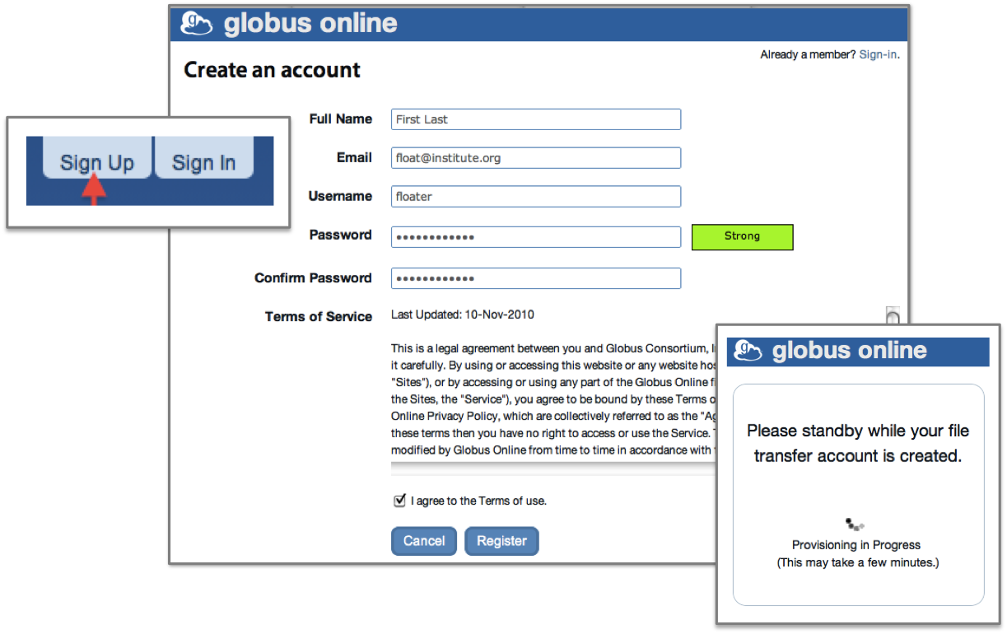
Getting Started (2 easy steps)
Sign up: Visit www.globusonline.org to create an account
Notes:
System builders: Condor, Swift, LIGO, etc.

Slide 17
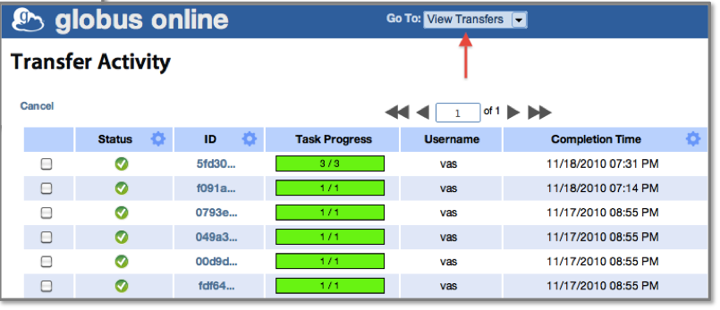
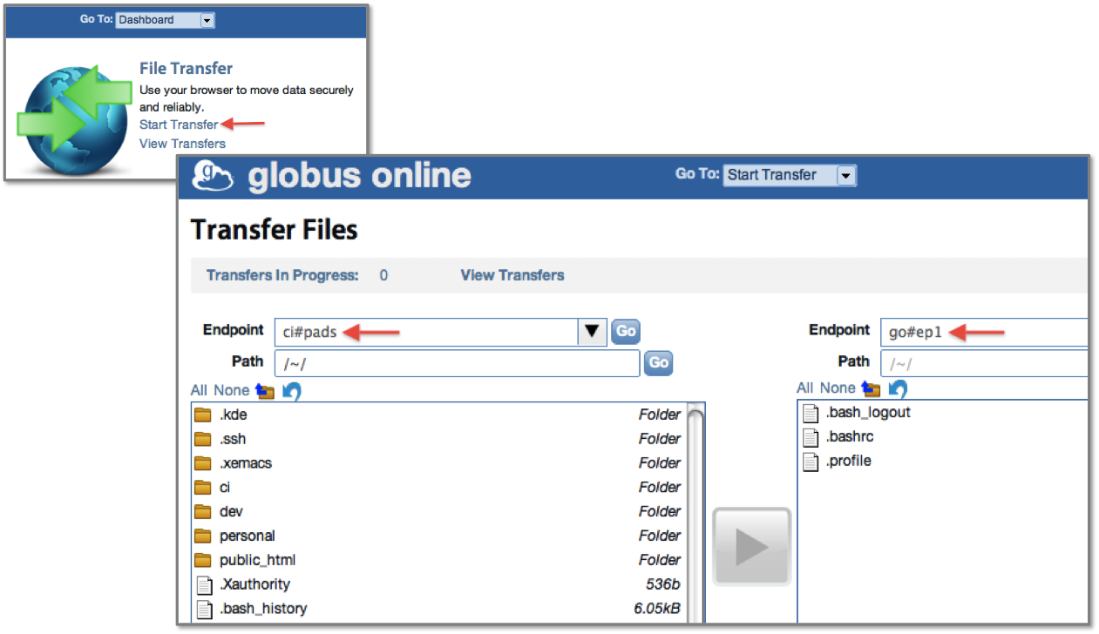
Getting Started (2 easy steps)
Start moving files: Pick your data and where you want to move it, then click to transfer
Notes:
System builders: Condor, Swift, LIGO, etc.

Slide 18
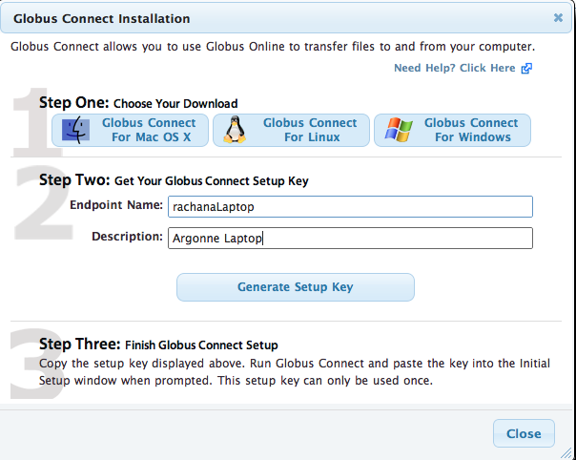
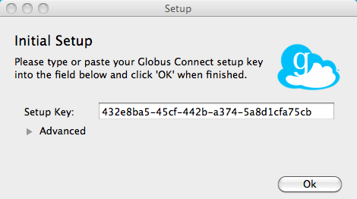
Globus Connect to/from your Laptop

Slide 19
Using the CLI
Interactive login to command line interface:
Running commands remotely:
Using CLI with gsissh:
$ ssh tuecke@cli.globusonline.org
$ ssh tuecke@cli.globusonline.org <command>
$ ssh tuecke@cli.globusonline.org scp –r –s 3 -D olcf#/~/myfile* mylaptop:/~/projects/p1
Task ID: 4a3c471e-edef-11df-aa30-1231350018b1
$ _
$ gsissh tuecke@cli.globusonline.org <command>

Slide 20
For More Information
Visit https://www.globusonline.org/signup to:
Get a free account and start moving files
Visit www.globusonline.org for:
Tutorials
FAQs
Pro Tips
Troubleshooting
Contact support@globusonline.org for:
Help getting started
Help using the service

