Slide 1
EMI-Data
The second year
Data
Patrick Fuhrmann
EMI Data area leader
At the EGI Technical Forum 2011, in Lyon

Slide 2
EMI Data 2011/12
Improving existing
Components
Integration
Standardization
Data
Improving user satisfaction

Slide 3
Objectives in a nutshell
Improving existing infrastructures
GLUE 2.0
FTS 3 (next generation File Transfer Services)
Storage element and catalogue synchronization
Integration
ARGUS integration
UNICORE integration
EMI Common data library
Standardization
SRM over SSL including delegation
POSIX file access and integration into SRM (File://)
WebDAV for file and catalogue access
Storage Accounting Record implementation
EMI Data clouds

Slide 4
Objectives in a nutshell
Improved user satisfaction
Adhering operating system standards for service operation and control, regarding configuration, log, temporary file location and service start/status/stop
Providing and supporting monitoring probes for EMI services
Improving usability of client tools, based on customer feedback by ensuring
better, more informative, less contradictory error messages
coherency of command line parameters.
Porting, releasing and supporting EMI components on identified platforms (full distribution on SL6 and Debian 6, UI on SL5/32 and the latest UBUNTU)
Introducing minimal denial of service protection for EMI services via configurable resource limits.
Providing optimized semi-automated configuration of service back-ends (e.g. databases) for standard deployments.

Slide 5
Starting with
Improving existing EMI components
GLUE 2.0
Storage element and catalogue synchronization
Next generation File Transfer Services, FTS 3

Slide 6
SE and catalogues synchronization
Storage element and catalogue synchronization
Synchronizing data location information between SE”s and catalogues.
Synchronizing access permission information between SE’s and catalogues.
See Fabrizio’s
Presentation
DPM, StoRM or
dCache
List of
removed
files
Command Line
Interface
LFC or experiment
catalogue
SE or Catalogue
specific plug-in
Generic Adapter
Generic Adapter
Messaging infrastructure

Slide 7
FTS 3
Next generation File Transfer Services, FTS 3 [Michail]
Redesign based on experience of last years
Prototype ready in April ‘12
Many interesting new approaches
Support of http
Feedback of real resource utilization (Storage element and network)
See Michail’s
Presentation

Slide 8
Integration
Integration
ARGUS integration
UNICORE integration
EMI common data client library

Slide 9
UNICORE Integration
UNICORE access to SRM and LFC
LFC Integration
Layer
LFC
UNICORE
Core
Services
Existing
Grid
Infrastructure
SRM
gridFTP
SRM Integration
Layer
SE
SE
SE
SMS abstraction

Slide 10
EMI common data client library
EMI Common data library [Jon]
Merging common ARC and gLite data client library components to a new EMI Data client library.
See Jon’s
Presentation

Slide 11
Starting with
Standardization
SRM over SSL including delegation
POSIX file access and integration into SRM (File://)
WebDAV for file and catalogue access
Storage Accounting Record implementation
EMI Data clouds

Slide 12
Standardization
Why Standardization in EMI-Data / EGI
Goal of EMI : Support as many communities as possible with the same middle-ware stack. E.g. recommendation of the first EMI review : “Appoint a Strategy Director to the project (…) so he/she can build bridges between the various User Groups as well as deploying a more Pro-Active partnering approach with the other projects in the DCI ecosystem”
Goal of EGI : Support as many communities as possible with the same infrastructure.
Only standard data access and control mechanisms allow middle-ware providers and sites to support a variety of communities (VO’s) at the same time with a minimum of effort. (sharing of resources)
Neither EMI nor EGI can effort to support esoteric computing models.

Slide 13
Standardization
NFS 4.1 / pNFS

Slide 14
Standardization
NFS 4.1 / pNFS for EMI storage
Why pNFS
We no longer have to support proprietary data access protocols and libraries for EMI storage elements. (DMP, dCache and StoRM)
EMI Data can compete with IBM, EMC and other big shots.
Simplicity of mountable file system.
Status SE’s
DPM/pNFS beta : evaluated at UK sites and in Taipei
dCache/pNFS evaluated in Germany and the US
dCache/pNFS in production at DESY for photon science
StoRM already POSIX, will become pNFS with GPFS supporting pNFS.

Slide 15
Standarization
NFS 4.1 / pNFS for EMI storage
Status Linux clients
pNFS fully supported in 2.6.39
Fedora 16 supports 2.6.39
Expected for RH 6.2
2.6.39 is ok for most communities, WLCG needs transition to SL 6 first, which is in the EMI pipeline anyway.
Evaluation results
See DPM presentation by Ricardo.
Plenty of results reported for dCache in previous conferences done at DESY/GridLab
Next steps
Wide area transfer evaluation
Building federations with NFS 4.1 / pNFS
Overcoming pNFS “vector read” deficiencies with ROOT.

Slide 16
Standardization
http/WebDAV/REST/Cloud

Slide 17
Standardization
Objective : WebDAV front-end for EMI storage (SE’s plus LFC)
LFC
storage element
Web
DAV
storage element
storage element
ROOT

Slide 18
Standardization
WebDAV front-end for EMI storage (SE’s plus LFC)
Possible Implementation
Logical Filename
Replica at site A
Replica at site B
Standard
Browser
Browse
directory
http
redirect
Fetch A
http GET
LFC
SRM get TURL
storage element

Slide 19
Standardization
What we actually want
Google
Storage
Amazon
S3
CloudFront
Gs,S3
REST,
WebDAV
HTTP
Gs,S3
REST,
WebDAV
HTTP
FTS 3
ROOT
EMI
Storage
EMI
Storage

Slide 20
New EMI-http group
EMI Data will propose a new activity : HTTP
Propose an OpenSource WebDAV client, which covers most of our use cases.
Contribute to that client if features are missing, which we need.
Evaluate 3rd party copy with http/WebDAV for FTS-3
EMI Objective : Investigates in
GS (Google Storage)
Amazon S3
Amazon Cloud Front
Stays in contact with ROOT people on different ROOT supported client interfaces.
http done
GS and S3 done
http(s) resp. WebDAV missing

Slide 21
Summary
EMI achieved essentially all our goals in the first year .
We got a lot of feedback from EGI/WLCG which we integrated into the objectives of the second year.
Got a ‘good’ review with some interesting remarks on how to proceed: “We should concentrate on commonalities among the communities”
Which is simplified by focusing on standard protocols and procedures.
POXIS file access
http/WebDAV/Cloud storage
Cloud is approaching EMI – Data, however strategy is still under investigation. (Cloud taskforce will come up with recommendations in October)
Will become an interesting second year for our Middleware stack.

Slide 22
Cheers
EMI is partially funded by the European Commission under Grant Agreement INFSO-RI-261611

Slide 23
Availability
Industry vendor solutions
Vendors are still careful. Nobody wants to be the first.
NetApp promised something for end of this year (already two times postponed)
IBM likely pNFS on GPFS end of 2012
BlueArc about beginning of next year.
…
EMI server
DPM in beta
StoRM with availability in GPFS
dCache : production
Clients (Linux)
With kernel 2.6.39
Fedora 16
Expected in RH 6.2

Slide 24
ROOT analysis (dCache)
Proprietary
Protocols in
dCache
pNFS
ROOT analysis on SUSY D3PDs
ROOT 5.26
TTreeCache switched ON
Reads each event in file(s)
25.000 Files in 5 pools
100 files per job
1 – 256 jobs running concurrently
Duration 24 hours.
Measurements done at DESY/gridLab by Federica Legger

Slide 25
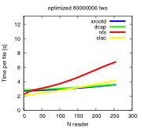
pNFS bad
Trying to find a case where NFS 4.1 is really bad (and found one)
Optimized for ROOT
Read two branches
TreeTCache ON
Xrootd/SLAC
Xrootd/dCache
NFS/pNFS
dCap (old vers)
Vector read effect. The ROOT driver is not doing vector read for plain file systems but for dCap/xRoot,

Slide 26
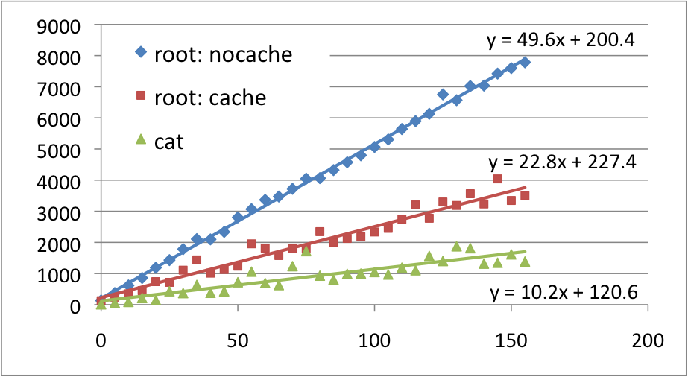
Wide area transfers (simulation)
Simulation of wide area transfers with
constant latencies
no packet losses.
Mean duration (sec)
DESY
CERN
Delay (ms)
FERMI
Measurements done at DESY/gridLab by Yves Kemp

